Slide 1
2012
Weed Management Update
Field Corn and Grain Sorghum
Eric P. Prostko, Ph.D.
Extension Weed Specialist
Dept. Crop & Soil Sciences

Slide 2

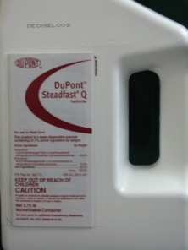


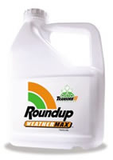

Field Corn
For most in GA …….
  Atrazine +
    Glyphosate (RR corn)
    Ignite/Liberty (LL corn)
    Steadfast Q
    Laudis or Capreno
    Halex GT (glyphosate + Callisto + Dual)
If I was King, I would make you spray 1 qt/A Atrazine PRE fb 1.5 qt/A + 1 of the above!

Slide 3
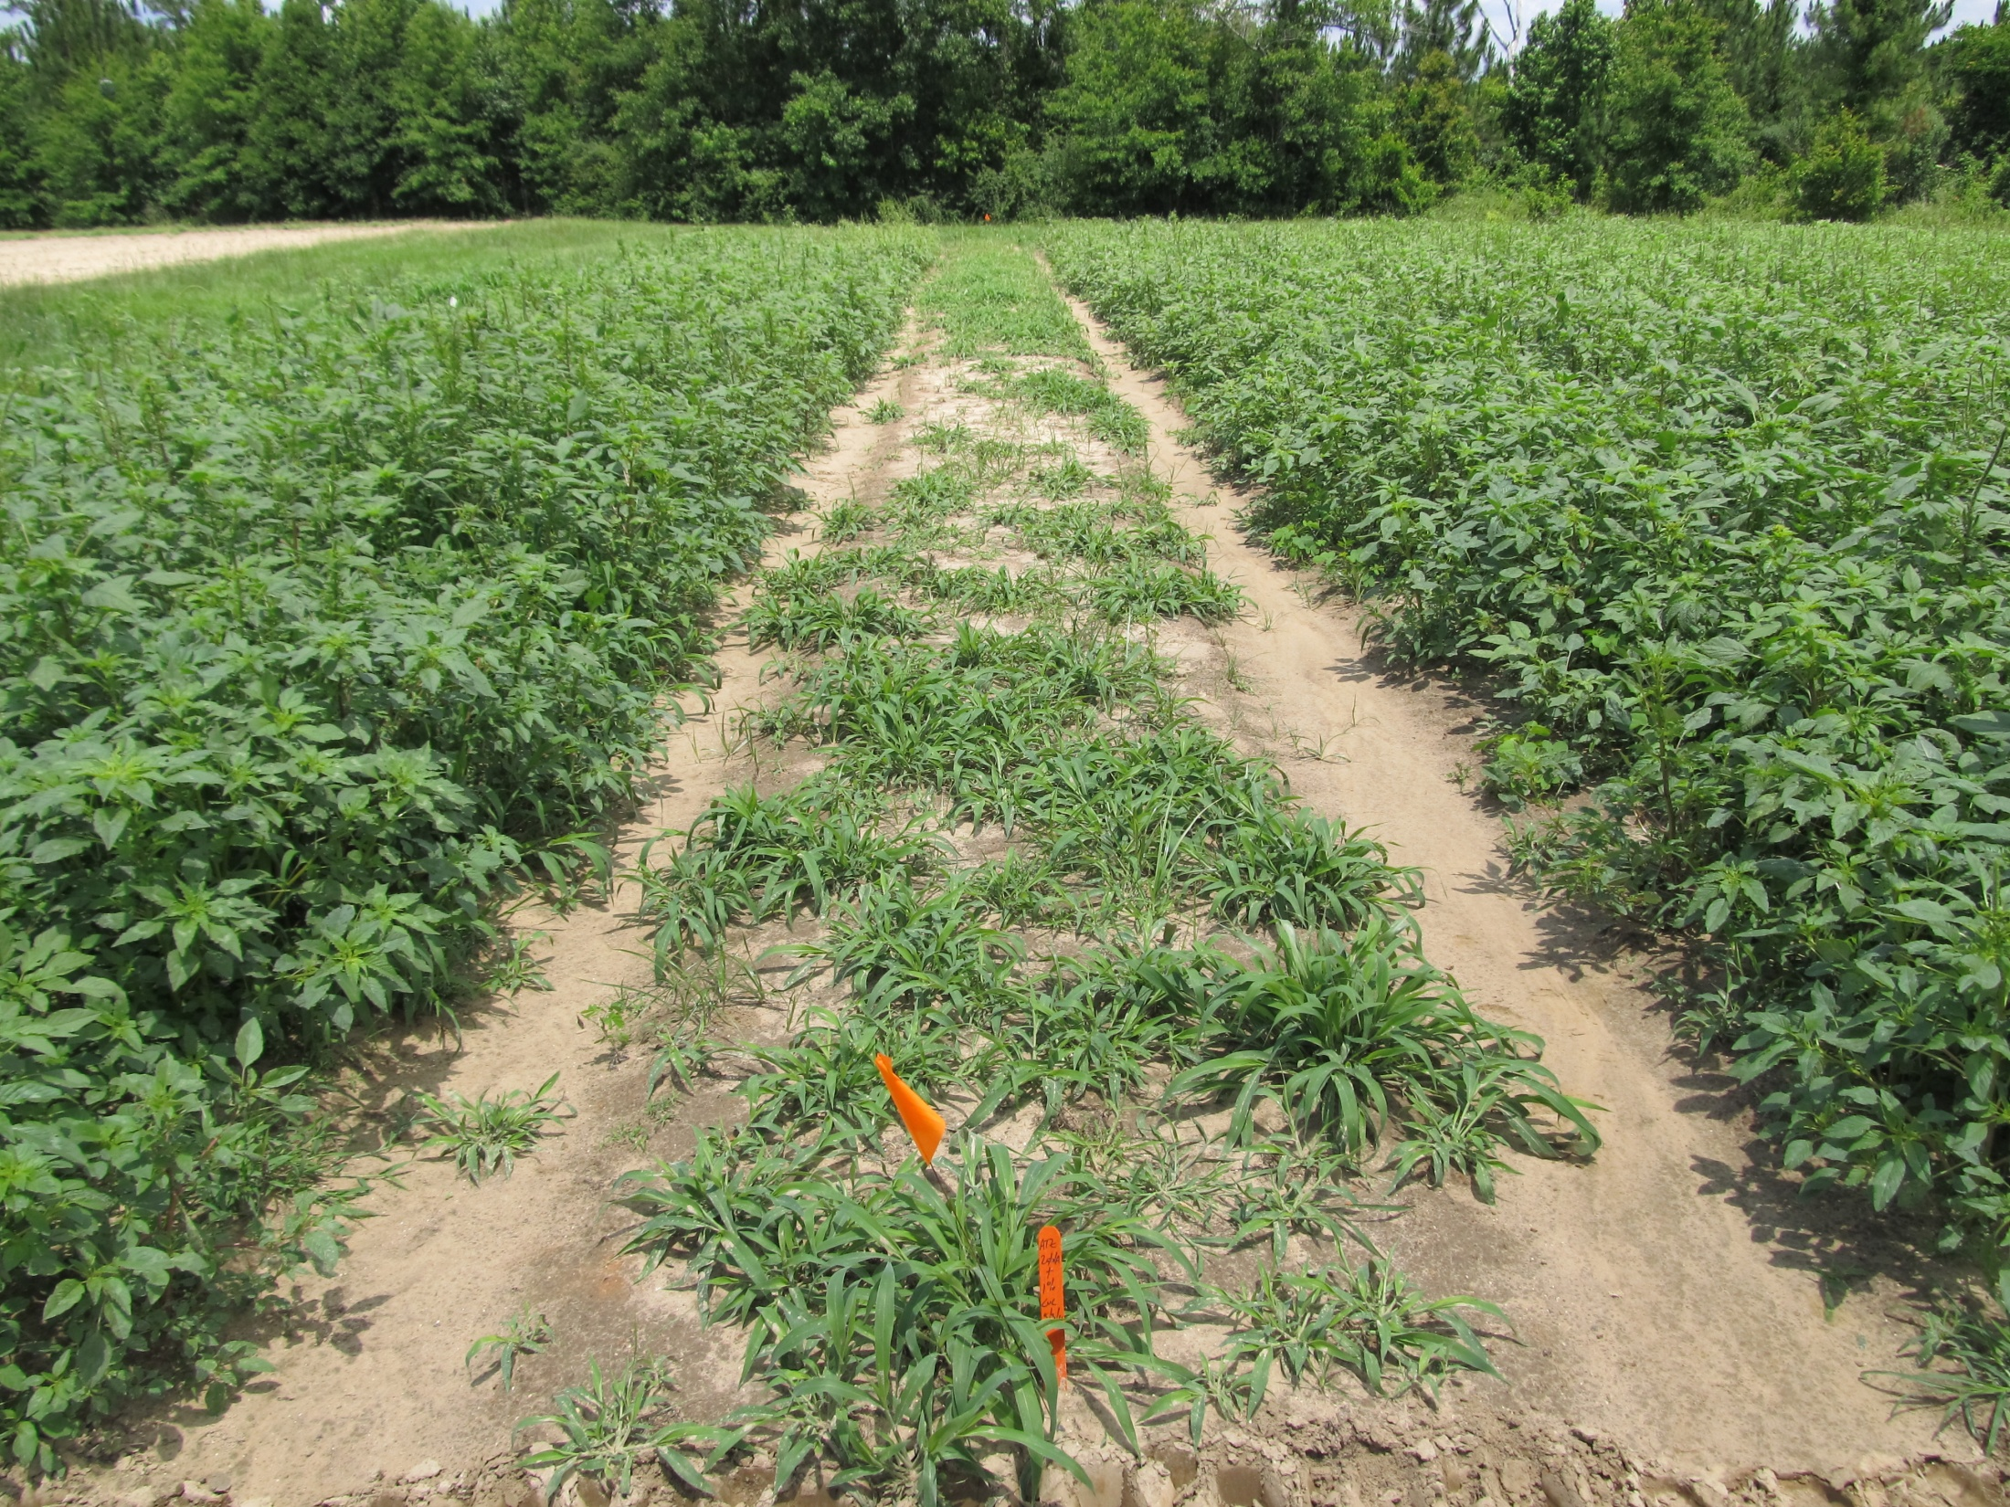
Atrazine 4L @ 2 qts/A + COC @ 1% v/v
Applied to 4”-9” Palmer Amaranth (6” average)
Photo 13 DAT

Slide 4
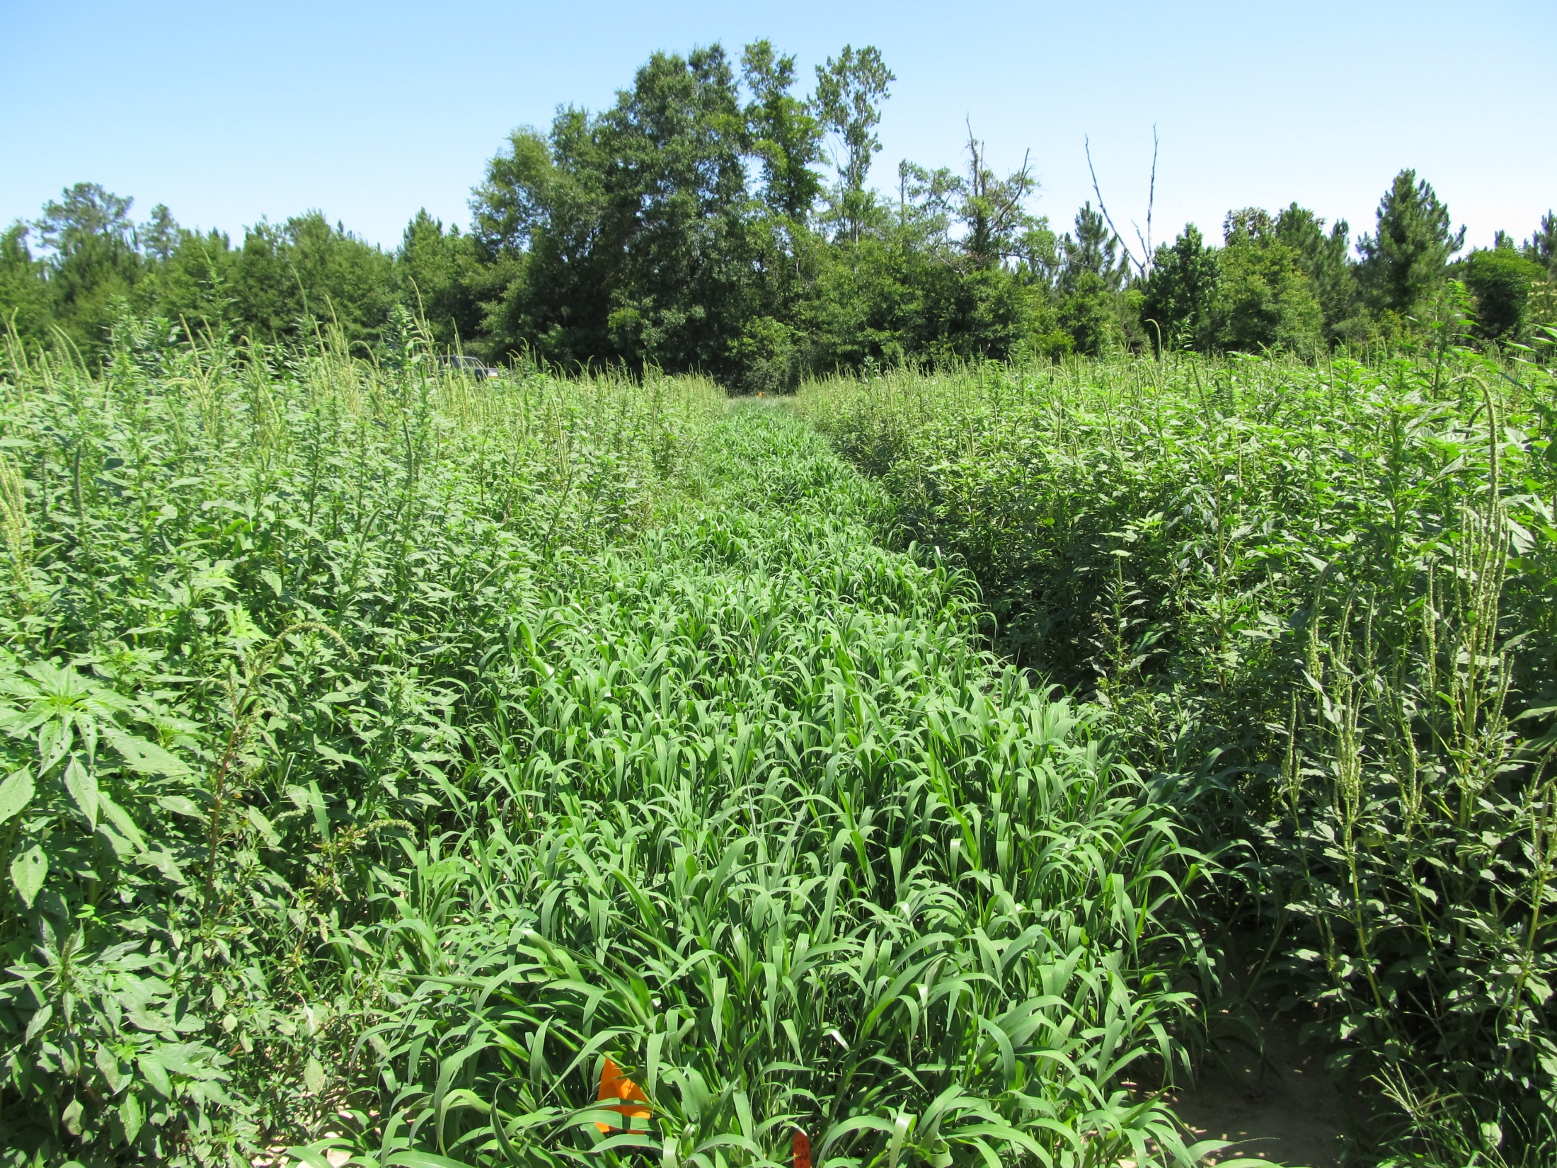
Atrazine 4L @ 2 qts/A + COC @ 1% v/v
Applied to 4”-9” Palmer Amaranth (6” average)
Photo 28 DAT

Slide 5

Future of Atrazine?
In April 2010, EPA stated that no additional testing is warranted to address the issue of atrazine and amphibian gonadal development.
On May 6, 2011, Save The Frogs petitioned the EPA to ban the use and production of atrazine.
Public comments were accepted until November 14, 2011
??

Slide 6
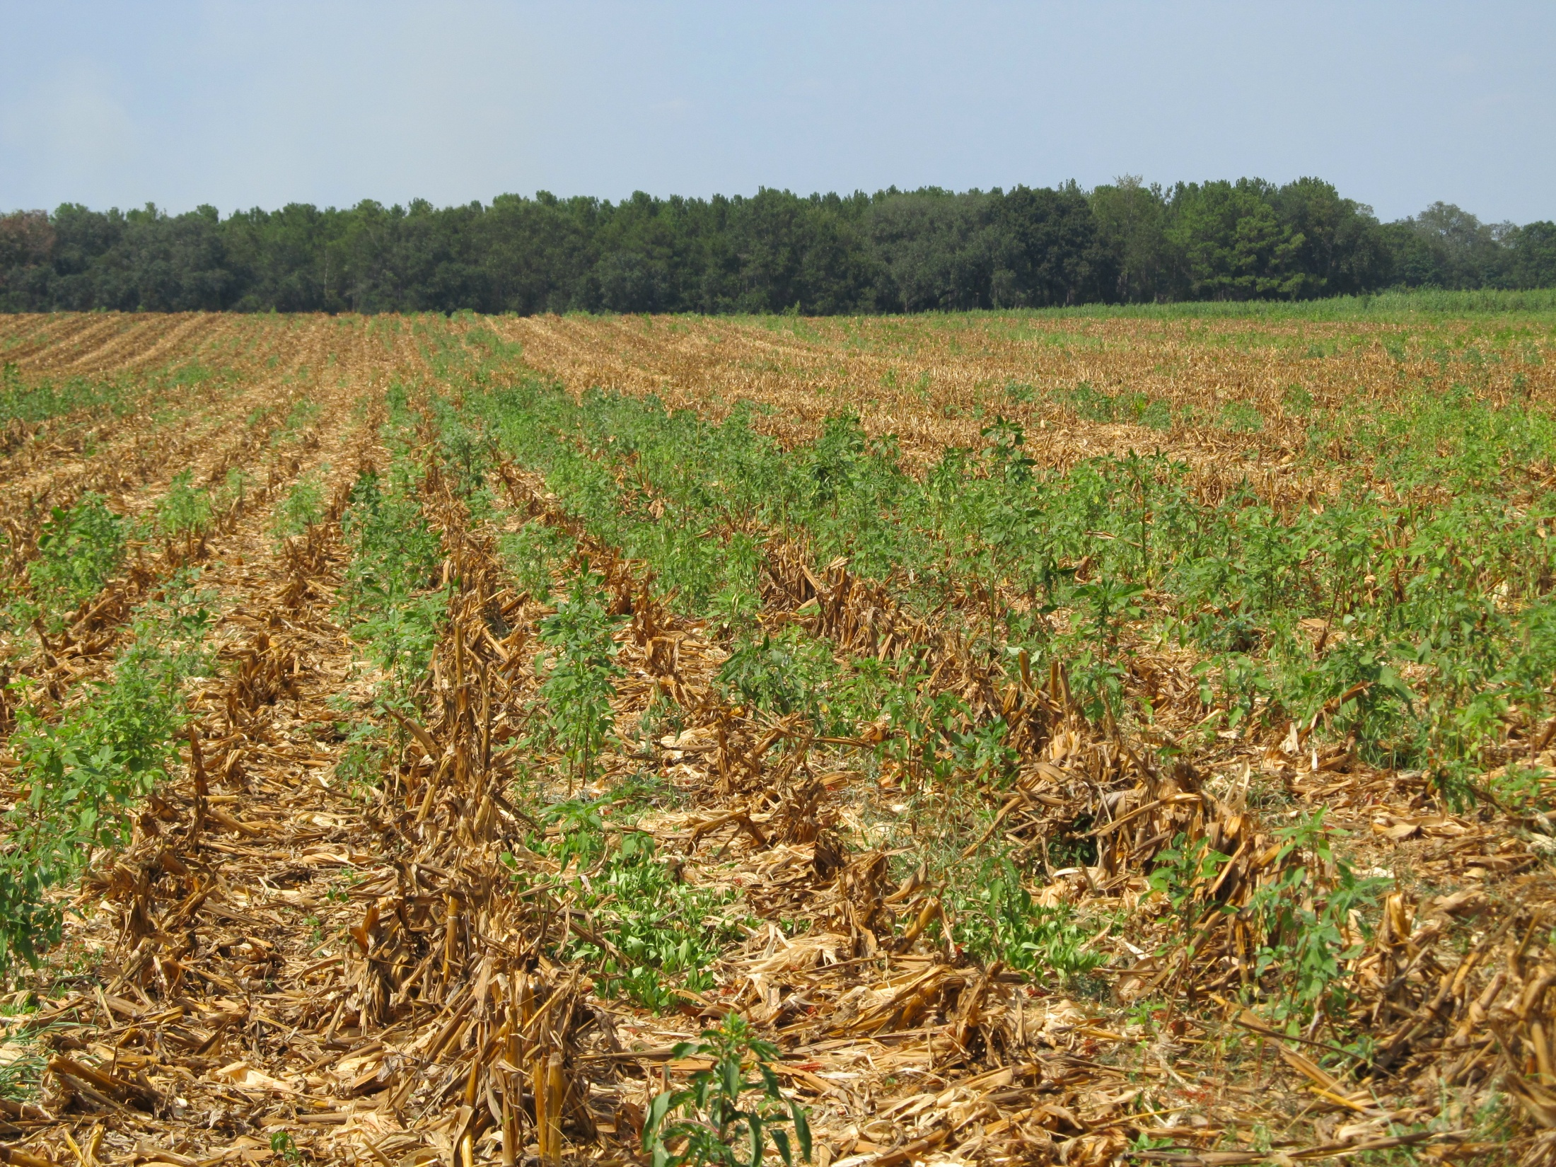
Post-Harvest Palmer Amaranth Populations Must be Managed!

Slide 7
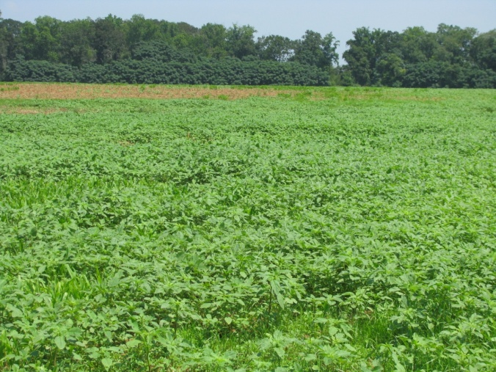
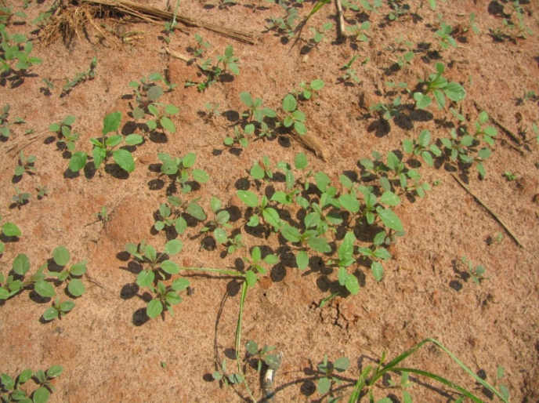
Post-Harvest (Corn) Pigweed Problems
Decreasing daylight hastens flower and seed production
  Flowering (3-4 weeks)
  Seed production (2-3 weeks)
  Some germination at 41⁰F (8%)
Control Options
  Mowing/Tillage (>6” weeds)
  Herbicides (<6” weeds)
    No small grain
      Gramoxone + Dual Magnum or Warrant (?)
    Small Grain planted soon
      Gramoxone + 2,4-D or dicamba
When can we stop worrying about seed production?
Keeley et al. 1987. Weed Science 35:199-204
Steckel et al., 2004. Weed Science 52:217-221

Slide 8
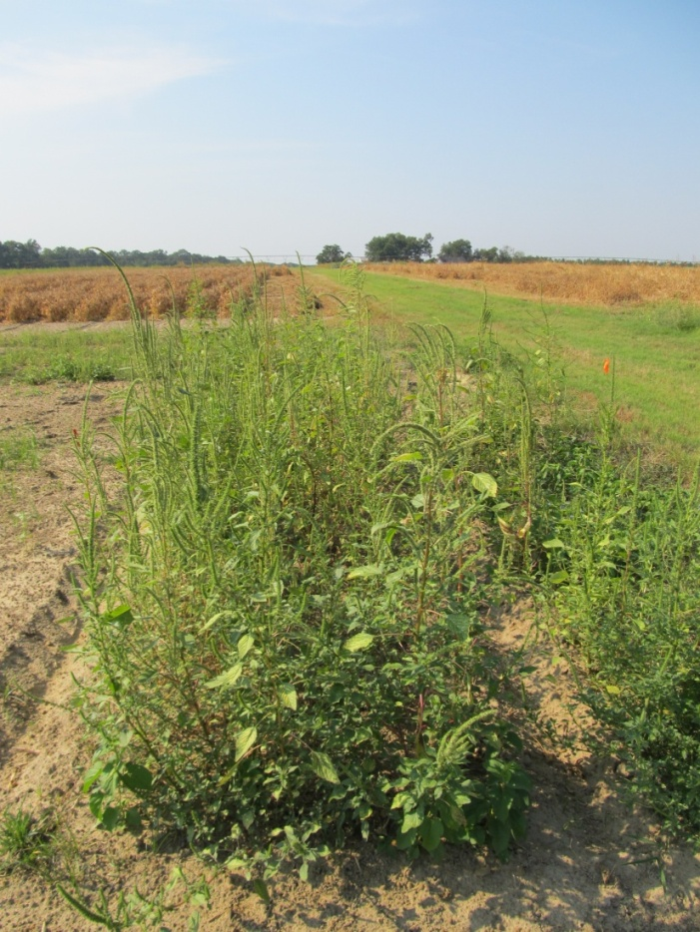
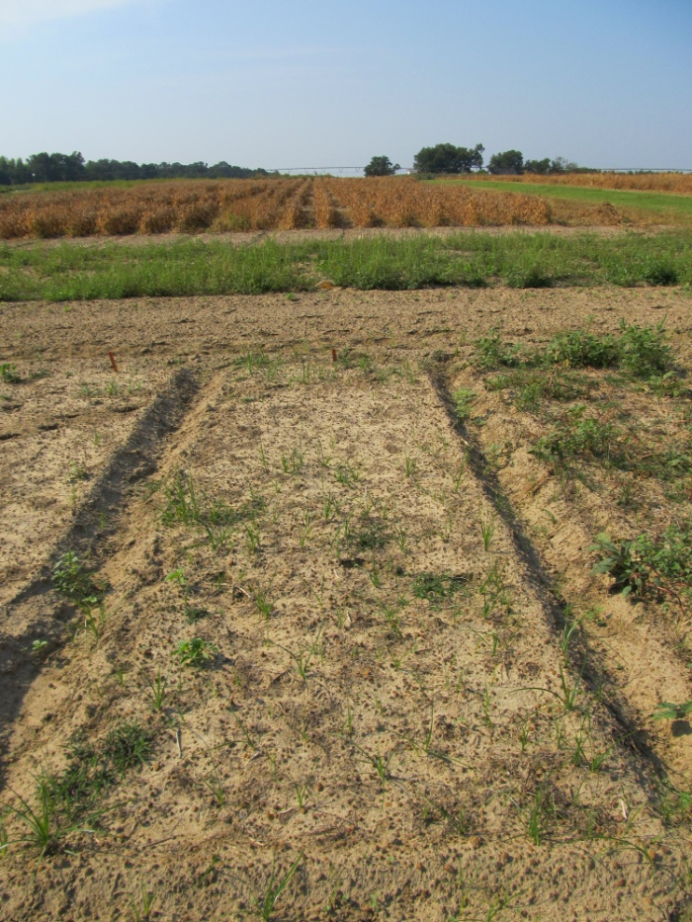
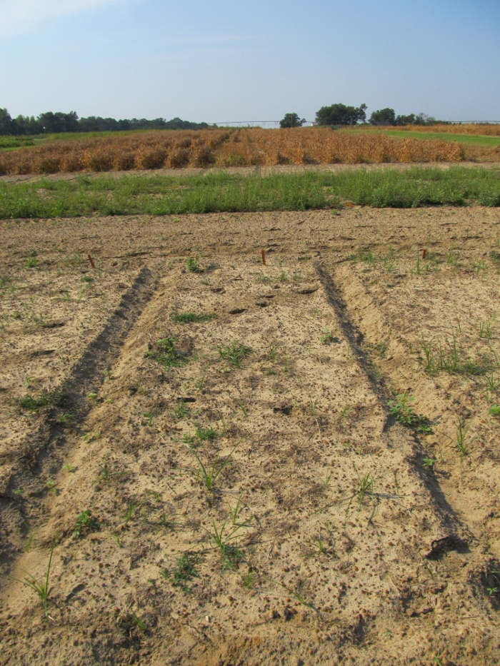
Post-Harvest Control of Palmer Amaranth
(6” average: 2”-17” range at application)
NTC
Gramoxone Inteon 2SL @ 3 pt/A
2,4-D Amine 3.8SL @ 1 pt/A
Primary @ 1% v/v
Gramoxone Inteon 2SL @ 3 pt/A
Clarity 4SL @ 8 oz/A
Primary @ 1% v/v
CN-01B-11
September 15
30 DAT

Slide 9
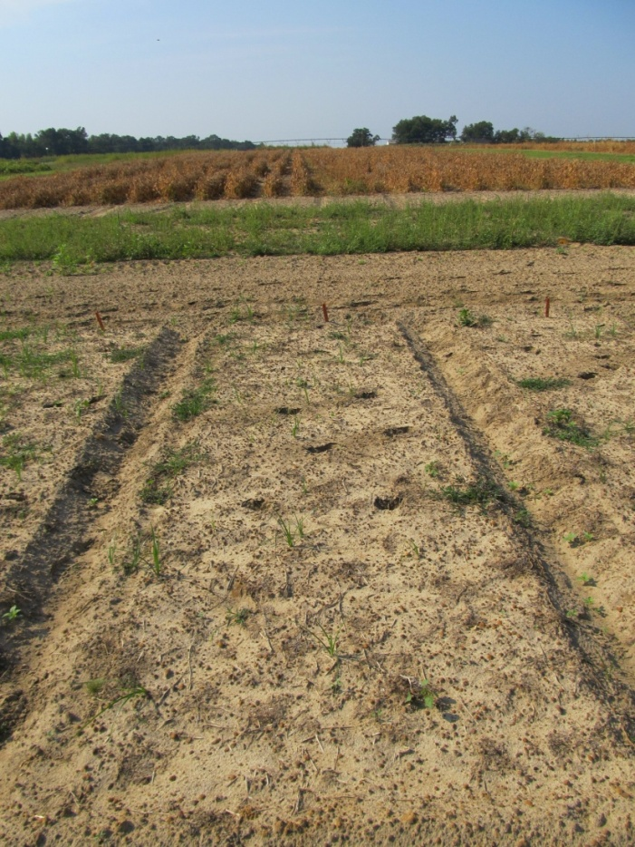
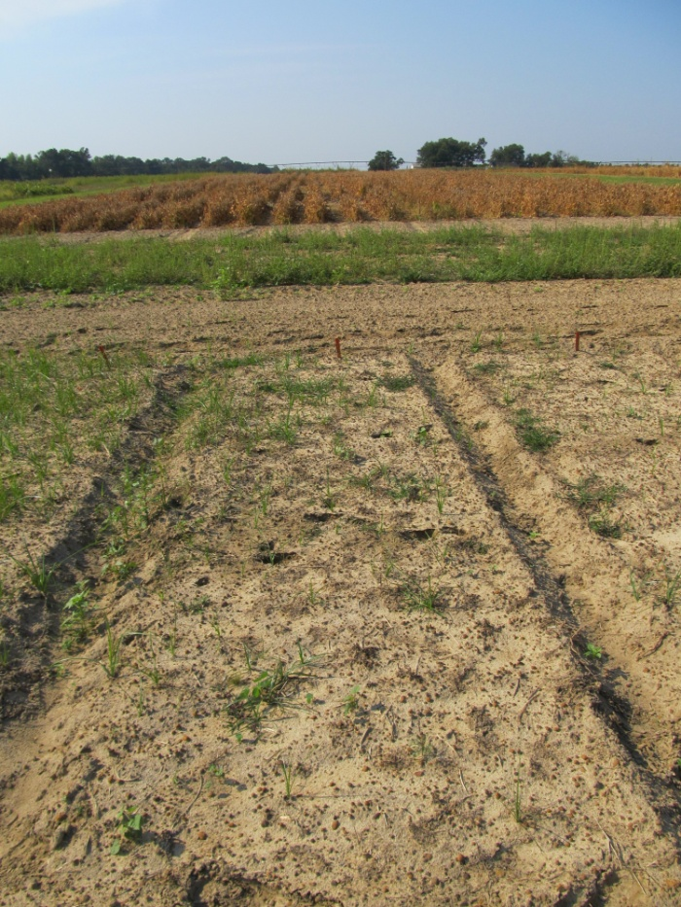
Post-Harvest Control of Palmer Amaranth
(6” average: 2”-17” range at application)
NTC
Gramoxone Inteon 2SL @ 3 pt/A
Dual Magnum 7.62EC @ 16 oz/A
Primary @ 1% v/v
Gramoxone Inteon 2SL @ 3 pt/A
Warrant 3ME @ 48 oz/A
Primary @ 1% v/v
CN-01B-11
September 15
30 DAT

Slide 10

Capreno
Bayer CropScience
Thiencarbazone-methyl (0.57 lb/gal) (MOA = 2)
Tembotrione (2.88 lbs/gal) (MOA = 27)
  Laudis
Isoxadifen (crop safener)
3.45 SC formulation
POST corn
  OT Up until V1-V6; PDIR – V7
3 oz/A of Capreno
  2.5 oz/A Laudis, normal rate is 3 oz/A
COC + AMS or UAN
OP/ALS Soil Interaction
Rotation Restrictions
  Corn = 0 months; wheat = 4 months; cotton, soybean, sorghum = 10 months; peanut = 12 months; canola, tobacco = 18 months
Tank-Mixes
  Atrazine, Ignite, Glyphosate

Slide 11
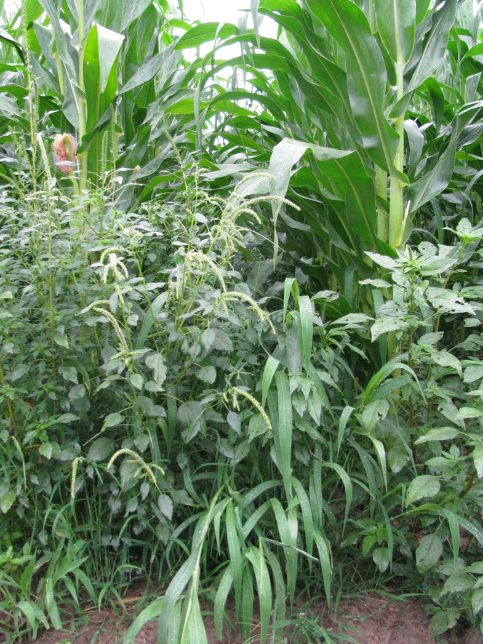
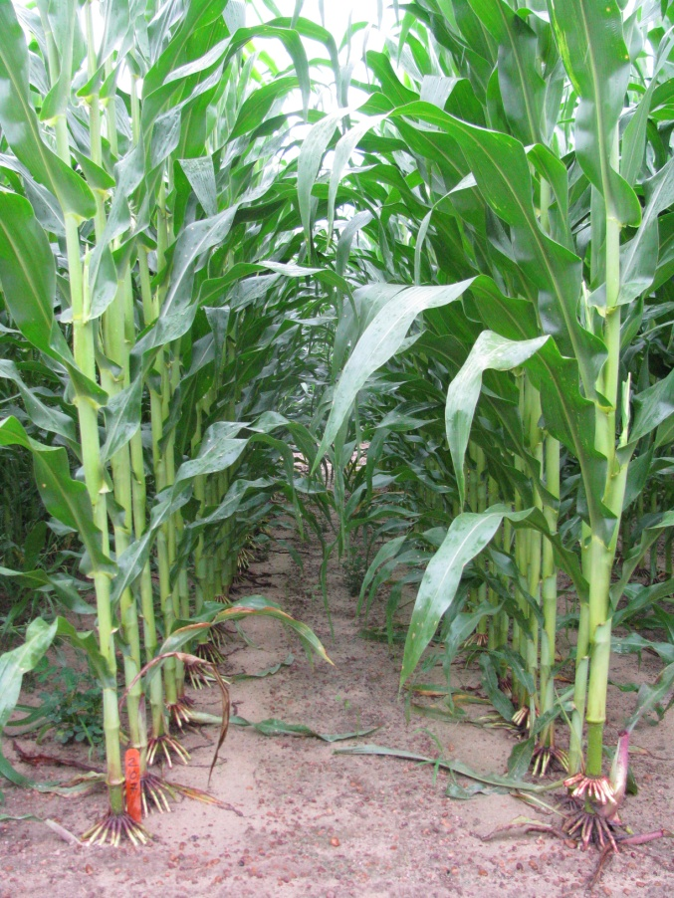
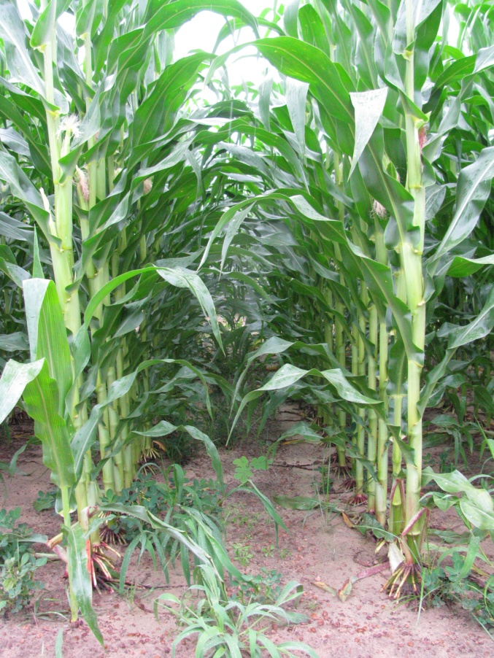
Capreno vs. Laudis (51 DAT)
NTC
Capreno 3.45SC @ 3 oz/A
MSO @ 1% v/v
AMS Xtra @ 2.5% v/v
Laudis 3.5SC @ 3 oz/A
MSO @ 1% v/v
AMS Xtra @ 2.5% v/v
CN-14-10
Applied 19 DAP

Slide 12




Sometime In The Near Future
(pyroxasulfone)
(pyroxasulfone + Cadet)
BASF
FMC
(Glyphosate + 2,4-D +
Assure Resistance)
DowAgrosciences
Isoxaflutole (Balance) +
Thiencarbazone + Crop safener
Bayer

Slide 13
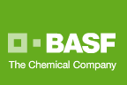
Zidua 85WG
Pyroxasulfone (KIH-485)
Residual control of annual grasses and certain broadleaf weeds including pigweed
Same MOA as Dual or Warrant but used at lower rates
Use rate: 1-2 oz/A
March 2012???

Slide 14
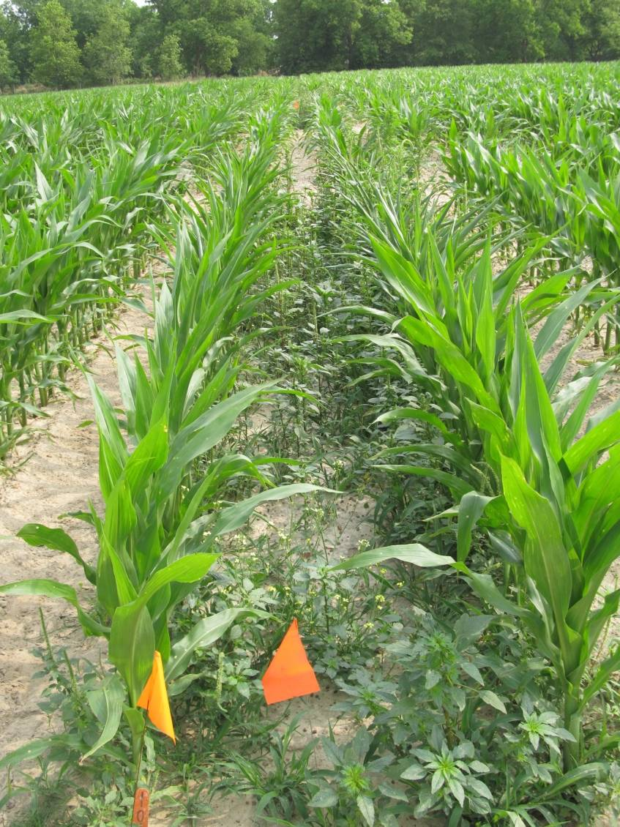
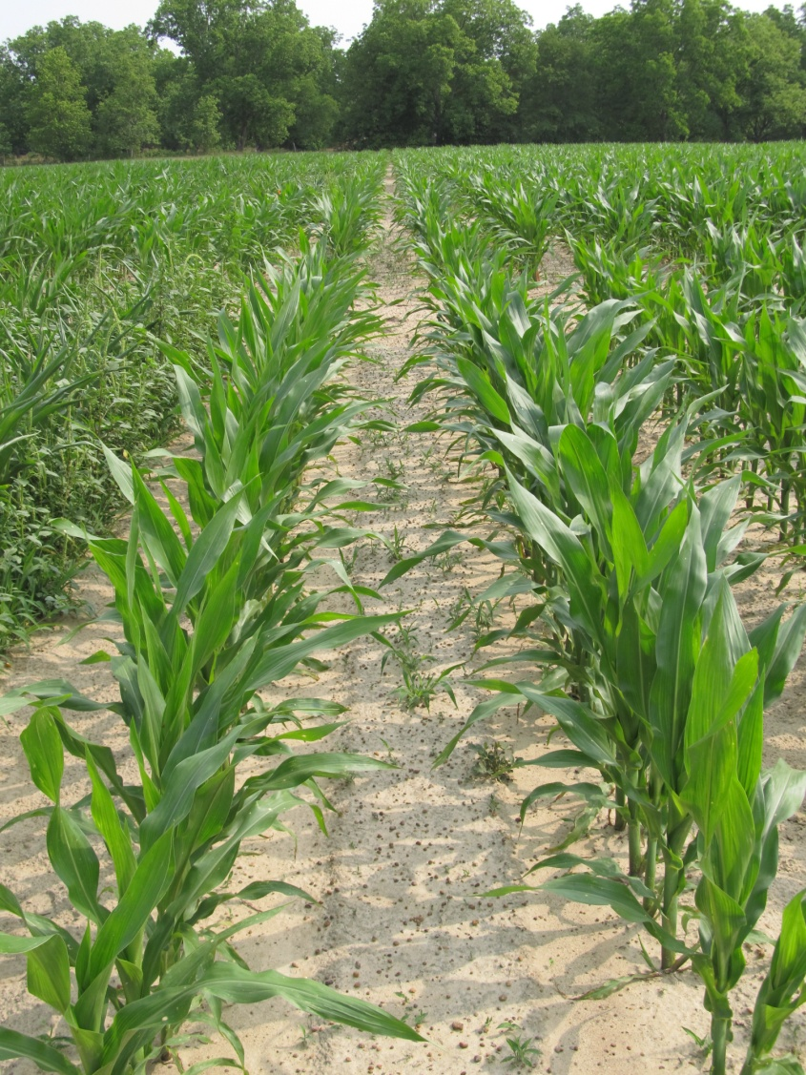
Weed Control in Field Corn with Zidua - 2011
NTC
Zidua 85WG @ 2 oz/A (PRE)
CN-11-11
May 11
47 DAT

Slide 15
Anthem 2.15L
Cadet (0.0632 lb/gal) + Pyroxasulfone (2.0868 lb/gal)
Residual control of annual grasses and certain broadleaf weeds including pigweed
Use rate: 3.5-7.0 oz/A (?)

Slide 16
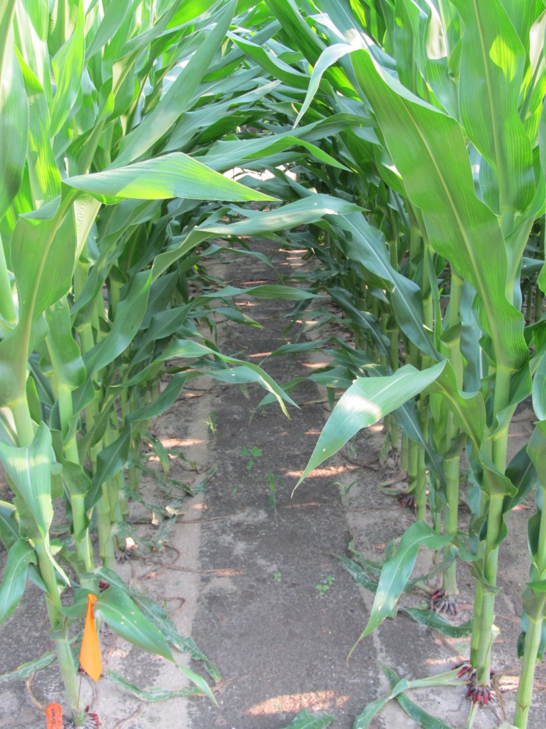
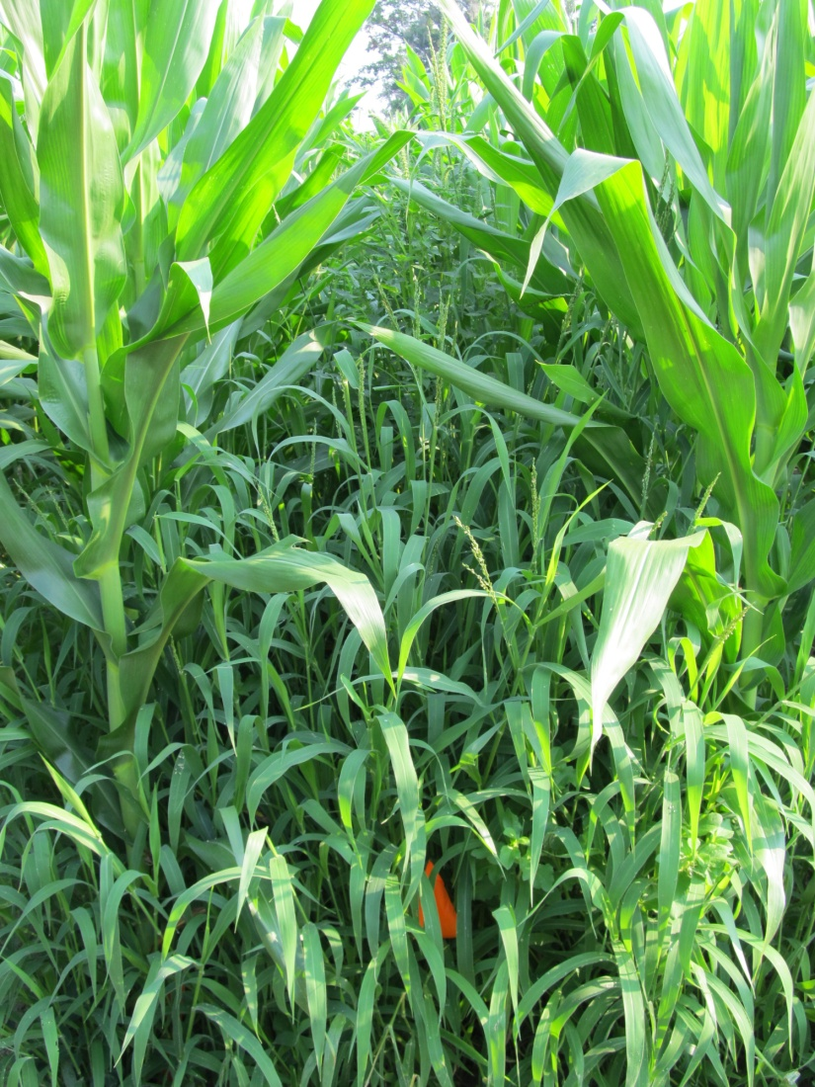
Weed Control in Field Corn with Anthem - 2011
Anthem 2.15SL @ 5 oz/A (EPOST)
Roundup W-Max 5.5SL @ 22 oz/A (EPOST)
Roundup W-Max 5.5SL @ 22 oz/A (MPOST)
NTC
CN-14-11
June 6
60 DAP

Slide 17

Corvus 2.63SC
3.33 oz/A
PRE or EPOST (V2)
Tank-Mixtures
  Atrazine, Ignite, Glyphosate
No adjuvants needed
0.75 lbs/gal - thiencarbazone (MOA = 2)
1.88 lbs/gal - isoxaflutole (MOA = 27)
  Balance Flexx
1.25 lbs/gal - cyprosulfamide (safener)
ALS/OP Interaction Problem
Rotations
  Field corn = 0 months; soybean = 9 months; cotton = 10 months; peanut = 12 months; canola, sorghum, tobacco = 17 months

Slide 18
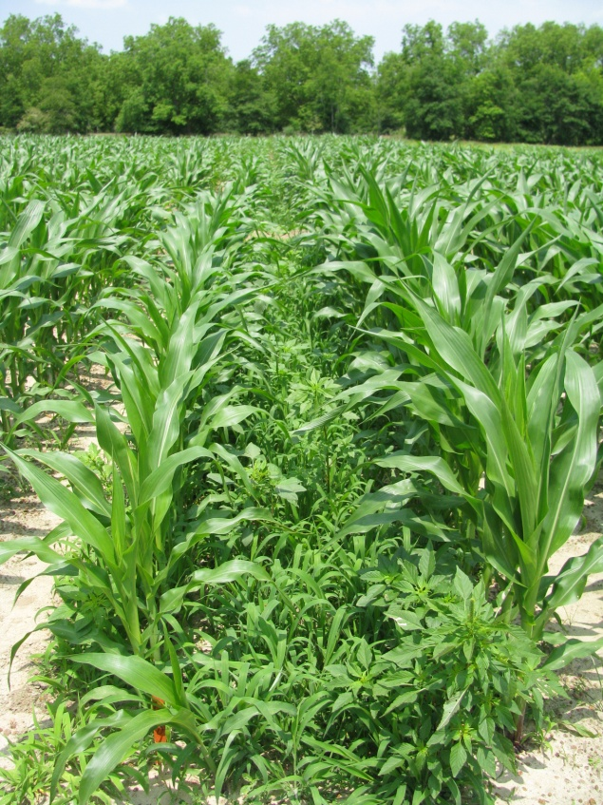
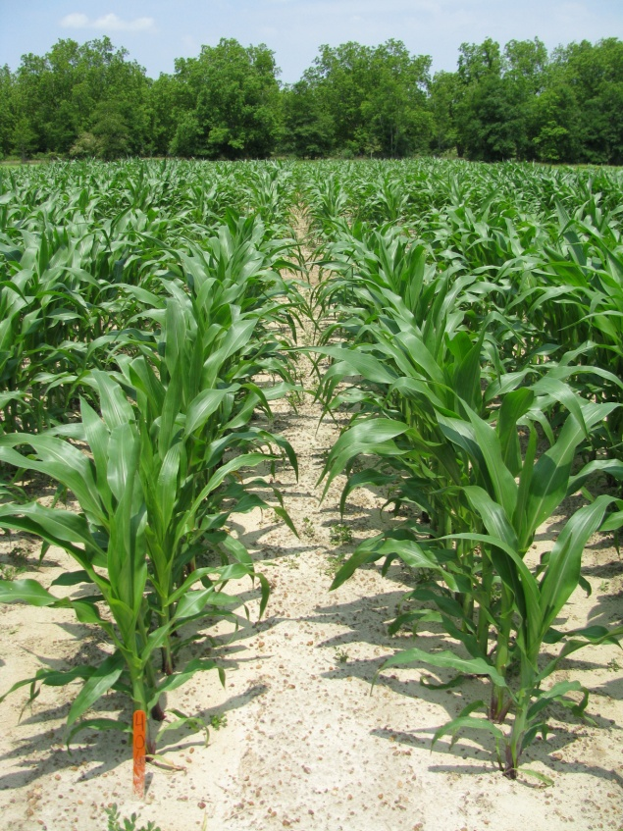
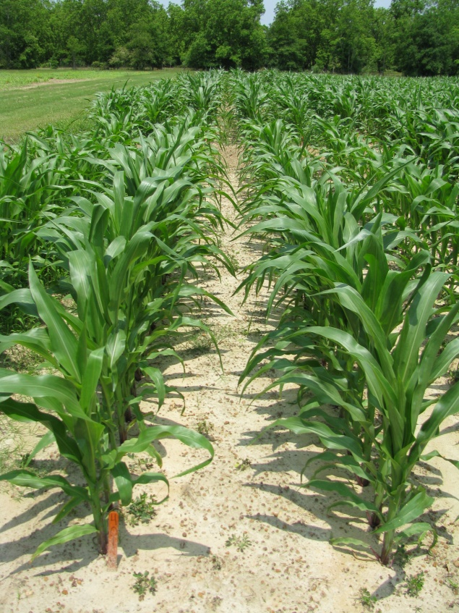
Weed Control in Field Corn with
Corvus 2.6SC @ 3 oz/A - 2010
NTC
PRE (0 DAP)
EPOST (13 DAP)
CN-02-10
May 11, 2010
47 DAP

Slide 19
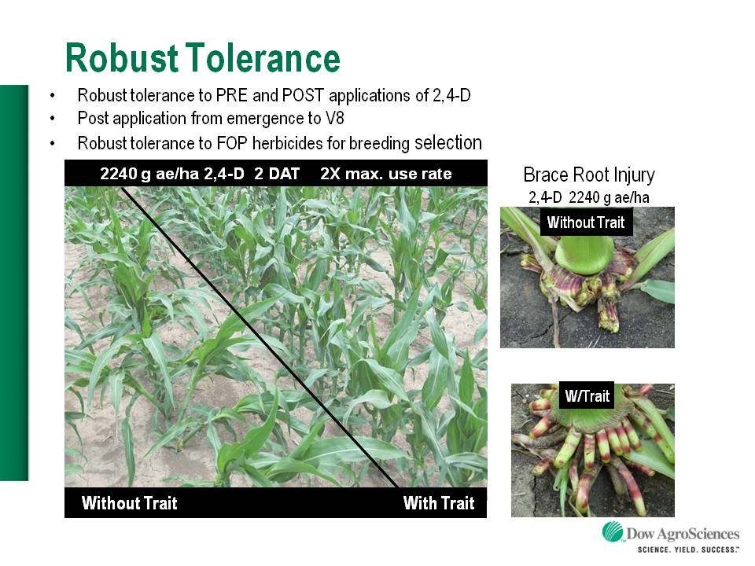
Enlist™ Herbicide Tolerant Corn
tolerance to 2,4-D and Assure
Colex-D™ technology
  2,4-D choline
  lower volatility
  lower drift potential
  enhanced handling/mixing characteristics
  reduced odor
1 PRE application + 2 POST applications (V8 stage)
Enlist™ Duo
  DMA-Glyphosate (1.71 lb ae/gal) + 2,4-D choline (1.63 lb ae/gal)
  3.5 pt/A
2013 Product Launch

Slide 20
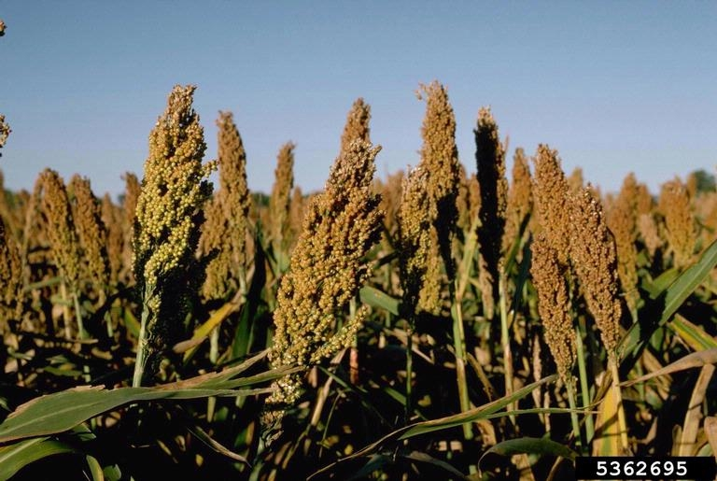
Grain Sorghum

Slide 21
GRAIN SORGHUM WEED CONTROL
Concep treated seed
Dual Magnum or Intrro/Micro-Tech or Warrant (PRE)
Atrazine (POST)
Paraquat (Hooded sprayer)

Slide 22
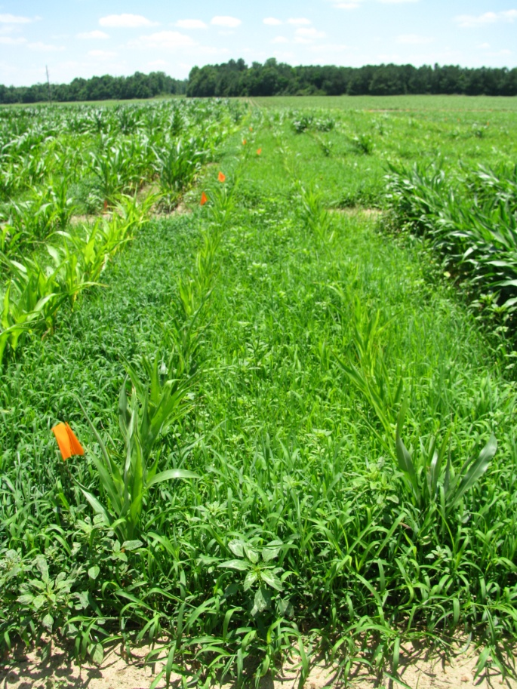
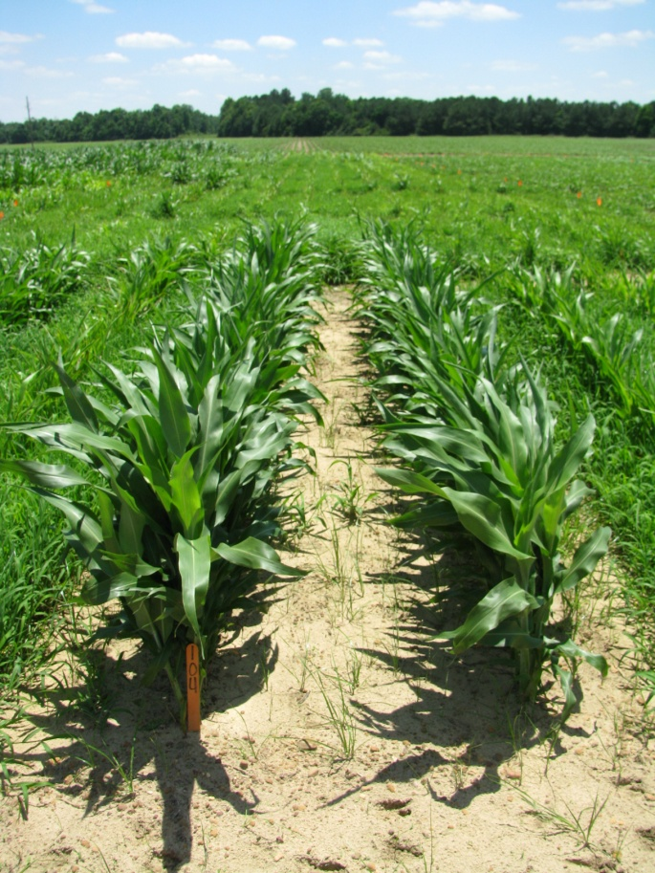
GR-Pigweed Control in Sorghum
Macon County (2010) – 47 DAP
NTC
Concep Treated Seed
Dual Magnum 7.62EC @ 1 pt/A (PRE)
Atrazine 4L @ 1.5 qt/A + COC @ 1% v/v (16 DAP)
SG-01-10
JUNE 7

Slide 23
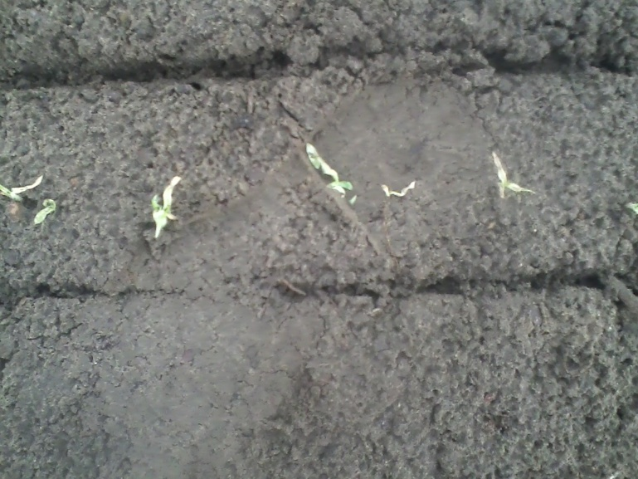
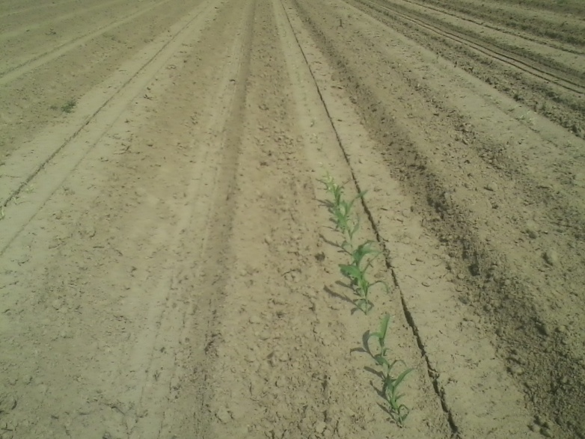
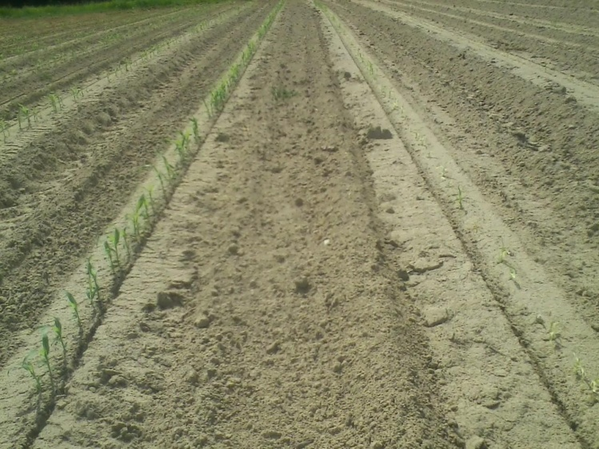
Reflex/Sorghum (10 month rotation restriction for a good reason!)

Slide 24

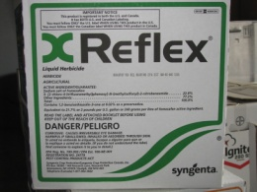
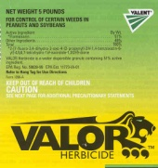

Future Concerns/Issues
ABUSE of Ignite/Liberty
Increased use of Dual Magnum and Warrant
Increased use of PPO herbicides
  Valor and Reflex

Slide 25
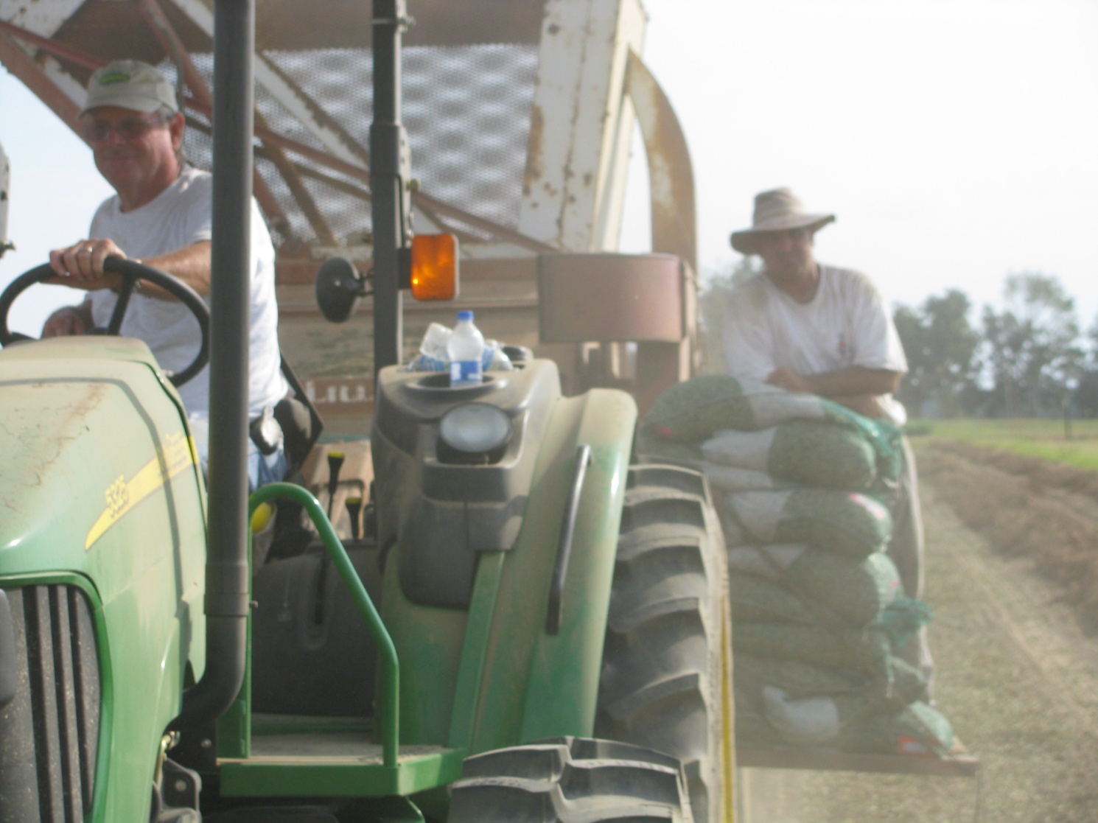
Questions/Discussion?
www.gaweed.com

