Slide 1
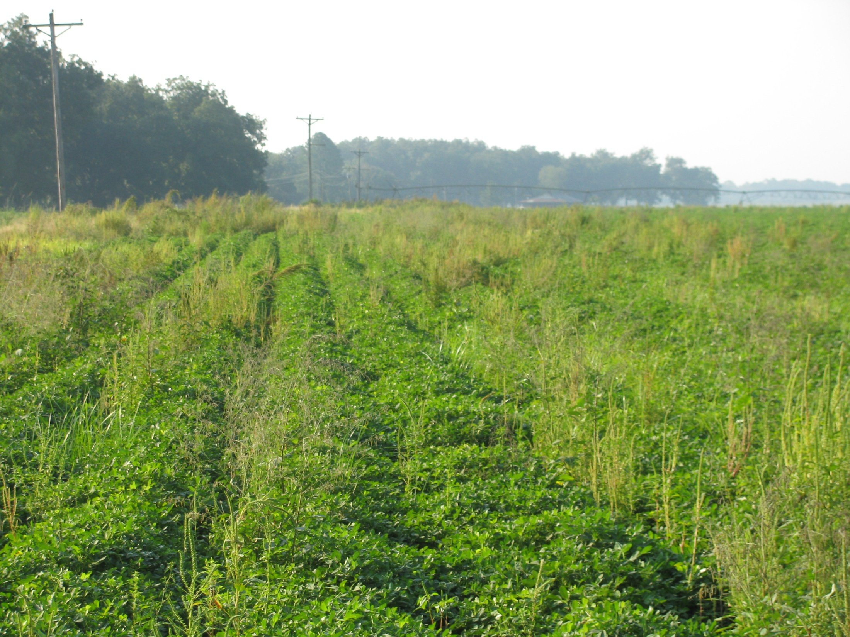
2011 Peanut Weed Control Update
Agent Training – December 2010
Eric P. Prostko, Ph.D.
Professor and Extension Weed Specialist
Department of Crop & Soil Sciences

Slide 2
Topics For Discussion
Spartan Charge
FL Beggarweed
Classic Update
Non-Selective Applicators
Tank-mixtures
Ignite
Palmer Amaranth

Slide 3
Spartan Charge 3.5L
FMC
March 2010
Spartan (3.15 lb/gal) + Aim (0.35 lb/gal)
Sulfentrazone + carfentrazone
Coarse soils with < 1.5% OM (3.75 oz/A)
3 oz/A of Spartan 4L
0.65 oz/A Aim 2EC
Concerns
FL. Beggarweed, Tropic croton
Another PPO!!!!!!!

Slide 4
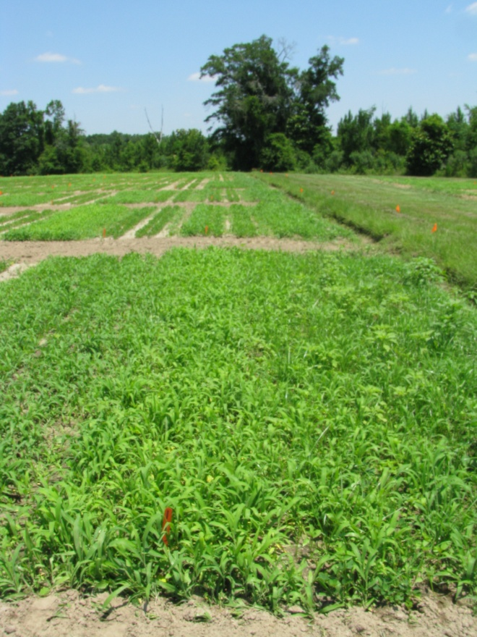
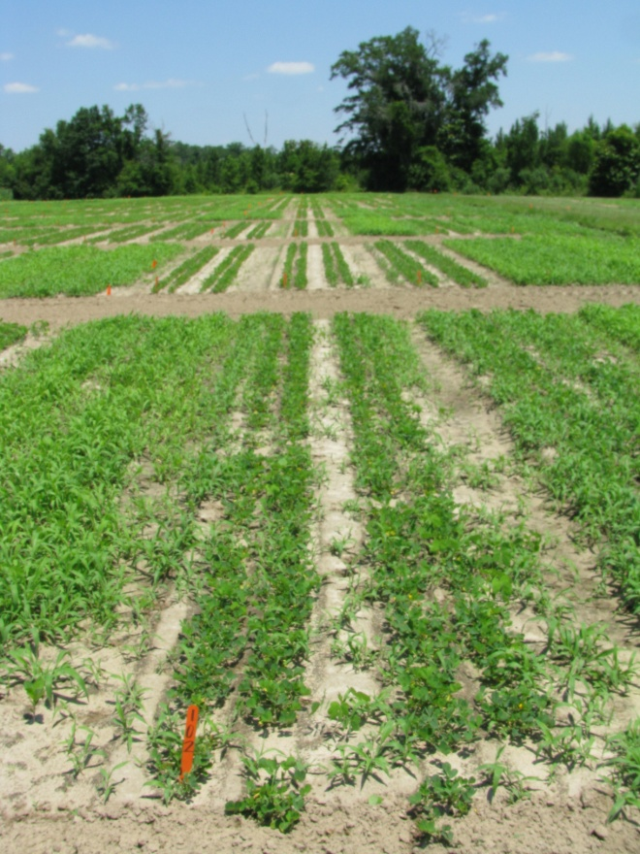
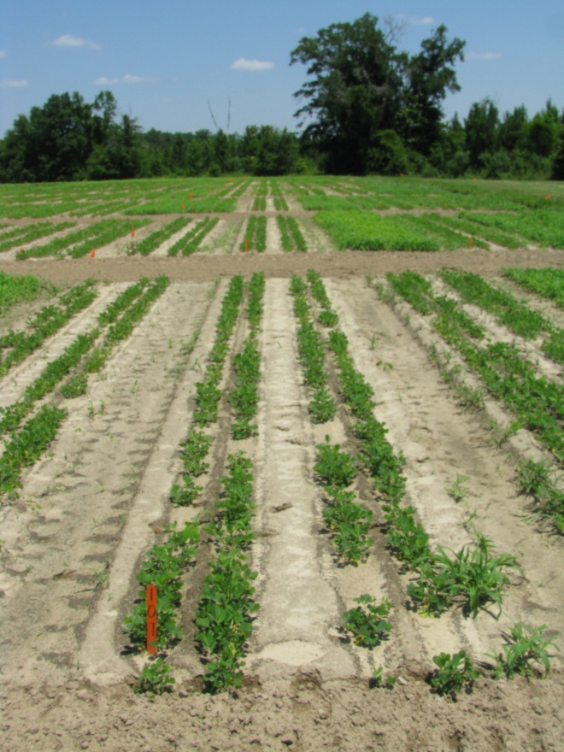
Weed Control in Peanut with Spartan Charge
NTC
Spartan Charge 3.5L @ 4 oz/A
Dual Magnum 7.62EC @ 16 oz/A
(PRE)
Valor 51WG @ 3 oz/A
Dual Magnum 7.62EC @ 16 oz/A
(PRE)
PE-16-10
June 8
25 DAT

Slide 5
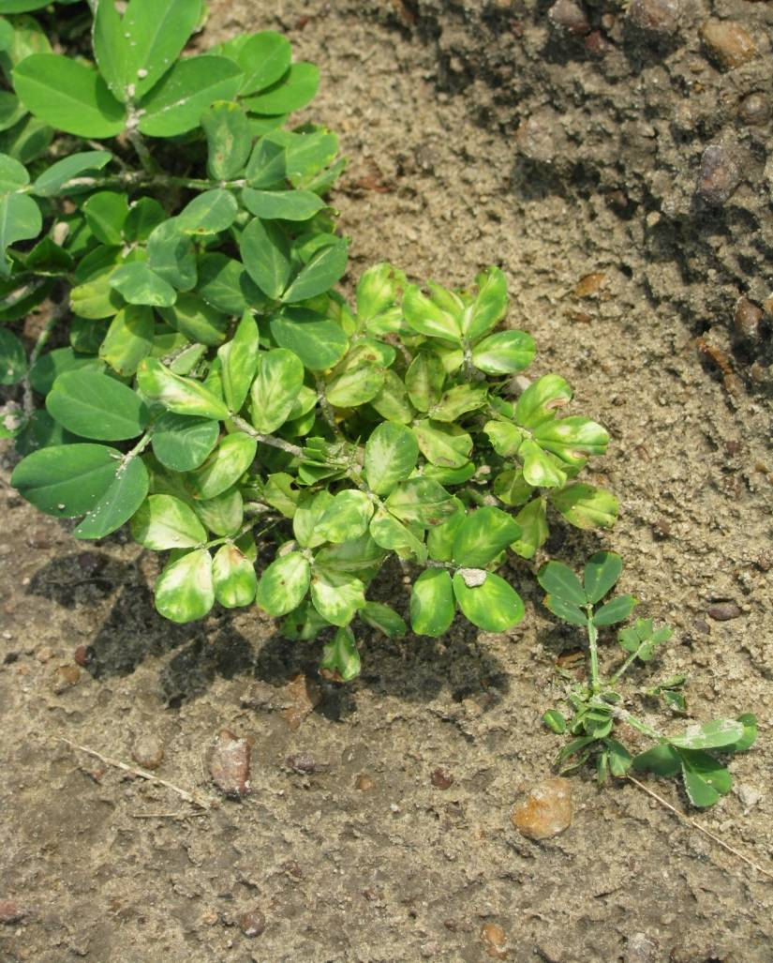
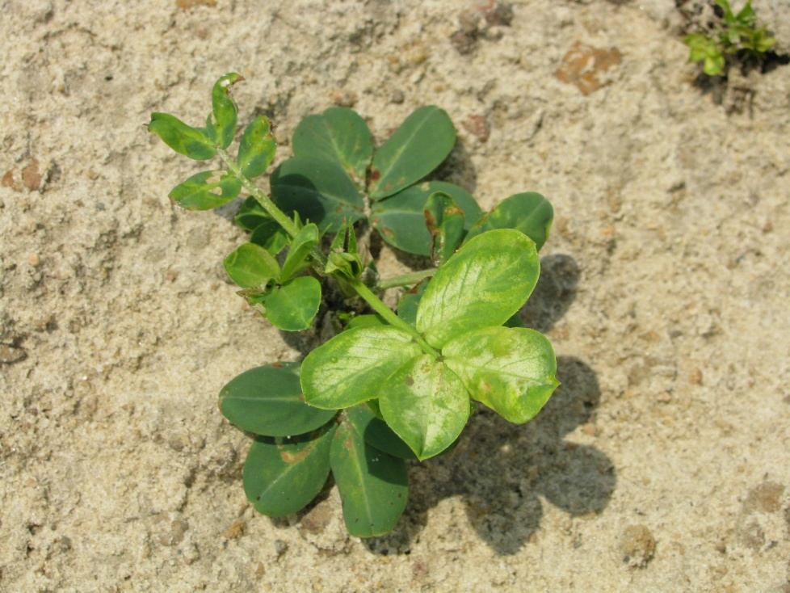
Spartan Injury

Slide 6
Florida Beggarweed Problems
Residual Herbicides
Valor (1)
Strongarm (2)
Dual (3)
Paraquat (cracking)
Tank-mixes reduce control
Cadre (POST)
< 2” tall (supression?)
Classic (LPOST)
problems with GA-06G, Tifguard
Non-Selective Applicators
paraquat

Slide 7
GA-06G Yield Response to Classic (0.5 oz/A) 2008-2009
Time of Application (DAE) | 2008 | 2009
0 | 5750 | 5710
60-69 | 5390 (-6.3%) | 4870 (-14.7%)
70-79 | 5536 | 5084 (-11%)
89-98 | 5138 (-10.6%) | 5388
105-110 | 5444 | 5811
LSD 0.10 CV | 343 5 | 572 8
DAE = Days After Peanut Emergence

Slide 8
FL-07 Yield Response to Classic (0.5 oz/A) 2009-2010
Time of Application (DAE) | 2009 | 2010
0 | 6093 | 6548
63 | 5795 (-4.9%) | 6709
72-77 | 6009 | 6292
88-91 | 6193 | 6597
104-105 | 6312 | 6443
LSD 0.10 CV | 297 4 | NS 6
DAE = Days After Peanut Emergence

Slide 9
Tifguard Yield Response to Classic (0.5 oz/A) 2010-2011
Time of Application (DAE) | 2010 | 2011
0 | 5471
63 | 4895
77 | 4892
91 | 4474 (-18%)
104 | 4206 (-23%)
LSD 0.10 CV | 605 10
DAE = Days After Peanut Emergence

Slide 10
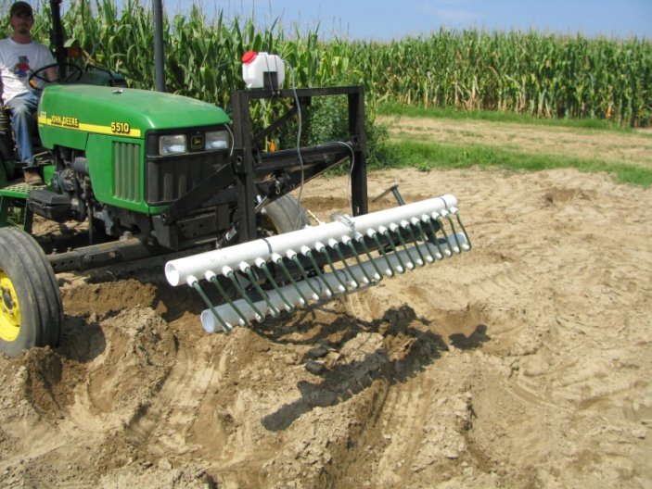
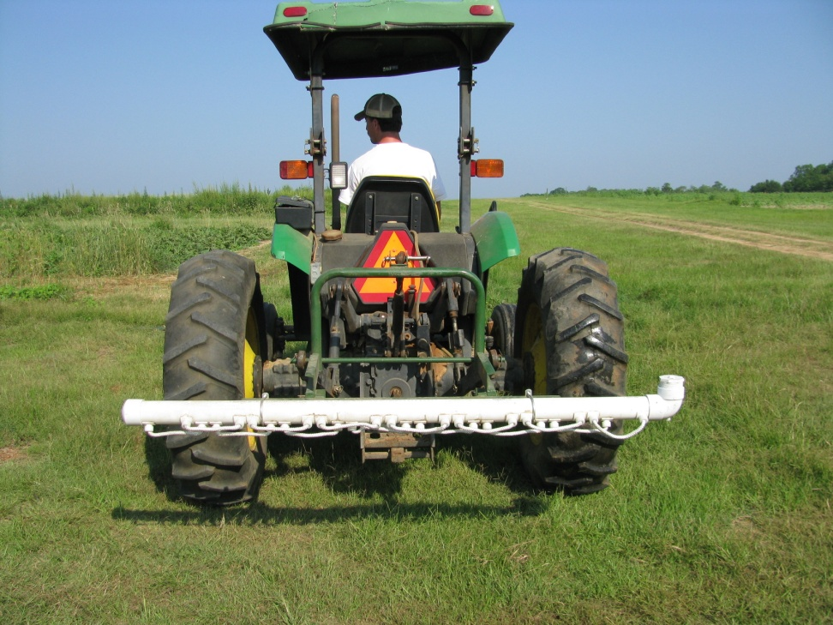
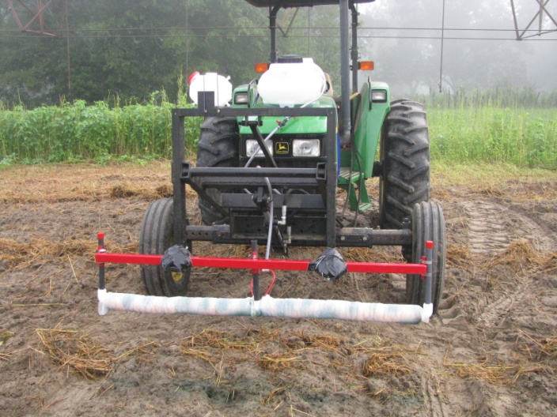
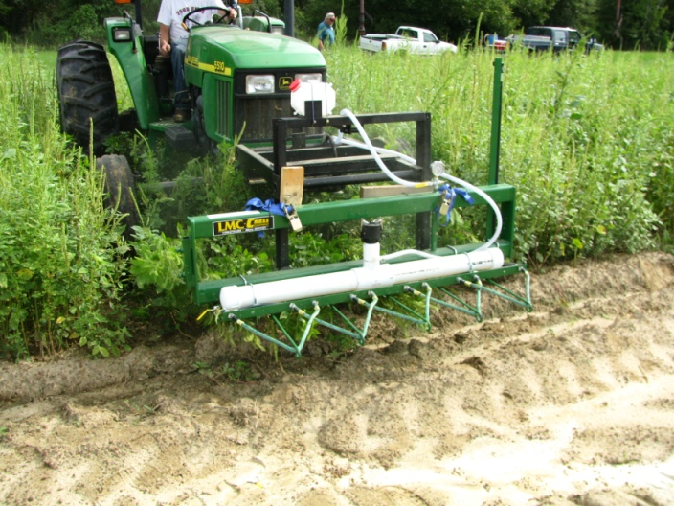
Non-Selective Applicators

Slide 11
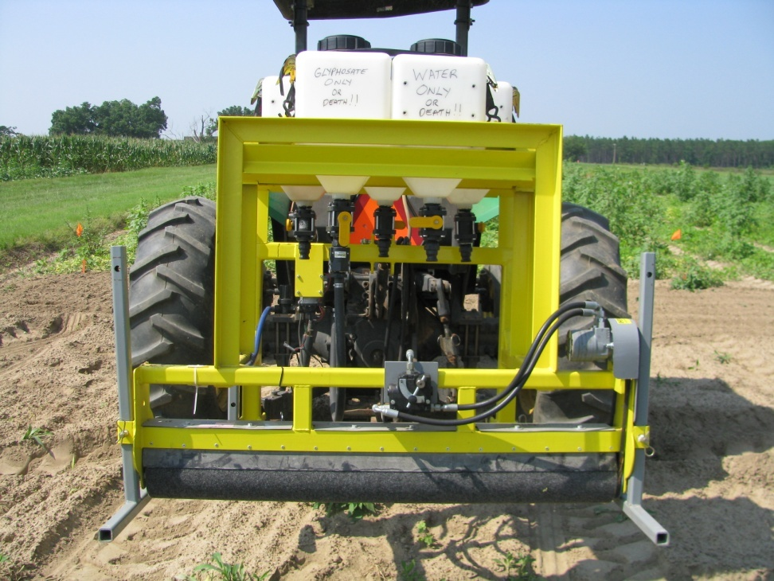
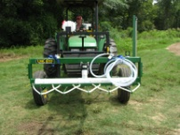
Summary of Palmer Amaranth Control (%) with Non-Selective Applicators Using Gramoxone Inteon
Trial # | Rating Date (DAT) | Gravity Flow Wick | Weed Wiper | Wick Master | Top Crop Wiper | LMC-Cross Wick | LSD (0.10)
1 | 10 | 63 | 86 | - | - | - | 9
2 | 14 | - | 90 | - | - | - | -
3 | 18 | - | 90 | - | - | - | -
4 | 24 | - | 99 | 69 | - | - | 4
5 | 29 | - | 99 | - | 99 | - | NS
6 | 28 | - | 92 | - | - | 85 | 3
50:50 solution of Gramoxone Inteon + Water except Trial #4 (25%)

Slide 12
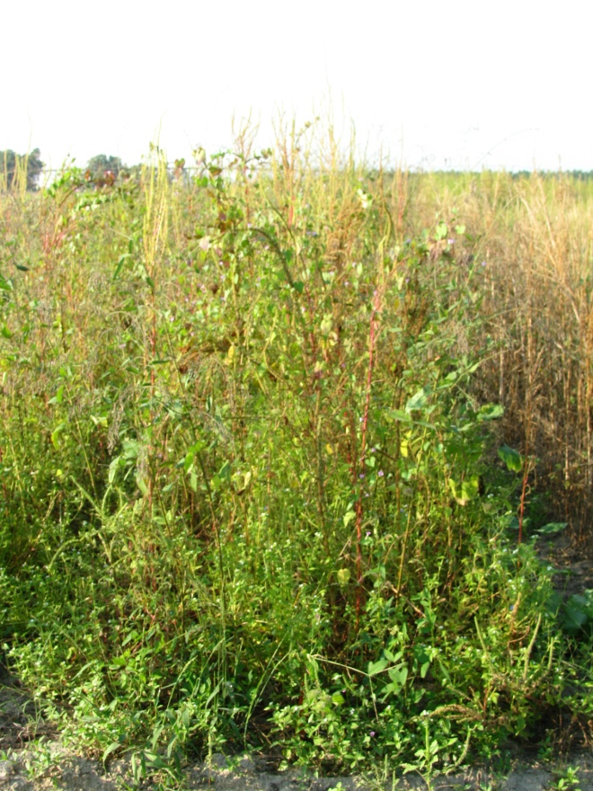
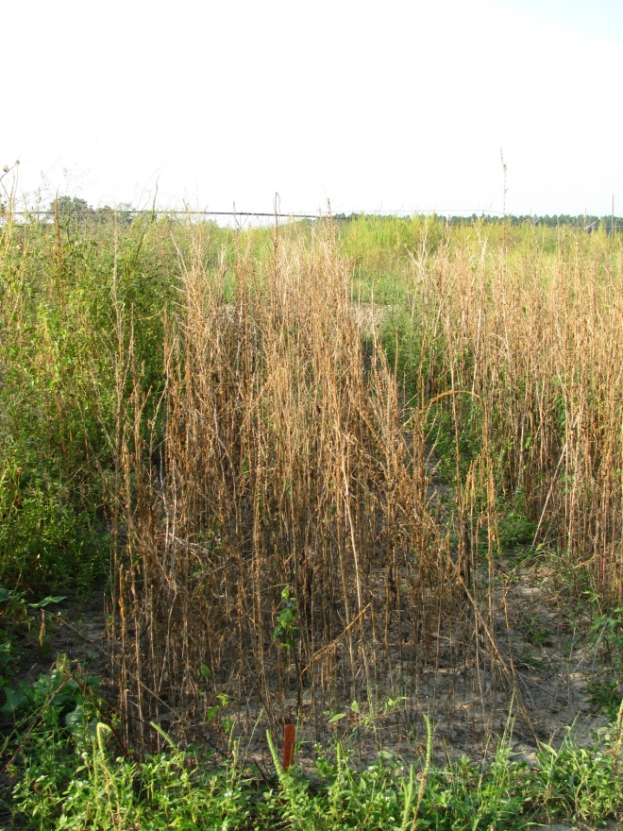
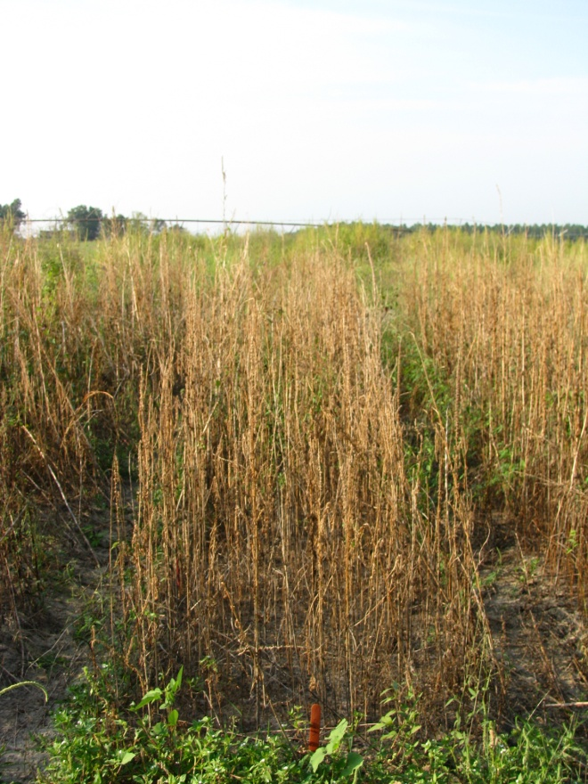
WeedWiper vs. TopCrop Sponge 50% Solution of Gramoxone Inteon 3.1 MPH, 20” Applicator Height AMAPA = 36-86” tall, 66” avg.
NTC
WeedWiper
TopCrop
PIG-07-10
9/21/10
29 DAT

Slide 13
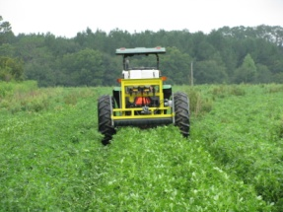
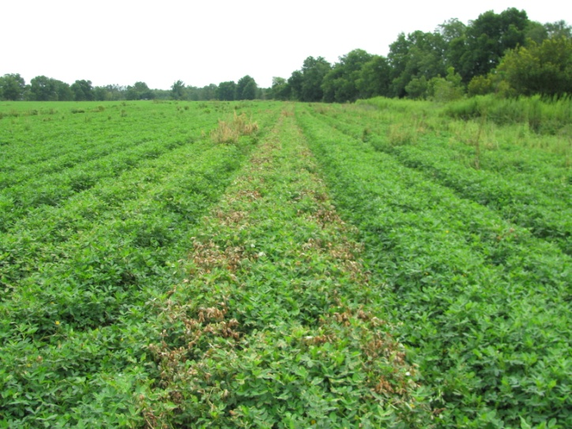
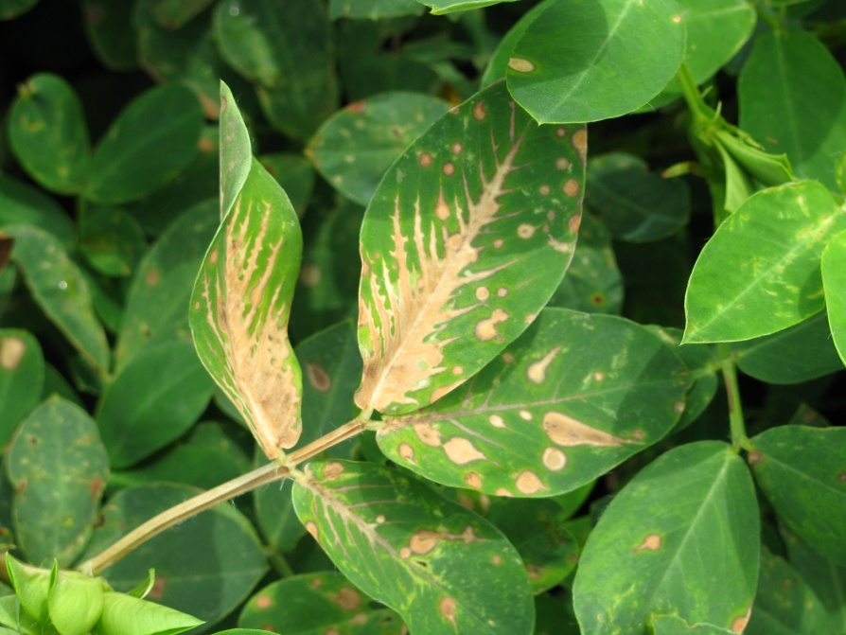
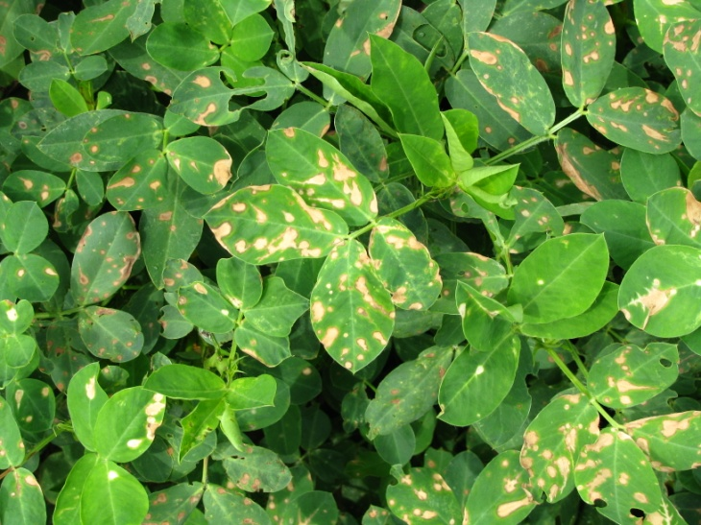
Our First Attempt in a Real Field Tift County, August 2010 (3 DAT)
Potential Problems
No gauge wheel
Hydraulic lift problem
No check valve on pump
Roller Speed
Tall peanut variety (GA-02C)
Dumb A** Scientist

Slide 14
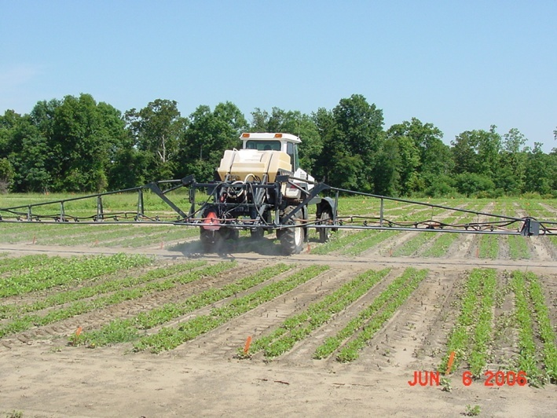
Tank-Mixtures (At least 24,000 potential tank-mixtures for peanuts)

Slide 15
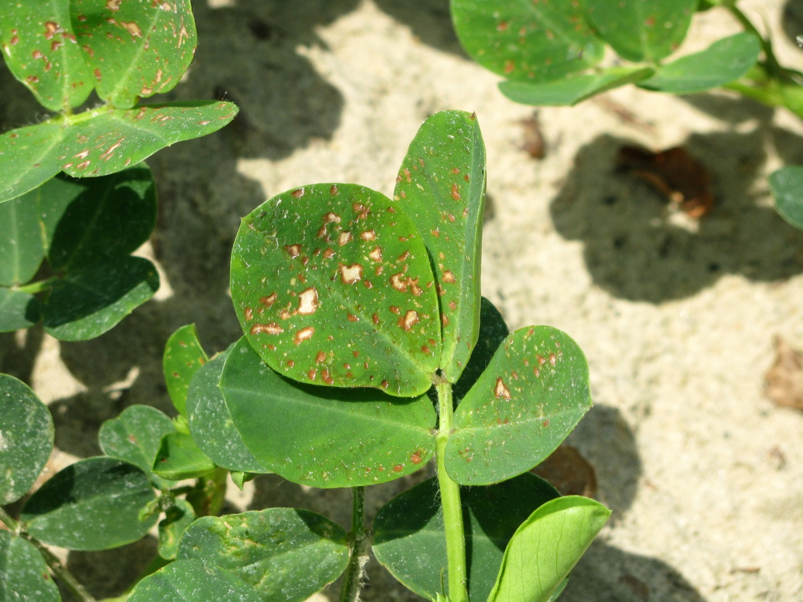
Leaf Burn Caused By Cadre 2AS (4 oz/A) + Dual Magnum 7.62EC (16 oz/A)+ 2,4-DB 1.75SL (18 oz/A) + Bravo WS 6L (24 oz/A) - 3 DAT

Slide 16
Peanut (GA-06G) Yield Response to Tank-Mixtures Cadre (C), Dual Magnum (DM), 2,4-DB (DB), Bravo WS (B) - Applied 30 DAP
lbs/A
PE-19-10
Cadre @ 4 oz/A, Dual Magnum @ 16 oz/A
2,4-DB @ 18 oz/A, Bravo WS @ 24 oz/A
LSD 0.10 = NS
CV = 10.32

Slide 17
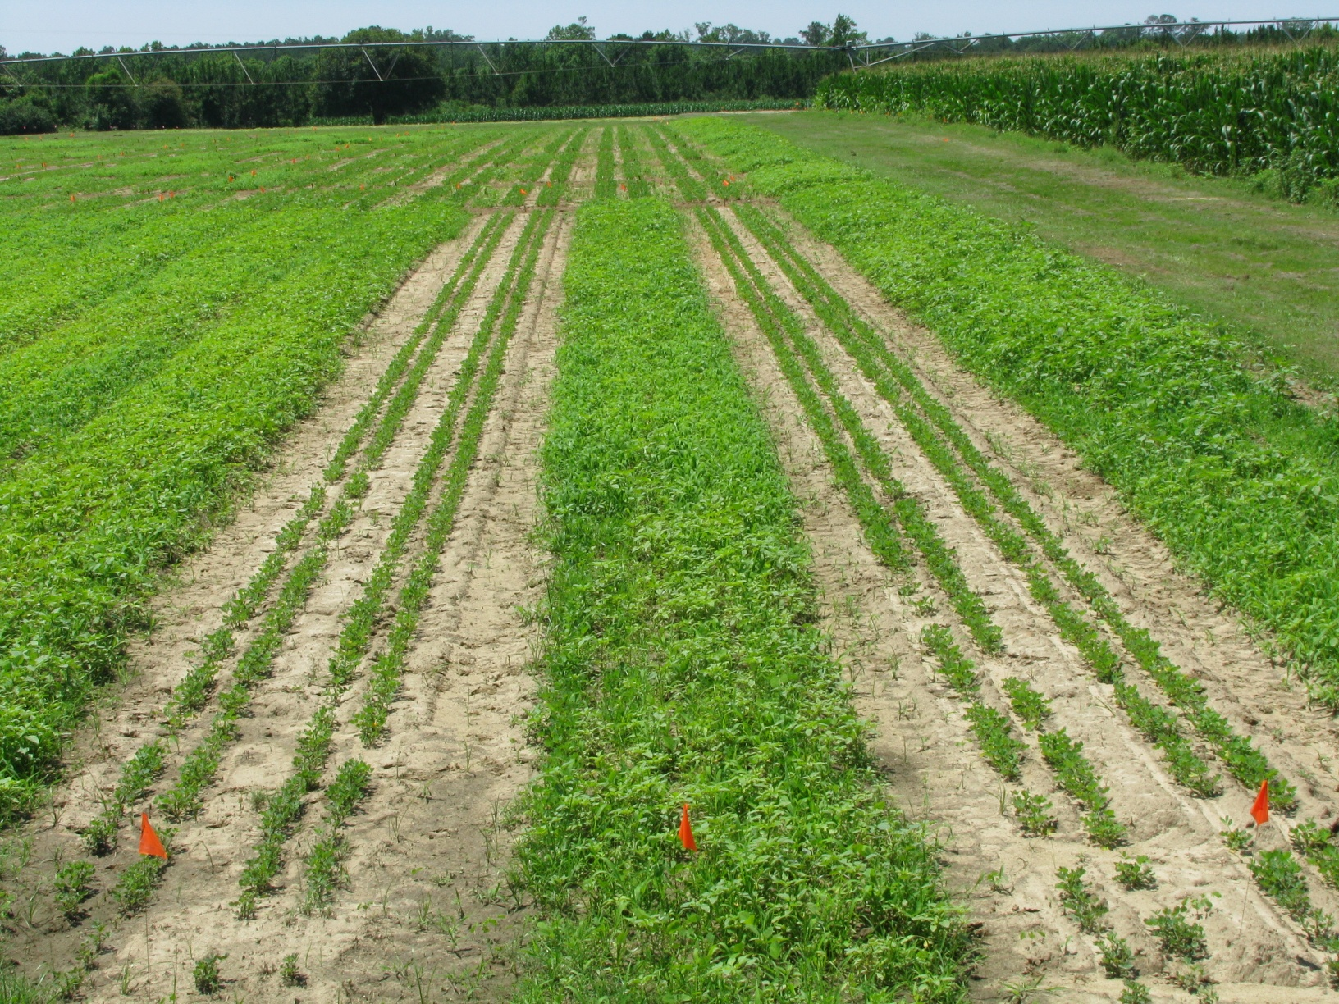
Gramoxone Inteon @ 12 oz/A + Storm @ 16 oz/A + Dual Magnum @ 1 pt/A + 2,4-DB @ 1 pt/A (Left)
NTC (Middle)
Gramoxone Inteon @ 12 oz/A + Storm @ 16 oz/A + Dual Magnum @ 1 pt/A (Right)
May 8, 2010
13 DAT

Slide 18
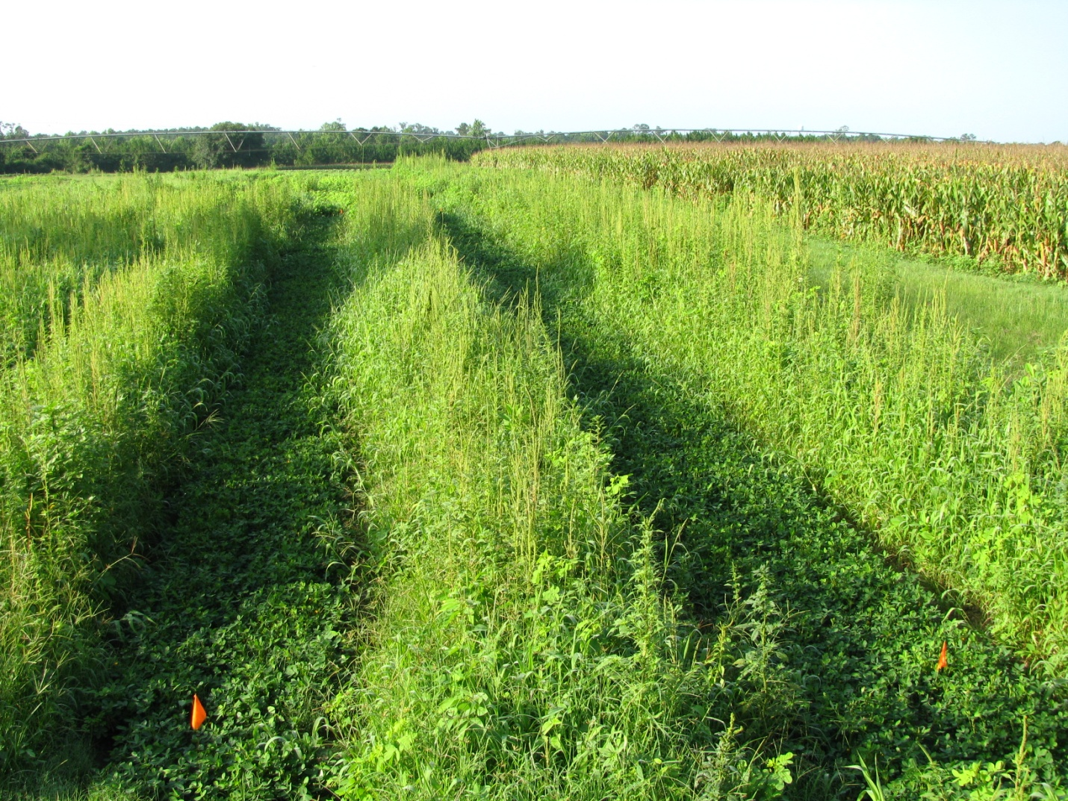
Gramoxone Inteon @ 12 oz/A + Storm @ 16 oz/A + Dual Magnum @ 1 pt/A + 2,4-DB @ 1 pt/A (Left)
NTC (Middle)
Gramoxone Inteon @ 12 oz/A + Storm @ 16 oz/A + Dual Magnum @ 1 pt/A (Right)
May 26, 2010
Cadre @ 4 oz/A + Dual Magnum @ 16 oz/A (June 16)
July 20, 2010
34 DAT (Cadre)

Slide 19
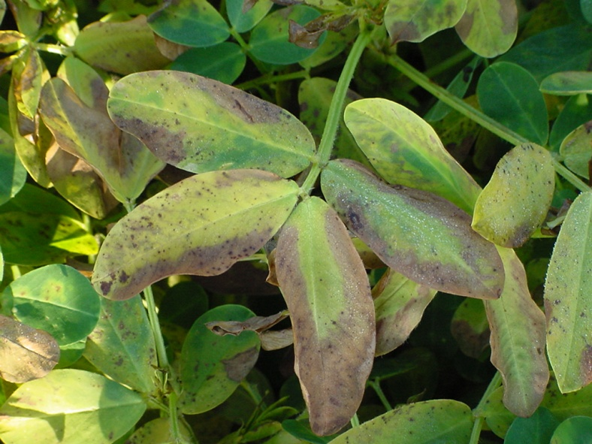
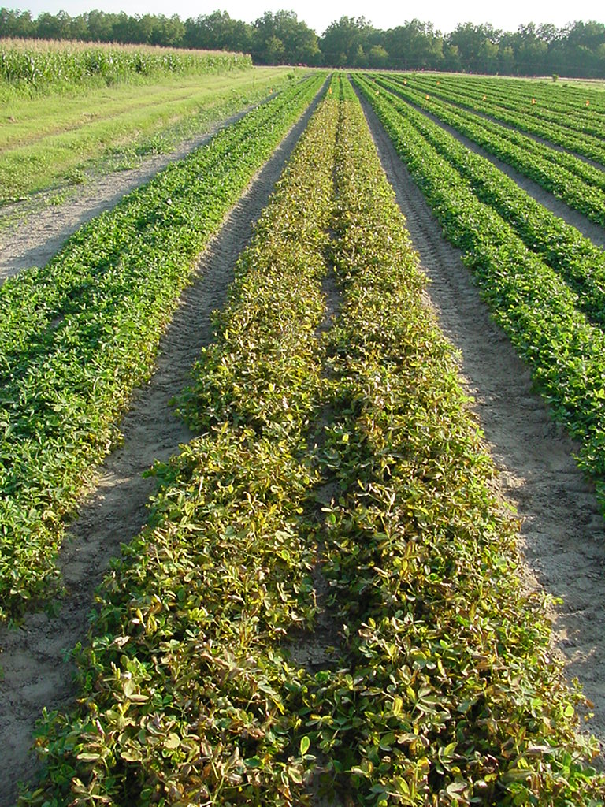
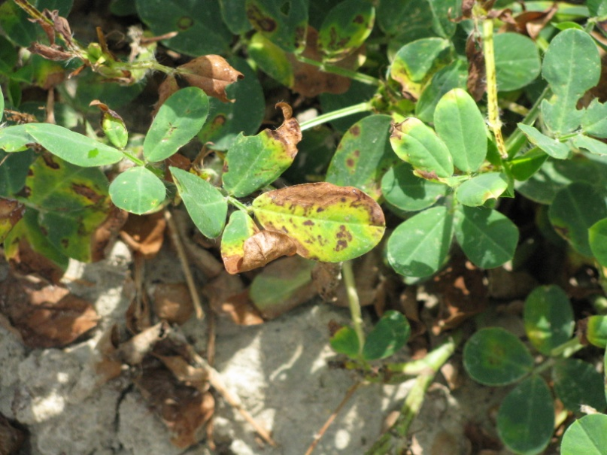
Ignite/Peanut

Slide 20
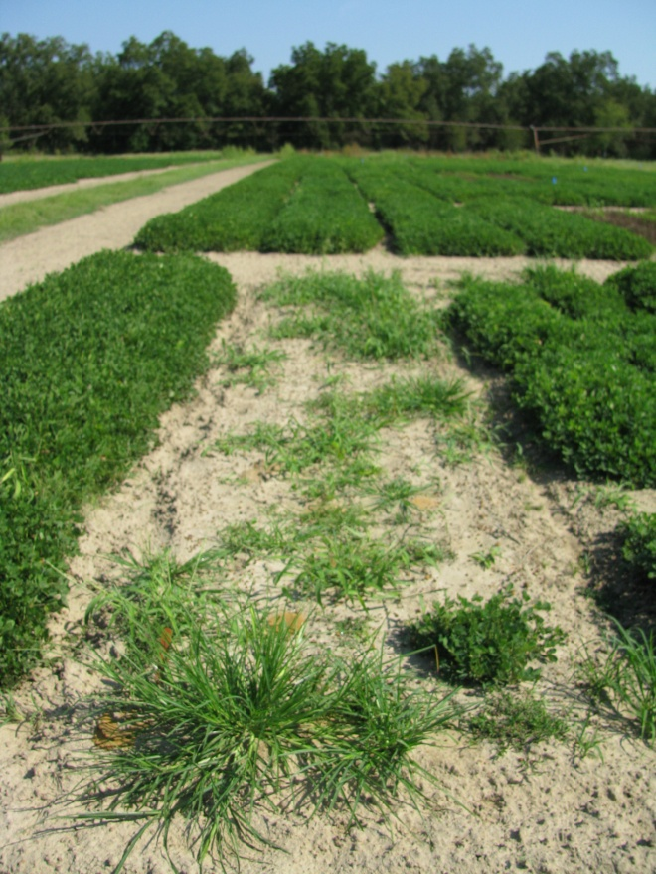
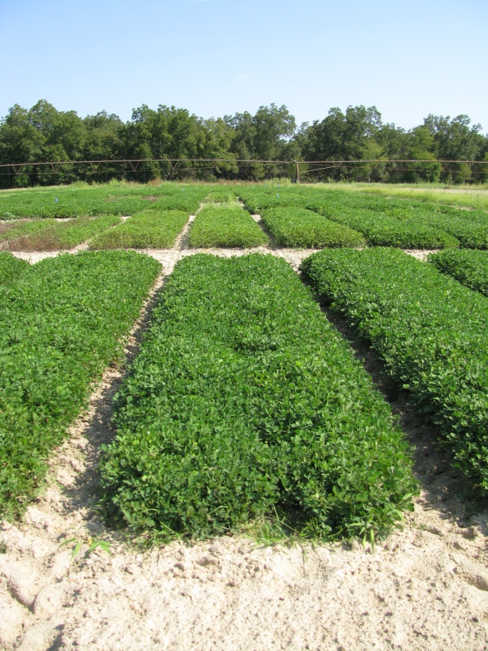
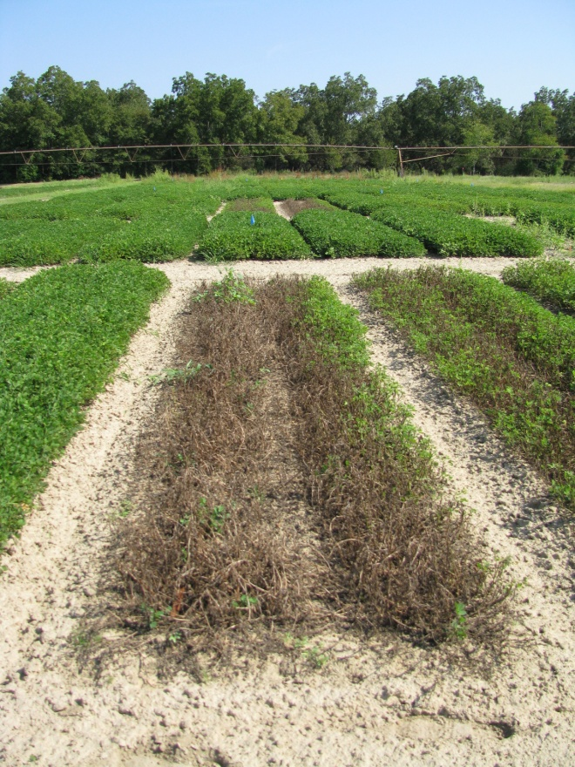
Peanut (GA-06G) Response to Ignite @ 32 oz/A
Applied 30 DAP
Applied 60 DAP
Applied 90 DAP
PE-01-10
September 17
129 DAP

Slide 21
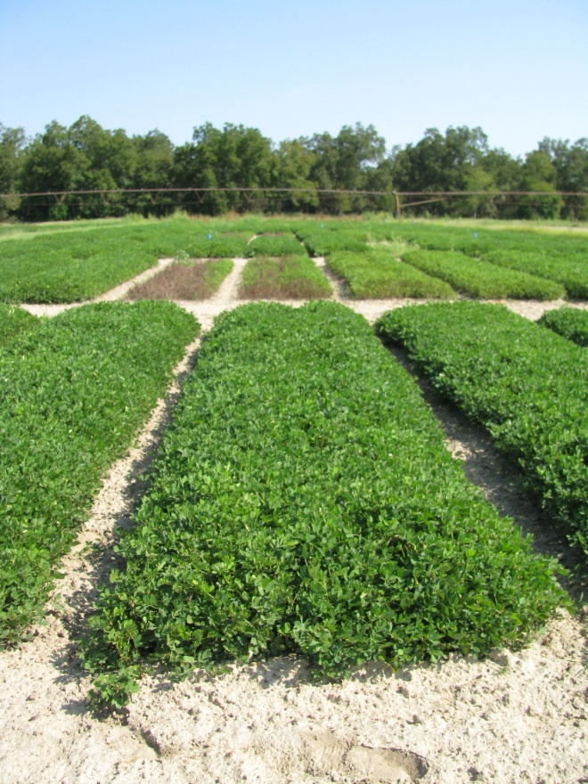
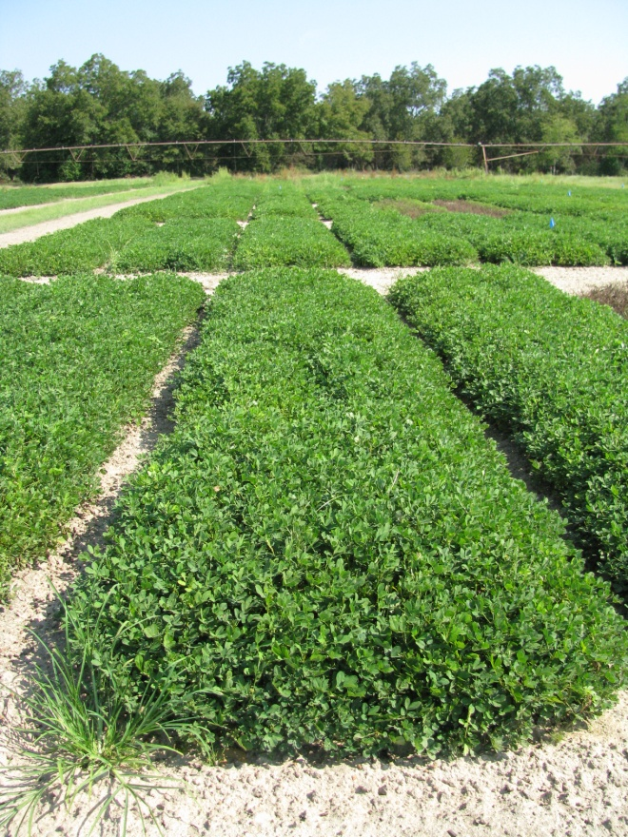
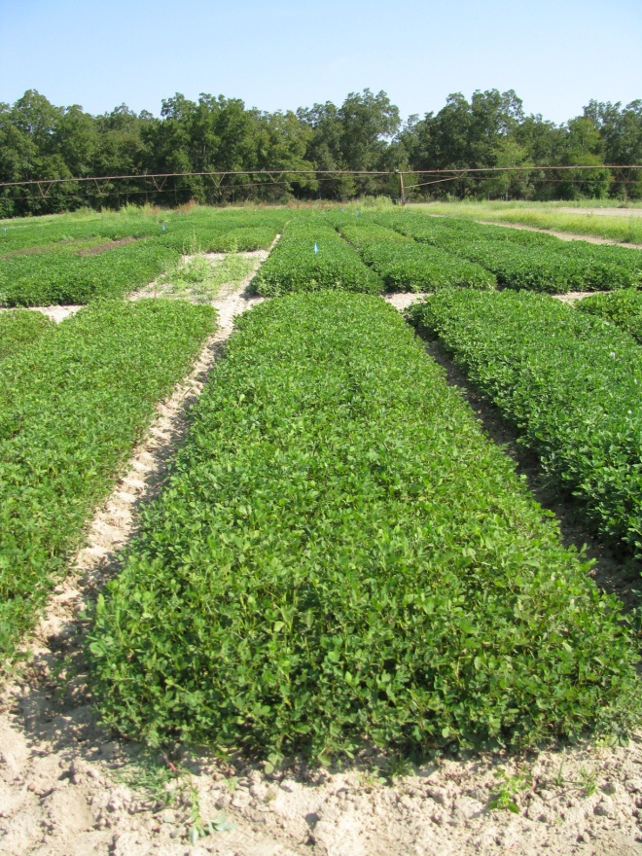
Peanut (GA-06G) Response to Ignite @ 2 oz/A
Applied 30 DAP
Applied 60 DAP
Applied 90 DAP
PE-01-10
September 17
129 DAP

Slide 22
Estimated Peanut Yields Losses (%) from Ignite 2.34SL
Rate/A (ozs) | Time (DAP)
 | 30 | 60 | 90
0 | 0 | 0 | 0
2 | 6.4 | 6.8 | 19.3
4 | 13.2 | 10.0 | 23.7
6 | 19.9 | 13.2 | 28.0
8 | 26.7 | 16.5 | 32.3
10 | 33.5 | 19.7 | 36.6
12 | 40.3 | 22.9 | 40.9
16 | 53.8 | 29.3 | 49.5
32 | 100 | 55.0 | 84.0
GA-06G
2 locations (Ponder, Plains)
2010

Slide 23
Palmer Amaranth Control Tactics
Start Clean!!!!!
Irrigation
Tillage
Extreme Cover Crops
Residual Herbicides
Timely POST’s
Others
Hand-Weeding
Non-Selective Applicators

Slide 24
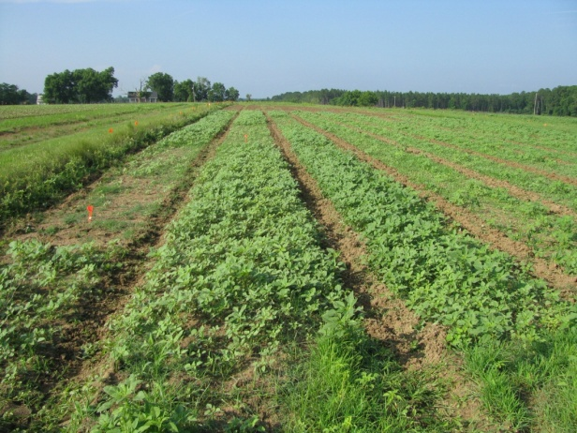
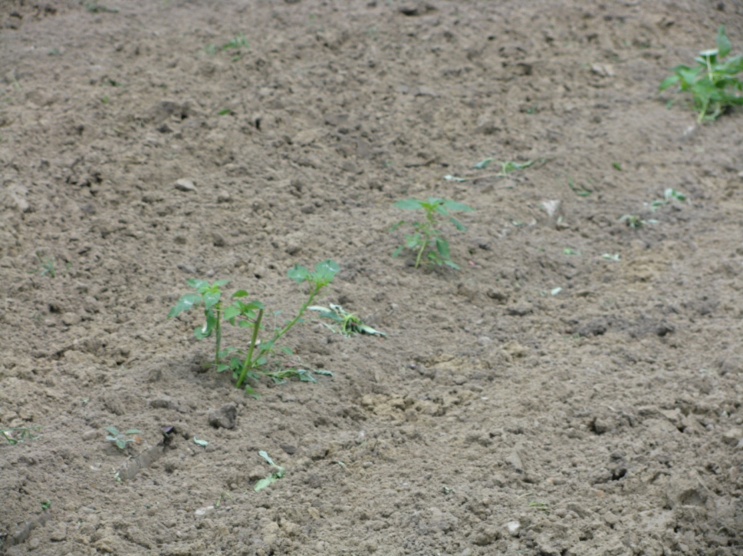
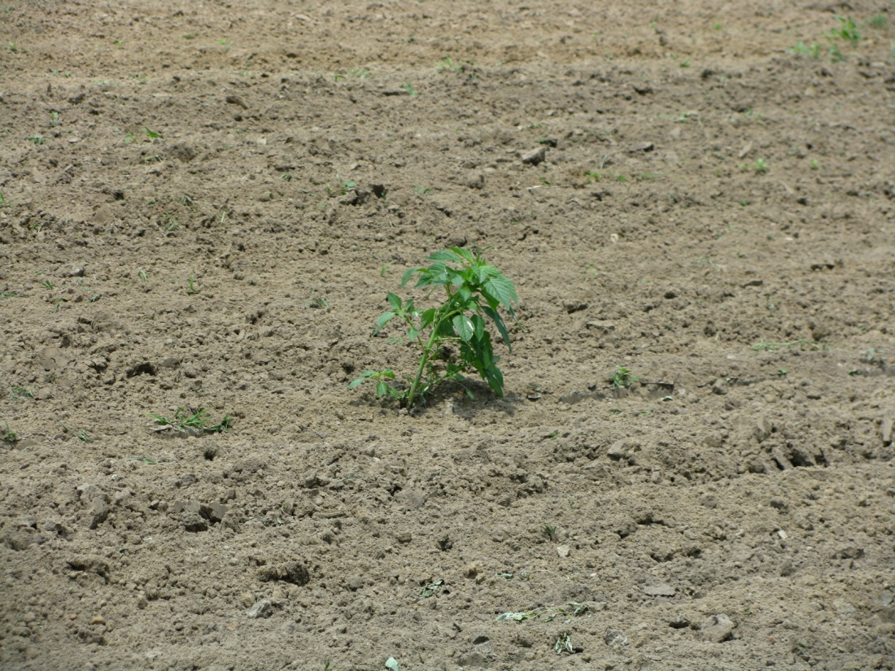
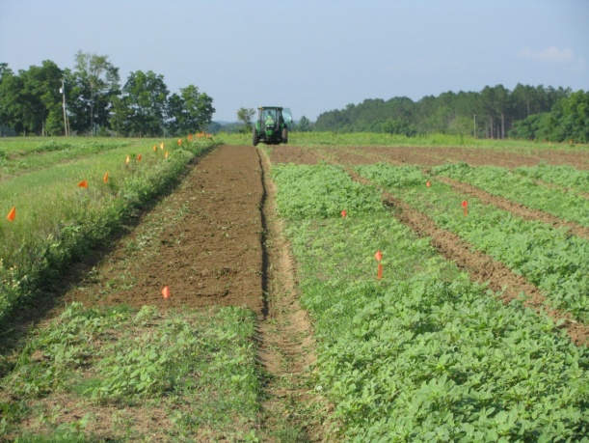
Many pigweed problems are due to weeds already up at planting!

Slide 25
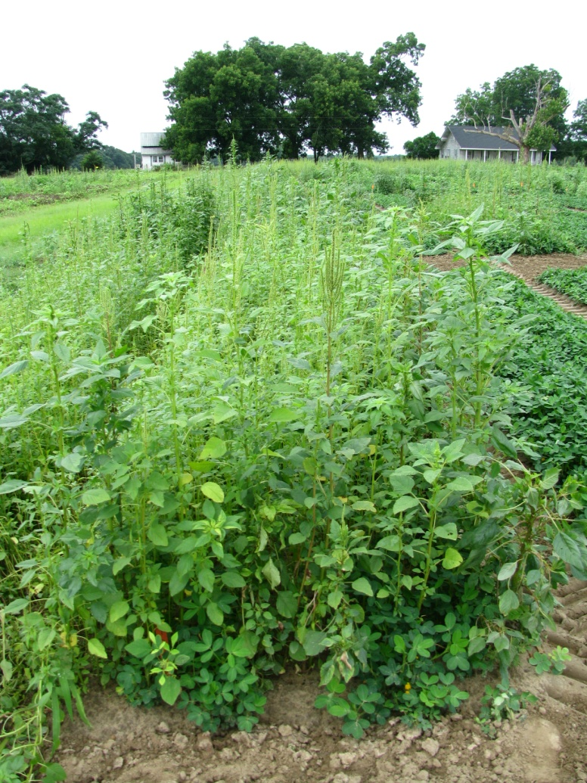
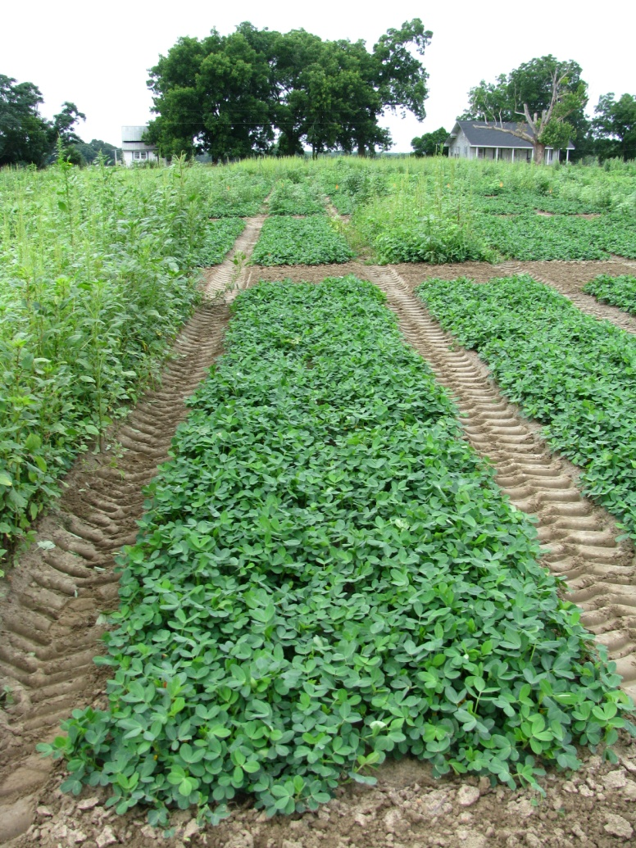
Palmer Amaranth Control - 2010
NTC
Prowl H₂0 3.8ASC @ 34 oz/A (PRE)
Valor SX 51WG @ 3 oz/A (PRE)
Cadre 2AS @ 4 oz/A (June 14)
COC @ 1% v/v (June 14)
(6597 lbs/A)
PE-03-10
June 29

Slide 26
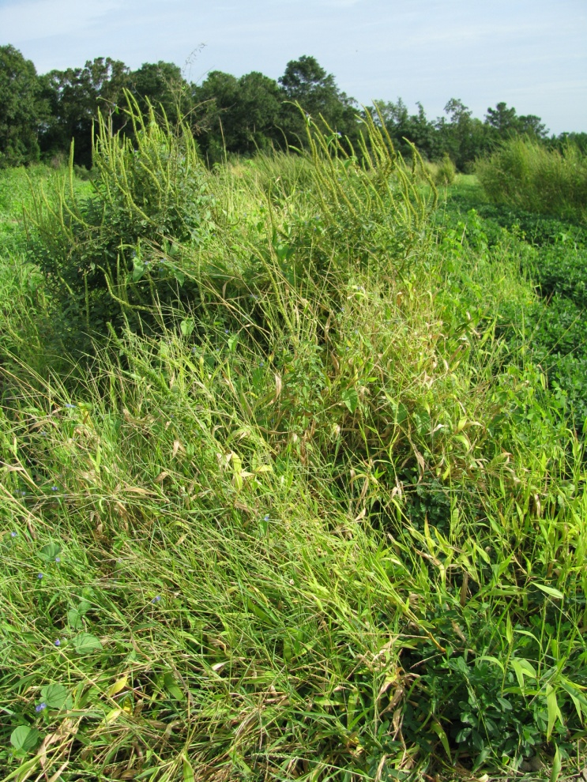
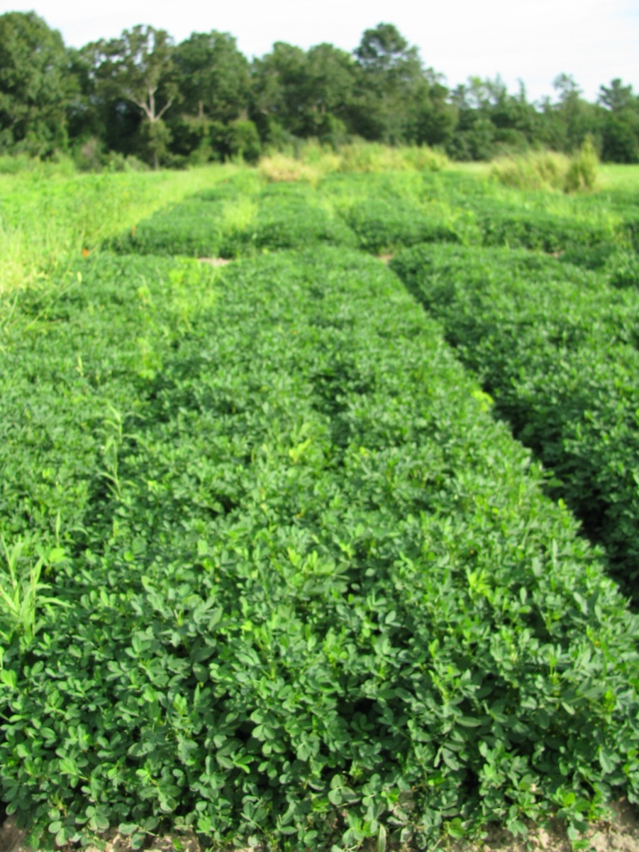
Peanut Weed Control - 2010
0 lbs/A
6998 lbs/A
NTC
Valor 51WG @ 3 oz/A (1 DAP)
Strongarm 84WG @ 0.23 oz/A (1 DAP)
Prowl H₂0 3.8SC @ 34 oz/A (1 DAP)
Cadre 2AS @ 4 oz/A (34 DAP)
COC @ 1% v/v (34 DAP)
PE-17-10
August 30
91 DAP

Slide 27
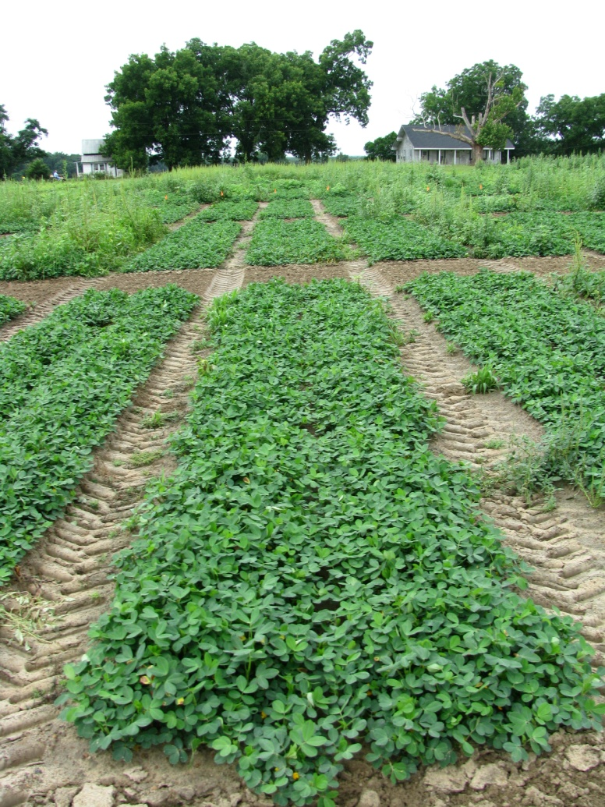
Palmer Amaranth Control - 2010
NTC
Gramoxone Inteon 2SL @ 12 oz/A (June 2)
Storm 4SL @ 16 oz/A (June 2)
Dual Magnum 7.62EC @ 16 oz/A (June 2)
Cadre 2AS @ 4 oz/A (June 14)
Dual Magnum 7.62EC @ 16 oz/A (June 14)
(5790 lbs/A)
PE-03-10
June 29

Slide 28
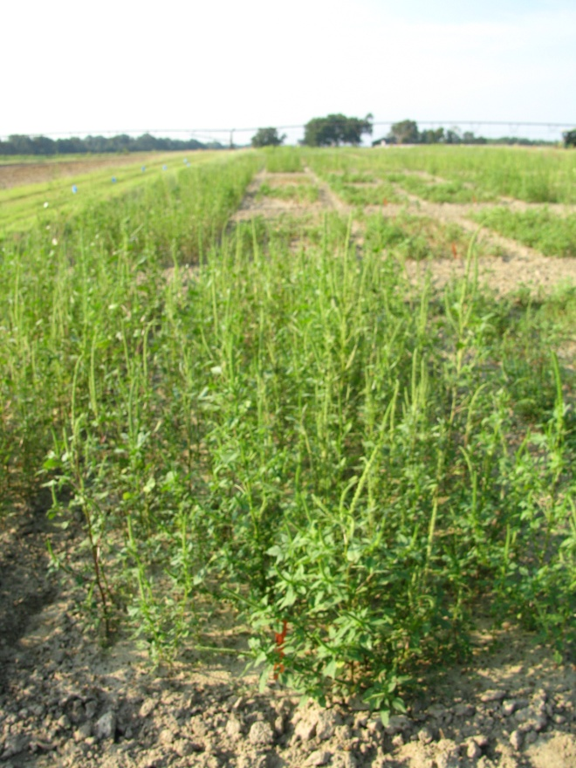
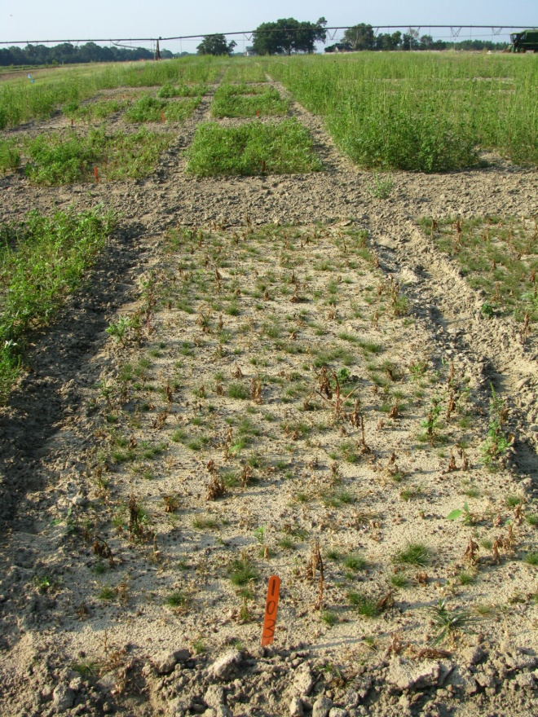
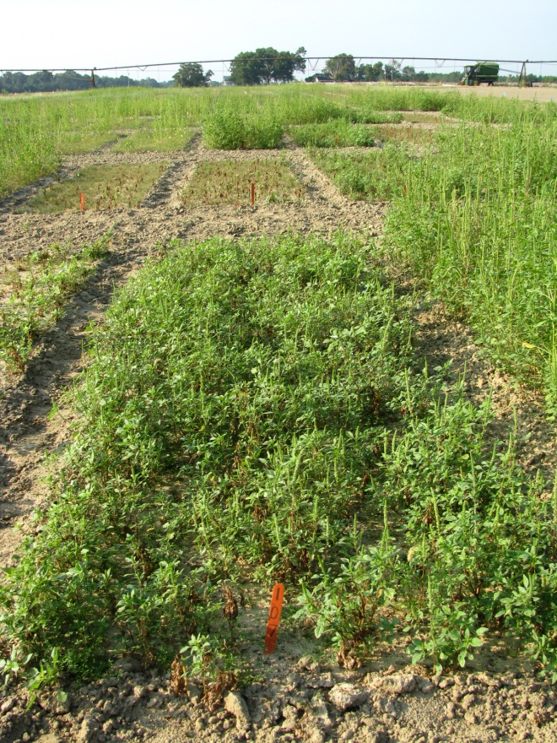
ET vs Cobra for Palmer Amaranth Control 14 DAT
NTC
Cobra 2EC @ 12.5 oz/A
80/20 @ 0.25% v/v
ET 0.208EC @ 2 oz/A
80/20 @ 0.25% v/v
AMAPA Size at Application
Low = 2”; High = 14”, Average = 7”
PE-11B-10
9/21/10

Slide 29
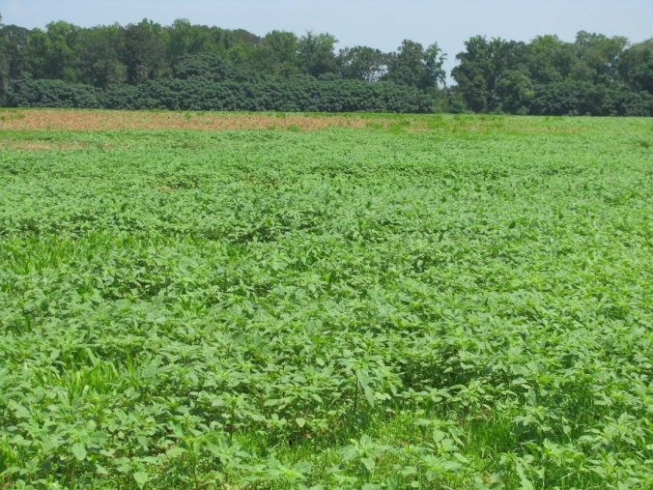
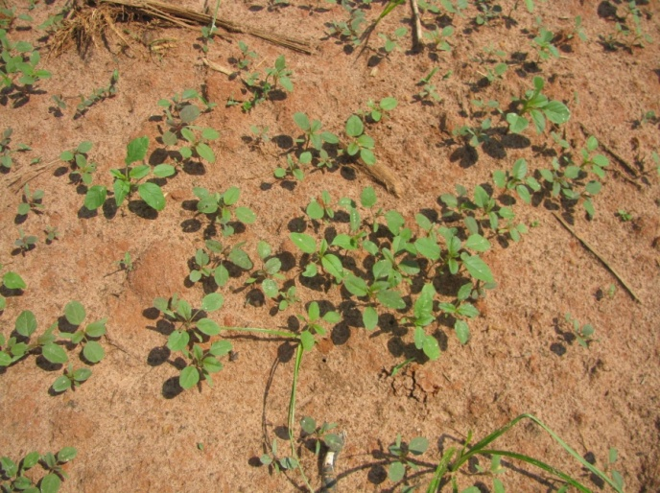
Post-Harvest (Corn) AMAPA Problems
Decreasing daylight hastens flower and seed production
Flowering (3-4 weeks)
Seed production (2-3 weeks)
Some germination at 41⁰F (8%)
Control Options
Mowing
Tillage
Herbicides
Paraquat + 2,4-D amine or dicamba
Residuals i.e Dual Magnum?
When can we stop worrying about seed production?
Keeley et al. 1987. Weed Science 35:199-204
Steckel et al., 2004. Weed Science 52:217-221

Slide 30
When can we stop worrying about Palmer seed production?
Year | First Frost Date (FFD) | FFD-35
2005 | Dec 20 | Nov 15
2006 | Nov 20 | Oct 16
2007 | Nov 8 | Oct 4
2008 | Nov 19 | Oct 15
2009 | Dec 21 | Nov 16
2010 | Dec 2 | Oct 27
Source: UGA Automated Environmental Monitoring Network
Tifton Campus Conference Center

Slide 31
When can we stop worrying about Palmer seed production?
Year | First Frost Date (FFD) | FFD-35
2005 | Nov 18 | Oct 14
2006 | Nov 4 | Sept 30
2007 | Nov 7 | Oct 3
2008 | Nov 18 | Oct 14
2009 | Dec 6 | Nov 1
2010 | Nov 7 | Oct 3
Source: UGA Automated Environmental Monitoring Network
Midville

Slide 32
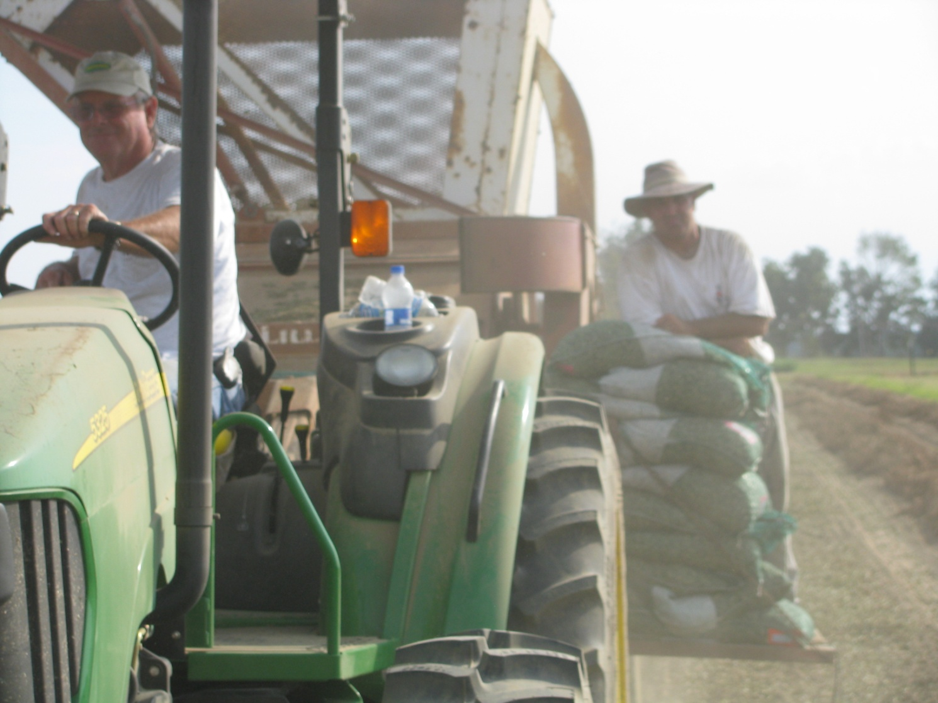
Questions?
229-392-1034 (cell)
www.gaweed.com

