Slide 1
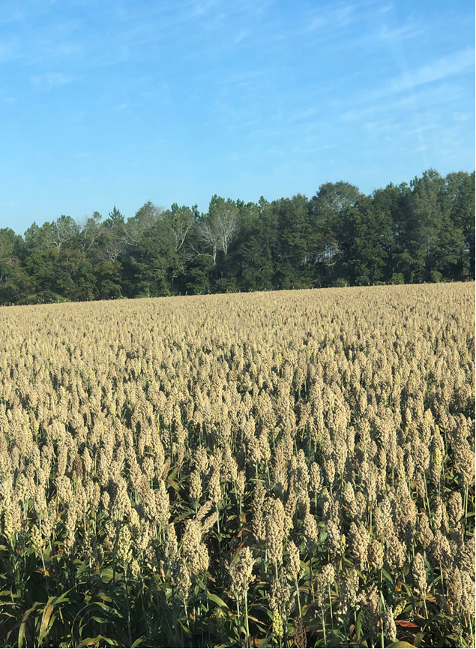

Weed Control in Grain Sorghum – 2026
Eric P. Prostko, Extension Weed Specialist
Seth McAllister, Terrell Co. (October 2022)

Slide 2
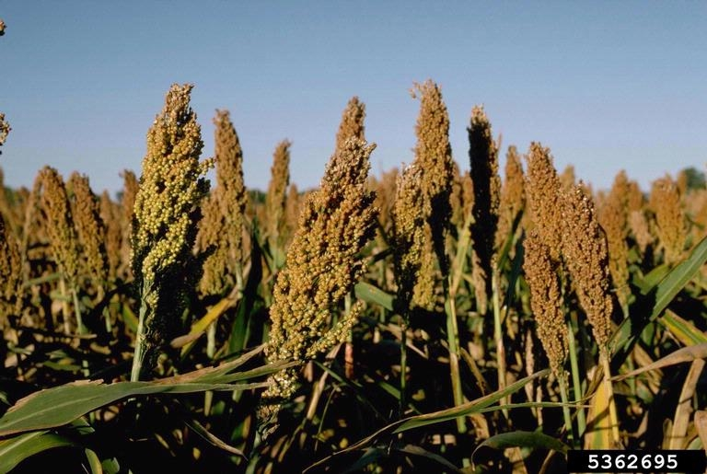
Grain Sorghum Weed Control
Start clean!
CONCEP treated seed
Dual Magnum or Outlook or Warrant (PRE)
Huskie 2.06EC @ 16 oz/A + Atrazine 4L @ 24 oz/A + NIS (EPOST)
Paraquat (Hooded sprayer)
Mechanical Cultivation

Slide 3
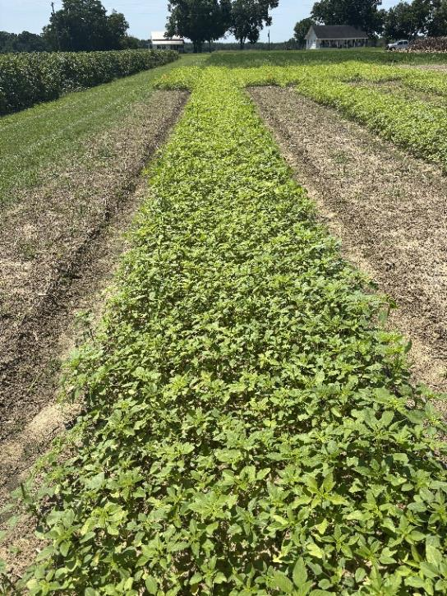
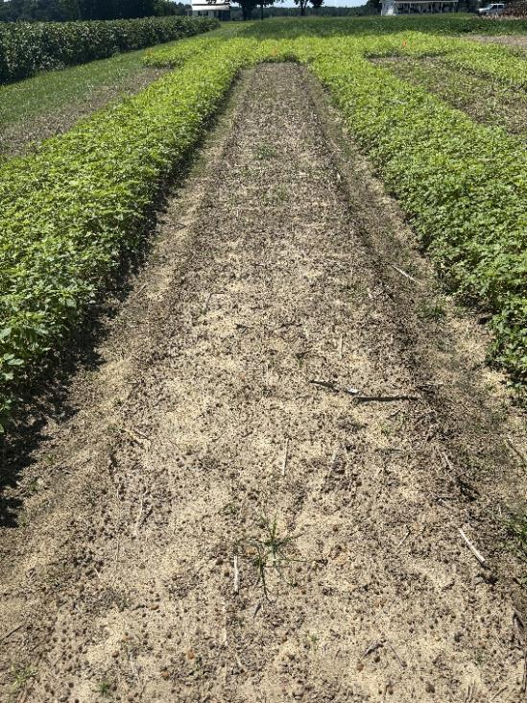
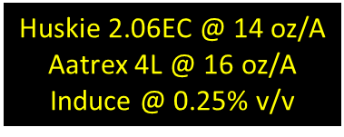
Huskie Formulation Test – 2025 (AMAPA: 1-7” tall; 3.7” average, 50% plants > average)
NTC
GS-01-25
August 26
7 DAT

Slide 4
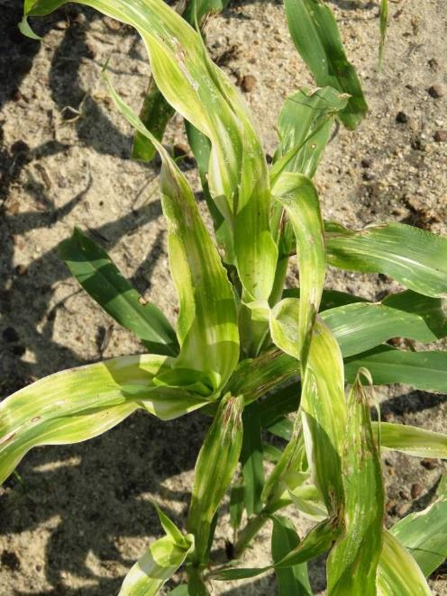
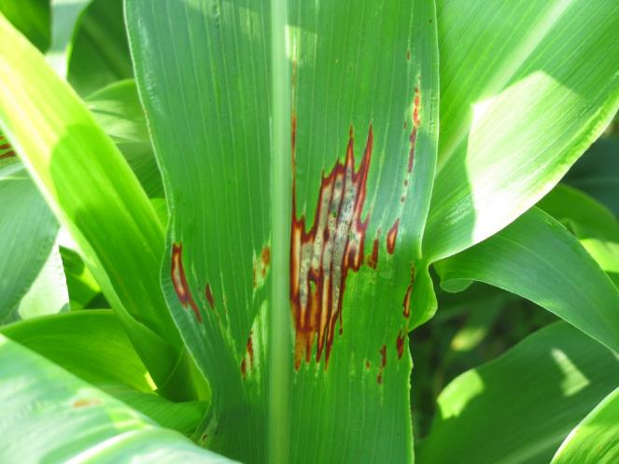

Huskie Injury on Sorghum

Slide 5
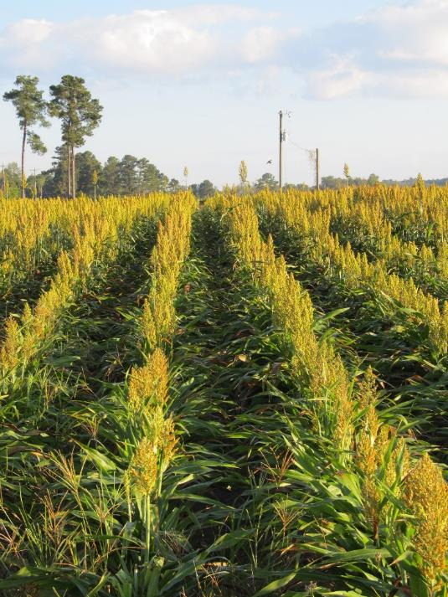
New Grain Sorghum Weed Control Technologies (Non-GMO)
Igrowth®
Alta/UPL
ImiFlex (imazamox)
PRE/POST
DoubleTeam™
S&W/Sorghum Partners/ADAMA
FirstAct (quizalofop)
POST
Inzen™
Pioneer/Corteva
Zest (nicosulfuron)
POST

Slide 6


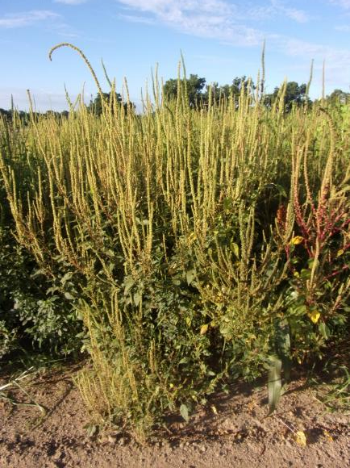
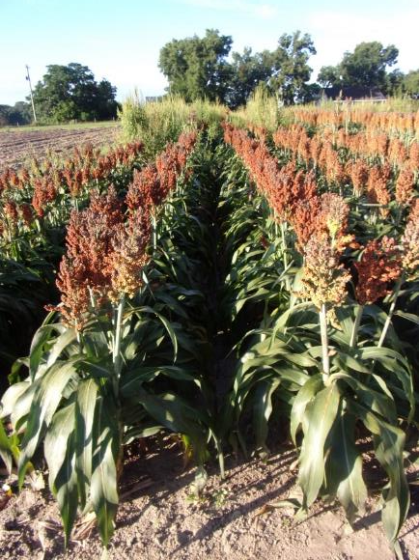
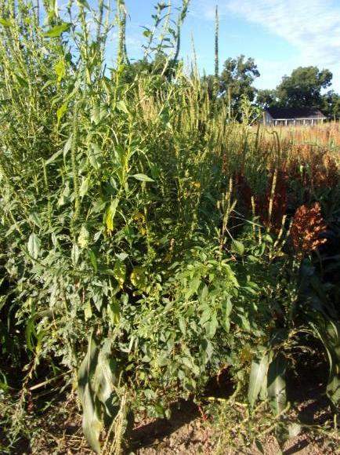
Grain Sorghum Weed Control – 2022 I-Growth
NTC
Mocassin II Plus 7.64EC @ 21 oz/A (PRE)
fb
Imiflex 1AS @ 6 oz/A
Agridex @ 1% v/v
POST (V7, 9-10” tall, 22 DAP)
Imiflex 1AS @ 4 oz/A
Agridex @ 1% v/v
EPOST (V3, 4” tall, 14 DAP)
GS-01-22
August 1
69 DAT (POST)/77 DAT (EPOST)

Slide 7
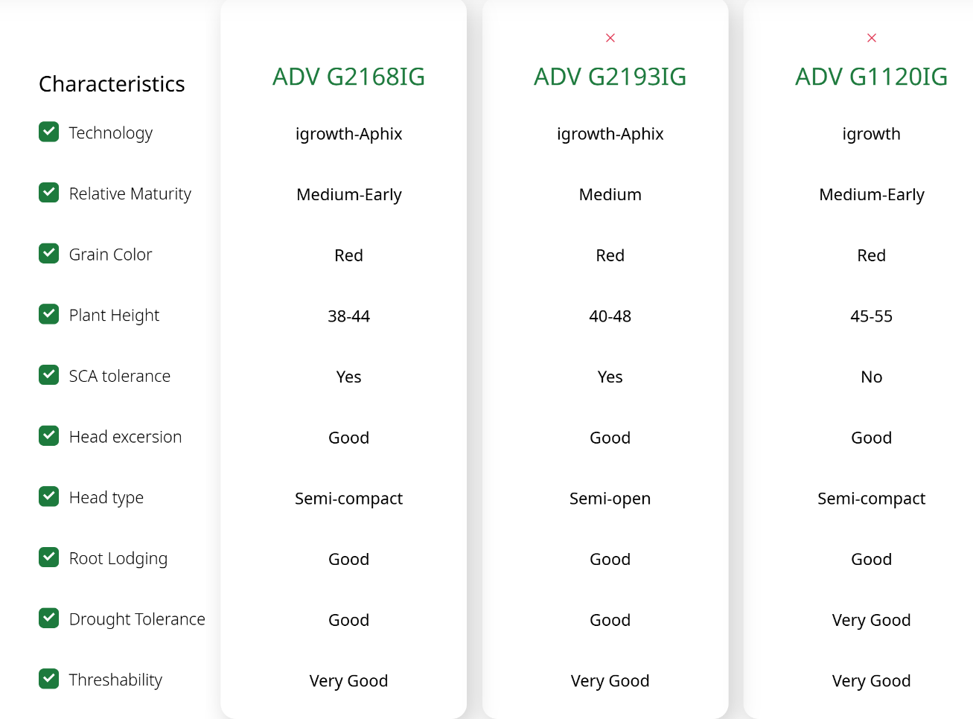

Igrowth Grain Sorghum Hybrids

Slide 8

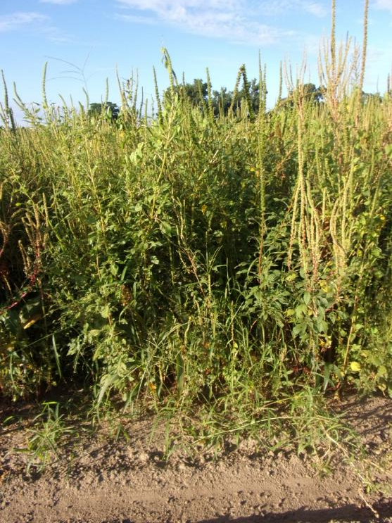
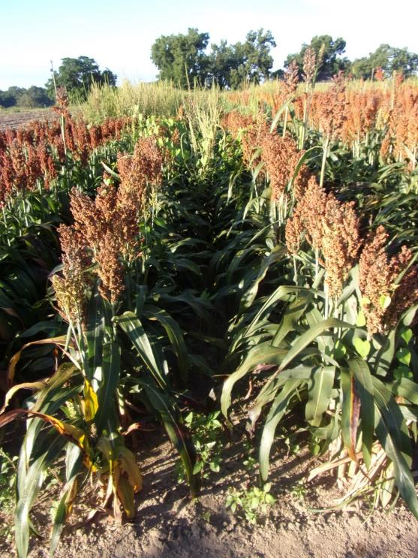
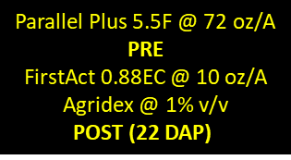
DoubleTeam Sorghum - 2022
NTC
GS-01-22
August 1
69 DAT (POST)

Slide 9
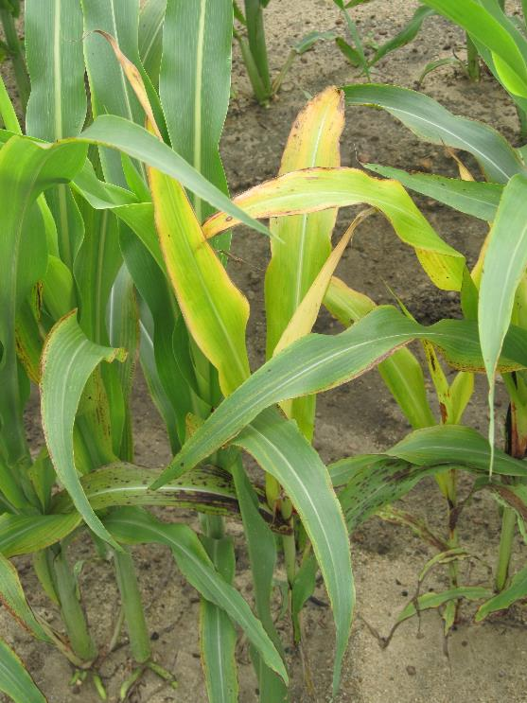
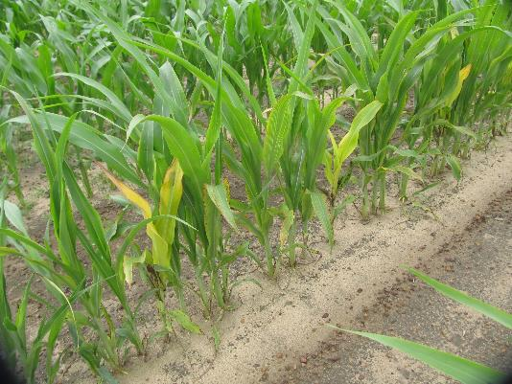
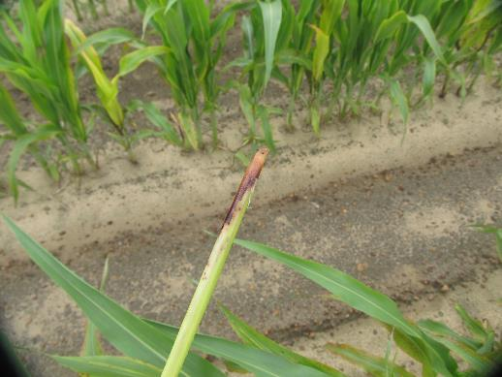
DoubleTeam™ System – First Act Off-Types
GS-02-21
June 23
9 DAT

Slide 10
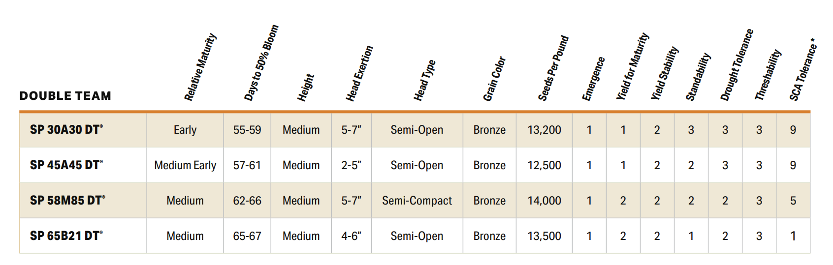

DoubleTeam Sorghum Hybrids
Numeric
1 = excellent
5 = average
9 = poor
SCA
1 = high tolerance
5 = moderate tolerance
9 = susceptible

Slide 11

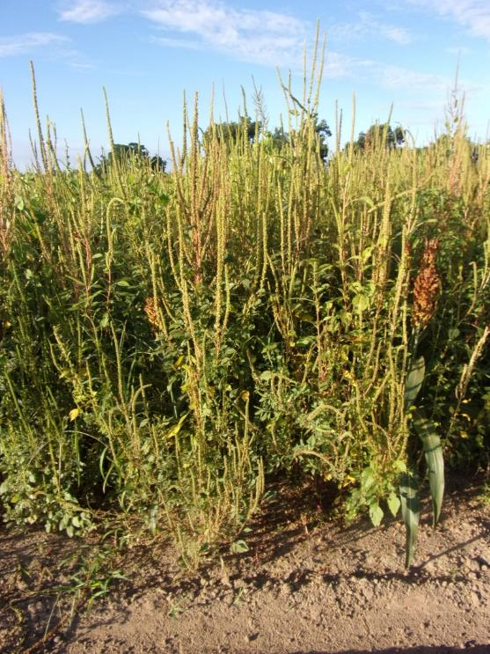
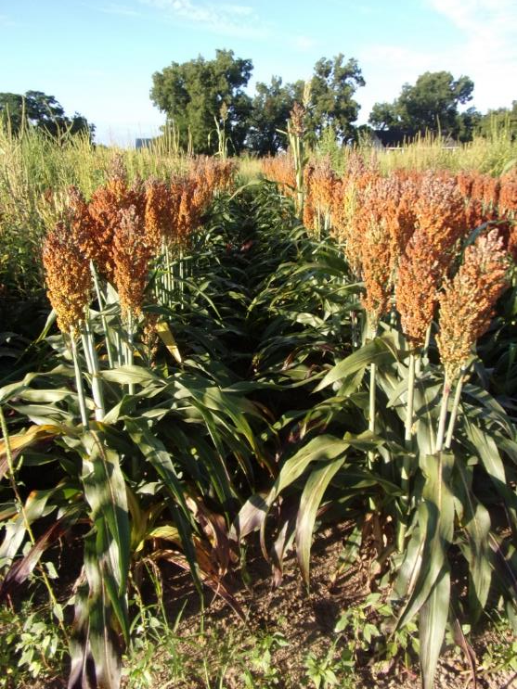
Inzen Grain Sorghum - 2022
NTC
Everprex 7.62EC @ 16 oz/A (PRE) fb
Zest 75DG @ 0.67 oz/A +
Aatrex 4L @ 48 oz/A + Agridex @ 1% v/v
(POST)
GS-01-22
August 1
69 DAT (POST)

Slide 12
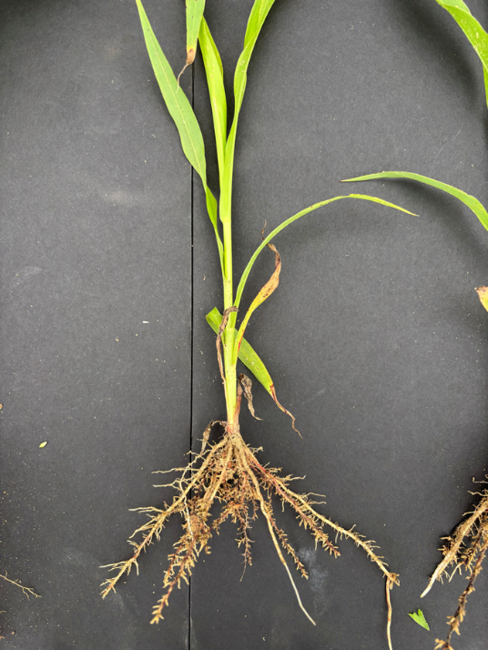
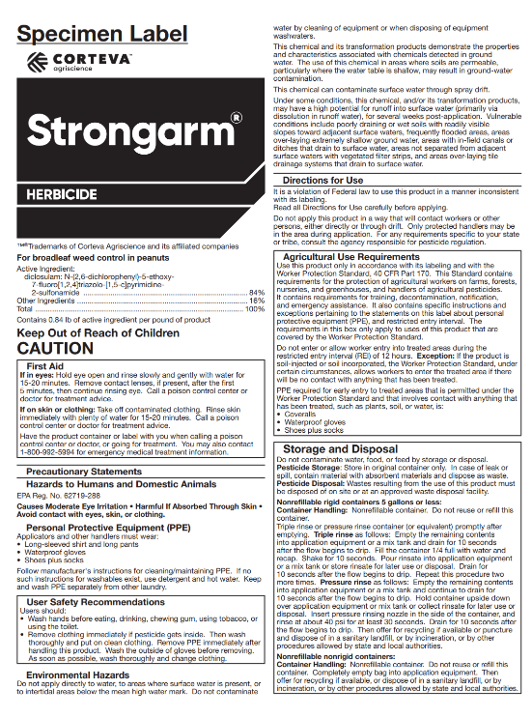
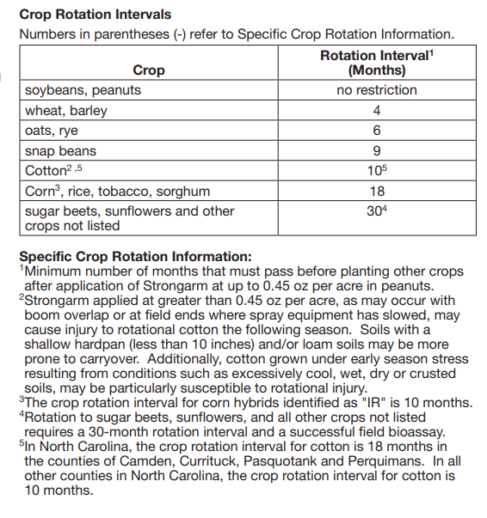
Strongarm and Sorghum?
“bottle-brush”
roots
Strongarm 84WG Applied 1 DAP 0.90 oz/A (2X rate)

Slide 13
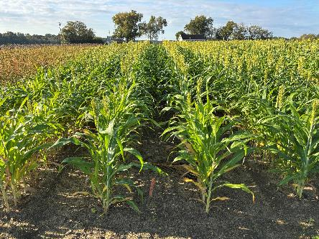
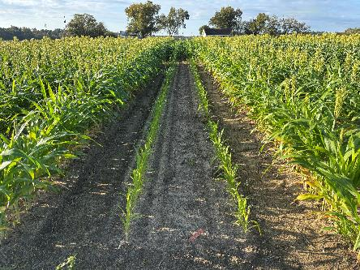
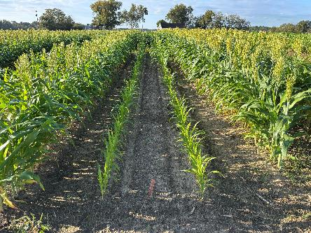
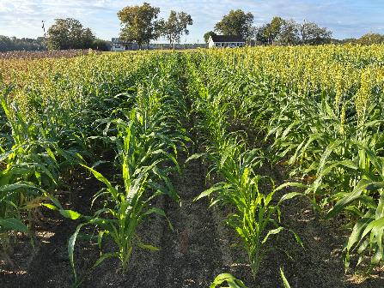




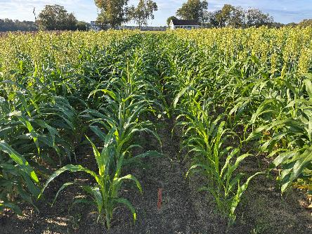
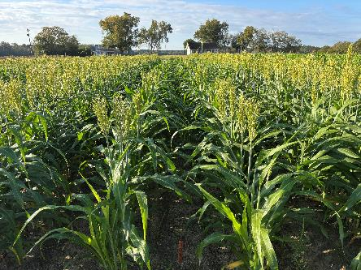
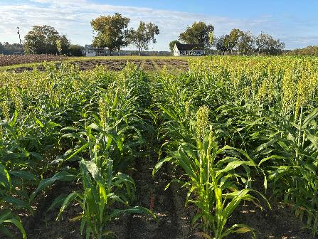



Grain Sorghum Response to Strongarm 84WG Applied 1 DAP
4 (1/2 lives)
~152 days
5 months
SG-02-25
October 22
65 DAP
1X = 0.45 oz/A

Slide 14

2026 Soybean Weed Control Update
Eric P. Prostko
Professor and Extension Weed Specialist
Dept. Crop & Soil Sciences

Slide 15



Dicamba Update (2024)
02/06/24: District of Arizona Court vacated 3 dicamba labels (Engenia, Tavium, Xtendimax) for entire country
Procedural errors [hearing (notice and comments) mandates for all stakeholders]
02/14/24: US EPA Existing Stocks Order
Existing stocks: stocks of previously registered pesticide products that are currently in the US and were packaged, labeled, and released for shipment prior to 02/06/24.
Soybean: sale & distribution until 05/31/24; use until 06/30/24.
Cotton: sale & distribution until 06/30/24; use until 07/30/24.

Slide 16
Dicamba Update (2025) EPA Proposed Label Changes (07/23/25)
A single use maximum application rate of 0.5 lb. acid equivalent (ae) dicamba/A.
No more than two applications allowed with a maximum annual application of 1 lb. ae dicamba/A from all combined dicamba-containing products.
Prohibition of aerial applications.
Maintaining a 240-ft downwind buffer.
The spray solution must include an approved drift reduction agent (DRA) and pH buffering volatility reduction (VRA) agent added to the tank in higher percentages as temperatures increase.

Slide 17
Dicamba Update (2025) EPA Proposed Label Changes (07/23/25)
Temperature-dependent application restrictions to manage volatility. Users have flexibility to implement temperature-dependent restrictions by reducing the percent of field treated, including by using precision agriculture techniques, or prohibiting certain tank mixes at higher temperatures.
No applications at temperatures above 95⁰F for day of application + 1 day.
Three points of mitigation required based on the runoff/erosion mitigation menu.
Users must access and follow any applicable endangered species bulletin from “Bulletins Live! Two” web-based system. Six points of runoff/erosion mitigation will be required in some pesticide use limitation areas where pesticide exposures are likely to impact the continued existence of a listed species, which may include a reduction in survival or recovery of the species.
Applicators are required to wear baseline attire (i.e., long-sleeve shirt, long pants and shoes plus socks) along with personal protective equipment including chemical-resistant gloves when handling these products. A NIOSH-approved dust/mist filtering respirator with any R, P, or HE filter is also required for all handlers of the BAPMA-salt-formulated product (Engenia®). There is a restricted entry interval of 24 hours. Use is restricted to a limited number of approved states by certified applicators only. Applicators are required to complete additional dicamba-specific annual training and maintain records of all applications.

Slide 18
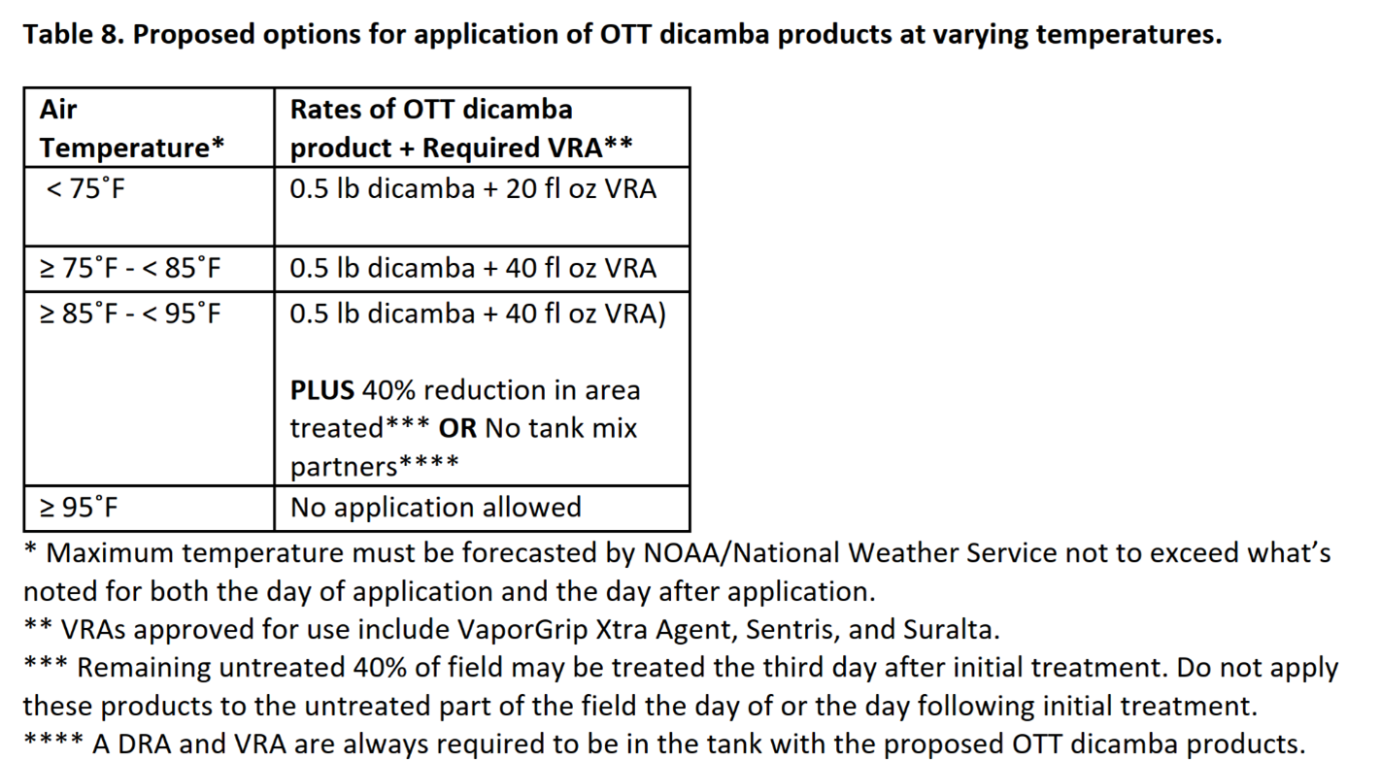
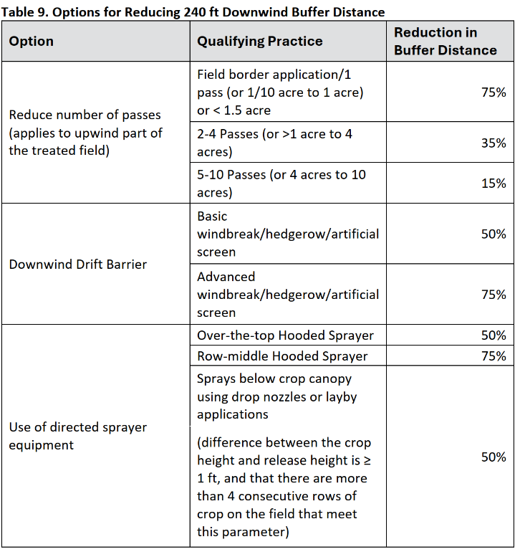
Proposed Dicamba/VRA/240’ buffer?

Slide 19
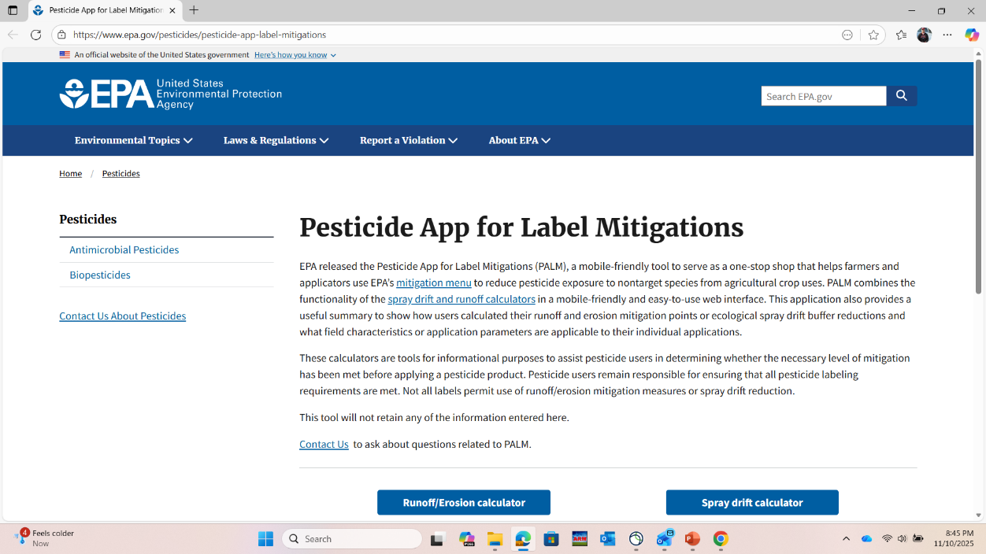
ESA Drift/Runoff Mitigation
https://www.epa.gov/pesticides/pesticide-app-label-mitigations

Slide 20




More Court Troubles?
Center for Food Safety vs. EPA
Originally filed 06/06/23
Motion for summary judgement filed 08/21/25
Federal Court of District of Columbia
Plaintiffs argue that EPA’s 2022 registration of Enlist One® and Enlist Duo® violate FIFRA because EPA failed to fully analyze the environmental and human health costs posed by use of Enlist products.
Plaintiffs argue that EPA overstated the benefits of using Enlist One® and Enlist Duo®
Plaintiffs argue that the drift buffer and runoff mitigations fail to mitigate the adverse effects of Enlist One® and Enlist Duo®

Slide 21
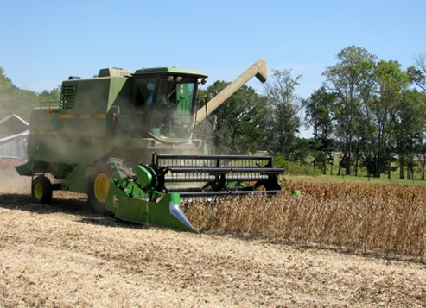
Soybean Weed Control Simplified
Start clean
Narrow rows (< 30”)
PRE
Metribuzin + Group 15 or Prowl
tolerant variety
Irrigation or rainfall
POST + Residual (weeds <3” tall)
Post = Reflex or Prefix or Warrant Ultra or Liberty or Zalo or Enlist One (2,4-D choline) or Enlist Duo (glyphosate + 2,4-D choline)
Residual = Anthem Flexx/Max or Dual or Warrant or Outlook or Zidua
Check tank-mix sites first

Slide 22
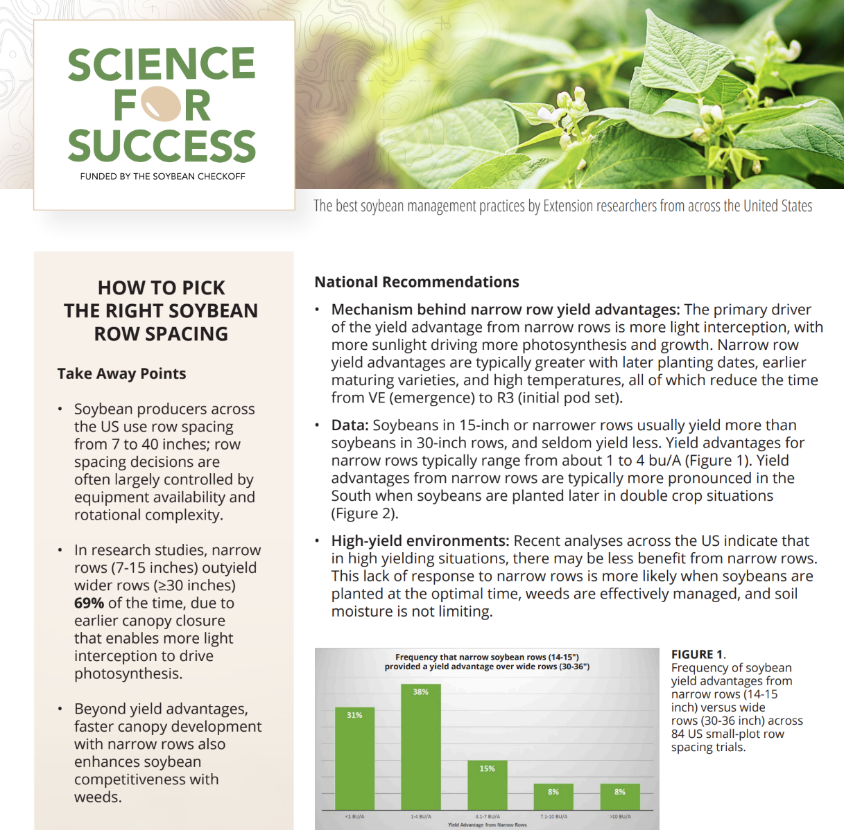
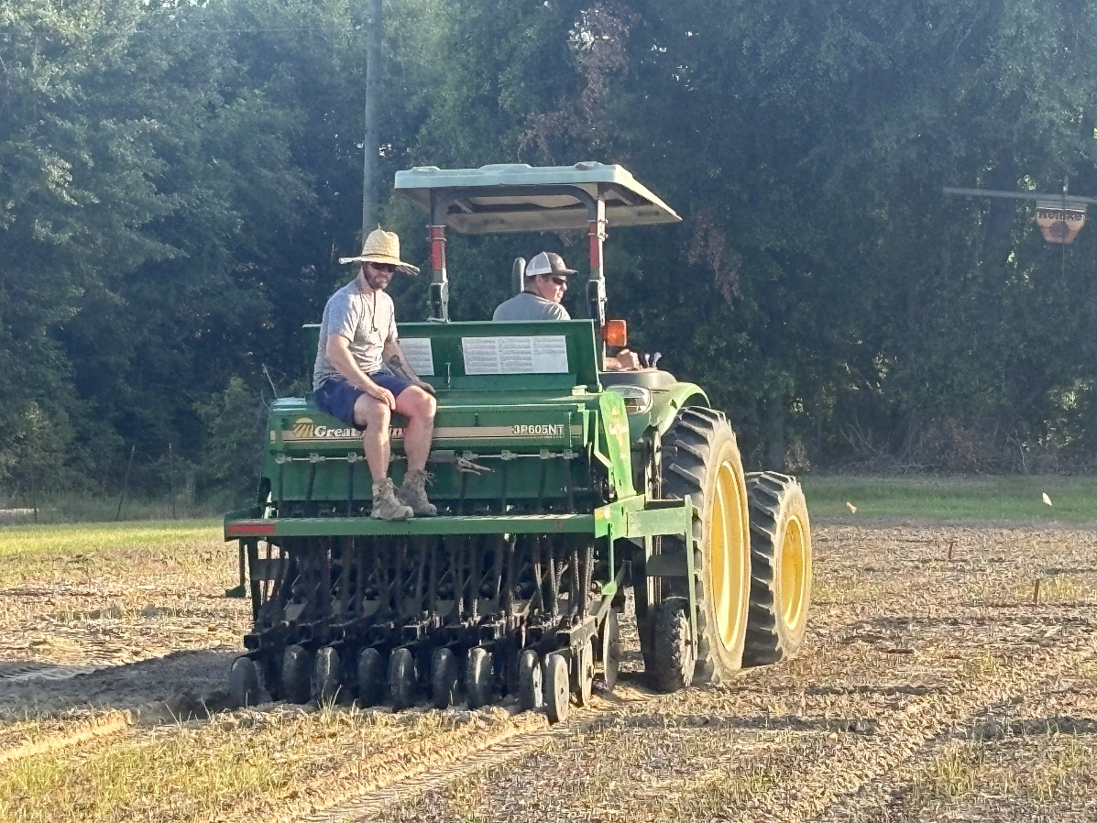
Soybean Row Spacing

Slide 23
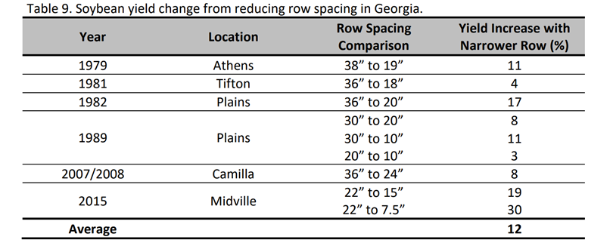
Soybean Row Spacing Research in Georgia

Slide 24
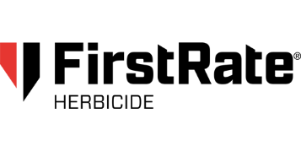
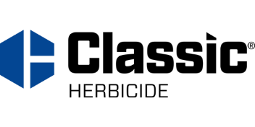

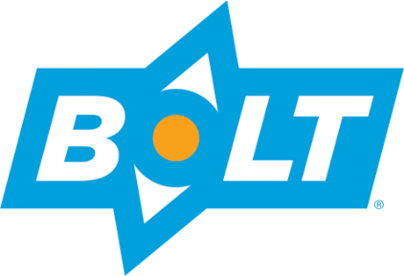
Conventional Soybeans
PPO resistant weeds = SOL (really!)
Metribuzin – PRE
Prowl or Group 15’s
Reflex, Cobra, Ultra Blazer, Prefix, Warrant Ultra
Classic or FirstRate (sicklepod + MG)
STS® (1993) - single gene (non-GMO)
Bolt™ (2015) - 2 genes (non-GMO)

Slide 25
2025 Top Soybean Cultivars Planted in Georgia [~$55-60/bag (140K); ~$30 for conventional]
Asgrow: AG71XF2; AG69XF0; AG66XF2; AG57XF1
Dynagro: DG72XT80
Integra: XF7223; XF6772S; XF7062
Pioneer: P56A71E; P68A41BE; P70A62E
Revere: 6927XF;62-F24;53-F84; 5429E3
Conventional: Hutcheson; AGS Woodruff; Virtue 4921; Musen; Pioneer P47A10; AGS V5422

Slide 26
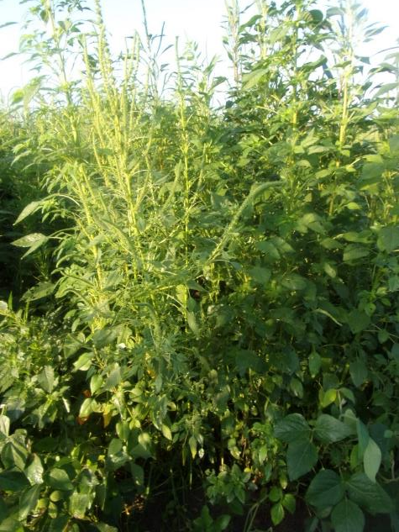
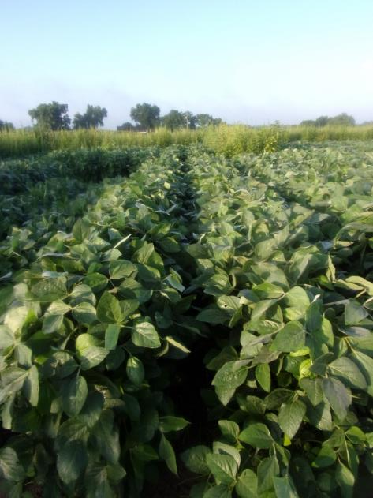
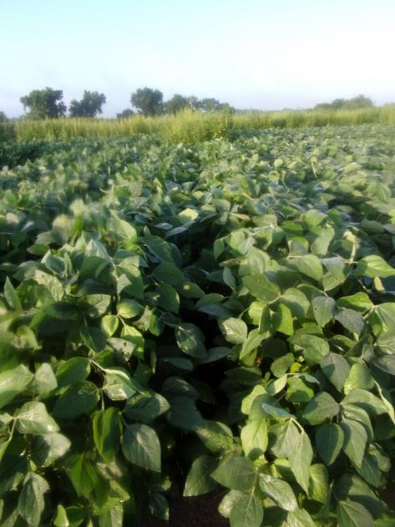
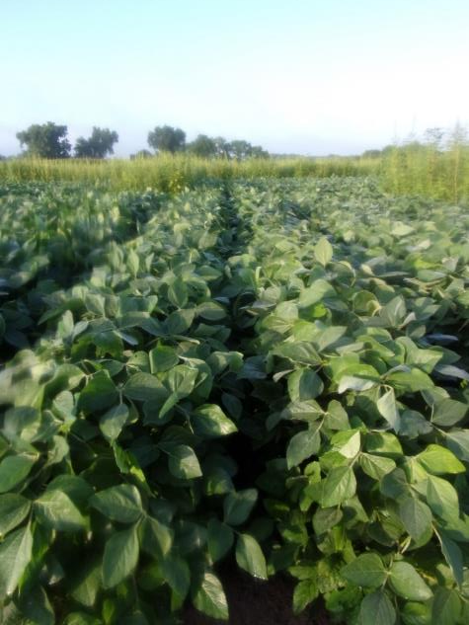
Soybean Weed Control - 2025
NTC
Tricor 4F @ 8 oz/A
Prowl H₂0 3.8SC @ 32 oz/A
(PRE)
Liberty Ultra 1.76SL @ 32 oz/A
Dual Magnum 7.62EC @ 16 oz/A
AMSOL @ 2.5% v/v
(POST - 36 DAP)
Tricor 4F @ 8 oz/A
Zidua 4.17SC @ 2.5 oz/A
(PRE)
Liberty Ultra 1.76SL @ 32 oz/A
Dual Magnum 7.62EC @ 16 oz/A
AMSOL @ 2.5% v/v
(POST - 36 DAP)
Tricor 4F @ 8 oz/A
Zidua 4.17SC @ 2.5 oz/A
(PRE)
Reflex 2SL @ 24 oz/A
Classic 25DG @ 0.5 oz/A
Induce @ 0.25% v/v
(POST - 36 DAP)
SB-05-25
June 30
55 DAP

Slide 27
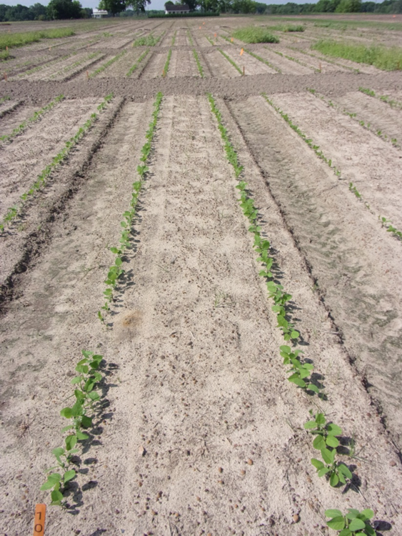
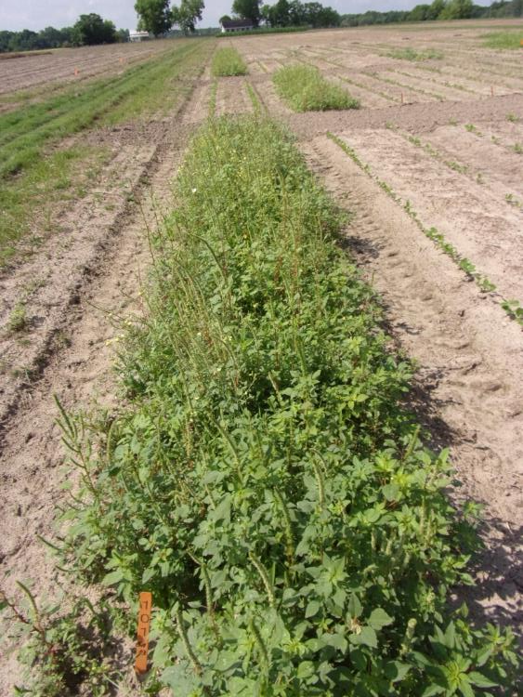
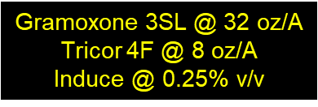
2025 Soybean Preplant Burndowns
NTC
SB-03-25
May 8
15 DAT

Slide 28
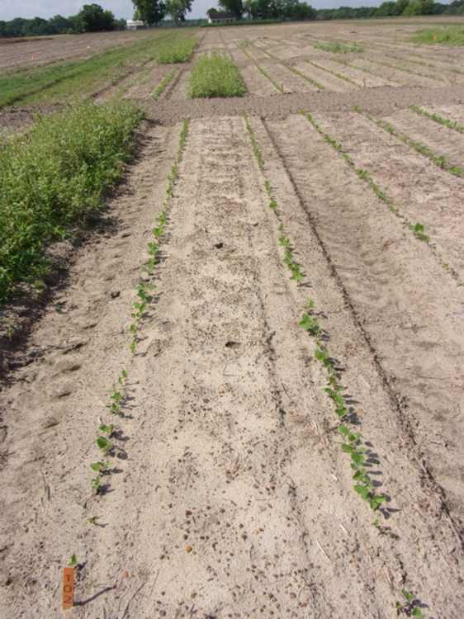
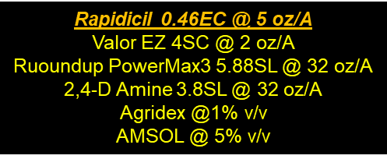
Rapidicil 0.46EC (epyrifenacil) Valent/Group 14 (PPO)
NTC
SB-03-25
May 8
15 DAT

Slide 29


Dicamba Preplant Injury (Non-Tolerant Soybean Variety)
SB-06-25
May 5
12 DAT
Clarifier (dicamba) 4SL @ 8 oz/A
Applied 3 days before planting
No Dicamba

Slide 30


Slide 31








Zalo Tank-Mixes – 2025 Zalo 2.52SL @ 32 oz/A + Induce @ 0.25% v/v
NTC
Zalo
+ Dual Magnum 7.62EC
@ 16 oz/A
+ Outlook 6EC
@ 16oz/A
+ Warrant 3ME
@ 48 oz/A
+ Zidua 4.17SC
@ 2.5 oz/A
+ Anthem Maxx 4.3SC
@ 2.5 oz/A
+ Reflex 2SL
@ 24 oz/A
SB-01-25
May 24
4 DAT

Slide 32

Volunteer Peanut in Soybeans
Generally, peanut is tolerant of all soybean herbicides except for dicamba, glyphosate, glufosinate, and metribuzin.
Control Options:
Metribuzin – PRE
8 oz/A of 4L = ~45% stand reduction
Liberty – POST
May need 2 apps
R. Ethredge
May 2025

Slide 33


Soybean Green Stem - 2025
1) Seasonal environment stresses (water, temperature, hailstorms, animal damage, excessive soil nitrogen availability at R6-R7); 2) certain viruses (bean pod mottle virus, tobacco ringspot virus and alfalfa mosaic virus): 3) insects (stinkbugs, common brown leafhopper, bean leaf beetle): 4) soybean genetics (cultivars); and 5) fungicides (especially strobilurims) are considered to be causal agents and risk factors associated with green stem.
UGA Ponder Farm
October 2025

Slide 34


UGA/OVT Green Stem Ratings - 2025

Slide 35


Soybean Harvest Aids
Roundup (glyphosate)
7 d PHI
Gramoxone (paraquat)
15 d PHI
Aim (carfentrazone)
3 d PHI
Sharpen (saflufenacil)
3 d PHI
Defol (sodium chlorate)
10 d PHI
Source: LSU, Dr. Jim Griffin et al.
R7 = beginning maturity, 1 pod on mainstem has reached mature pod color

Slide 36



Harvest Weed Seed Information* (https://growiwm.org/how-harvest-weed-seed-control/)
*soybean, sorghum, wheat

Slide 37

Soybean Yield and Planting Date
In 2023 (17 trials in 7 states),the effects of agricultural management practices (4–40 years), soil health metrics, inherent soil properties, location-specific factors, and soil fertility analytical results were investigated on soybean seed yield.
Planting date was the most influential factor impacting soybean seed yield, with planting before May 26 consistently resulting in greater yields.

Slide 38

Soybean Yield and Micronutrients
2019/2020
46 sites/16 states
1 application of micronutrients applied at R3
Brandt Smart B-Mo, Harvest More Urea Mate, Brandt Smart Quatro Plus, FertiRain, Sure-K, Maximum N-Pact K
Based on the results of this study and the current body of published agronomic research, there is no scientific evidence to support the use of foliar fertilizer products on soybeans in the absence of visual symptoms of nutrient deficiency.

Slide 39

Soybean Yield and Biological Seed Treatments
2022/2023
100 different sites in 22 states
9 ”biostimulants” tested
Among the tested biostimulant seed treatments, none of the products consistently improved soybean yield compared to the nontreated control.
Published February 2025

Slide 40

Questions/Comments?
229-392-1034 (cell)

