Slide 1
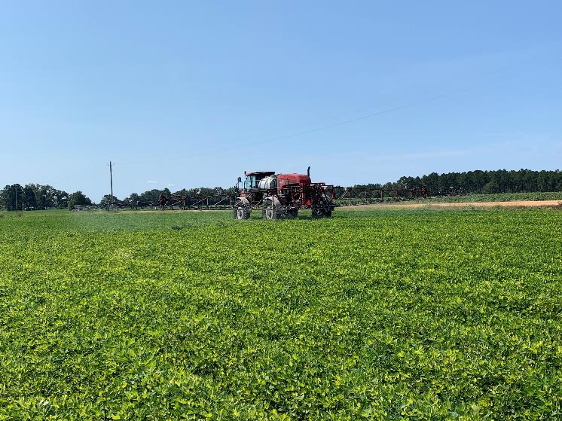

2026 Peanut Weed Control Update
Eric P. Prostko
Extension Weed Specialist
Dept. Crop & Soil Sciences

Slide 2
Peanut (GA-06G) Yield As Influenced by Treatment
Yield (lbs/A)
PE-09-25

Slide 3
Peanut (GA-06G) Yield As Influenced by Treatment
ab
Yield (lbs/A)
LSD (P=0.10) = 1101
CV = 24.1
PE-09-25

Slide 4
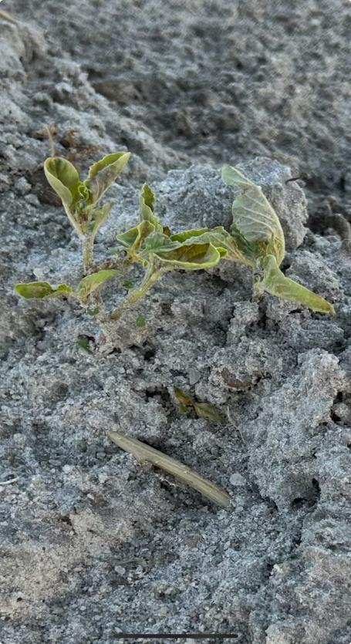
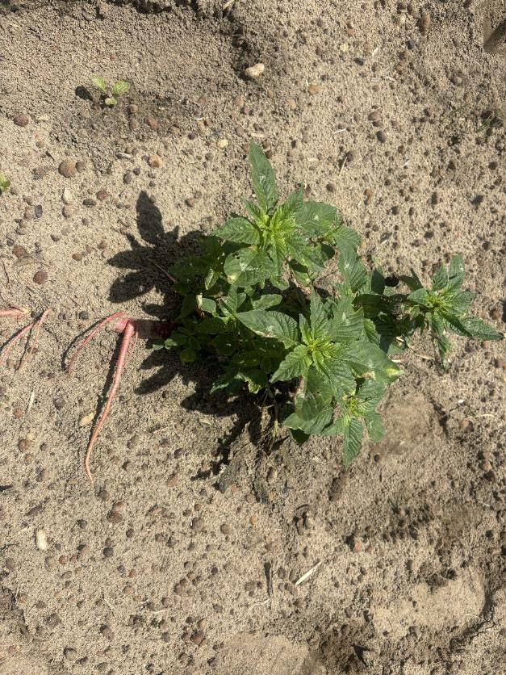
This Ain’t Starting Clean!!!

Slide 5
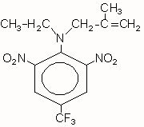
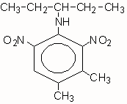
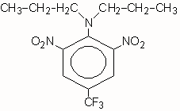
Treflan vs. Sonalan vs. Prowl
Dinitroaniline Herbicide Family, HRAC/WSSA Group 3
Inhibitors of microtubule assembly
Treflan
(trifluralin)
Sonalan
(ethalfluralin)
Prowl
(Pendimethalin)

Slide 6
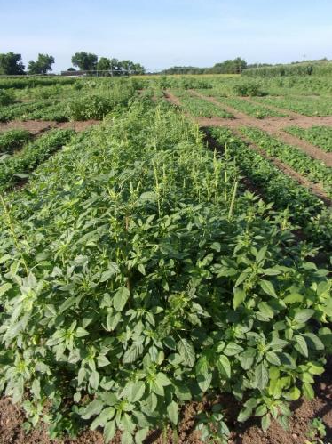
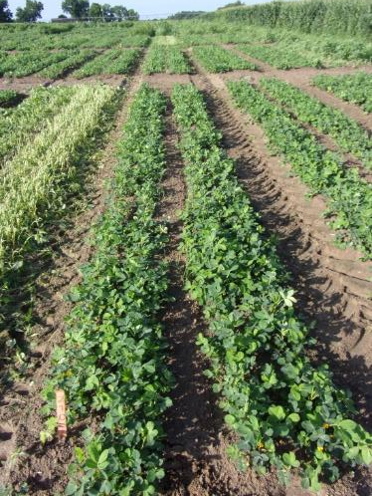
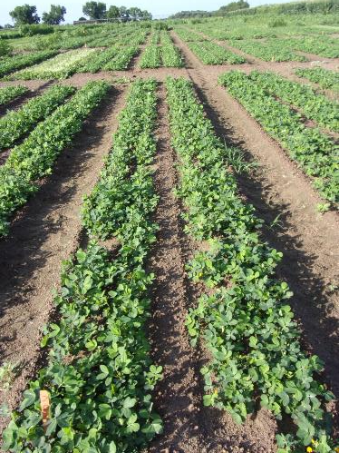
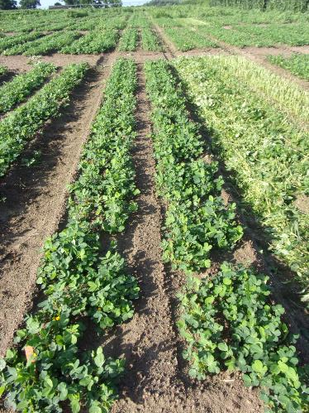
Prowl vs. Sonalan vs. Treflan** - 2025 (0.5” irrigation-24 HAT)
NTC
Prowl H₂0 3.8SC @ 32 oz/A
Valor EZ 4SC @ 3 oz/A
Strongarm 84WG @ 0.225 oz/A
(PRE)
Sonalan HFP 4EC @ 32 oz/A
Valor EZ 4SC @ 3 oz/A
Strongarm 84WG @ 0.225 oz/A
(PRE)
Treflan 4EC @ 32 oz/A
Valor EZ 4SC @ 3 oz/A
Strongarm 84WG @ 0.225 oz/A
(PRE)
**Treflan is NOT labeled for use on peanuts in the SE. Only NM, OK and TX!!
PE-01-25
June 11
37 DAP

Slide 7
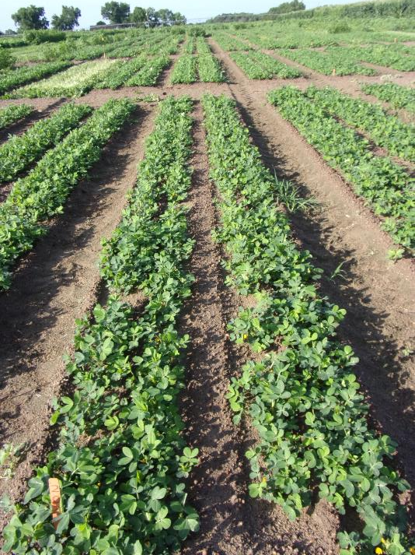
Prowl vs. Sonalan - 2025 (0.5” irrigation-24 HAT)
NTC
Prowl H₂0 3.8SC @ 32 oz/A
Valor EZ 4SC @ 3 oz/A
Strongarm 84WG @ 0.225 oz/A
(PRE)
Sonalan HFP 4EC @ 32 oz/A
Valor EZ 4SC @ 3 oz/A
Strongarm 84WG @ 0.225 oz/A
(PRE)
PE-01-25
June 11
37 DAP

Slide 8
Herbicide Use in Georgia Peanuts – 2018 and 2023
Sources: USDA/NASS: 2018 Agrichemical Use Survey-Peanut, May 2019, No. 2019-2; 2023 Agrichemical Use Survey-Peanut, May 2024, No. 2024-3.

Slide 9
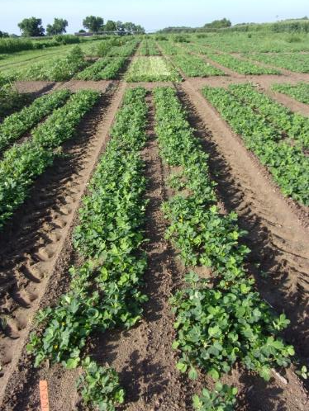
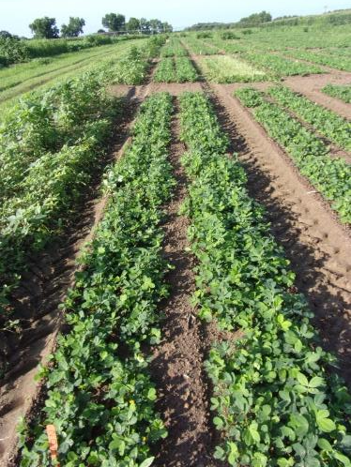
Pendimethalin Formulations - 2025
NTC
Prowl H₂0 3.8SC @ 32 oz/A
Valor EZ 4SC @ 3 oz/A
Strongarm 84WG @ 0.225 oz/A
(PRE)
Pendalin H₂0 3.8SC @ 32 oz/A
Valor EZ 4SC @ 3 oz/A
Strongarm 84WG @ 0.225 oz/A
(PRE)
Satellite Hydrocap 3.8SC @ 32 oz/A
Valor EZ 4SC @ 3 oz/A
Strongarm 84WG @ 0.225 oz/A
(PRE)
PE-01-25
June 11
37 DAP

Slide 10
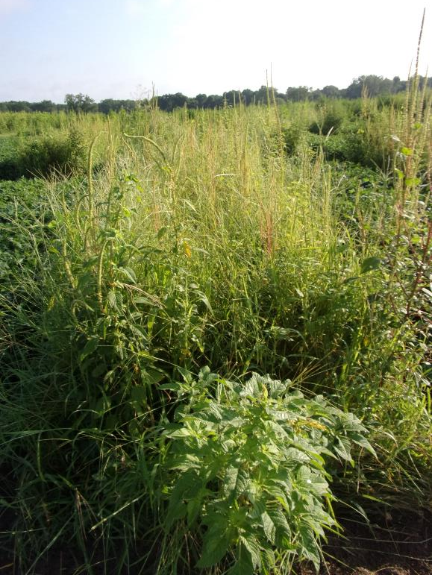
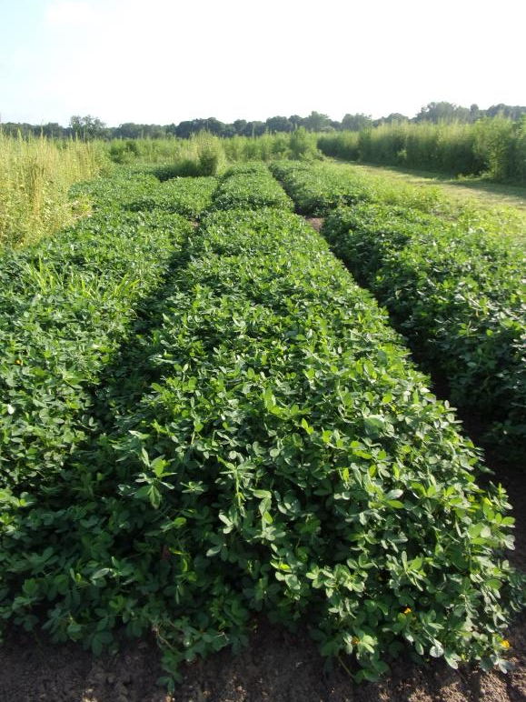
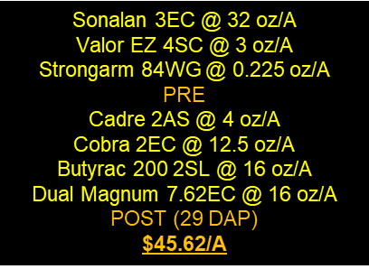
Peanut Weed Control - 2025 “Timely” Program
PE-10-25
July 10
72 DAP
NTC

Slide 11
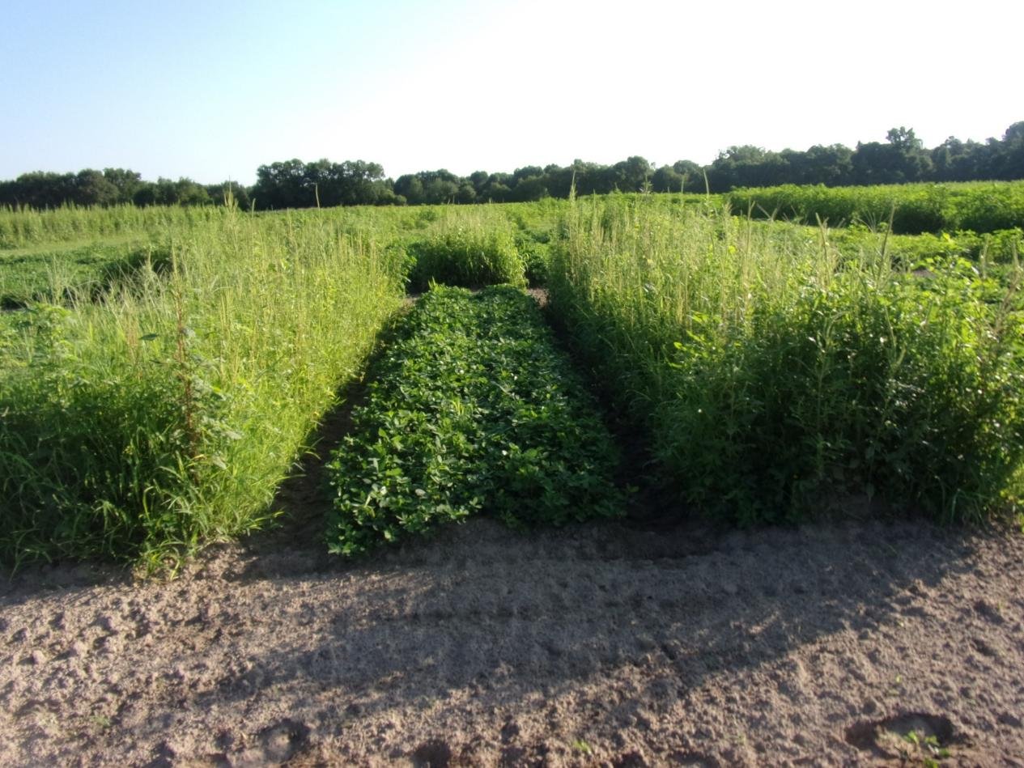
Did not get a PRE out ??? No worries! Estimated total herbicide cost = $43.38/A
Gramoxone 3SL @ 8 oz/A
Ultra Blazer 2SL @ 16 oz/A
Basagran 5SL @ 6.4 oz/A
Enversa 3ME @ 48 oz/A
Induce @ 0.25 v/v
EPOST (15 DAP)
Cadre 2AS @ 4 oz/A
Cobra 2EC @ 12.5 oz/A
Butyrac 200 2SL @ 16 oz/A
Enversa 3ME @ 48 oz/A
Induce @ 0.25% v/v
POST (29 DAP)
PE-10-25
June 23
55 DAP

Slide 12
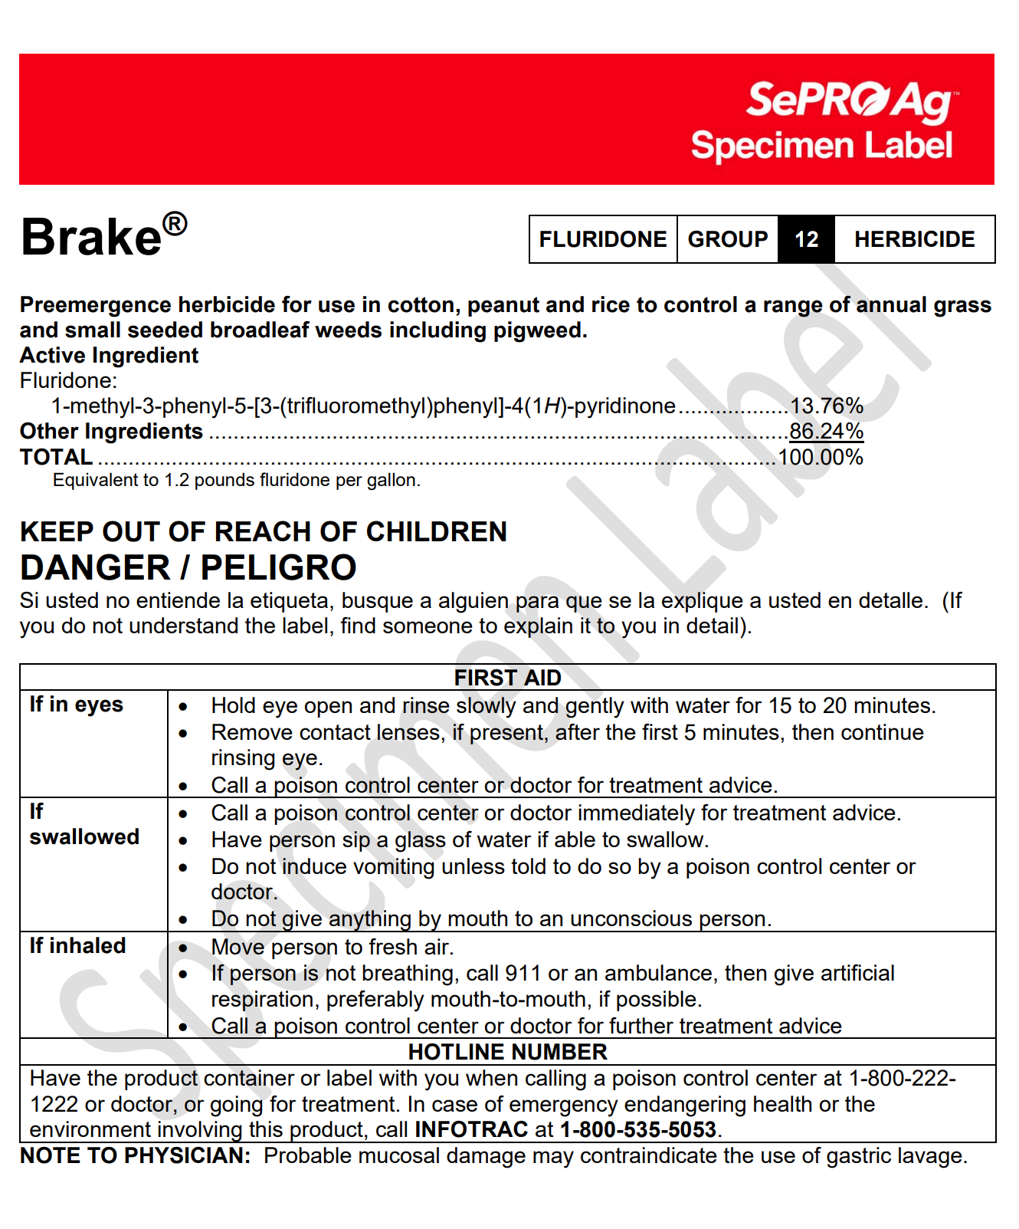
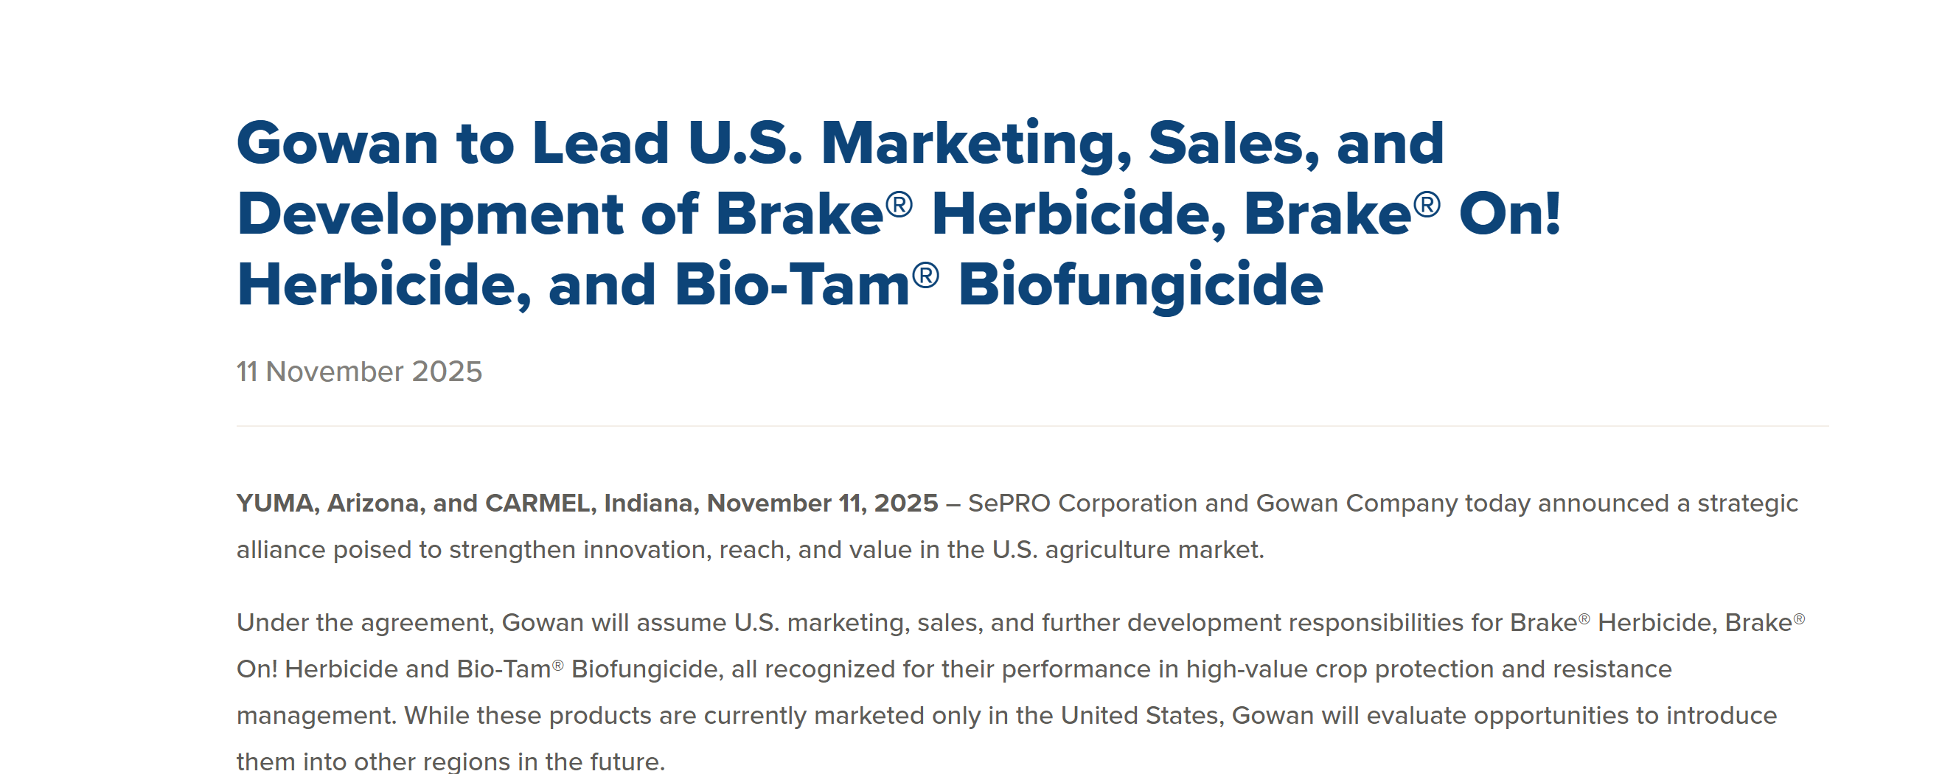


Brake (fluridone)?
2025 Brake Price = $165/gal (12 oz/A = $15.47/A)

Slide 13
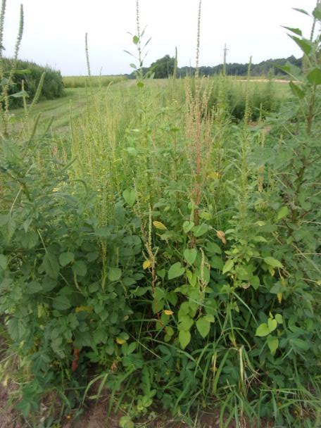
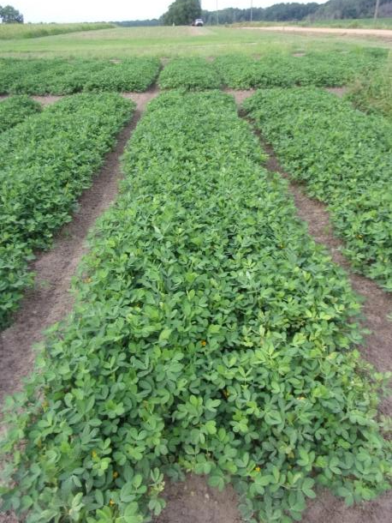
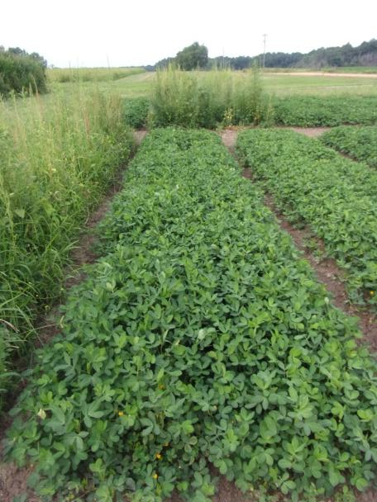
Peanut Weed Control – 2025 Georgia 4-WAY? ($51.94/A)
NTC
Prowl H₂0 3.8SC @ 32 oz/A
PPI
Brake 1.2SC @ 8 oz/A
Valor EZ 4SC @ 1.5 oz/A
Strongarm 84WG @ 0.225 oz/A
PRE
Cadre 2AS @ 4 oz/A
Cobra 2EC @ 12.5 oz/A
Butyrac 200 2SL @ 16 oz/A
Dual Magnum 7.62EC @ 16 oz/A
POST (42 DAP)
Prowl H₂0 3.8SC @ 32 oz/A
Brake 1.2SC @ 8 oz/A
Valor EZ 4SC @ 1.5 oz/A
Strongarm 84WG @ 0.225 oz/A
PRE
Cadre 2AS @ 4 oz/A
Cobra 2EC @ 12.5 oz/A
Butyrac 200 2SL @ 16 oz/A
Dual Magnum 7.62EC @ 16 oz/A
POST (42 DAP)
PE-07-25
July 9
69 DAP

Slide 14
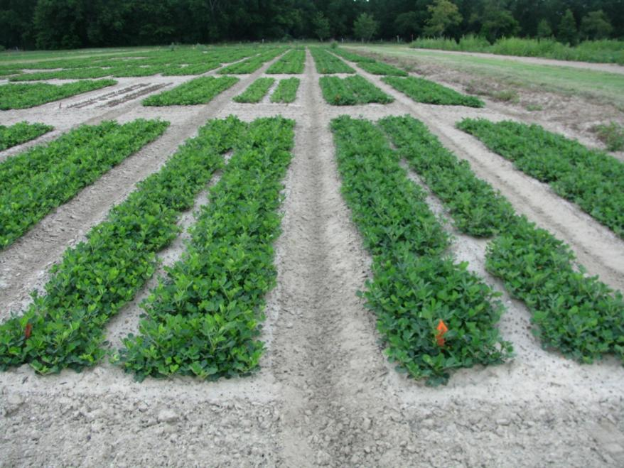
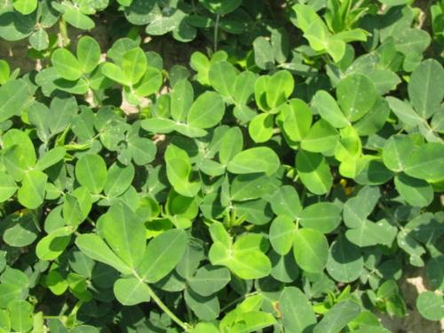
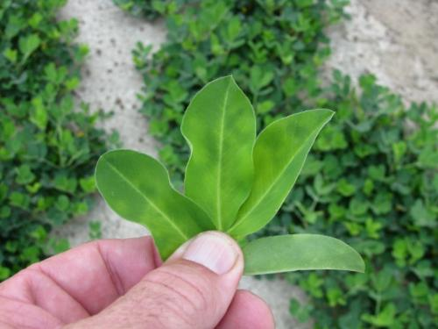
Cadre “Yellow Flash” – 3 DAT
TREATED
NTC
June 25, 2010
GA-06G

Slide 15
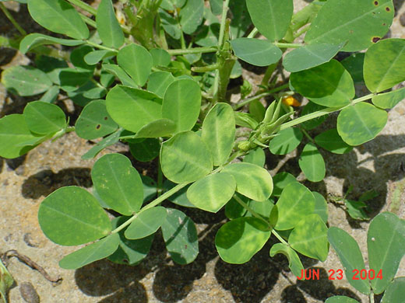
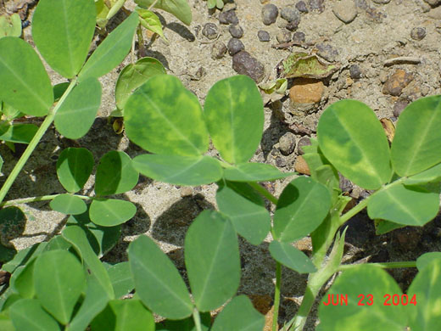
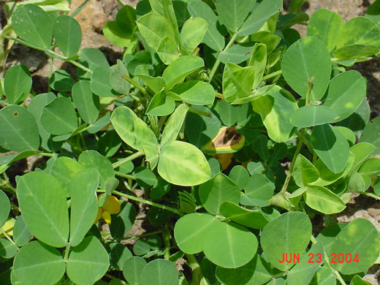
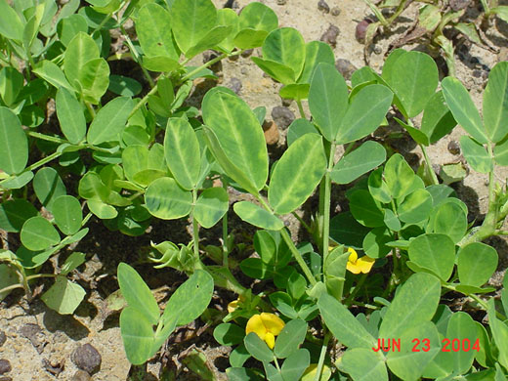
Strongarm “Yellow” Flash

Slide 16
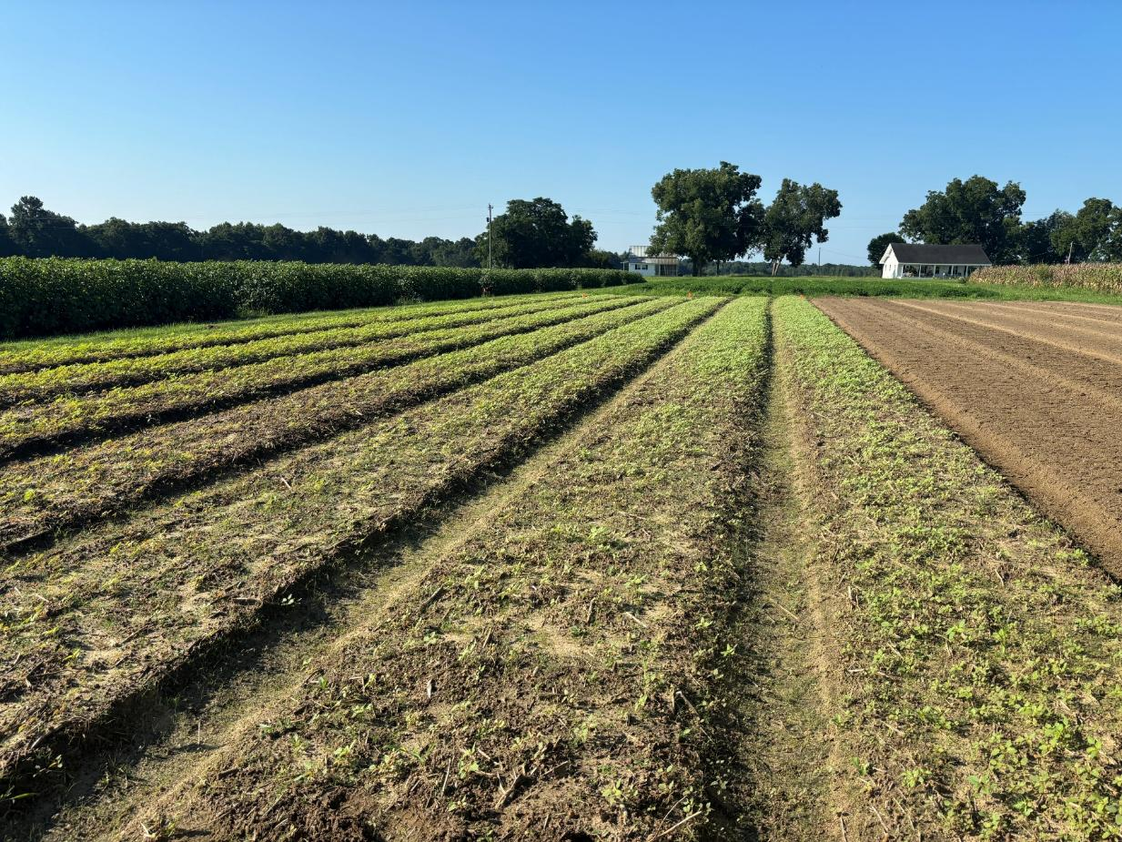
Are these Palmer amaranth plants small?

Slide 17
Palmer Amaranth Height 8 Days After Tillage
Low = 1”; High = 7”; Average = 3.7”
50% > than average
GS-01-25
August 19

Slide 18
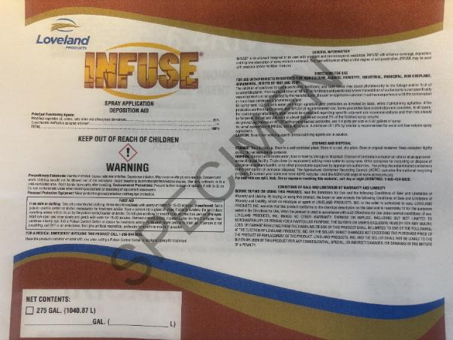
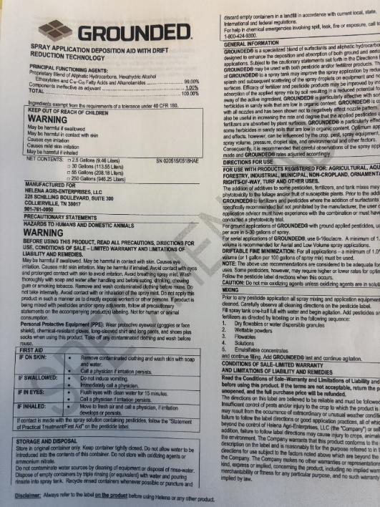
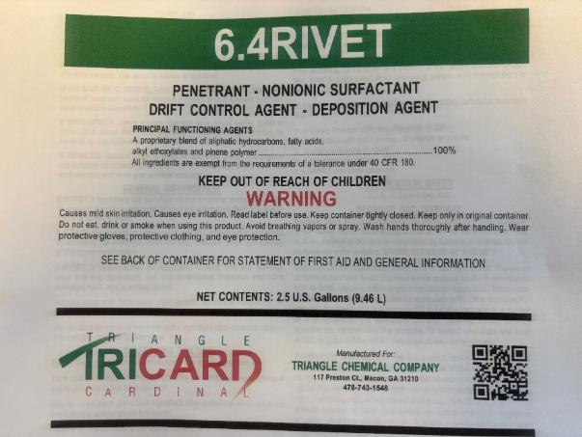
Deposition Aids for Herbicides?

Slide 19
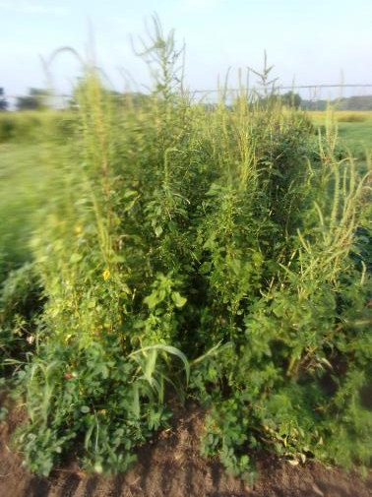
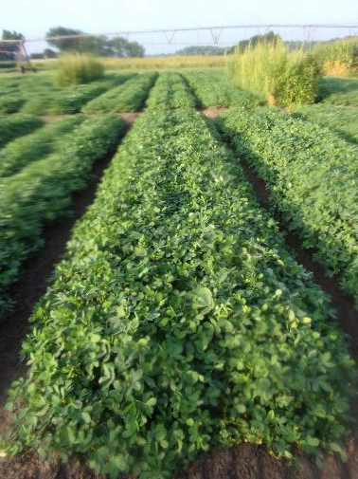
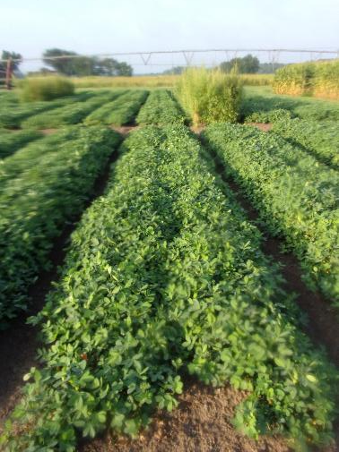
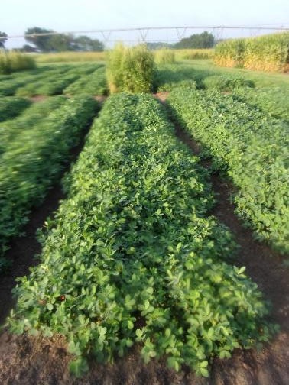
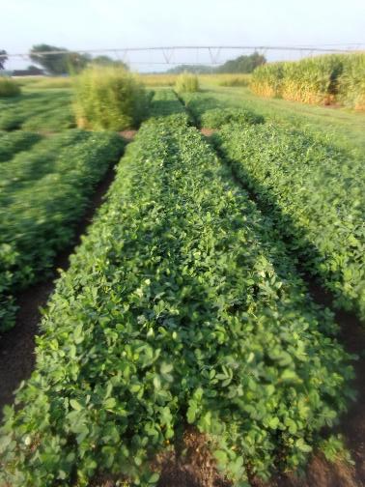
Sonalan 3EC @ 32 oz/A + Valor EZ 4SC @ 3 z/A + Strongarm 84WG @ 0.225 oz/A - Applied PRE then Cadre 2AS @ 3 oz/A + Cobra 2EC @ 12.5 oz/A + Butyrac 2SL @ 16 oz/A + Dual Magnum 7.62EC @ 16 oz/A Applied POST (38 DAP) (with or without adjuvants)
NTC
No Adjuvant
+ Grounded
@ 16 oz/A
+ 6.4Rivet
@ 16 oz/A
+ Infuse
@ 16 oz/A
PE-04-25
July 10
67 DAP

Slide 20
Sonalan 3EC @ 32 oz/A + Valor EZ 4SC @ 3 z/A + Strongarm 84WG @ 0.225 oz/A - Applied PRE then Cadre 2AS @ 3 oz/A + Cobra 2EC @ 12.5 oz/A + Butyrac 2SL @ 16 oz/A + Dual Magnum 7.62EC @ 16 oz/A Applied POST (38 DAP) (with or without adjuvants)
abc
bc
bc
PE-04-25
LSD 0.10 = 549
CV = 8.41

Slide 21
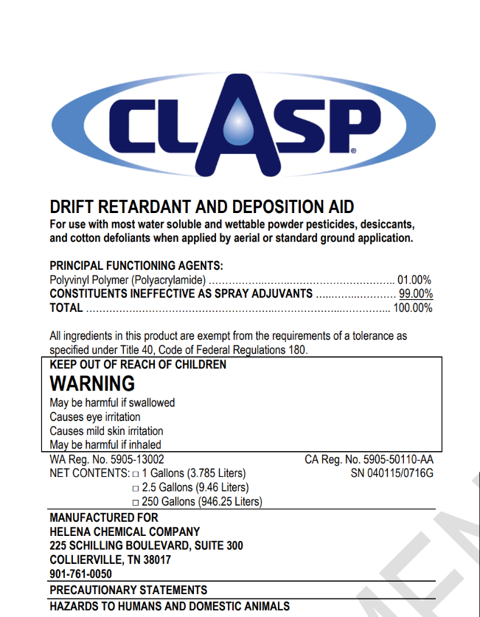
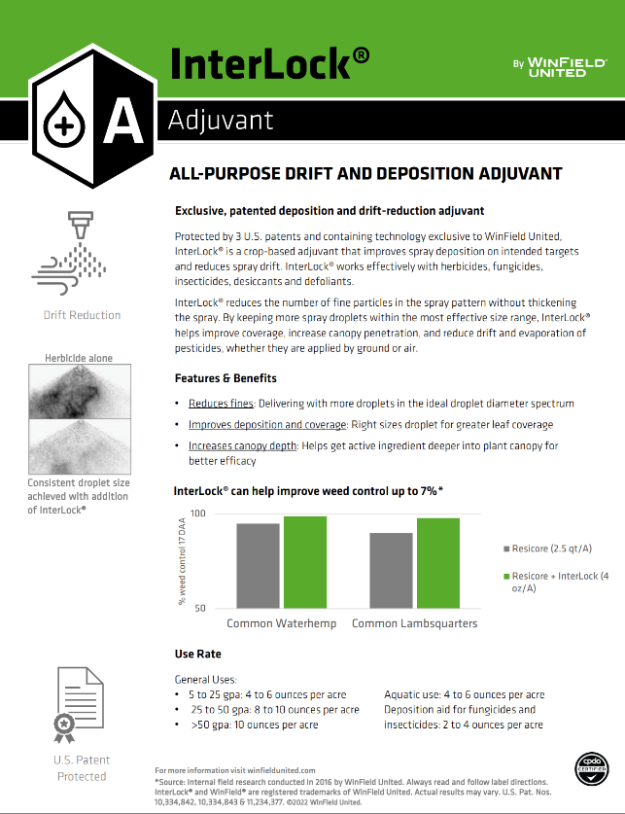
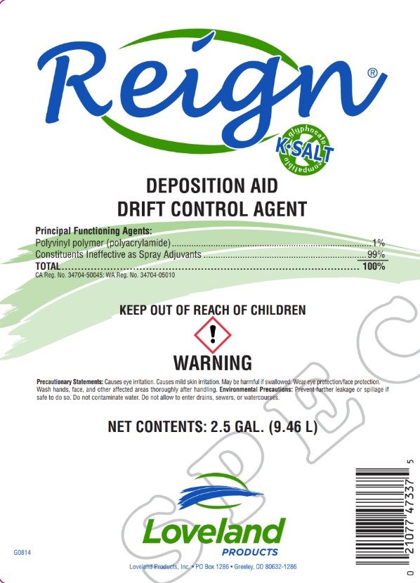
2025 DRA/Peanut Study

Slide 22
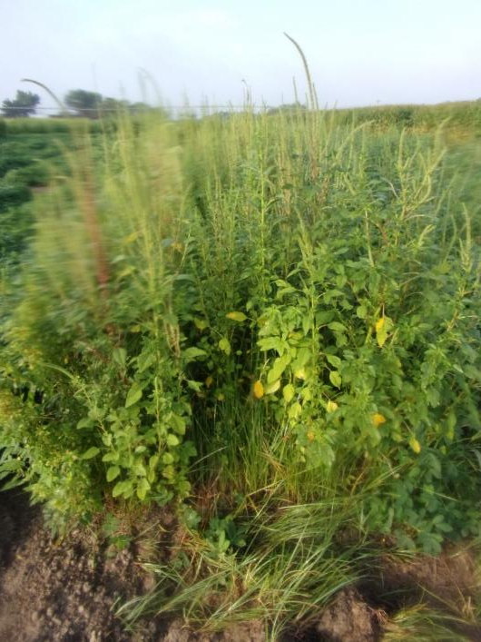
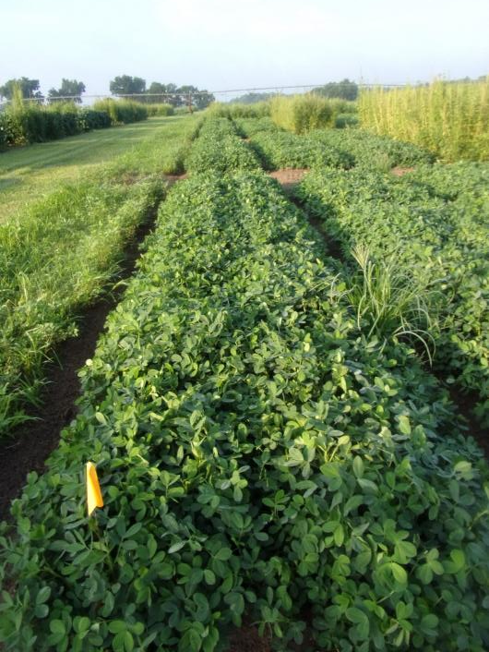
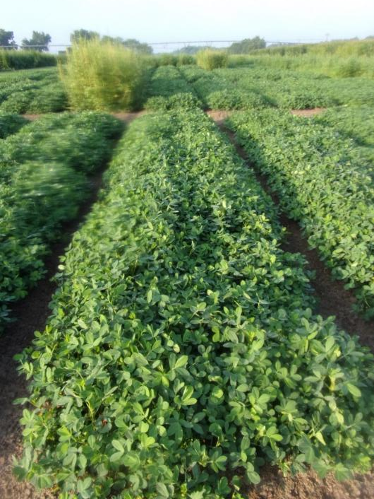
DRA/Peanut Study - 2025
Prowl H₂0 @ 32 oz/A
Valor EZ @ 3 oz/A
Strongarm @ 0.225 oz/A
PRE
Cadre @ 4 oz/A
Cobra @ 12.5 oz/A
Butyrac @ 16 oz/A
Dual Magnum @ 16 oz/A
POST (37 DAP)
NTC
No DRA
Clasp @ 32 oz/100 gals
PE-03-25
July 10
66 DAP

Slide 23
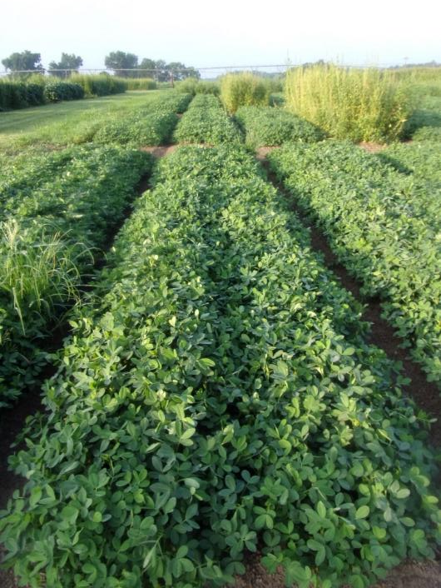
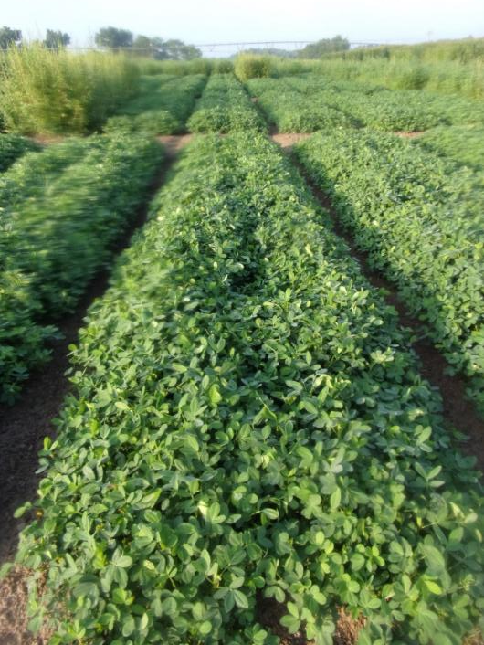
DRA/Peanut Study - 2025
Gramoxone @ 8 oz/A
Ultra Blazer @ 16 oz/A
Basagran @ 6.4 oz/A
Dual Magnum @ 16 oz/A
EPOST (14 DAP)
Cadre @ 4 oz/A
Cobra @ 12.5 oz/A
Butyrac @ 16 oz/A
Dual Magnum @ 16 oz/A
POST (37 DAP)
NTC
No DRA
Clasp @ 32 oz/100 gals
PE-03-25
July 10
66 DAP

Slide 24
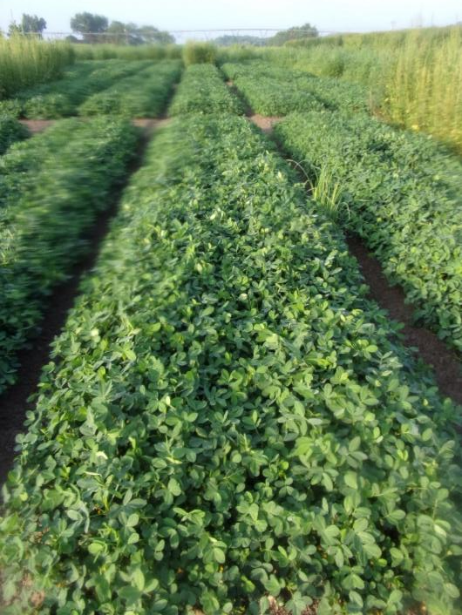
DRA/Peanut Study - 2025
Prowl H₂0 @ 32 oz/A
Valor EZ @ 3 oz/A
Strongarm @ 0.225 oz/A
PRE
Cadre @ 4 oz/A
Cobra @ 12.5 oz/A
Butyrac @ 16 oz/A
Dual Magnum @ 16 oz/A
POST (37 DAP)
NTC
No DRA
InterLock @ 4 oz/A
PE-03-25
July 10
66 DAP

Slide 25
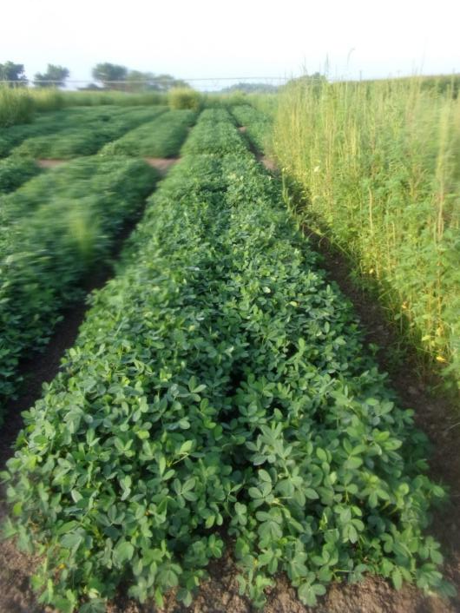
DRA/Peanut Study - 2025
Gramoxone @ 8 oz/A
Ultra Blazer @ 16 oz/A
Basagran @ 6.4 oz/A
Dual Magnum @ 16 oz/A
EPOST (14 DAP)
Cadre @ 4 oz/A
Cobra @ 12.5 oz/A
Butyrac @ 16 oz/A
Dual Magnum @ 16 oz/A
POST (37 DAP)
NTC
No DRA
InterLock @ 4 oz/A
PE-03-25
July 10
66 DAP

Slide 26
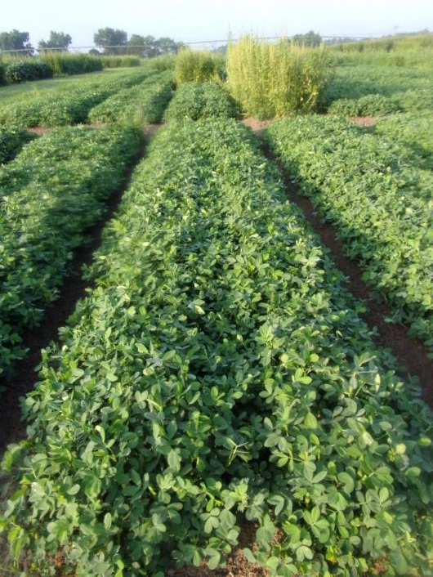
DRA/Peanut Study - 2025
Prowl H₂0 @ 32 oz/A
Valor EZ @ 3 oz/A
Strongarm @ 0.225 oz/A
PRE
Cadre @ 4 oz/A
Cobra @ 12.5 oz/A
Butyrac @ 16 oz/A
Dual Magnum @ 16 oz/A
POST (37 DAP)
NTC
No DRA
Reign @ 32 oz/100 gals
PE-03-25
July 10
66 DAP

Slide 27
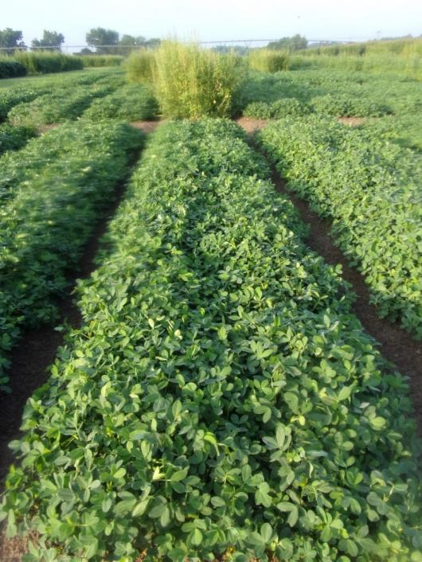
DRA/Peanut Study - 2025
Gramoxone @ 8 oz/A
Ultra Blazer @ 16 oz/A
Basagran @ 6.4 oz/A
Dual Magnum @ 16 oz/A
EPOST (14 DAP)
Cadre @ 4 oz/A
Cobra @ 12.5 oz/A
Butyrac @ 16 oz/A
Dual Magnum @ 16 oz/A
POST (37 DAP)
NTC
No DRA
Reign @ 32 oz/100 gals
PE-03-25
July 10
66 DAP

Slide 28




2025 HPPD/Peanut Rotation Study
Current Rotation Restrictions for Peanuts
Callisto (mesotrione) = 10 months
Impact (topramezone) = 9 Months
Laudis (tembotrione) = 11 months
Shieldex (tolpyralate) = 9 months

Slide 29


2025 HPPD/Peanut Rotation Study HPPD Applied 57 DBP
PE-08B-25
July 10
57 DAP
NTC
Laudis 3.5SC @ 6 oz/A

Slide 30

2025 HPPD/Peanut Rotation Study HPPD Applied 57 DBP
PE-08B-25
July 10
57 DAP
NTC
Impact 2.8SC @ 1.5 oz/A

Slide 31

2025 HPPD/Peanut Rotation Study HPPD Applied 57 DBP
PE-08B-25
July 10
57 DAP
NTC
Callisto 4SC @ 6 oz/A

Slide 32

2025 HPPD/Peanut Rotation Study HPPD Applied 57 DBP
PE-08B-25
July 10
57 DAP
NTC
Shieldex 3.33SC @ 2 oz/A

Slide 33

P=0.3123
CV= 5.44
TifNV-HG

Slide 34

Problems - 2025

Slide 35

Beware of Google/AI Recommendations!

Slide 36

Peanut and Atrazine – 2025 Atrazine @ ~65 DAP
B. Hayes
August 18
~5-7 DAT

Slide 37
Peanut Yield Response to Aatrex 4L (atrazine)
PE-02-25
GA-06G
LSD 0.10 = 681
CV = 11.8

Slide 38




Liberty Drift on Peanut From Drone
Corn sprayed 08/13/25
Sample collected 08/21/25
J. Kichler
08/19/25

Slide 39

Dicamba Injury on Peanut - 2025
Dicamba Applied: April 5
Peanut Planted: April 29
24 days after applicaton
No rain from application until 0.6” day after planting.
Only 25% peanut emergence
Dicamba is not labeled for preplant use in peanut!
If it was (but never will be):
0.50 lb ae/A = 28 days + 1” irrigation/ rainfall
0.25 lb ae/A = 14 days + 1” irrigation/ rainfall
J. Odom
May 12, 2025

Slide 40


Peanut Injury? Roundup or Atrazine or K Deficiency or B Toxicity?
Roundup and Atrazine tests were negative?
Sampled too late???
Potassium (K) in leaf tissue was 3.85%
sufficiency range = 1.70-3.00%
Boron (B) was very high in leaf tissue analysis (174 ppm)
sufficiency range = 20-60 ppm
B toxicity in peanut tissue is likely when B concentration exceeds 100 ppm.
Grower applied 1 qt/A of B (10%) in 2nd and 4th fungicide sprays.
T. Price
Cook Co.
09/18/25

Slide 41
Herbicide Residues Detected in Cotton Tissue Samples as Influenced by Time After Application*
*Source: Wright-Smith HE, Culpepper AS, Crabtree CR, Grey TL, Randell-Singleton TM, Vance JC (2024) Herbicide residue detection in cotton as influenced by time, drift rate, and sampling method. Weed Sci. 72: 798–803.

Slide 42


Trifloxysulfuron Injury Peanut - 2025
Recognition 20.4WDG @ 1.95 oz/A applied in April?
0.0249 lb ai/A
2.1X to 5.3X of cotton rate
Peanuts Planted in May?
Same ai as Envoke in cotton
Envoke 75WDG
0.10-0.25 oz/A
0.0047-0.0117 lb ai/A
7 month peanut plant-back restriction
0.003 and 0.007 ai/A PRE reduced peanut yields 7.5% and 12.6%.
Porterfield and Wilcut (2003). Weed Technology 17(3):41-445.
J. Bennett/J. Porter
Wilcox/Pulaski Co.
June 2025

Slide 43


What do the top Georgia peanut growers do? 2024 Georgia Peanut Achievement Club Winners
16 growers
116 to 1520 acres (range)
5360 lb/A average yield
4145-6089 lbs/A (range)
2024 GA State Avg. = 3800 lbs/A
100% - irrigated
79% - conventional tillage
71% - twin rows
Top 5 Herbicides
100%: flumioxazin
100%: s-metolachlor/metolachlor
79%: 2,4-DB
71%: diclosulam
64%: imazapic

Slide 44


Questions/Comments/Thanks for Listening!

