Slide 1

Field Corn Weed Control Update
2026
Eric P. Prostko
Extension Weed Specialist
Dept. Crop & Soil Sciences

Slide 2

Where is grain agronomist?
04/17/25 – 5:17 AM

Slide 3
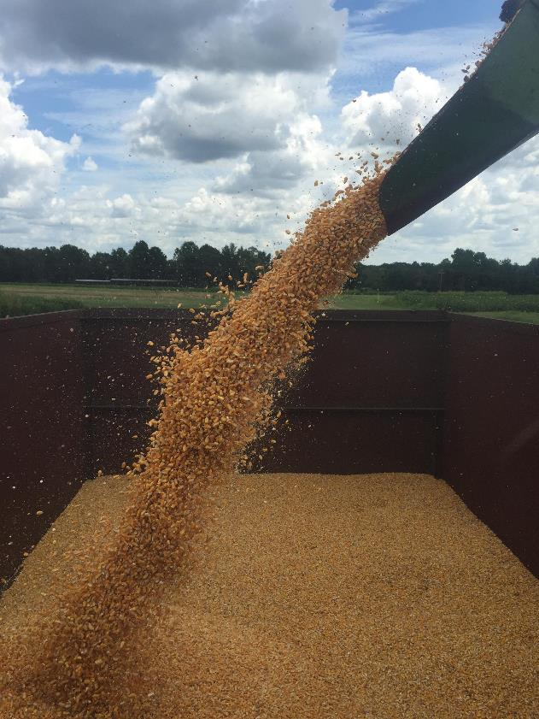
Topics for Discussion
AI Recommendations
Weed Control Costs
Ryegrass
Halex GT vs Home-Made
Enlist Corn
V. Corn Control/Replant
Boron???
Cocklebur
V. peanut
Post-Harvest
Problems

Slide 4
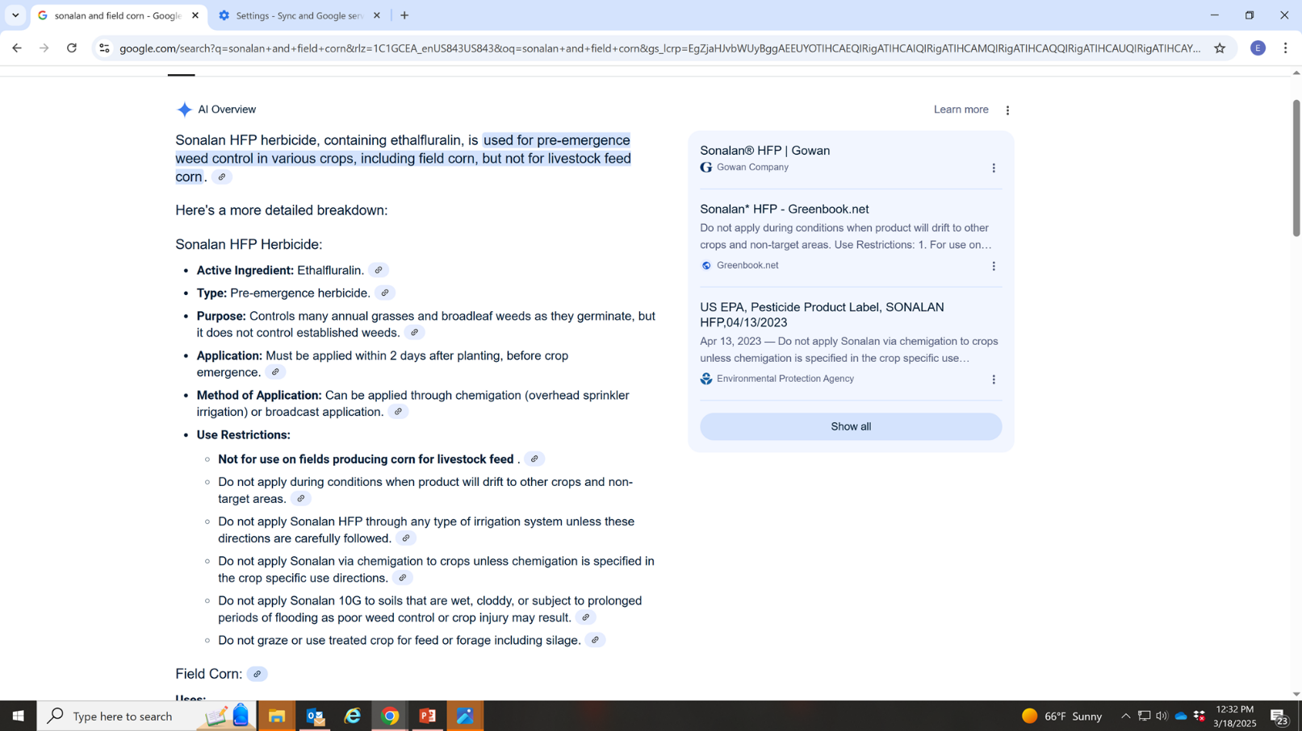
Beware of Google/AI Recommendations!

Slide 5
Field Corn Yield Loss (%) Caused by Uncontrolled Weeds in UGA Weed Science Irrigated Research Trials (2007-2025)
Treated vs. Non-treated
200 Bu/A X 0.32 X $4.14 = $265/A
250 Bu/A X 0.32 X $4.14 = $331/A
300 Bu/A X 0.32 X $4.14 = $397/A
What about harvest?
What about next year?

Slide 6
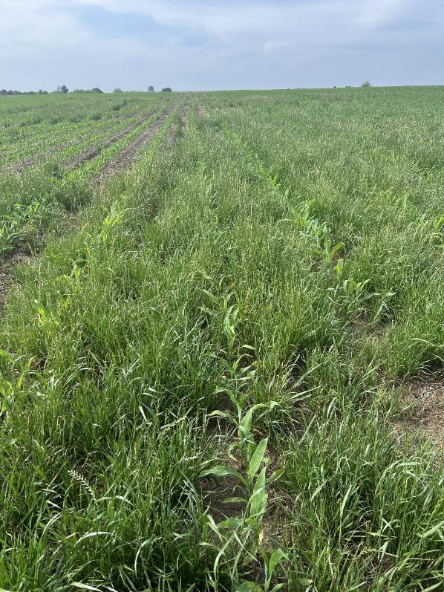
Ryegrass in Field Corn - 2025
Glyphosate resistant???
  Assume it is?
Gramoxone – preplant
  2 apps
Accent Q or Steadfast Q
  Counter (INFR)?
  Hybrid Tolerance?
Liberty
  Need warm temps
Enlist Corn?
  Assure II (quizalofop)
    Hoelon (diclofop resistant population?)
G. Harris
04/21/25
Turner Co.

Slide 7
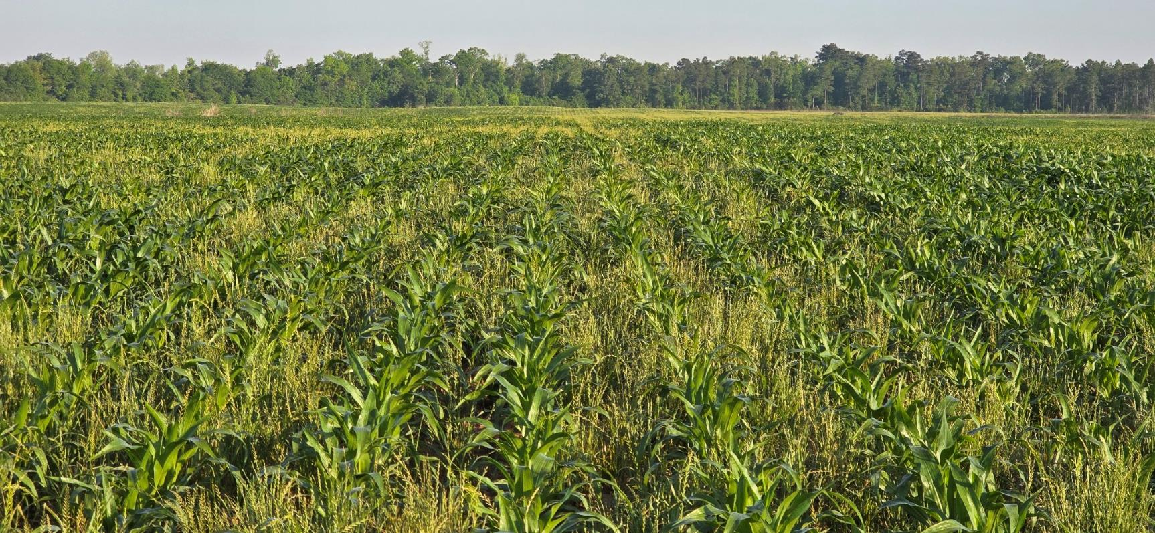
Ryegrass in Corn – 2025
Treated with Liberty @ 43 oz/A + AMS @ 2 lbs/A + Atrazine @ 32 oz/A + Zidua @ 2 oz/A
no burndown
wet weather
wind
C. Traugh
Seminole Co.
April 17, 2025
7 DAT

Slide 8
Annual Ryegrass Control (10-25 days after early flower application) with Roundup WeatherMax 5.5SL (Averaged over 6 locations)
Adapted from:Lins et al. 2007. Weed Technology 21:602-605

Slide 9

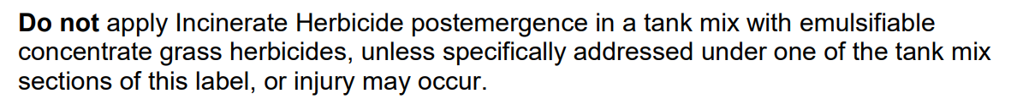
Brand Name Halex GT vs Home-Made Halex GT
Brand Name Halex GT 4.389SC
  $42/gal @ 58 oz/A = $19.03/A
    0.947 lbs ai/A s-metolachlor + 0.947 lbs ae/A glyphosate (K-salt) + 0.0947 bs ai/A mesotrione
Home-Made Halex GT
  Incinerate 4SC (mesotrione) = $165/gal @ 3 oz/A = $3.87/A
  CornerStone 5 Plus 5.5SL (glyphosate-IPA, 4 lb ae/gal) = $15/gal @ 30.3 oz/A = $3.55/A
  Charger Basic 7.62EC (s-metolachlor) = $40/gal @ 16 oz/A = $5.00/A
$19.03/A vs. $12.42/A ($6.61/A savings)
But mesotrione labels say……….

Slide 10
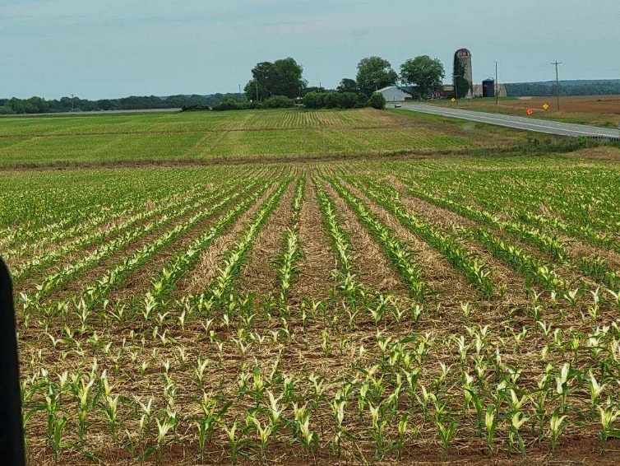
Home-Made Halex GT - 2025
Roundup
Dual Magnum
Generic Callisto
Is this potential injury worth $6.61/A??
Who will pay for new innovations/discovery?
J. Cook/M. Grizzle
May 9, 2025

Slide 11
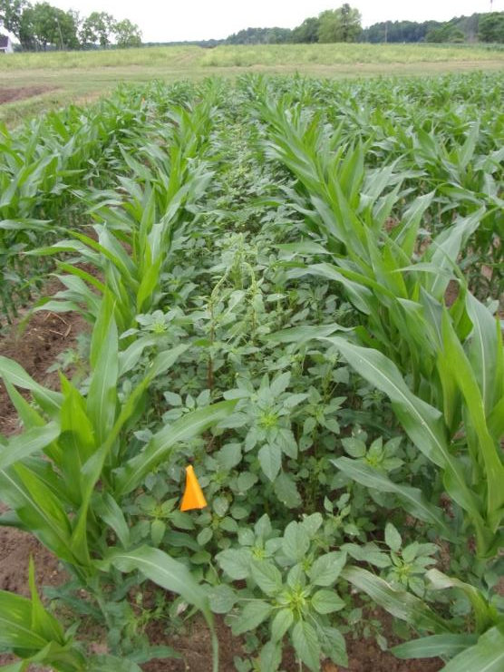
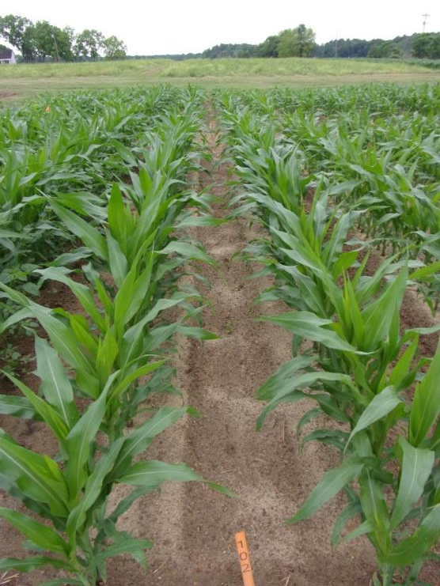
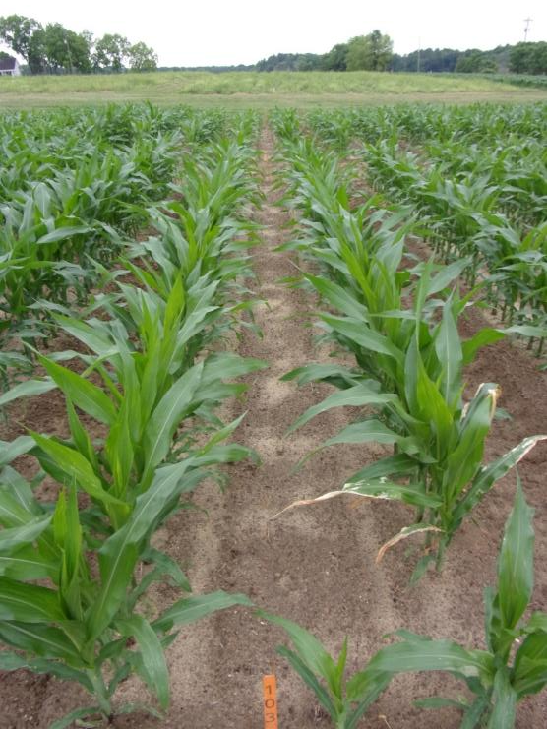
Field Corn Weed Control – 2025
Halex GT (Applied 16 DAP, V3-4, P2042VYHR)
NTC
Halex GT 4.389SC @ 58 oz/A
Aatrex 4L @ 64 oz/A
Induce @ 0.25% v/v
RUPM3 5.88SL @ 25.3 oz/A
Callisto 4SC @ 3 oz/A
Dual Magnum 7.62EC @ 16 oz/A
Aatrex 4L @ 64 oz/A
Induce @ 0.25% v/v
CN-07-25
May 7
34 DAP

Slide 12
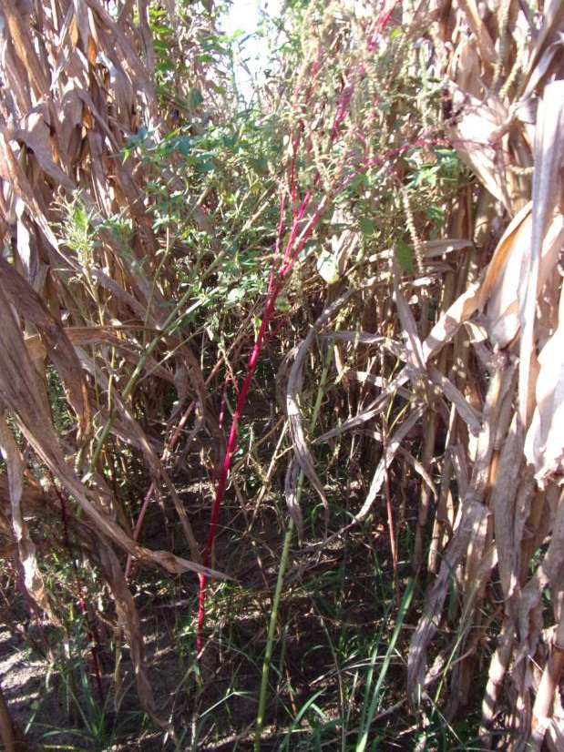
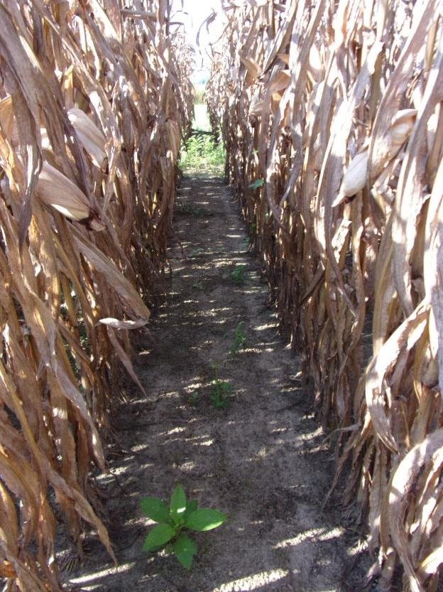
Field Corn Weed Control - 2025
Halex GT 4.389SC @ 58 oz/A
Aatrex 4L @ 64 oz/A
Induce @ 0.25% v/v
Applied 16 DAP
CN-07-25
August 19
138 DAP
NTC

Slide 13
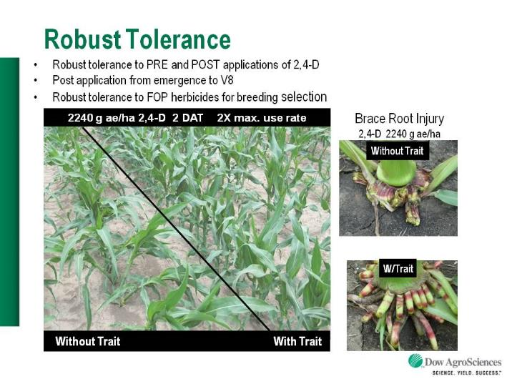

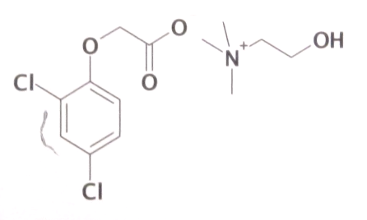
Enlist™ Herbicide Tolerant Corn
tolerance to 2,4-D, quizalofop, glyphosate, glufosinate
  Trait – 2014
  Enlist Duo® - 2014
  Enlist One® - 2017
Colex-D™ technology
  2,4-D choline
  lower volatility (than ester)
  enhanced handling/mixing characteristics
  reduced odor
1 PRE application + 2 POST applications (30” or V8 stage, 12 days apart)
Enlist Duo®
  DMA-Glyphosate (1.71 lb ae/gal) + 2,4-D choline (1.63 lb ae/gal)
  3.5 pt/A
Enlist One®
  2,4-D choline (3.8 lb ae/gal)
  1.5-2.0 pts/A
2,4-D choline

Slide 14
Enlist™ Herbicide Tolerant Corn Programs
Program #1
  1) Atrazine – PRE followed by
  2) Liberty + Enlist One + One of the following (Anthem Maxx, Dual Magnum, Enversa, Outlook, Prowl, Warrant, Zidua) - POST
Program #2
  1) One of the following PRE (Dual Magnum, Enversa, Outlook, Warrant) followed by
  2) Liberty + Enlist One + Atrazine - POST
2,4-D choline

Slide 15

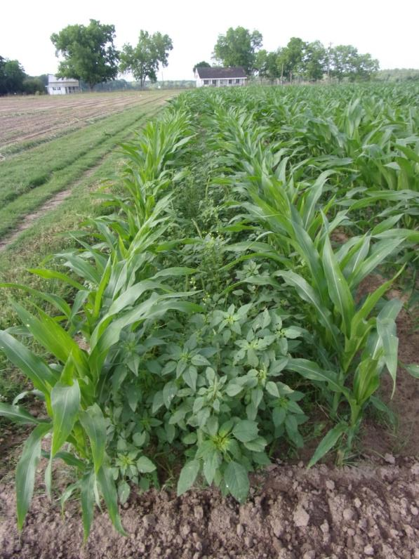
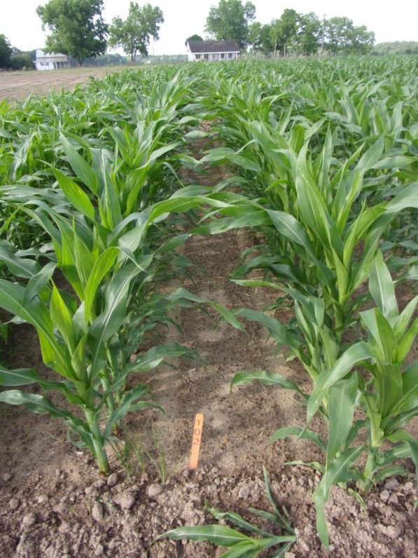
Enlist Field Corn Weed Control - 2025
CN-04-25
May 8
29 DAT
NTC
Liberty Ultra 1.76SL@ 24 oz/A
Enlist One 3.8SL @ 32 oz/A
Aatrex 4L @ 32 oz/A
Applied 14 DAP (V3-V4)

Slide 16

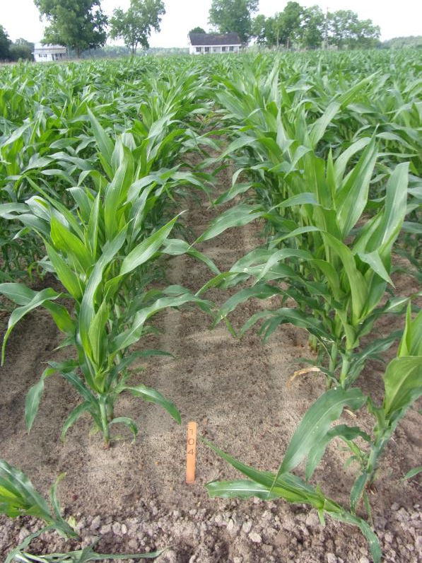
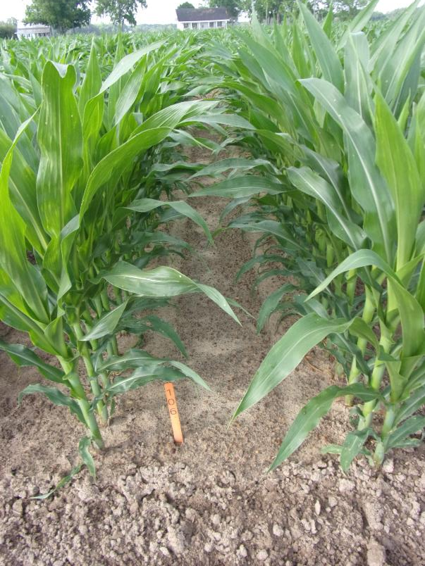
Enlist™ Field Corn Weed Control - 2025
NTC
Liberty Ultra 1.76SL @ 24 oz/A
Enlist One 3.8SL @ 32 oz/A
Dual Magnum 7.62EC @ 16 oz/A
Applied 14 DAP (V3-V4)
Liberty Ultra 1.76SL @ 24 oz/A
Enlist One 3.8SL @ 32 oz/A
Outlook 6EC @ 12.8 oz/A
Applied 14 DAP (V3-V4)
CN-04-25
May 8
29 DAT

Slide 17
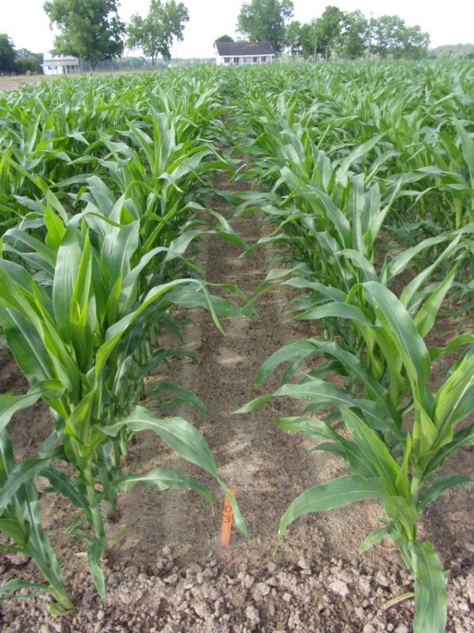
Enlist Field Corn Weed Control - 2025
CN-04-25
May 8
29 DAT
NTC
Liberty Ultra 1.76SL@ 24 oz/A
Enlist One 3.8SL @ 32 oz/A
Prowl H₂O 3.8SC @ 32 oz/A
Applied 14 DAP (V3-V4)

Slide 18
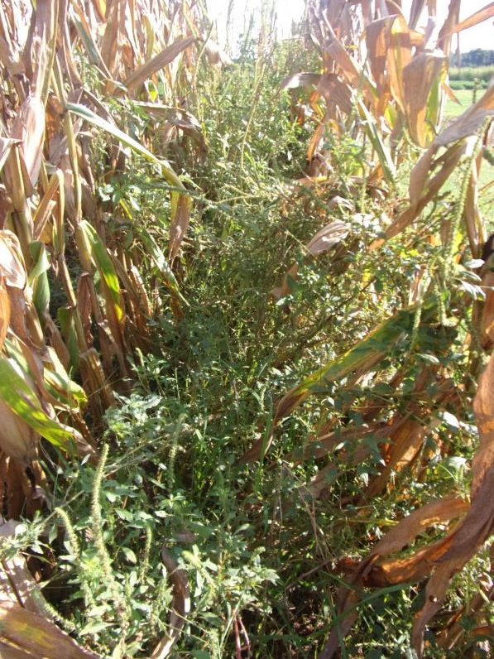
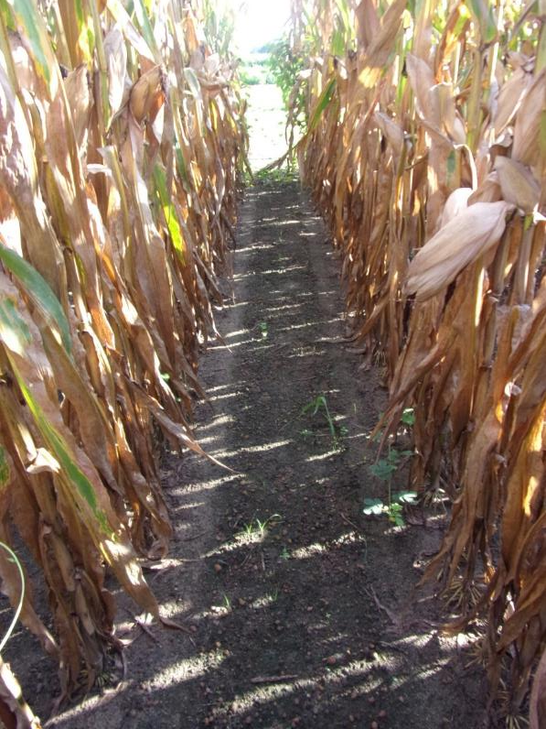
Enlist Field Corn Weed Control - 2025
CN-04-25
July 30
112 DAT
NTC
Liberty Ultra 1.76SL @ 24 oz/A
Enlist One 3.8SL @ 32 oz/A
Anthem Maxx 4.3SC @ 3 oz/A
Applied 14 DAP (V3-V4)

Slide 19
Enlist Field Corn Hybrids for Georgia – 2025
Averaged Over 22 Locations
Source: K. Phillips, Pioneer

Slide 20
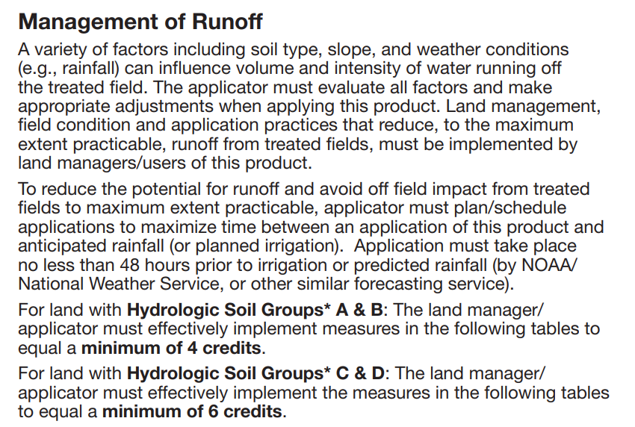
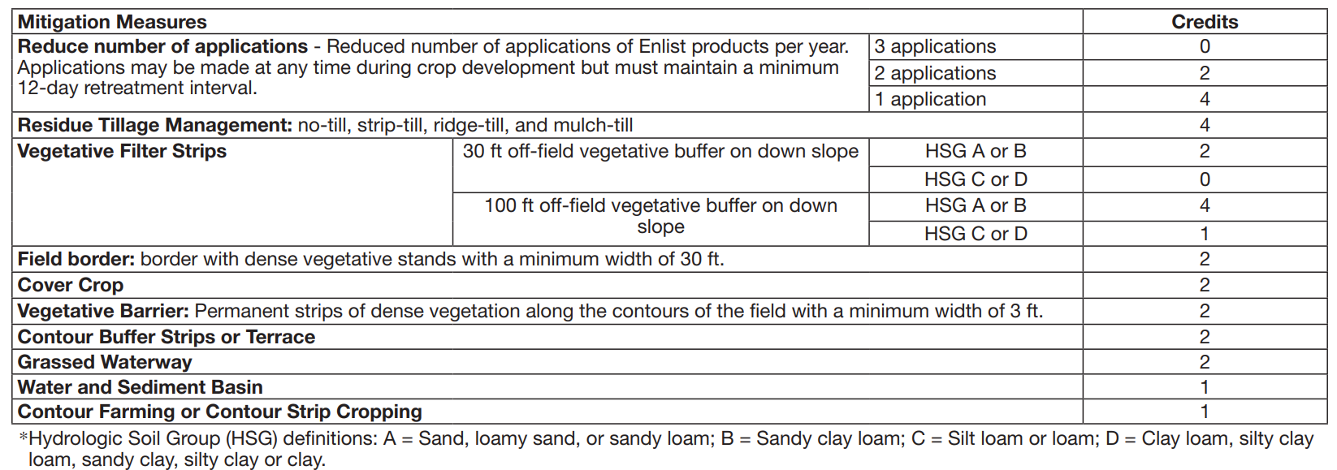
Enlist One/ESA/Runoff Mitigation
(4-6 credits)

Slide 21
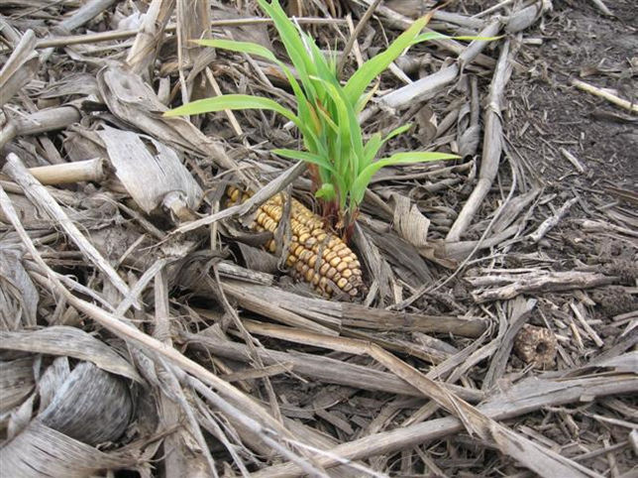
Volunteer Corn/Replant?

Slide 22
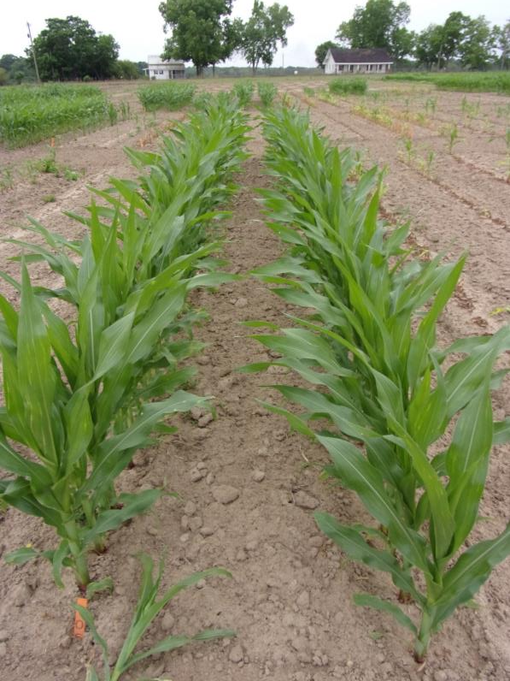
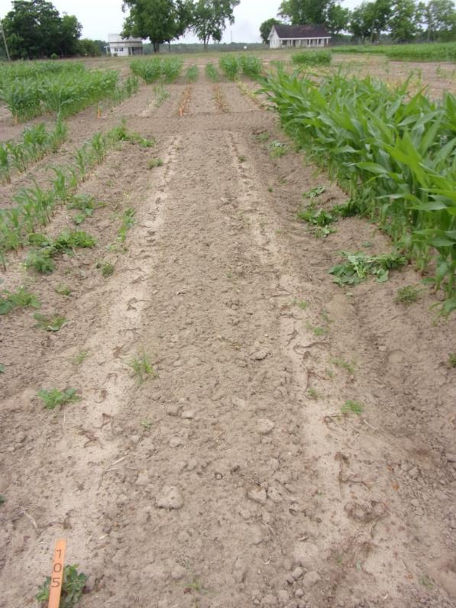
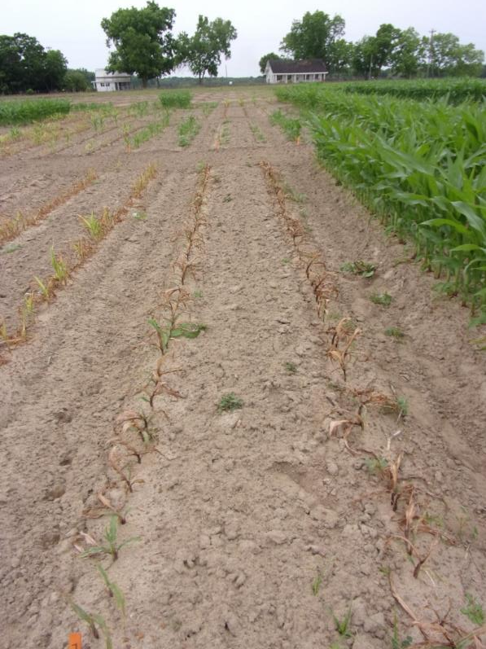
Field Corn Control with Select Max 0.97EC @ 6 oz/A + Induce @ 0.25% v/v
NTC
Applied V3-V4
28 DAT
Applied V5-V6
18 DAT
CN-01-25
May 7
42 DAP

Slide 23
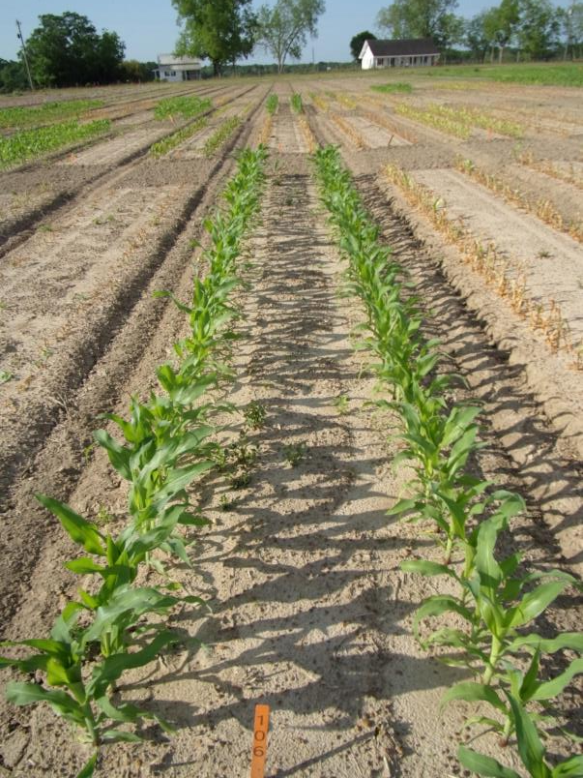
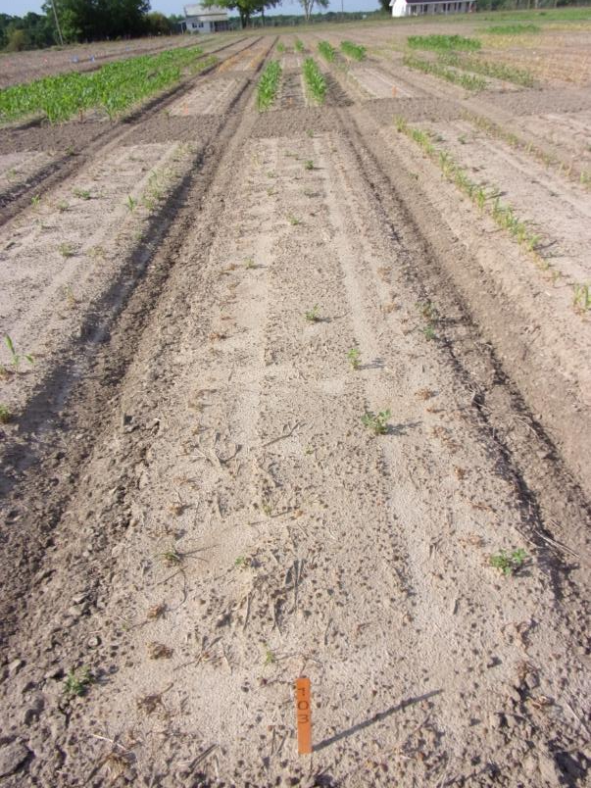
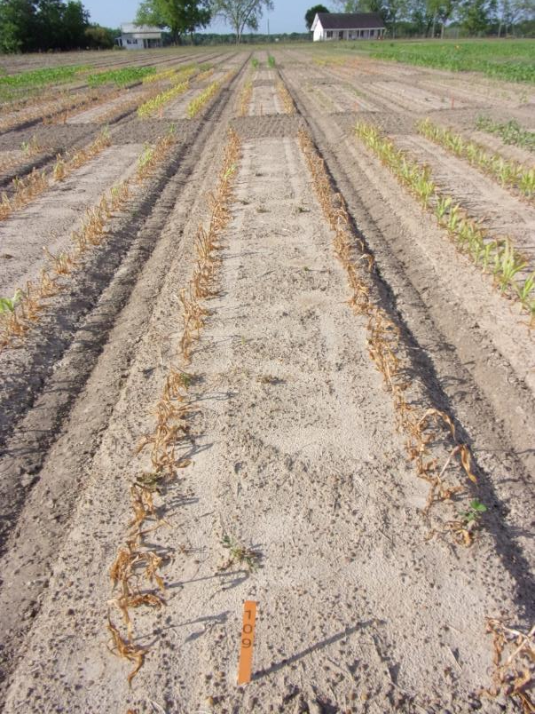
Field Corn Control with Gramoxone 3SL @ 32 oz/A + Tricor 4F @ 4 oz/A + Induce @ 0.25% v/v
NTC
Applied V3-V4
17 DAT
Applied V5-V6
7 DAT
CN-01-25
April 26
31 DAP

Slide 24
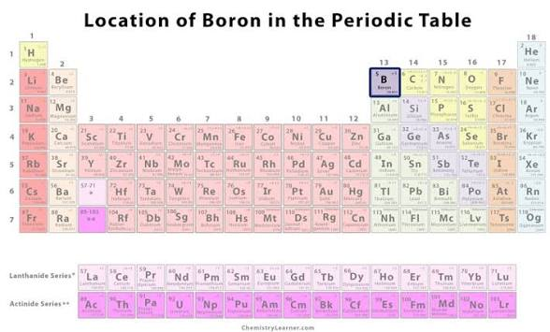
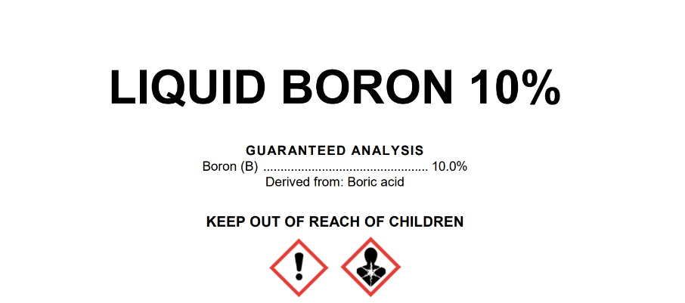
Boron?

Slide 25
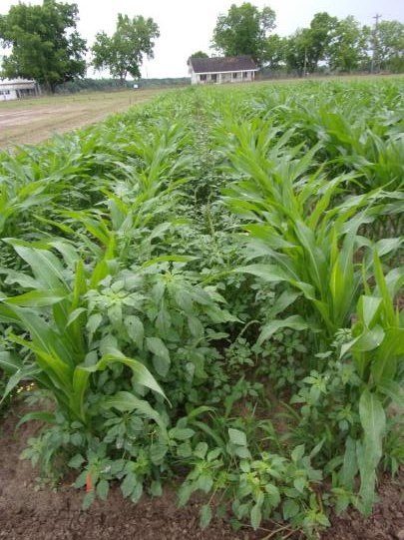
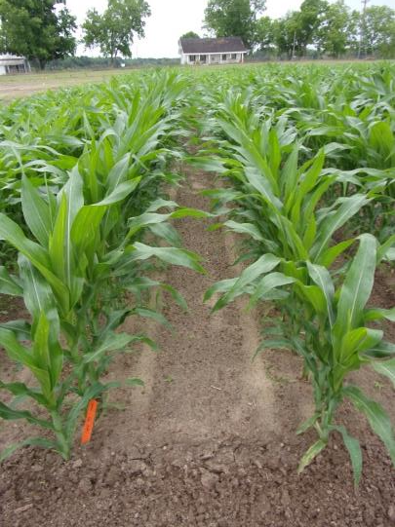
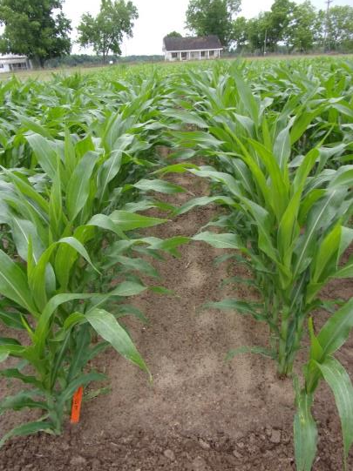
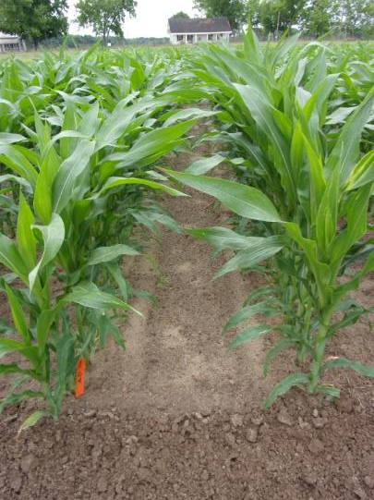
Roundup + Atrazine + Zidua + Boron - 2025
NTC
Roundup PowerMax3 5.88SL @ 27 oz/A
Aatrex 4L @ 64 oz/A
Zidua 4.17SC @ 2.5 oz/A
Roundup PowerMax3 5.88SL @ 27 oz/A
Aatrex 4L @ 64 oz/A
Zidua 4.17SC @ 2.5 oz/A
10% Liquid Boron @ 32 oz/A
Roundup PowerMax3 5.88SL @ 27 oz/A
Aatrex 4L @ 64 oz/A
Zidua 4.17SC @ 2.5 oz/A
10% Liquid Boron @ 64 oz/A
CN-08-25
May 7
28 DAT

Slide 26
Roundup PowerMax3 5.88SL @ 27 oz/A + Aatrex 4L @ 64 oz/A + Zidua 4.17SC @ 2.5 oz/A ± 10% Liquid Boron @ 32 oz/A or 64 oz/A
P = 0.3167
CV = 8.42
Yield (Bu/A)
CN-08-25
Pioneer P13777PWUE
Applied 14 DAP (V3-V4)

Slide 27
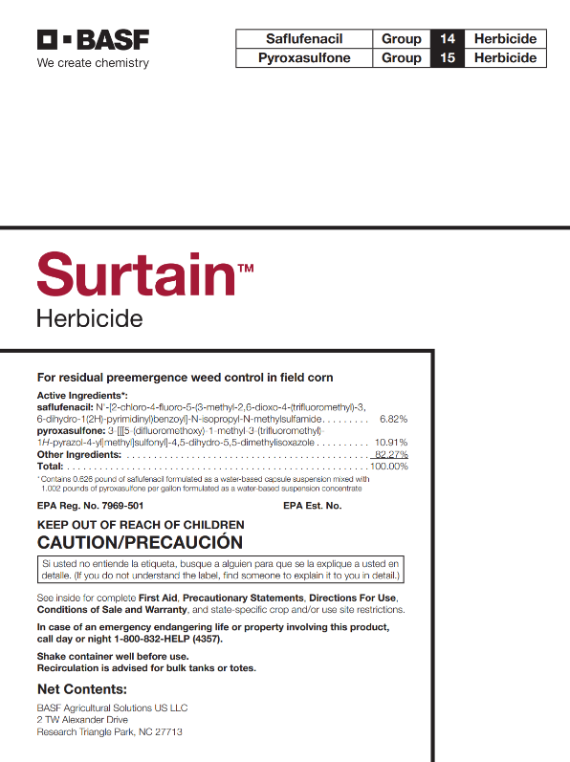
Surtain Herbicide
Surtain 1.628SC
  saflufenacil (Sharpen) – 0.626 lbs/gal
  pyroxaslfone (Zidua) – 1.002 lbs/gal
solid encapsulated herbicide technology
11 oz/A
PRE-V3
residual control only
Have not been a huge fan of pyroxasulfone applied PRE?
  injury

Slide 28
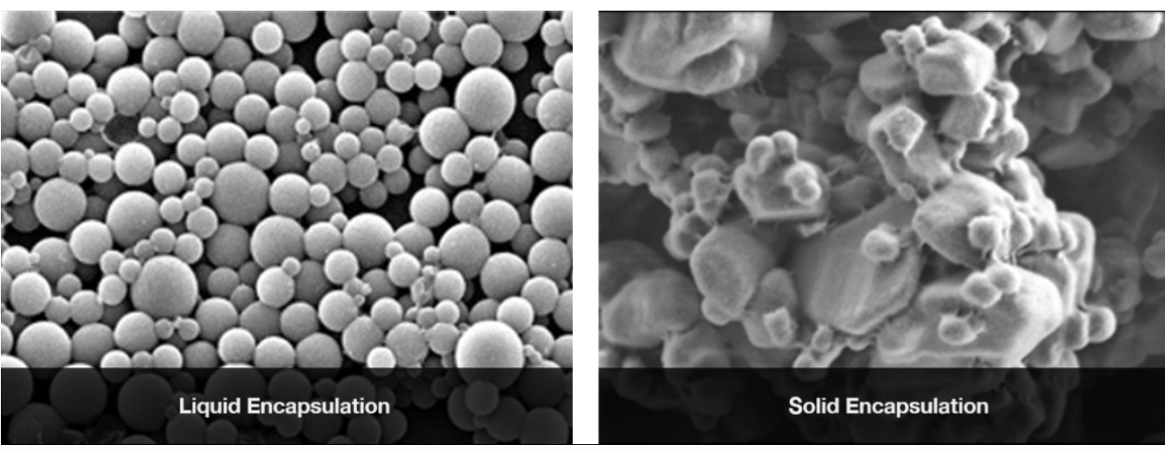
Surtain (saflufenacil + pyroxasulfone) Encapsulation
Surtain
Source: BASF

Slide 29
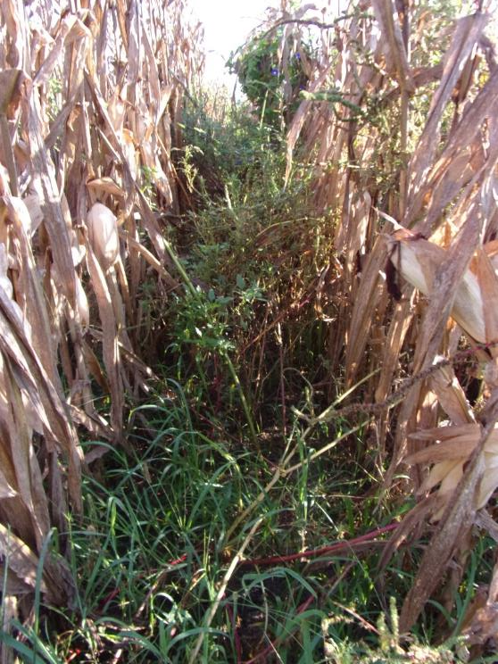
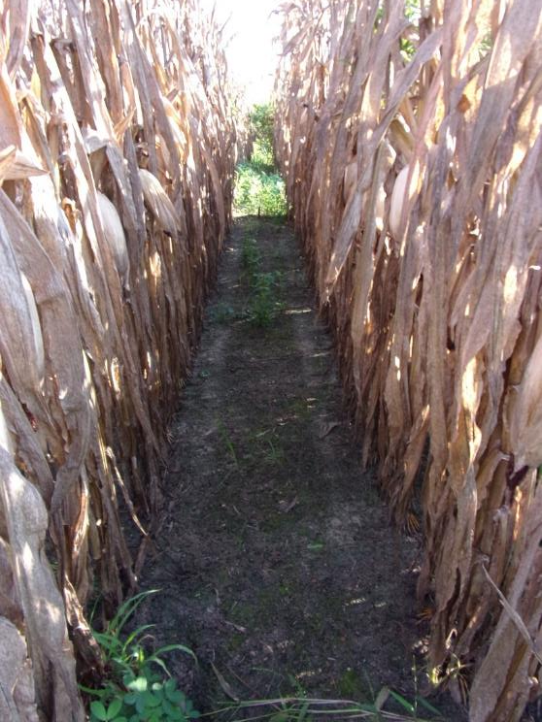
Field Corn Weed Control - 2025
NTC
Roundup PowerMax3 5.88SL @ 30 oz/A
Surtain 1.628SC @ 11 oz/A
Aatrex 4L @ 32 oz/A
Induce @ 0.25% v/v
AMSOL @ 2.5% v/v
Applied 14 DAP
CN-06-25
August 19
138 DAP

Slide 30
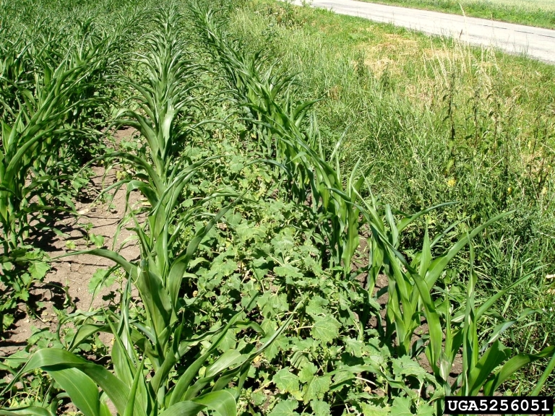
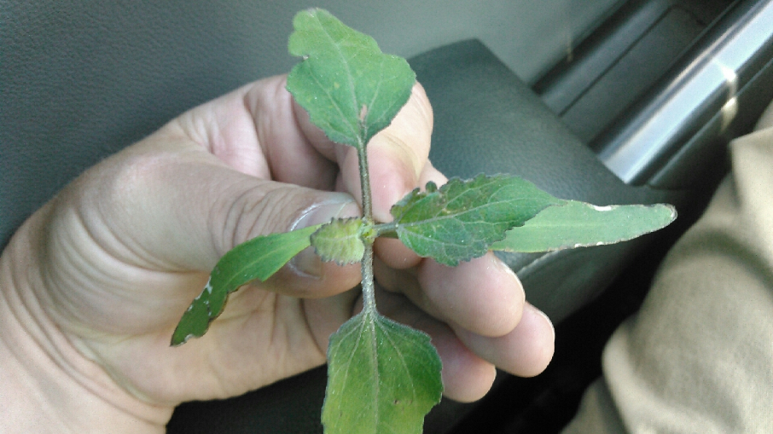
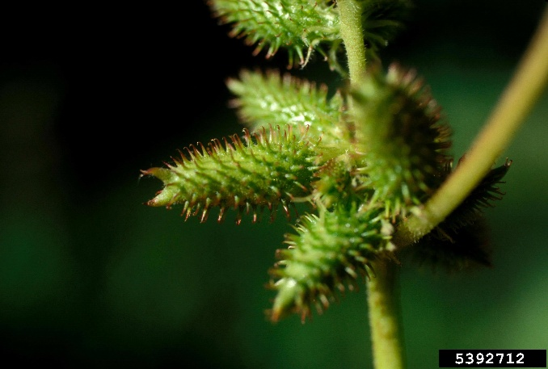
Cocklebur in Field Corn
PRE: Acuron, Atrazine, Corvus, Resicore, Sharpen
POST: Armezon, Atrazine, Basagran, Callisto, Capreno,
Clarity, Enlist One, Halex GT, Impact, Laudis, Liberty,
Revulin Q, Roundup, Sandea, Status
*2 seeds/bur
*now/later
*can emerge from 6”

Slide 31
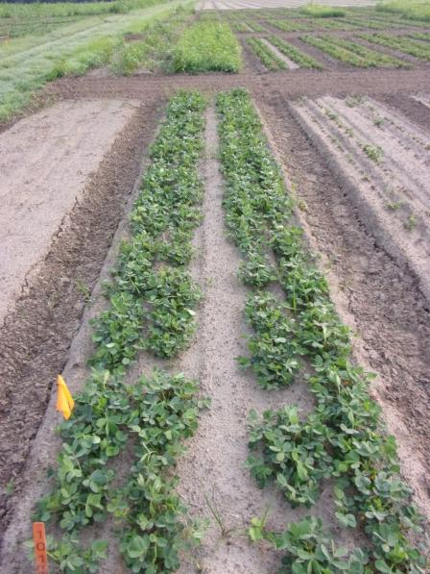
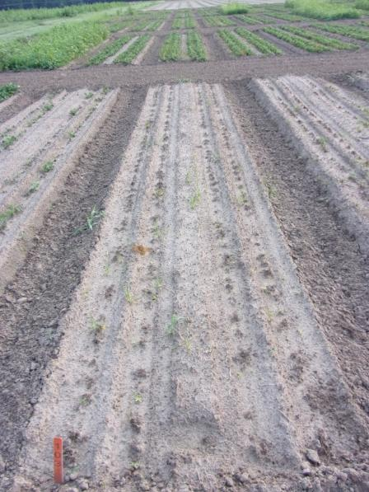
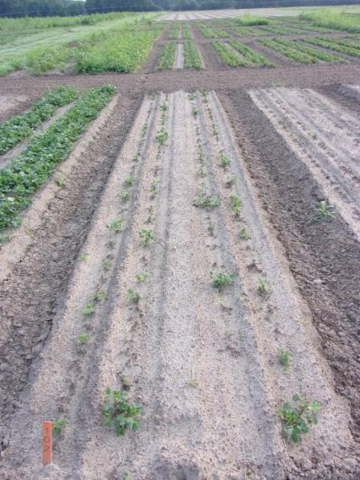
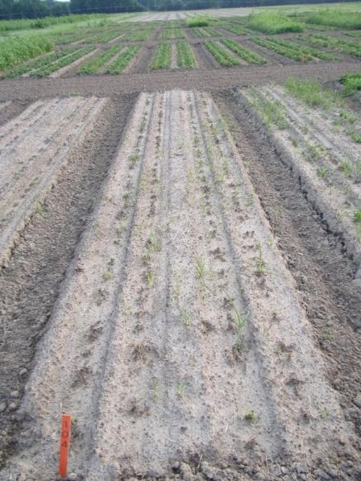
Peanut Control?
Peanuts: V4-5; 2-3” tall;4-5” wide
NTC
Liberty Ultra 1.76SL @ 24 oz/A
Laudis 3.5SC @ 3 oz/A
Aatrex 4L @ 64 oz/A
Agridex @ 1% v/v
AMSOL @ 2.5% v/v
Roundup PowerMax3 5.5SL @ 30 oz/A
Laudis 3.5SC @ 3 oz/A
Aatrex 4L @ 64 oz/A
AMSOL @ 2.5% v/v
PE-13-25
June 3
20 DAT

Slide 32
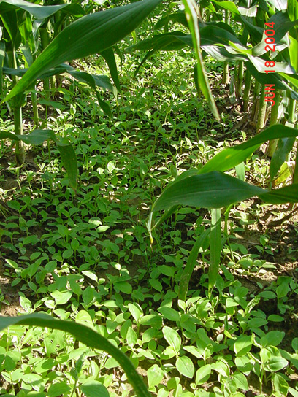
BD/TSW Control in Field Corn
Residuals
  Dual Magnum, Outlook, Warrant, Zidua, Anthem Maxx
POST
  2,4-D (crop injury issues unless Enlist hybrid)
  Basagran
  Halex GT/Callisto
Lay-By/Hood
  Aim
  Evik
  Gramoxone
Post-Harvest
  Gramoxone, 2,4-D

Slide 33
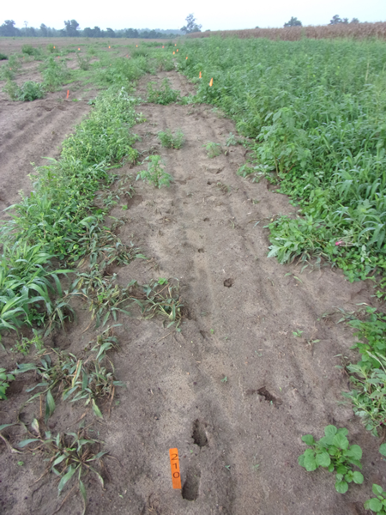
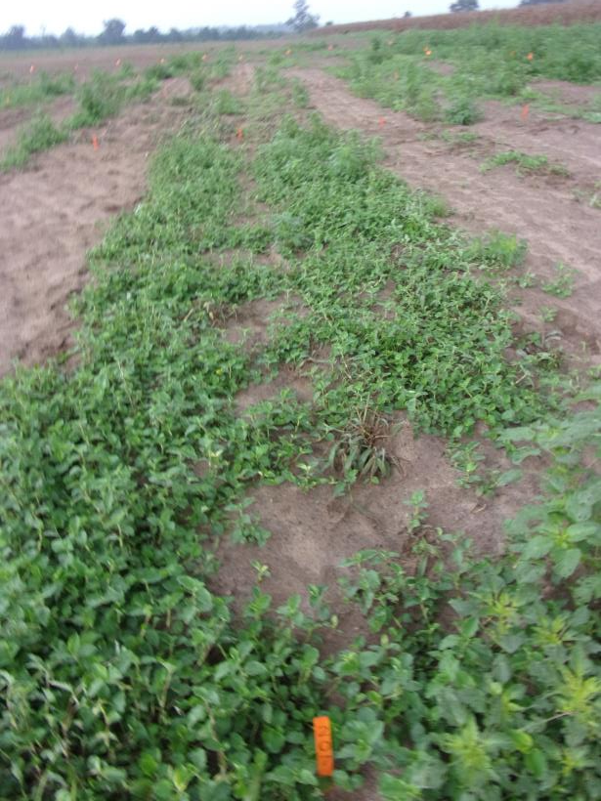
Benghal Dayflower/Tropical Spiderwort – HPPD’s
Callisto 4SC @ 3 oz/A
Agridex @ 1% v/v
TSW-01-22
August 17
22 DAT

Slide 34
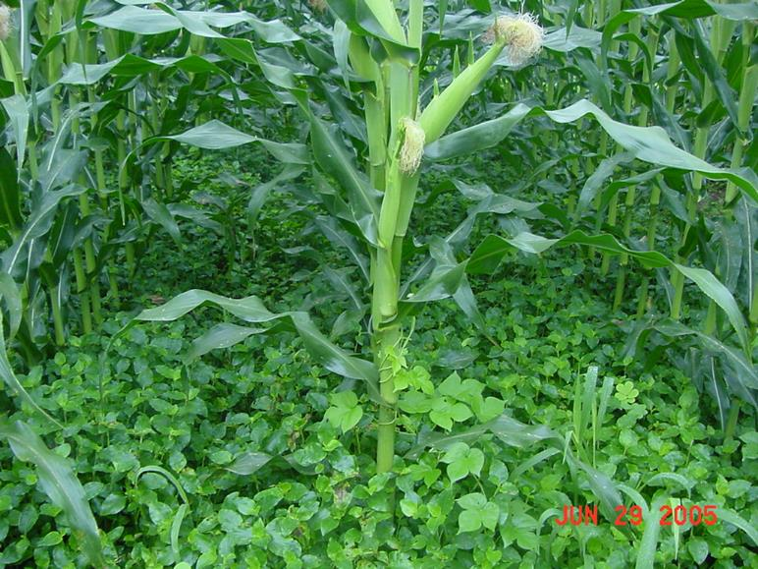


BD/TS Control in Field Corn
Untreated
Gramoxone Max 3SC @ 16 oz/A
Dual Magnum 7.62EC @ 1.33 pt/A
Herbimax @ 1% v/v
Lay-By
CN-09-05
12 DAT

Slide 35



Post-Harvest Tropical Spiderwort Control – 2024
COMBE: 12-16” tall; flowering; POST1 = 09/10/24; POST2= 09/17/24
NTC
Gramoxone 3SL @ 32 oz/A
Induce @ 0.25% v/v
POST1 + POST2
Roundup P-MAX3 5.88 SL @ 32 oz/A
Enlist One 3.8SL @ 24 oz/A
POST1 + POST2
PH-01A-24
October 2
15 DAT (POST2)

Slide 36



Post-Harvest

Slide 37


Post-Harvest Weed Control - 2021
Gramoxone 2L @ 3 pts/A + Tricor 4L @ 8 oz/A + NIS @ 0.25% v/v
09/24/21
Day of Application
10/22/21
28 Days After Treatment
(strips left on purpose as checks)

Slide 38

Special Problems

Slide 39



Imazapyr/Triclopyr Contamination – Drone Application
Triclopyr = 0.01 mg/kg
Imazapyr = 3.8 µg/kg
Jay, FL
April/May 2025

Slide 40



Name Recognition?
Counter INFR

Slide 41



Reflex (fomesafen) Carryover on Field Corn
J. Bennett
May 1, 2025

Slide 42




Field Corn/Potash – 2025
Integra 6410
09/09/24
K Soil Test

Slide 43


Pigweed Symptoms
Source: S. McAllister

Slide 44



Pigweed Tissue Tests
Peanut Field
(K = 2.1%)
Corn Field (Bad)
K = 0.61%
Corn Field (Good)
K = 2.03%
Source: N. Chammoun

Slide 45


Questions/Comments?

