Slide 1
Caparol® (prometryn) or Reglone® (diquat) for Weed Control in Peanut??
Eric P. Prostko* and Nick J. Shay
University of Georgia
Dept. Crop & Soil Sciences

Slide 2
U.S. Row Crop Production – 2024 Acres Planted
Source: USDA/NASS, Acreage (06/28/24)

Slide 3
Peanut Herbicide History Since the 1980’s
Dual - 1980
Poast - 1985
Premerge/Dinitro/ Dyanap (dinoseb) was cancelled in 1986
Sonalan - 1988
Classic - 1988
Paraquat - 1988
Lasso (alachlor) Issues - 1991
Pursuit - 1991
Zorial/Solicam - 1993
Tough - 1992
Select - 1996
Cadre - 1996
Frontier - 1996
Dual Magnum - 1997
Outlook - 1999
Strongarm - 2000
Valor - 2001
Spartan - 2003
Cobra - 2005
Fusilade - 2009
Warrant - 2014
Zidua - 2017
Anthem Flex - 2020
Brake - 2023
Rexovor - ????????
Liberty - ???????

Slide 4
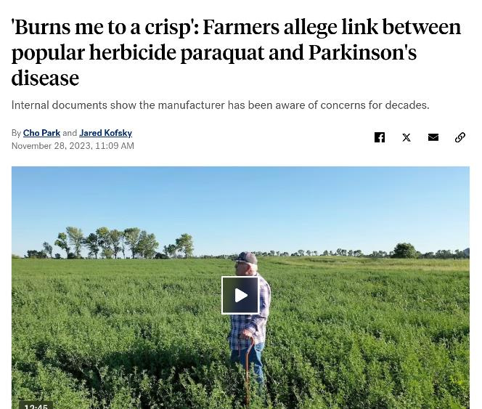
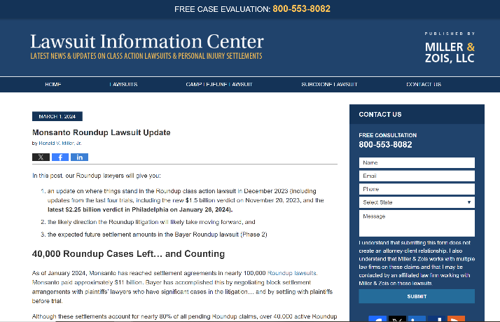
The Future of Herbicides?

Slide 5
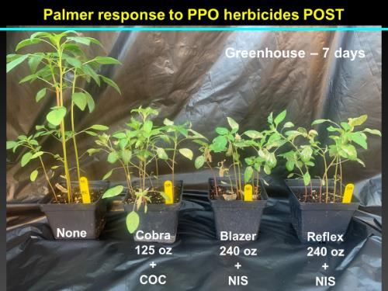
PPO-Resistance (PRE and POST) Has Recently Been Confirmed in Georgia (Randell-Singleton et al. 2024)

Slide 6
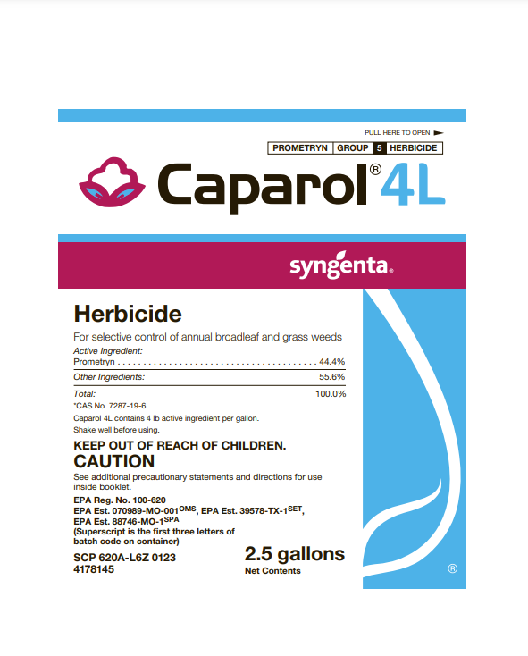
Caparol®
Prometryn
Commercially available in cotton in 1964
Same herbicide family as atrazine
Triazine
HRAC/WSSA Group 5
PSII-Inhibitor
Peanut label in other countries?
Australia
2024 Prices
Caparol 4L @ 32 oz/A (~$10) vs. Valor EZ 4SC @ 3 oz/A (~$12)

Slide 7
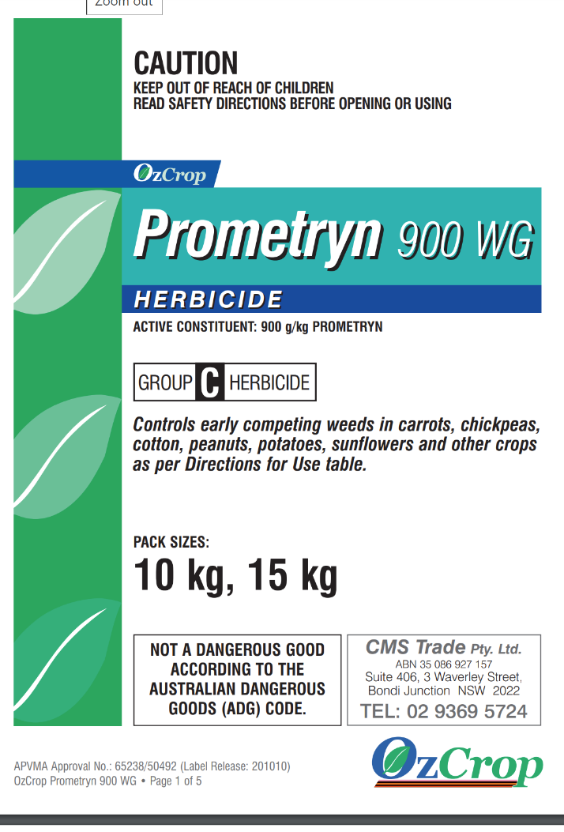
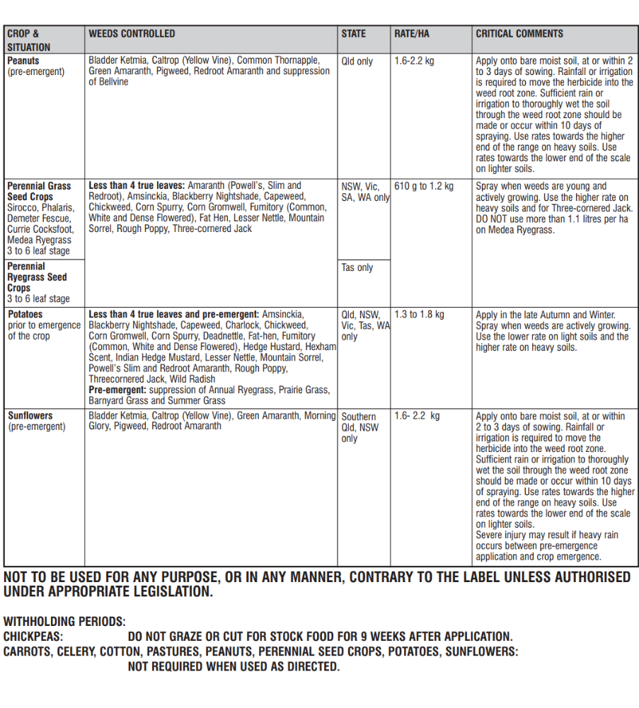

Slide 8
Caparol® and Pigweed?
*Source: Whitaker et al. 2011. Journal of Cotton Science 15:89-99.

Slide 9
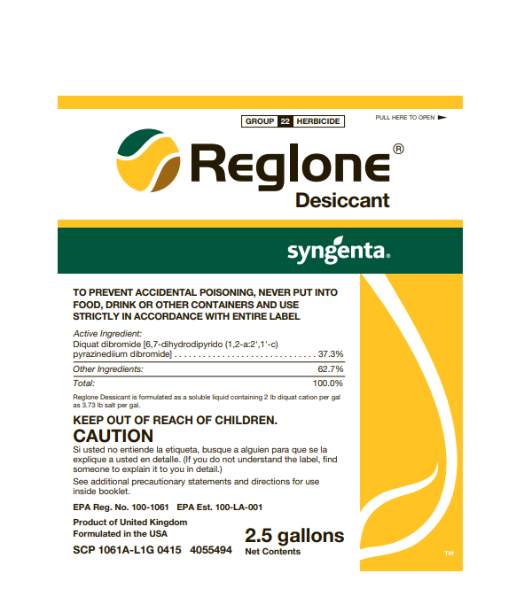
Reglone®
Diquat
Been around since 1955
Same herbicide family as paraquat
Bipyridilium
Harvest Aid/Desiccant
alfalfa, canola, clover, potato, tree/vine/small fruits/vegetables (non-bearing)
HRAC/WSSA Group 22
PSI inhibitor
2024 Prices
Gramoxone 3SL @ 8 oz/A (~$2) vs. Reglone 2SL @ 12 oz/A (~$8)
diquat
paraquat

Slide 10
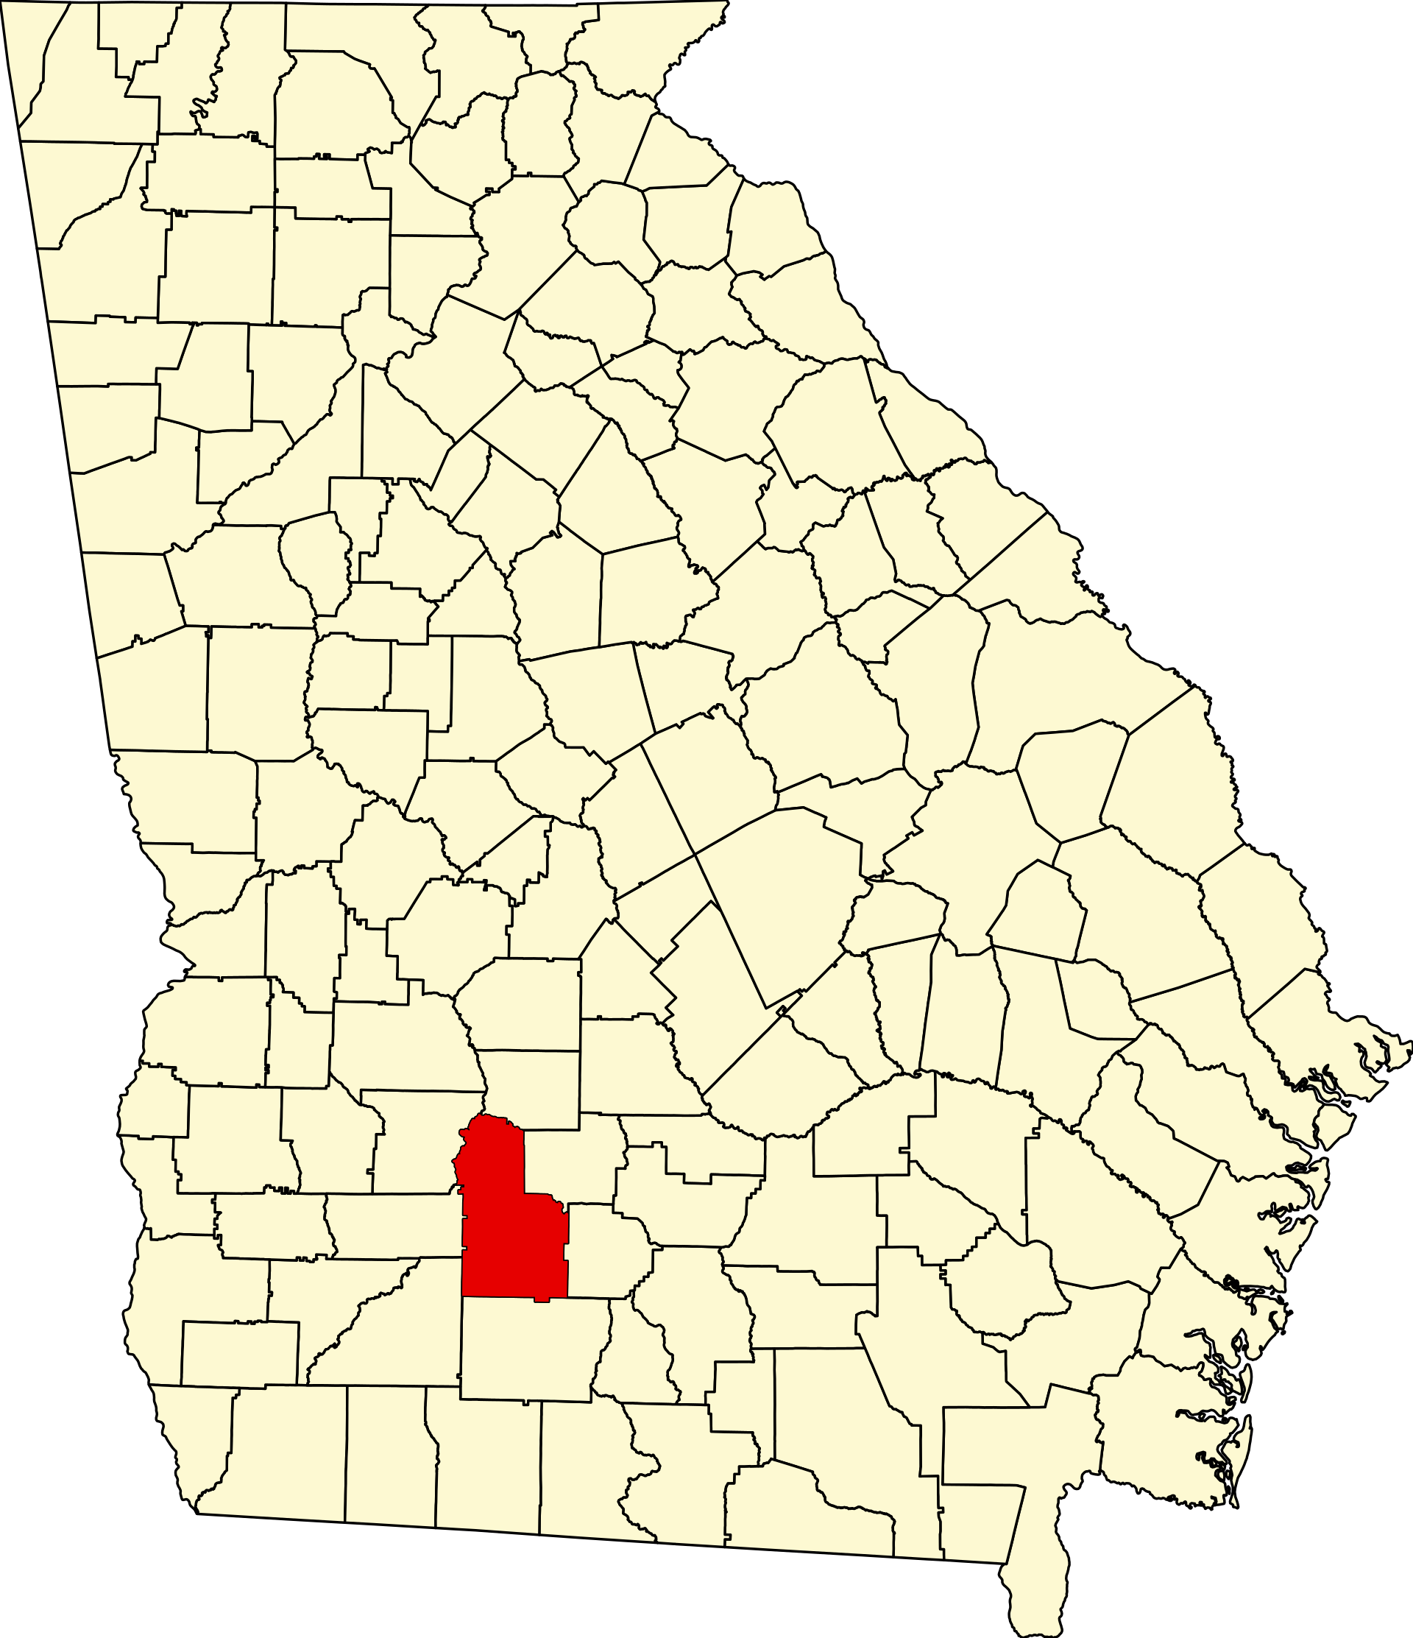
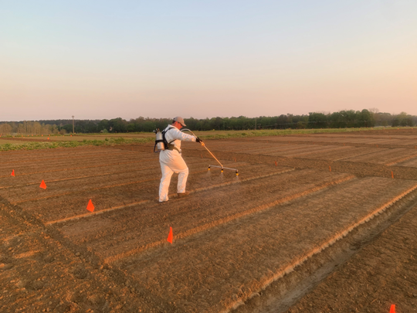
Materials and Methods
UGA Ponder Farm (Ty Ty)
small plots, 15 GPA, 11002AIXR tips
2022
Caparol 4L @ 24, 32, 48 oz/A alone and in tank-mixes
RCBD, 3 reps
2023
Repeated 2022 Caparol test
Reglone 2SL @ 6.4 and 8.6 oz/A compared to Gramoxone 2SL
Lower rates (oopsy)
ANOVA, P=0.10, Fisher’s

Slide 11
Results - 2022
Screven Co. 2021

Slide 12
Peanut Stunting – 2022 (12 DAT)
Sonalan HFP 4EC @ 32 oz/A
Valor EZ @ 3 oz/A
Strongarm 84WG @ 0.225 oz/A
Caparol 4L @ 24 oz/A

Slide 13
Peanut Weed Control – 2022 (22 DAT)
LSD 0.10 = 3.44
LSD 0.10 = 3.83
Sonalan HFP 4EC @ 32 oz/A
Valor EZ @ 3 oz/A
Strongarm 84WG @ 0.225 oz/A
Caparol 4L @ 24 oz/A

Slide 14
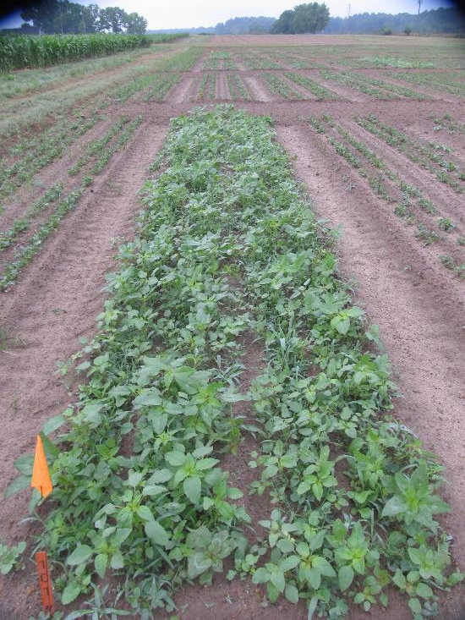
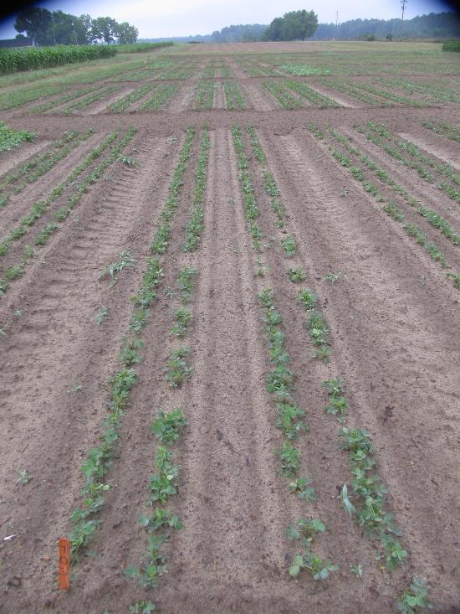
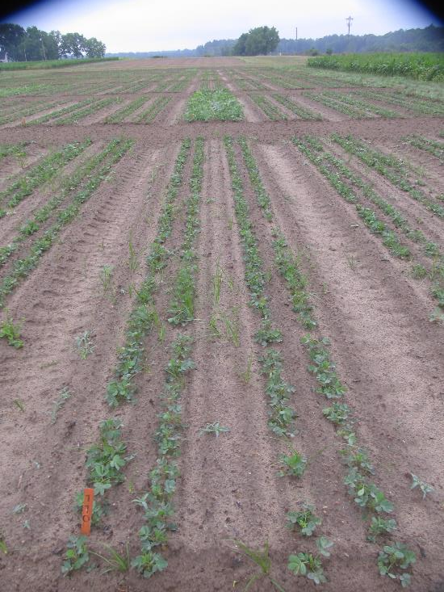
Peanut Weed Control - 2022 Valor + Strongarm vs. Caparol + Strongarm
NTC
Sonalan HFP 4EC @ 32 oz/A
Valor EZ 4SC @ 3 oz/A
Strongarm 84WG @ 0.225 oz/A
Applied PRE (1 DAP)
Sonalan HFP 4EC @ 32 oz/A
Caparol 4L @ 24 oz/A
Strongarm 84WG @ 0.225 oz/A
Applied PRE (1 DAP)
PE-12-22
May 20
22 DAT

Slide 15
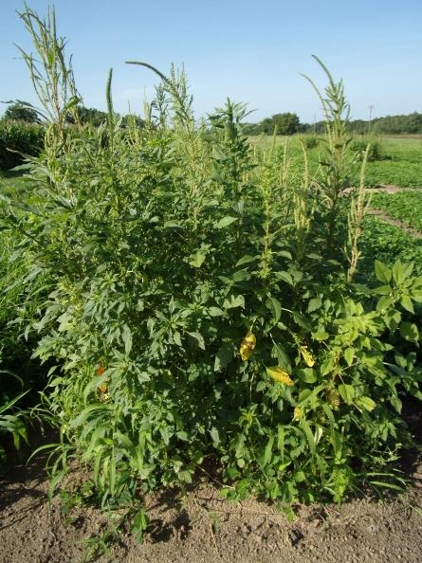
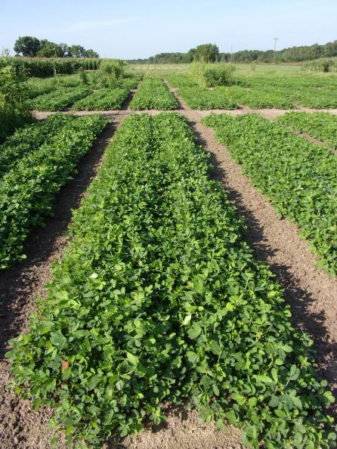
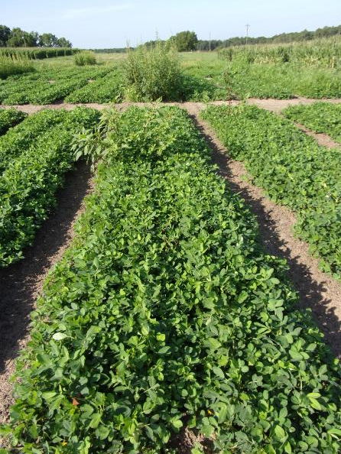
Peanut Weed Control - 2022 Valor + Strongarm vs. Caparol + Strongarm
NTC
Sonalan HFP 4EC @ 32 oz/A
Valor EZ 4SC @ 3 oz/A
Strongarm 84WG @ 0.225 oz/A
PRE (1 DAP)
Cadre 2AS @ 4 oz/A
2,4-DB 2SL @ 16 oz/A
Dual Magnum 7.62EC @ 16 oz/A
POST (27 DAP)
Sonalan HFP 4EC @ 32 oz/A
Caparol 4L @ 24 oz/A
Strongarm 84WG @ 0.225 oz/A
PRE (1 DAP)
Cadre 2AS @ 4 oz/A
2,4-DB 2SL @ 16 oz/A
Dual Magnum 7.62EC @ 16 oz/A
POST (27 DAP)
PE-12-22
June 21
55 DAP

Slide 16
Peanut Yield – 2022
Sonalan HFP 4EC @ 32 oz/A
Valor EZ @ 3 oz/A
Strongarm 84WG @ 0.225 oz/A
Caparol 4L @ 24 oz/A

Slide 17
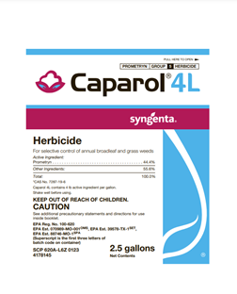
Results - 2023

Slide 18
Peanut Stunting – 2023 (14 DAT)
Prowl H₂0 3.8SC @ 32 oz/A
Valor EZ @ 3 oz/A
Strongarm 84WG @ 0.225 oz/A
Caparol 4L @ 32 oz/A

Slide 19
Peanut Weed Control – 2023 (20 DAT)
LSD 0.10 = 6.15
LSD 0.10 = 12.88
Prowl H₂0 3.8SC @ 32 oz/A
Valor EZ @ 3 oz/A
Strongarm 84WG @ 0.225 oz/A
Caparol 4L @ 32 oz/A

Slide 20
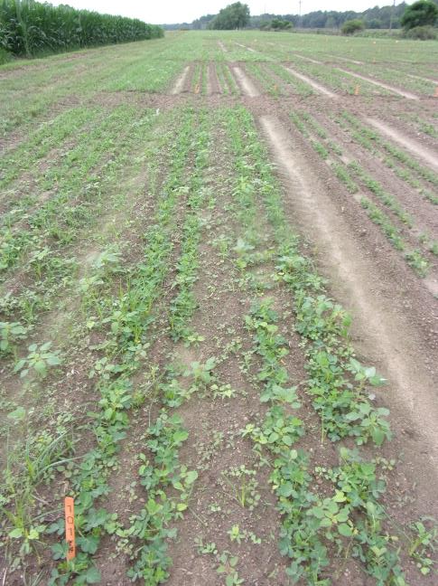
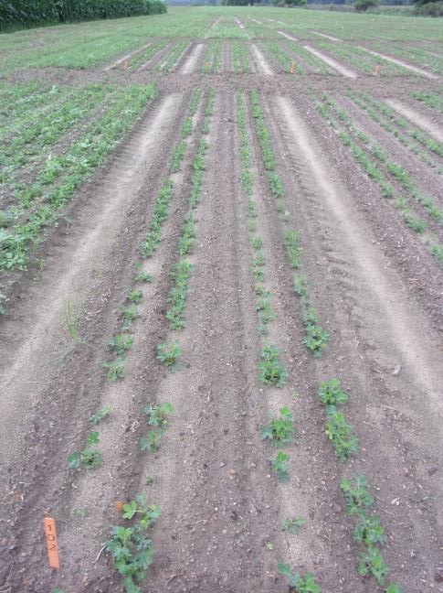
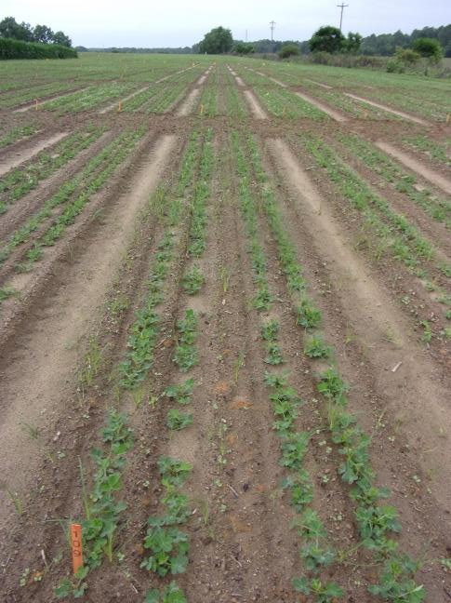
Peanut Weed Control – 2023 Valor + Strongarm vs. Caparol + Strongarm 1st rainfall/irrigation event was 8 DAP (0.5” irrigation)
NTC
Prowl H₂0 3.8SC @ 32 oz/A
Valor EZ 4SC @ 3 oz/A
Strongarm 84WG @ 0.225 oz/A
Prowl H₂O 3.8SC @ 32 oz/A
Caparol 4L @ 32 oz/A
Strongarm 84WG @ 0.225 oz/A
PE-14-23
May 24
21 DAP

Slide 21
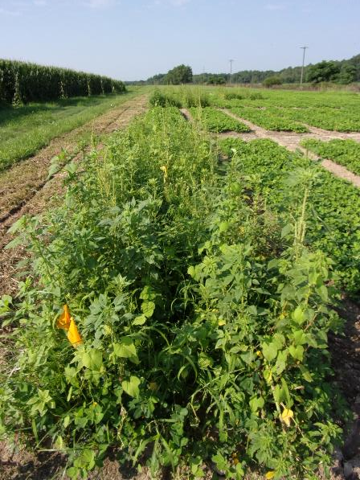
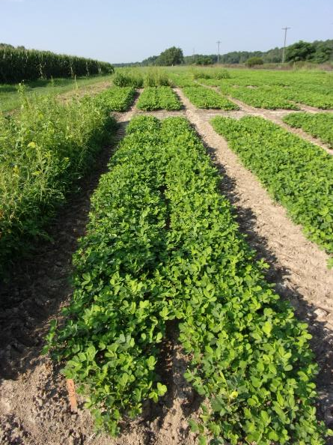
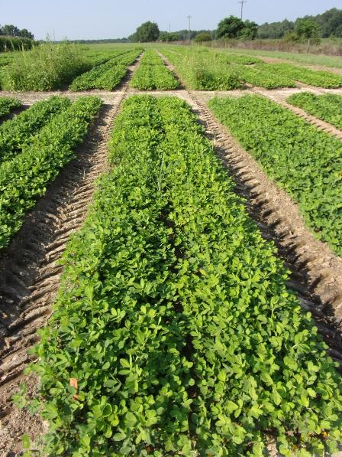
Peanut Weed Control - 2023 Valor + Strongarm vs. Caparol + Strongarm
NTC
Prowl H₂0 3.8SC @ 32 oz/A
Valor EZ 4SC @ 3 oz/A
Strongarm 84WG @ 0.225 oz/A
PRE (1 DAP)
Cadre 2AS @ 4 oz/A
Dual Magnum 7.62EC @ 16 oz/A
2,4-DB 2SL @ 16 oz/A
POST2 (28 DAP)
Prowl H₂0 3.8SC @ 32 oz/A
Caparol 4L @ 32 oz/A
Strongarm 84WG @ 0.225 oz/A
PRE (1 DAP)
Cadre 2AS @ 4 oz/A
Cobra 2EC 12.5 oz/A
Dual Magnum 7.62EC @ 16 oz/A
2,4-DB 2SL @ 16 oz/A
POST1 (22 DAP)
PE-14-23
June 28
56 DAP

Slide 22
Peanut Yield – 2023
Prowl H₂0 3.8SC @ 32 oz/A
Valor EZ @ 3 oz/A
Strongarm 84WG @ 0.225 oz/A
Caparol 4L @ 32 oz/A

Slide 23
Reglone®

Slide 24
Peanut Injury (%) – 2023 (2 DAT)
Gramoxone 2SL @ 12 oz/A
Storm 4SL @ 16 oz/A
Dual Magnum 7.62EC @ 16 oz/A
Reglone 2SL @ 8.6 oz/A
(LSD 0.10 = 2.45)
(LSD 0.10 = 2.82)

Slide 25
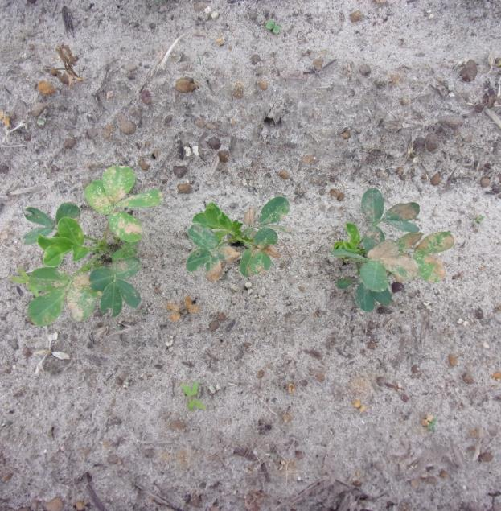
Peanut Injury – 2 DAT
NTC
Gramoxone + Storm + Dual Magnum
Reglone + Storm + Dual Magnum

Slide 26
Weed Control (%) – 2023 (8 DAT)
Gramoxone 2SL @ 12 oz/A
Storm 4SL @ 16 oz/A
Dual Magnum 7.62EC @ 16 oz/A
Reglone 2SL @ 8.6 oz/A
(LSD 0.10 = 10.84)
(LSD 0.10 = NS)
(LSD 0.10 = 5.85)
(LSD 0.10 = 8.09)

Slide 27
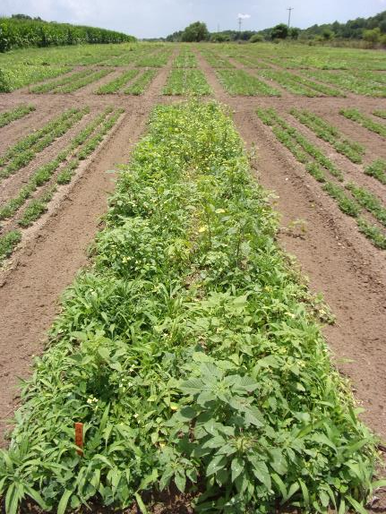
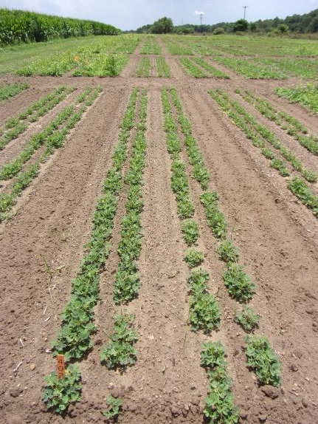
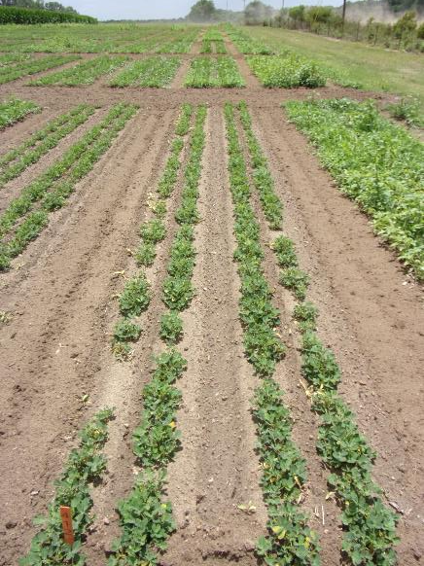
Gramoxone vs. Reglone - 2023
NTC
Gramoxone 2SL @ 12 oz/A
Storm 4SL @ 16 oz/A
Dual Magnum 7.62EC @ 16 oz/A
Applied 13 DAP
Cadre 2AS @ 4 oz/A
Dual Magnum 7.62EC @ 16 oz/A
2,4-DB 2SL @ 16 oz/A
Applied 27 DAP
Reglone 2SL @ 8.6 oz/A
Storm 4SL @ 16 oz/A
Dual Magnum 7.62EC @ 16 oz/A
Applied 13 DAP
Cadre 2AS @ 4 oz/A
Dual Magnum 7.62EC @ 16 oz/A
2,4-DB 2SL @ 16 oz/A
Applied 27 DAP
PE-12-23
June 7
35 DAP

Slide 28
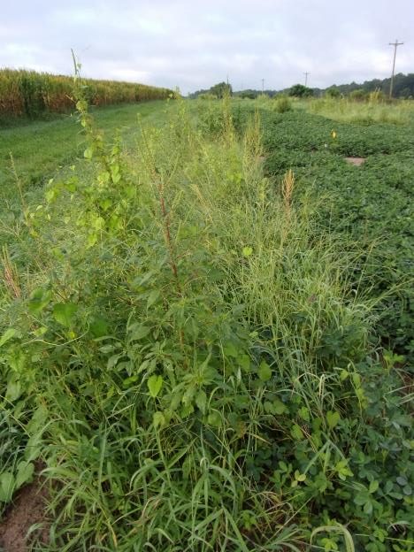
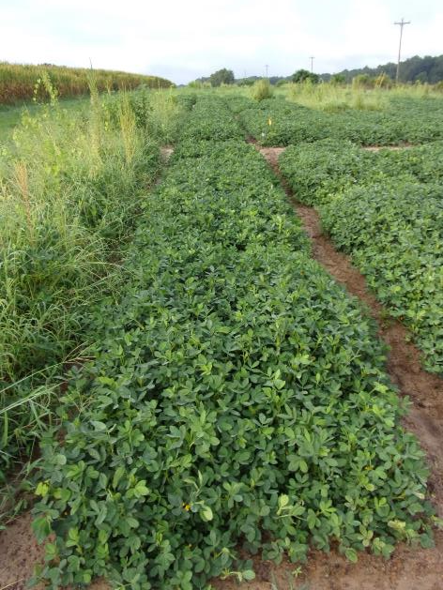
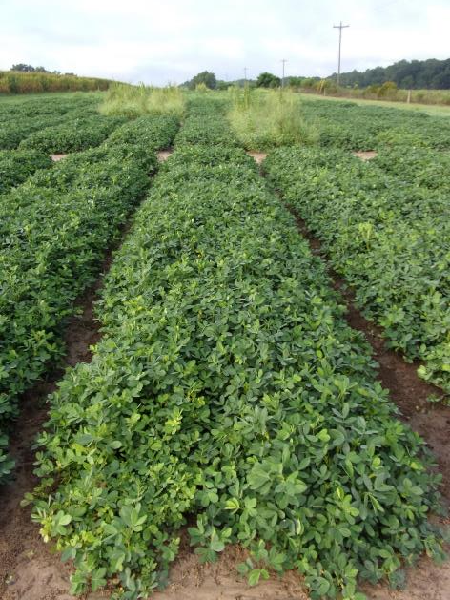
Gramoxone vs. Reglone - 2023
NTC
Gramoxone 2SL @ 12 oz/A
Storm 4SL @ 16 oz/A
Dual Magnum 7.62EC @ 16 oz/A
Applied 13 DAP
Cadre 2AS @ 4 oz/A
Dual Magnum 7.62EC @ 16 oz/A
2,4-DB 2SL @ 16 oz/A
Applied 27 DAP
Reglone 2SL @ 8.6 oz/A
Storm 4SL @ 16 oz/A
Dual Magnum 7.62EC @ 16 oz/A
Applied 13 DAP
Cadre 2AS @ 4 oz/A
Dual Magnum 7.62EC @ 16 oz/A
2,4-DB 2SL @ 16 oz/A
Applied 27 DAP
PE-12-23
July 24
83 DAP

Slide 29
Peanut Yield – 2023
Gramoxone 2SL @ 12 oz/A
Storm 4SL @ 16 oz/A
Dual Magnum 7.62EC @ 16 oz/A
Reglone 2SL @ 8.6 oz/A

Slide 30
Summary/Future
Caparol®
Less injurious than Valor
Less effective than Valor
Moisture activation issues
OK in PRE + POST system?
Reglone®
Less or more injurious than Gramoxone??
rate
Similar weed control to Gramoxone
$/A
Future
Repeated studies in 2024
Caparol tank-mixes with Valor, Brake, Rexovor (ALS-resistant AMAPA)
Appropriate rates for Reglone

Slide 31
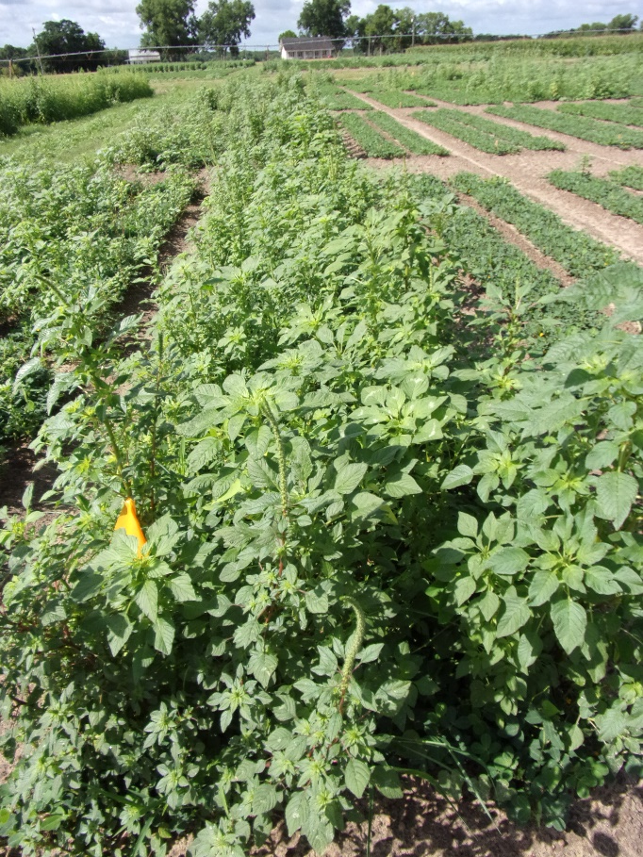
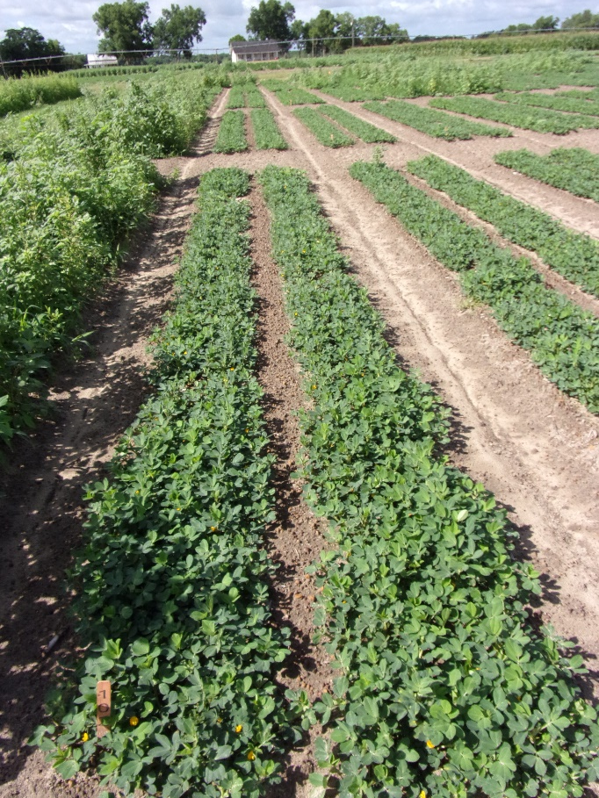
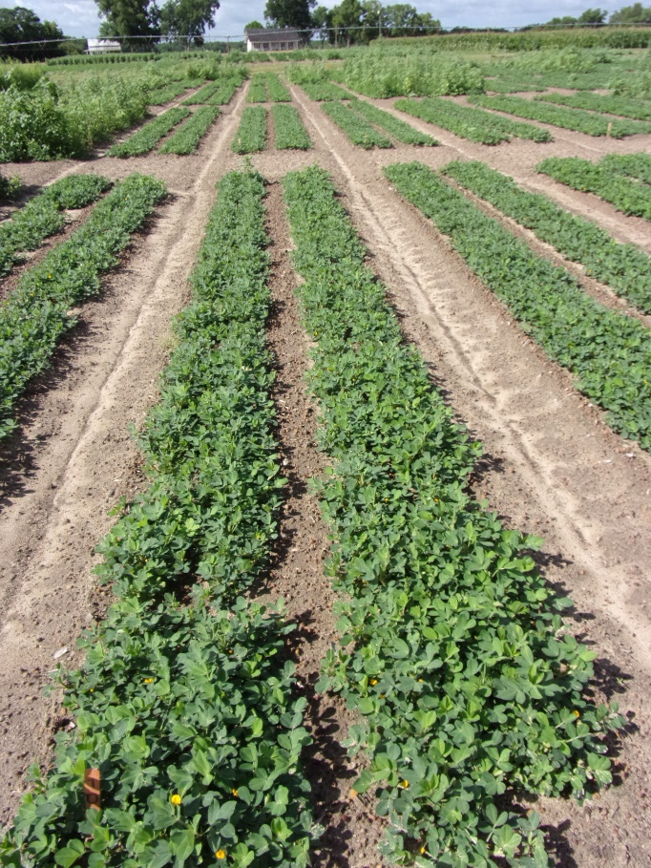
Gramoxone vs. Reglone - 2024
NTC
Gramoxone 3SL @ 8 oz/A
Storm 4SL @ 16 oz/A
Dual Magnum 7.62EC @ 16 oz/A
EPOST (13 DAP)
Cadre 2AS @ 4 oz/A
Dual Magnum 7.62EC @ 16 oz/A
Butyrac 20 2SL @ 16 oz/A
POST (34 DAP)
Reglone 2SL @ 12 oz/A
Storm 4SL @ 16 oz/A
Dual Magnum 7.62EC @ 16 oz/A
EPOST (13 DAP)
Cadre 2AS @ 4 oz/A
Dual Magnum 7.62EC @ 16 oz/A
Butyrac 20 2SL @ 16 oz/A
POST (34 DAP)
PE-10-24
June 28
59 DAP

Slide 32
Weed Control in Peanut - 2024
Prowl H₂0 3.8SC @ 32 oz/A
Caparol 4L @ 32 oz/A
Brake 1.2SL @ 12 oz/A
PRE
Cadre 2AS @ 4 oz/A
Butyrac 200 2SL @ 16 oz/A
Dual Magnum 7.62EC @ 16 oz/A
POST (34 DAP)
PE-07-24
June 28
59 DAP
NTC

Slide 33
Questions/Comments? www.gaweed.com

