Slide 1
2024 Peanut Weed Control Update
Eric P. Prostko
Extension Weed Specialist
Dept. Crop & Soil Sciences

Slide 2
2023 Problems

Slide 3
Glyphosate/Peanut
6.8 ppm
glyphosate
detected

Slide 4
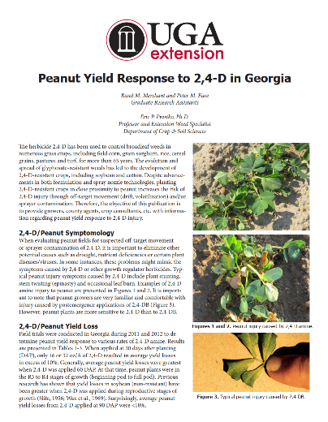
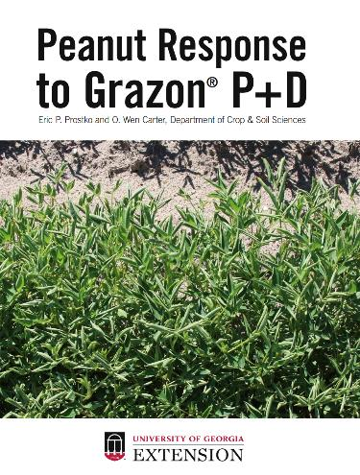
Sadly, I have information about peanut response to the following “non-peanut” herbicides:
2,4-D
Dicamba
Roundup
Liberty
Diuron
Garlon
Arsenal
Milestone
Grazon P+D

Slide 5
Numerical Peanut Yield Loss (%) from “Non-Peanut” Herbicides Applied at 1/10thX Rates at Different Times in Georgia

Slide 6
Dicamba is NOT labeled for preplant use in peanuts!

Slide 7
Soil-Applied Dicamba Injury on Peanut

Slide 8
What are you buying?

Slide 9
Perennial Weeds in Peanut -I
maypop passionflower
J. Hand, Tift Co.
07/06/23
horsenettle
L. Stanley, Montgomery Co.
07/07/23

Slide 10
Perennial Weeds in Peanut - II
dogfennel
G. Hancock, Turner Co.
06/23
Blue heliotrope
07/17

Slide 11
Perennial Weeds in Peanut - III
alligatorweed
R. Ethredge, Seminole Co.
07/24/23
goldenrod?
M. Frye, Wayne Co.
08/11/23

Slide 12
Revenge Spraying Rarely Works!

Slide 13
Gramoxone 3SL @ 16 oz/A + Ultra Blazer 2SL @ 24 oz/A + 2,4-DB 1.75SL @ 16 oz/A + Anthem Flex 4SE @ 3 oz/A + PowerLock @ 8 oz/A Applied ~60 DAP/Mid-Afternoon application/12 GPA
J. Bennett
Wilcox Co.
07/10/23
~3 DAT

Slide 14
Gramoxone 3SL @ 16 oz/A + Ultra Blazer 2SL @ 24 oz/A + 2,4-DB 1.75SL @ 16 oz/A + Anthem Flex 4SE @ 3 oz/A + PowerLock @ 8 oz/A Applied ~60 DAP/Mid-Afternoon application/12 GPA
J. Bennett
Wilcox Co.
07/18/23
~11 DAT

Slide 15
Peanut Weed Control - 2023
“The Program”
Weed-free at planting (tillage/cover crops/herbicides)
Twin Rows (if possible)
Multiple Over-Lapping Residuals (PRE/EPOST/POST)
Timely POST’s (3” or less)
Prevent Seed-Rain from Escapes (hand-weeding, non-selective applicators/mowing)
PE-14-23
July 24
83 DAP

Slide 16
The Peanut Herbicide Toolbox 24 Active ingredients
PPLNT/PPI/PRE
Brake
Sonalan
Prowl/Pendimax
Dual Magnum/Generics
Outlook/Propel
Pursuit
Spartan Charge
Solicam
Strongarm/Diclom
Warrant
Valor
Roundup (PPLNT)
POST
Aim (Harvest Aid)
Gramoxone
Basagran
Ultra Blazer
Cadre/Impose
Classic
Cobra
Fusilade
Poast/Poast Plus
Pursuit
Select/Arrow/Trigger
Storm
2,4-DB
Anthem Maxx/Zidua
(residual only)

Slide 17
Peanut Tillage Systems
Conventional Tillage (Macon Co.)
Strip-Tillage (Worth Co.)
June 2022

Slide 18
Pre-Plant Burndowns - 2023
NTC
NTC
Roundup PowerMax3 5.88SL @ 22 oz/A
2,4-D 3.8SL @ 16 oz/A
Valor EZ 4SC @ 2 oz/A
BD-01-23
March 30
21 DAT

Slide 19
Pre-Plant Burndowns - 2023
NTC
NTC
Gramoxone 2SL @ @ 48 oz/A
2,4-D 3.8SL @ 16 oz/A
Valor EZ 4SC @ 2 oz/A
Induce @ 0.25% v/v
BD-01-23
March 30
21 DAT

Slide 20
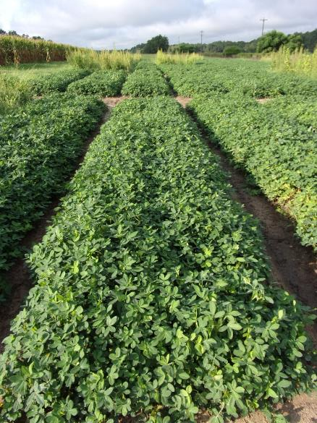
Peanut Weed Control – 2023 Prowl vs. Sonalan
5445 lbs/A
5501 lbs/A
NTC
Prowl H₂0 3.8SC @ 32 oz/A
Valor EZ 4SC @ 3 oz/A
Strongarm 84WG @ 0.225 oz/A
PRE (1 DAP)
Cadre 2AS @ 4 oz/A
Dual Magnum 7.62EC @ 16 oz/A
2,4-DB 2SL @ 16 oz/A
POST (28 DAP)
Sonalan 3EC @ 32 oz/A
Valor EZ 4SC @ 3 oz/A
Strongarm 84WG @ 0.225 oz/A
PRE (1 DAP)
Cadre 2AS @ 4 oz/A
Dual Magnum 7.62EC @ 16 oz/A
2,4-DB 2SL @ 16 oz/A
POST (28 DAP)
PE-14-23
July 24
83 DAP

Slide 21
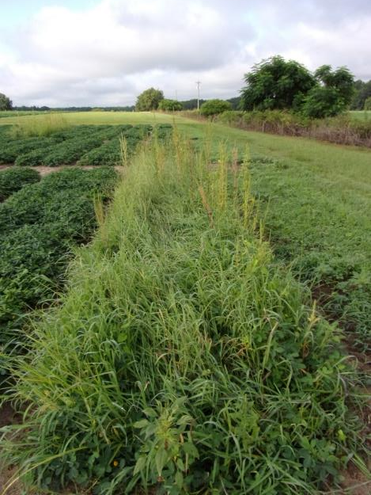
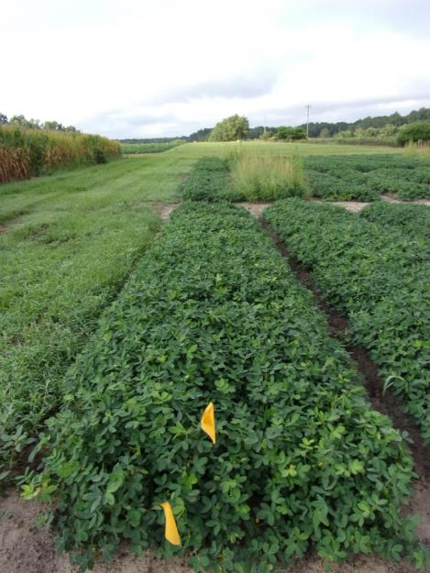
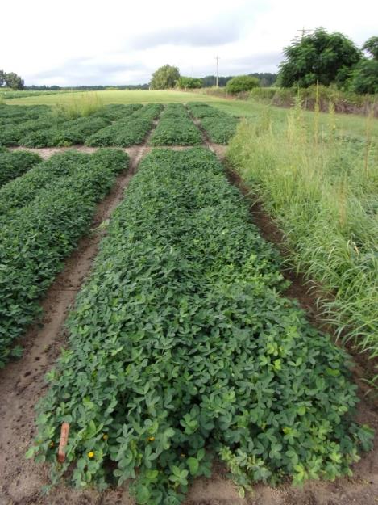
Peanut Weed Control – 2023 Dual Magnum vs. Anthem Flex
Gramoxone 2SL @ 12 oz/A
Dual Magnum 7.62EC @ 16 oz/A
Storm 4SC @ 16 oz/A
Applied 13 DAP
Cadre 2AS @ 4 oz/A
2,4-DB 2SL @ 16 oz/A
Dual Magnum 7.62EC @ 16 oz/A
Induce @ 0.25% v/v
Applied 28 DAP
Gramoxone 2SL @ 12 oz/A
Anthem Flex 4SE @ 3 oz/A
Storm 4SC @ 16 oz/A
Induce @ 0.25% v/v
Applied 13 DAP
Cadre 2AS @ 4 oz/A
2,4-DB 2SL @ 16 oz/A
Anthem Flex 4SE @ 3 oz/A
Induce @ 0.25% v/v
Applied 28 DAP
NTC
PE-15-23
July 24
83 DAP

Slide 22
WSSA Group 15 Herbicides?

Slide 23
Tropical Spiderwort/Benghal Dayflower/Spreading Dayflower
Plow (i.e. bury seed)
Twin Rows
Group 15’s (Dual Magnum, Warrant, Outlook, Zidua, Anthem Flex)
Paraquat
Cadre?
Strongarm?
Manage after field corn harvest.

Slide 24
Spreading Dayflower in Peanut - 2023
NTC
Gramoxone 2SL @ 12 oz/A
Broadloom 4LC @ 8 oz/A
Dual Magnum 7.62EC @ 16 oz/A
PE-112-23
Berrien Co.
June 20 - 18 DAT

Slide 25
Spreading Dayflower in Peanut - 2023
NTC
Broadloom 4LC @ 32 oz/A
Dual Magnum 7.62EC @ 16 oz/A
PE-112-23
Berrien Co.
June 20 - 18 DAT

Slide 26
Spreading Dayflower in Peanut - 2023
NTC
Strongarm 84WG @ 0.45 oz/A
Dual Magnum 7.62EC @ 16 oz/A
PE-112-23
Berrien Co.
June 20 - 18 DAT

Slide 27
Generic Strongarm?
Aceto/Actylis
Only 1 year of field data?
GreenPointAG
$620/lb (2023)
0.45 oz/A = $17.43
Strongarm
$849/lb?
$630/lb?

Slide 28
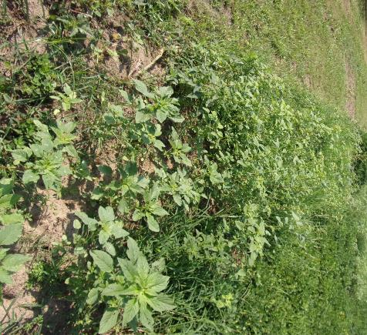
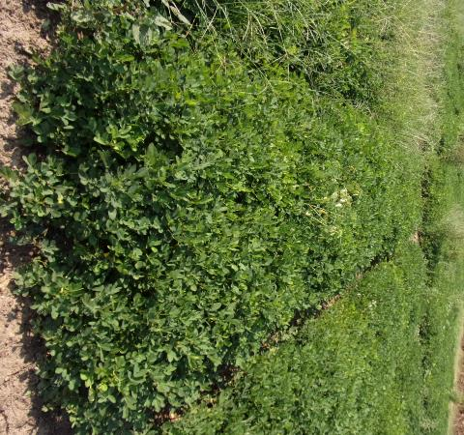
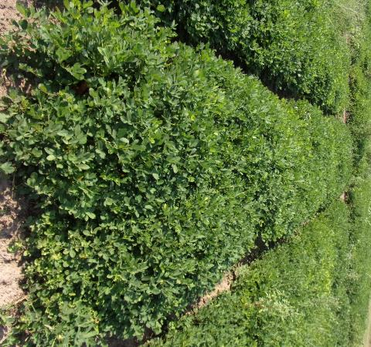
Peanut Weed Control – 2023 Strongarm vs. Diclom 1st irrigation/rainfall event @ 9 DAP
NTC
Sonalan 3EC @ 32 oz/A
Valor EZ 4SC @ 3 oz/A
Strongarm 84WG @ 0.225 oz/A
Applied 1 DAP
Cadre 2AS @ 4 oz/A
2,4-DB 2SL @ 16 oz/A
Dual Magnum 7.62EC @ 16 oz/A
Cobra 2EC @ 12.5 oz/A
Applied 29 DAP
Sonalan 3EC @ 32 oz/A
Valor EZ 4SC @ 3 oz/A
Diclom 84WG @ 0.225 oz/A
Applied 1 DAP
Cadre 2AS @ 4 oz/A
2,4-DB 2SL @ 16 oz/A
Dual Magnum 7.62EC @ 16 oz/A
Cobra 2EC @ 12.5 ozA
Applied 29 DAP
PE-11-23
August 23
114 DAP

Slide 29
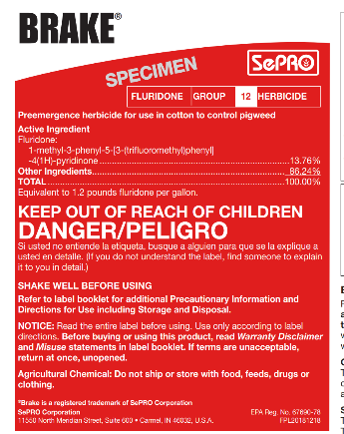
Future Products
Brake 1.2SL
SePRO
fluridone
WSSA/HRAC Group 12
PRE
2023
Rexovor 4.17SL
BASF
trifludimoxazin
WSSA/HRAC Group14
PRE
2025??

Slide 30
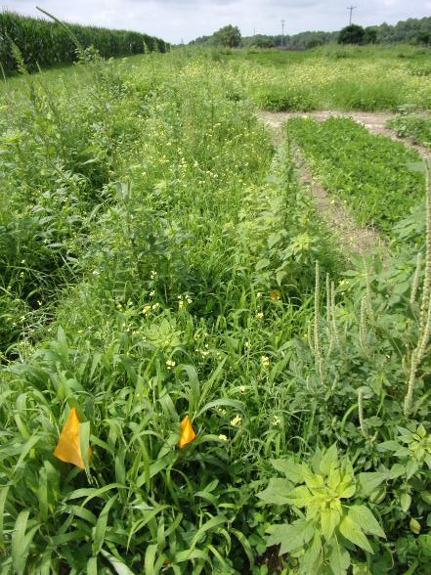
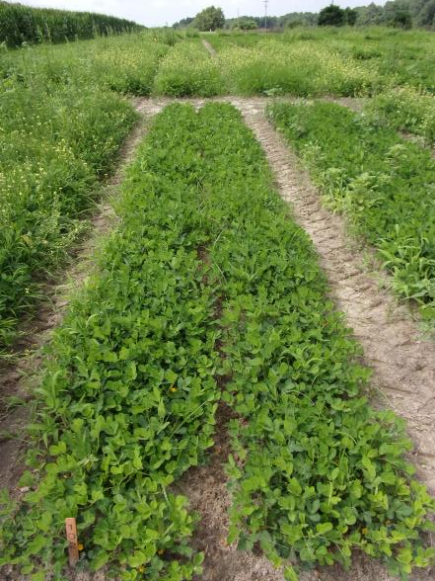
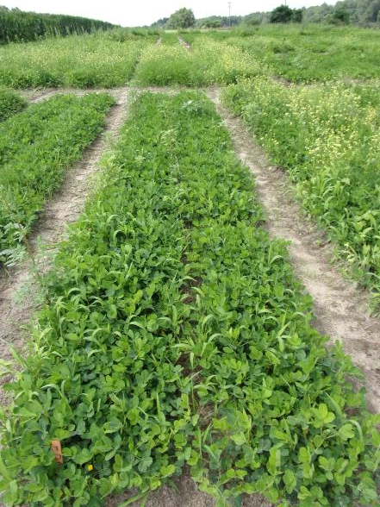
Peanut Weed Control – 2023 Valor vs. Brake
NTC
Prowl H₂0 3.8SC @ 32 oz/A
Valor EZ 4SC @ 3 oz/A
Strongarm 84WG @ 0.225 oz/A
PRE (1 DAP)
Prowl H₂0 3.8SC @ 32 oz/A
Brake 1.2SL @ 12 oz/A
Strongarm 84WG @ 0.225 oz/A
PRE (1 DAP)
PE-13-23
June 26
23 DAP
1st Rainfall/Irrigation event did not occur until 8 DAP

Slide 31
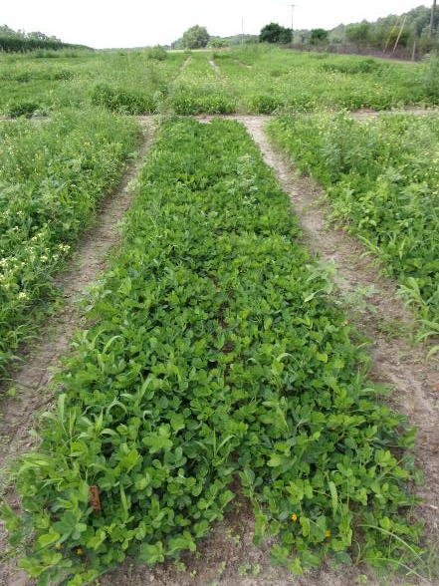
Peanut Weed Control – 2023 Valor vs. Rexovor
NTC
Prowl H₂0 3.8SC @ 32 oz/A
Valor EZ 4SC @ 3 oz/A
Strongarm 84WG @ 0.225 oz/A
PRE (1 DAP)
Prowl H₂0 3.8SC @ 32 oz/A
Rexovor 4.17SC @ 1 oz/A
Strongarm 84WG @ 0.225 oz/A
PRE (1 DAP)
PE-13-23
June 26
23 DAP
1st Rainfall/Irrigation event did not occur until 8 DAP

Slide 32
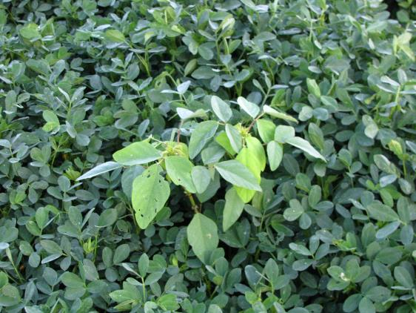
UGA Current Classic®/Cultivar Use Recommendations
NO
GA-06G
Tifguard
GA-12Y
7-13% yield losses
YES
Florida-07
GA Greener
GA-07W
GA-09B
No problems 60 DAE or 90 DAE or 105 DAE
5% yield loss when applied 75 DAE
GA-20VHO
GA-18RU
AUNPL-17
TIFNV HIGH O/L
FLORUN 331
GA-16HO
No problems at 60 DAE or 85 DAE.
17% yield loss when applied 75 DAE

Slide 33
I sprayed herbicide X and it did not work therefore I must have resistance?
Rate
Timing
Environment
Hot/dry
Rain-free period
Calibration
Coverage
Droplet size
Nozzle type, pressure
Boom height
Tractor speed
Resistance

Slide 34
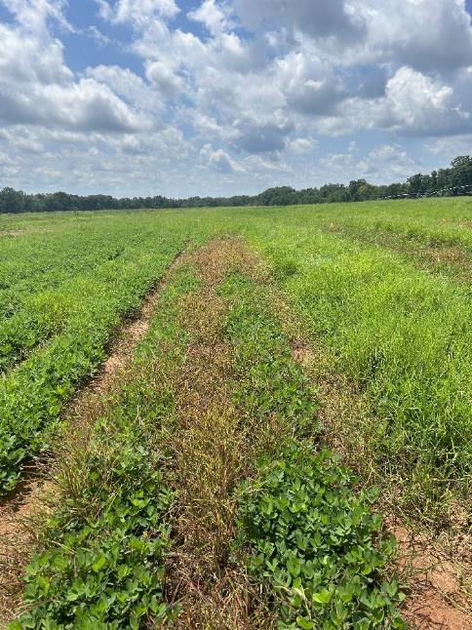
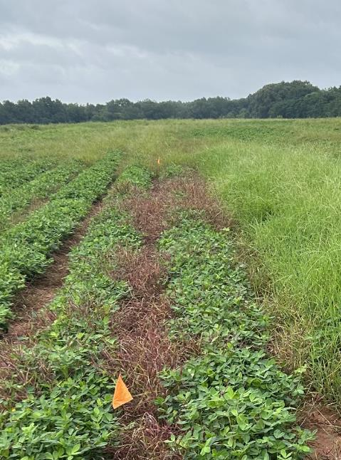
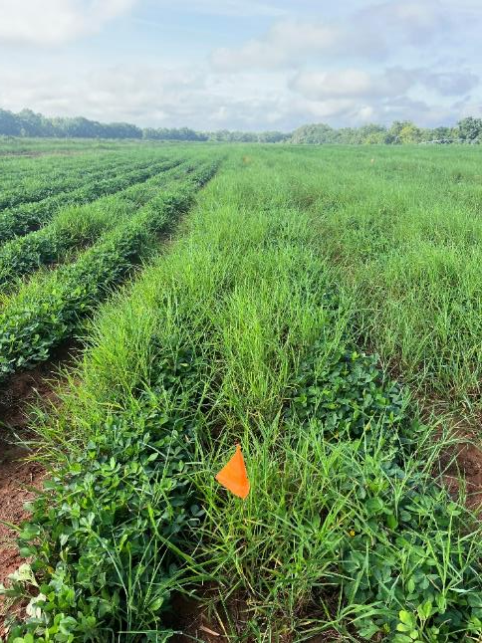
Annual Grass Control in Peanut SelectMax 0.97EC @ 24 oz/A + Agridex @ 1% v/v 15 GPA, 3.5 MPH, AIXR11002 nozzles
07/31/23
0 DAT
08/07/23
7 DAT
08/11/23
11 DAT
Schley Co.
August 2023

Slide 35
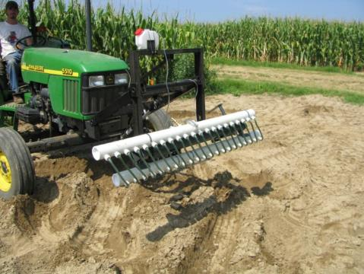
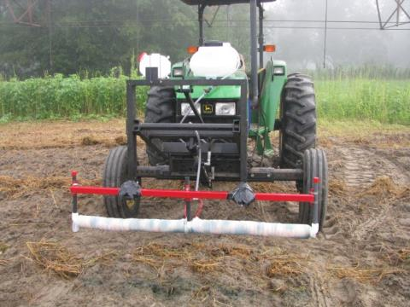
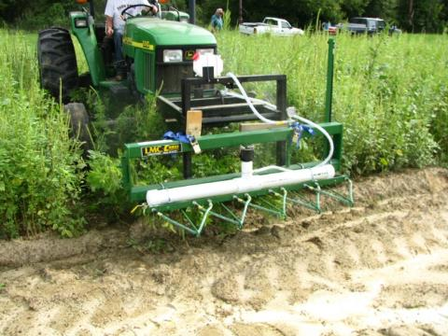
Non-Selective Applicators

Slide 36
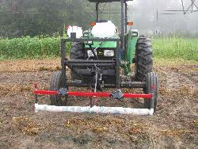
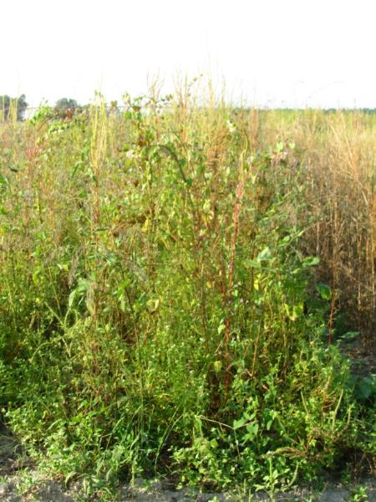
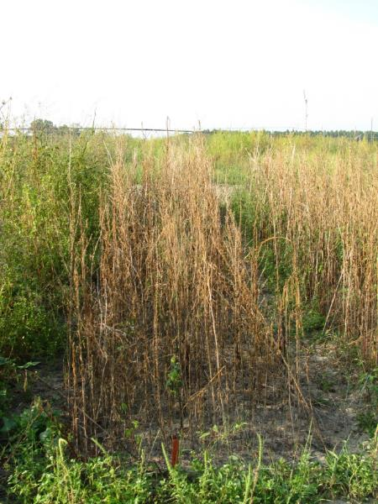
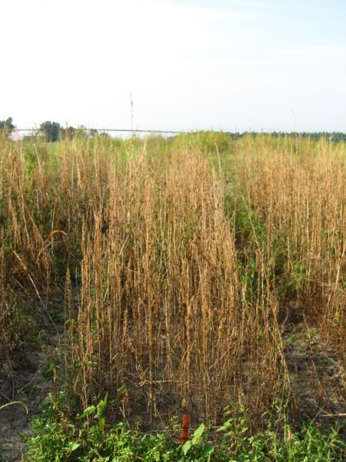
WeedWiper vs. TopCrop Wiper 50% Solution of Gramoxone Inteon 3.1 MPH, 20” Applicator Height AMAPA = 36-86” tall, 66” avg.
NTC
WeedWiper
TopCrop
PIG-07-10
9/21/10
29 DAT

Slide 37
Flail Mower and Peanut - 2021
August 10, 2021
GA-16HO
92 DAP

Slide 38
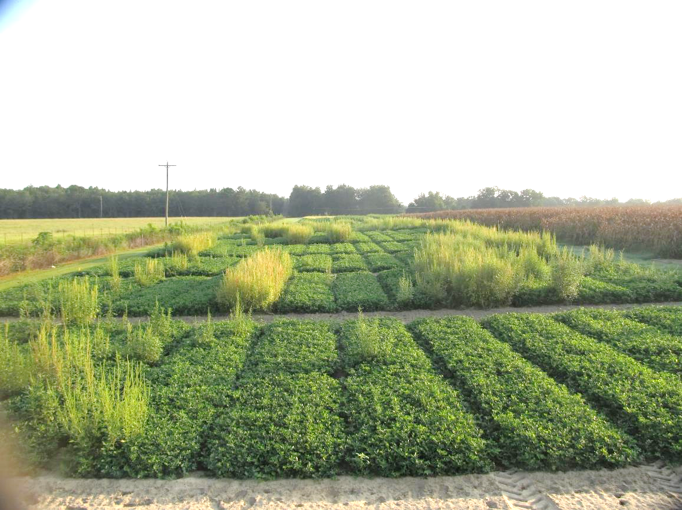
Flail Mower and Peanut – 2021 Before
August 10, 2021
GA-16HO
92 DAP

Slide 39
Flail Mower and Peanut – 2021 After (2 passes in opposite directions, ~2 MPH)
August 10, 2021
GA-16HO
92 DAP

Slide 40
What do the top Georgia peanut growers do? 2022 Georgia Peanut Achievement Club Winners
17 growers
101 to 1194 acres (range)
5688 lb/A average yield
4718-6493 lbs/A (range)
GA State Avg. = 4250 lb/A
94% - irrigated
59% - bottom plow
76% - twin rows
71% don’t “crack” spray
Herbicides
53% - Sonalan
76% - Valor
53% - Dual
65% - Cadre
65% - 2,4-DB
41% - Prowl
35% - Strongarm
12% - Zidua
12% - clethodim
29% - paraquat

Slide 41
Questions/Comments

