Slide 1
Weed Control in Field Corn 2024

Slide 2
2023 Problems

Slide 3
Laurens County - 2023
R. Joyce

Slide 4
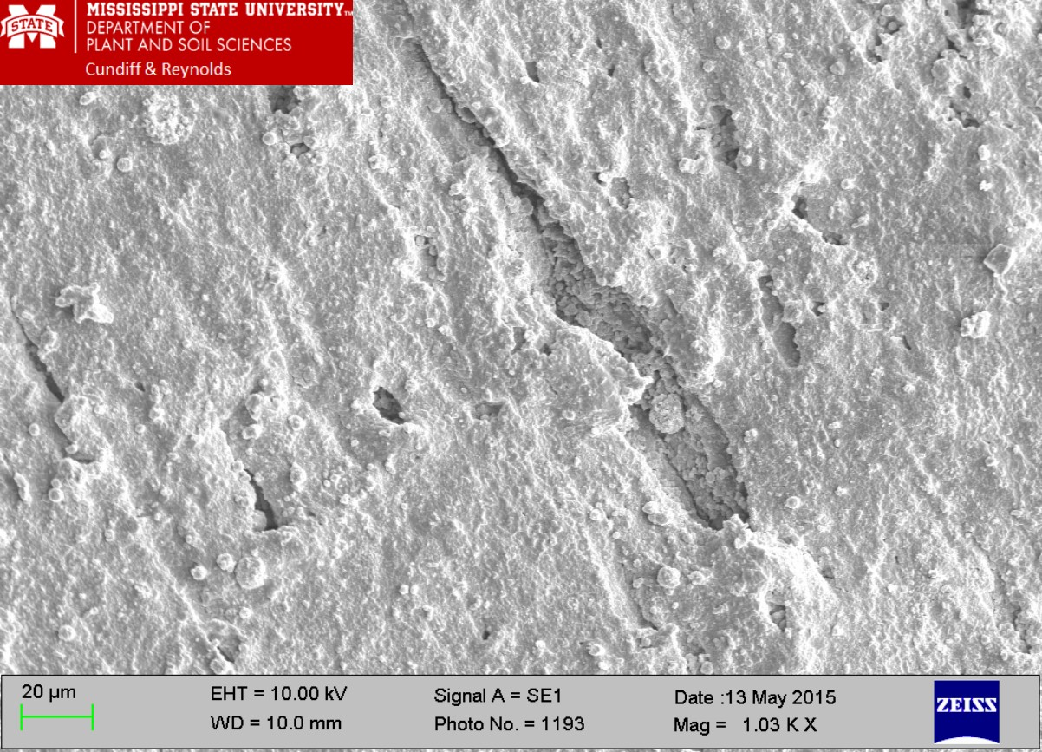
Scanning Electron Micrograph of a Goodyear (Black/Versigard Synthetic Rubber) Hose Used 8 Times.

Slide 5
Halex GT/Counter - 2023
G. Slaughter
June 20, 2023

Slide 6
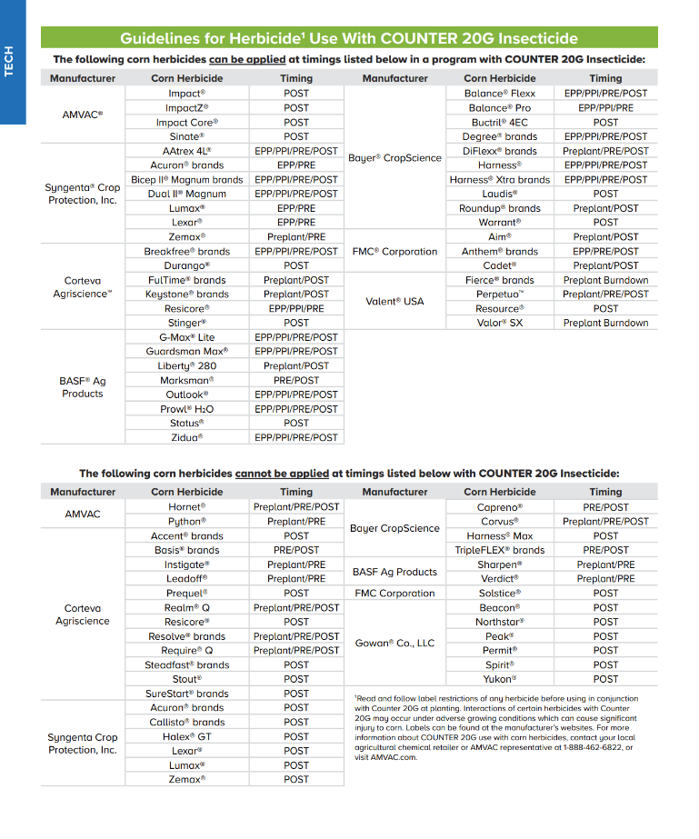
Counter/Herbicides

Slide 7
Seminole County – March 2023
Nematodes
Root-knot = 7
Lesion = 4
Stubby = 82
40 is threshold
Ring = 10
Spiral = 1
R. Ethredge

Slide 8
Macon County – March 2023
Nematodes
Root-knot = 100-140
100 is threshold
Stubby = 170-200
40 is threshold
Lesion = 50-210
200 or more is threshold
K. Brown

Slide 9
Bulloch County – Spring 2023
Planted March 24
Pioneer 1622
*Shallow planting depth (1.5”)
First 7 DAP
*1.52” rain
*3 nights below 49 F
2022 – Peanuts
½X rate Strongarm in August
*70 stubby nematodes/100 cc
40/threshold
Replant showed same symptoms even after using Counter 20G INFR
Oxadiazon @ 1.9 ppm + Prodiamine @ 0.08 ppm detected in soil
Was impregnated on fertilizer
*
W. Tyson

Slide 10
Pierce County - 2023
pH = 5.0; P was very high; K, Mg, Ca were all low

Slide 11
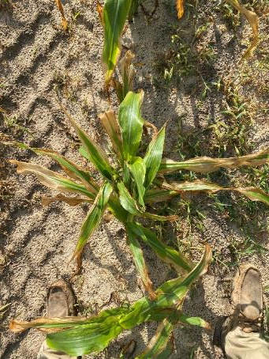
Tattnall Co. - 2023
Stine 9818-32N
Possible linuron sprayer contamination
Linex 4L @ 24 oz/A applied to V3-V4 (12”) tall field corn (P1197VYHR) caused a 22-32% yield reduction.
Richburg et al. 2020. Weed Technology 34:277-283.
2.3 ppm of linuron was detected in tissue sample
Photos: D. Bowen (May 2023)

Slide 12
Volunteer Corn Control
Best option is clethodim
takes about 10 days to really work
6 day plant-back restriction
yes, it’s VERY real
Liberty and Gramoxone have been inconsistent (for me)
RR + LL hybrids

Slide 13
Dims/Fops Have Soil Residual Properties
Assure II 0.88EC @ 24 oz/A
Prime Oil @ 1% v/v
Applied 1 DBP
Assure II 0.88EC @ 24 oz/A
Prime Oil @ 1% v/v
Applied 0 DBP
CN-14-23
May 26
49 DAP

Slide 14
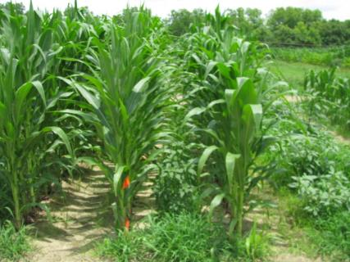
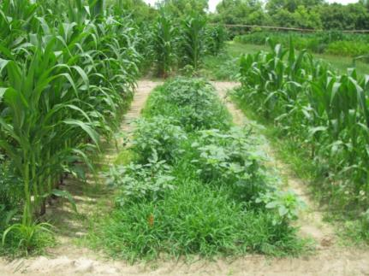
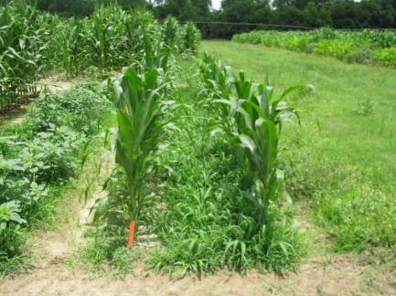
RR Corn Control (Pioneer 33M57) 40 DAT*
NTC
(123 Bu/A)
SelectMax 0.97EC @ 6 oz/A
Induce @ 0.25% v/v
AMS X-TRA @ 2.5% v/v
(0 Bu/A)
Gramoxone Inteon 2SL @ 40 oz/A
Atrazine 4L @ 32 oz/A
Agridex @ 1% v/v
(27 Bu/A)
*Applied to 7” tall corn, V4 stage of growth

Slide 15
What happens when you spray Liberty on a non-LL corn hybrid?
CN-01B-16
DKC 66-59
Liberty @ 29 oz/A +
Atrazine @ 48 oz/A
Applied V4-V5 (6”)
*Only made 28 Bu/A!!!!!
*Other treatments made ~231 Bu/A
*88% yield loss
6 DAT
15 DAT

Slide 16
Yellow Nutsedge in Field Corn - 2023
Not very competitive
800/100 row ft = 10% yield loss
PRE
Dual lI Magnum (PRE)
Only yellow
POST
Roundup + Atrazine + Sandea (0.67 oz/A)
purple + yellow
Basagran 4SL
32 oz/A + 1% COC
2 applications (7-10 days)
only yellow
P. Sapp - May 11, 2023

Slide 17
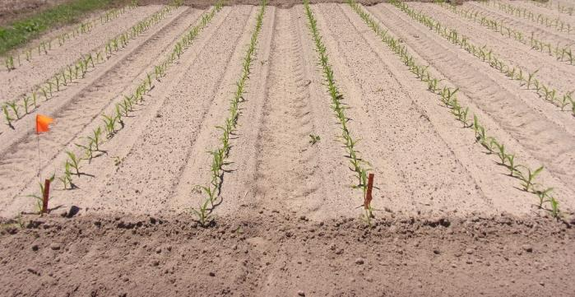
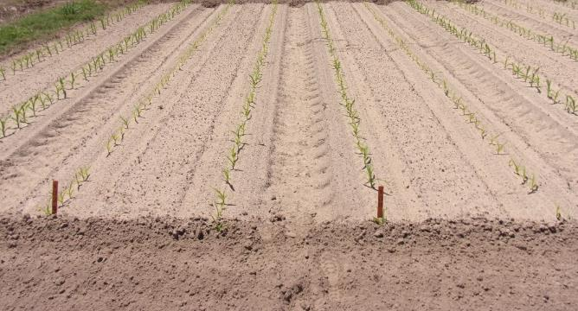
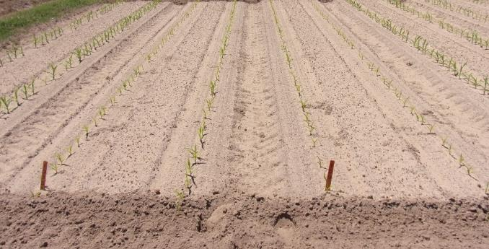
Sandea/PRE/Counter – 2023 Don’t do it!!!!!!
NTC
Sandea @ 0.67 oz/A
No Counter
Counter
Sandea @ 1.34 oz/A
9-15% yield loss (0.67 oz/A)
14-30% yield loss (1.34 oz/A)
CN-04-23
April 18
19 DAP

Slide 18
2,4-D Injury in Non-Enlist™ Field Corn
Rate
No more than 1 pt/A
Timing
Not after 8”
Hybrid
P1289
P1608
P1633
Tank-Mixes
glyphosate
adjuvants

Slide 19
Tropical Spiderwort
does not like deep tillage
hard to control in-season with typical programs
need Group 15’s for residual
Anthem Maxx, Dual Magnum, Warrant, Outlook, Zidua
Halex GT/Callisto???
Lay-By
2,4-D, Aim, Evik, Gramoxone
Post-Harvest
2,4-D, Aim, Gramoxone

Slide 20
Tropical Spiderwort Control in Field Corn - 2005
Untreated
Aim 2EC @ 1.5 ozs/A
Dual Magnum 7.62EC @ 1.33 pt/A
Herbimax @ 1% v/v
34 DAT

Slide 21
Tropical Spiderwort Control in Field Corn - 2005
Untreated
Evik 80DF @ 2 lbs/A
Dual Magnum 7.62EC @ 1.33 pt/A
Herbimax @ 1% v/v

Slide 22
Tropical Spiderwort Control in Field Corn - 2005
Untreated
Gramoxone Max 3SC @ 16 oz/A
Dual Magnum 7.62EC @ 1.33 pt/A
Herbimax @ 1% v/v

Slide 23
Field Corn Yield Loss (%) Caused by Uncontrolled Weeds in UGA Weed Science Research Trials (2007-2023) Treated vs. Non-treated
200 Bu/A X 0.33 X $4.00 = $264/A
250 Bu/A X 0.33 X $4.00 = $330/A
What about harvest?
What about next year?

Slide 24
As always………
start clean
cover crops, tillage, herbicides
multiple residuals
Timely POST’s
Post-Harvest
“The Greatest American County Agent”

Slide 25
Pre-Plant Burndowns - 2023
NTC
NTC
Gramoxone 3SL @ 32 oz/A
Aatrex 4L @ 32 oz/A
Induce @ 0.25% v/v
BD-01-23
March 30
21 DAT

Slide 26
Conventional Field Corn
Dual, Warrant, Outlook (PRE)
Callisto, Laudis, Shieldex, Revulin Q, Steadfast Q (POST)
+ Atrazine (64 oz/A) + Prowl (32 oz/A)
Anthem Maxx, Dual, Warrant, Outlook, Zidua if you don’t like/want/Prowl but………..
adjuvant as needed/required

Slide 27
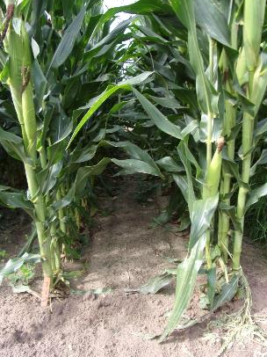
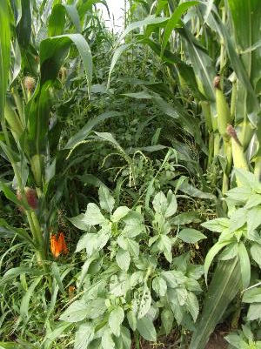
Field Corn Weed Control - 2023 No Roundup or Liberty??
Callisto 4SC @ 3 oz/A
Laudis 3.5SC @ 3 oz/A
Impact 2.8SC @ 1 oz/A
Shieldex 3.33SC @ 1 oz/A
1) Warrant 3ME @ 48 oz/A
PRE fb
2) HPPD +
Aatrex 4L @ 64 oz/A +
Prowl H₂O 3.8SC @ 32 oz/A +
Agridex @ 1% v/v
POST (23 DAP)
NTC = 233 Bu/A
Treated = 257-270 Bu/A
CN-02-23
June 13
52 DAP
P2042VYHR
Revulin Q 51.2DG @ 3.5 oz/A
NTC

Slide 28
Field Corn Weed Control - 2023
Callisto 4SC @ 3 oz/A
Aatrex 4L @ 64 oz/A
Prowl H₂0 3.8SC @ 32 oz/A
Agridex @ 1% v/v
POST (24 DAP)
CN-02-23
May 2
17 DAT
NTC

Slide 29
Field Corn Weed Control - 2023
Laudis 3.5SC @ 3 oz/A
Aatrex 4L @ 64 oz/A
Prowl H₂0 3.8SC @ 32 oz/A
Agridex @ 1% v/v
POST (24 DAP)
CN-02-23
May 2
17 DAT
NTC

Slide 30
Field Corn Weed Control - 2023 No Roundup or Liberty?
205 Bu/A
265 Bu/A
Steadfast Q 37.7DG @ 1.5 oz/A
Aatrex 4L @ 64 oz/A
Prowl H₂O 3.8SC @ 32 oz/A
Induce @ 0.25% v/v
POST (19 DAP)
NTC
CN-16-23
May 19
50 DAP
D58VC65

Slide 31
RR and/or Liberty Systems

Slide 32
Field Corn Weed Control - 2023
NTC
Roundup P-MAX3 5.88SL @ 22 oz/A
Aatrex 4L @ 32 oz/A
Prowl H₂0 3.8SC @ 32 oz/A
POST (17 DAP)
CN-12-23
April 27
15 DAT

Slide 33
Field Corn Weed Control - 2023
CN-15-23
May 30
48 DAT
NTC

Slide 34
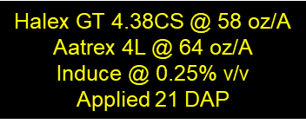
Field Corn Weed Control - 2023
CN-15-23
May 30
48 DAT
NTC

Slide 35
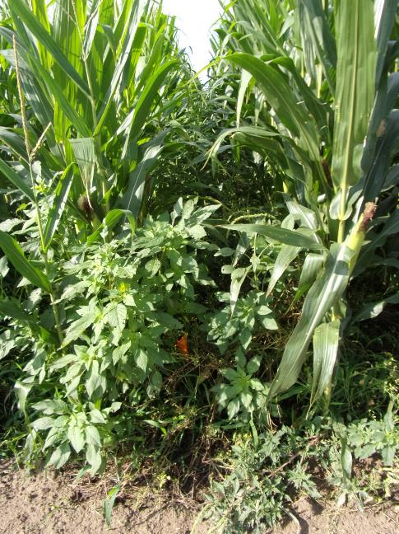
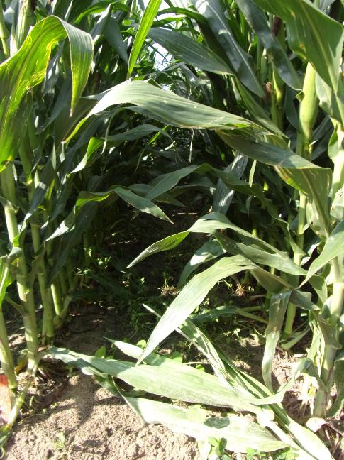
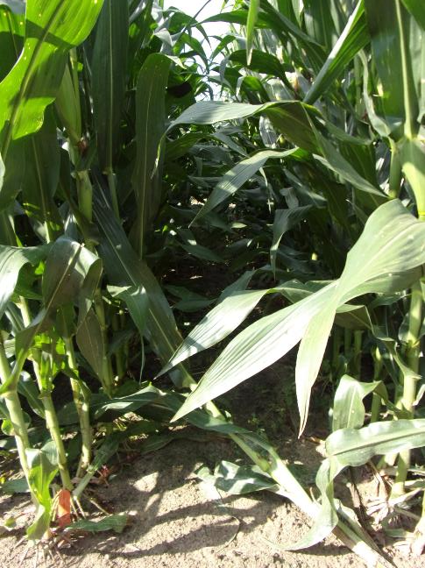
Field Corn Weed Control – 2023 No Roundup or Atrazine
NTC
202 Bu/A
Dual II Magnum 7.64EC @ 16 oz/A
(PRE)
Liberty 2.34SL @ 32 oz/A
Laudis 3.5SC @ 3 oz/A
Prowl H₂0 3.8SC @ 32 oz/A
Induce @ 0.25% v/v
POST (24 DAP)
242 Bu/A
Dual II Magnum 7.64EC @ 16 oz/A
(PRE)
Liberty 2.34SL @ 32 oz/A
Impact 2.8SC @ 1.25 oz/A
Prowl H₂0 3.8SC @ 32 oz/A
Induce @ 0.25% v/v
POST (24 DAP)
246 Bu/A
CN-01-23
June 13
85 DAP
P2042VYHR

Slide 36
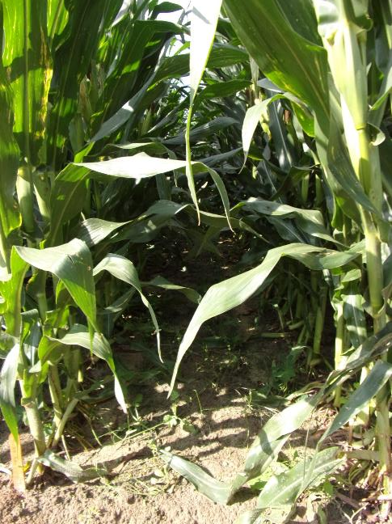
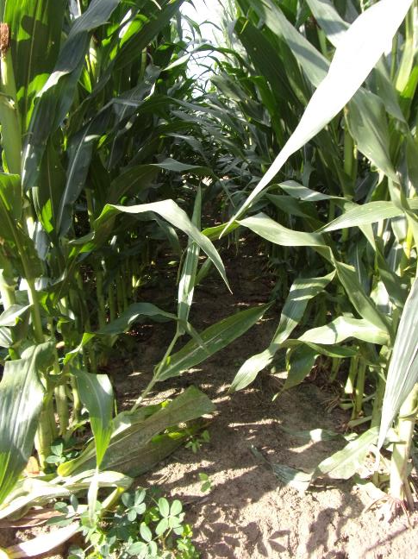
Field Corn Weed Control – 2023 No Roundup or Atrazine
NTC
202 Bu/A
Dual II Magnum 7.64EC @ 16 oz/A
(PRE)
Liberty 2.34SL @ 32 oz/A
Shieldex 3.33SC @ 1.35 oz/A
Prowl H₂0 3.8SC @ 32 oz/A
Induce @ 0.25% v/v
POST (24 DAP)
257 Bu/A
Dual II Magnum 7.64EC @ 16 oz/A
(PRE)
Liberty 2.34SL @ 32 oz/A
Callisto 4SC @ 3 oz/A
Prowl H₂0 3.8SC @ 32 oz/A
Induce @ 0.25% v/v
POST (24 DAP)
254 Bu/A
CN-01-23
June 13
85 DAP
P2042VYHR

Slide 37
New(er) Products Being Tested - I Not in UGA Pest Control Handbook (yet?)
AMVAC
Sinate (glufosinate + topramezone)
Impact Core (topramezone + acetochlor)
BASF
Surtain (encapsulated saflufenacil + pyroxasulfone)
Bayer
Convintro (diflufenican)
TriVolt (isoxaflutole + thiencarbazone + flufenacet)
Corteva
Kyro (encapsulated acetochlor + topramezone + clopyralid)
Resicore (mesotrione + acetochlor + clopyralid)
Resicore XL (mesotrione + encapsulated acetochlor + clopyralid)
Syngenta
Acuron GT (bicyclopyrone + s-metolachlor + mesotrione + glyphosate)
Acuron XR (bicyclopyrone + s-metolachlor + mesotrione + atrazine)
Storen (s-metolachlor + mesotrione + bicyclopyrone + pyroxasulfone)

Slide 38
New(er) Products Being Tested - II Not in UGA Pest Control Handbook (yet?)
Helm
Katagon (tolpyralate + nicosulfuron)
Helmet Maxx (metolachlor + atrazine + mesotrione)
Helena
Empyros (tolpyralate + s-metolachlor)
Empyros Triad (tolpyralate + s-metolachlor + atrazine)
Empyros Triad Flex (tolpyralate + s-metolachlor + atrazine)
Valent
Maverick (mesotrione + pyroxasulfone + clopyralid)
Summit Agro
Restraint (tolpyralate + acetochlor + dichlormid)

Slide 39
Field Corn Weed Control - 2023
Dual II Magnum 7.64E @ 16 oz/A
PRE
Kyro 3.49ZC @ 45 oz/A
Aatrex 4L @ 32 oz/A
Roundup PowerMax3 5.88SL @ 26.7 oz/A
Prime Oil @ 1% v/v
AMSOL @ 2.5% v/v
POST (28 DAP)
NTC
CN-11-23
August 15
135 DAP

Slide 40
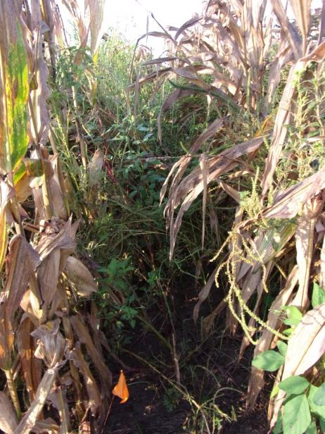
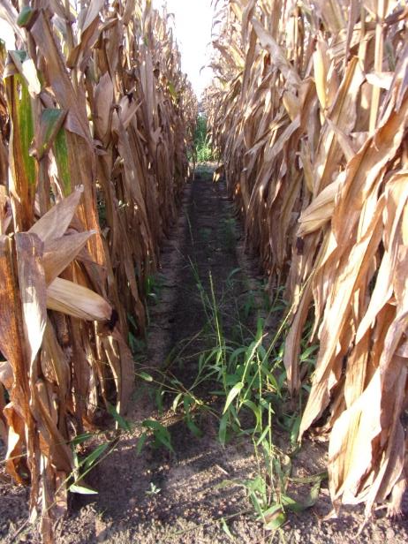
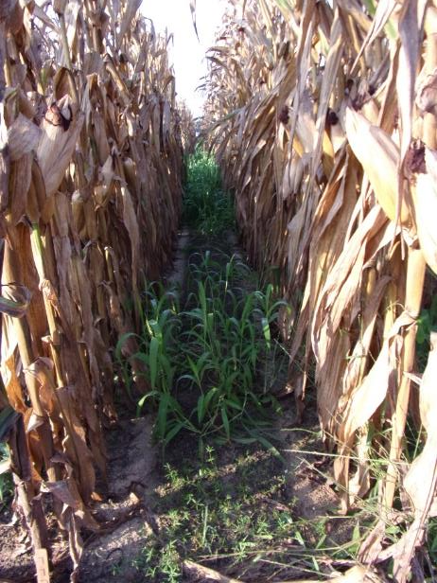
Field Corn Weed Control - 2023
NTC
Empyros 3.82L @ 45 oz/A
Aatrex 4L @ 32 oz/A
Grounded @ 16 oz/A
PRE
No Counter 20G INFR
Empyros 3.82L @ 45 oz/A
Aatrex 4L @ 32 oz/A
Grounded @ 16 oz/A
PRE
Counter 20G INFR
CN-10-23
August 15
139 DAP

Slide 41
Field Corn Weed Control – 2023 Late-Season
Storen 3.22ZC @ 57.6 oz/A
Aatrex 4L @ 48 oz/A
RoundupPowerMax3 5.88SL @ 28 oz/A
AMSOL @ 2.5% v/v
POST (20 DAP)
NTC
CN-12-23
August 18
150 DAP

Slide 42
Field Corn Weed Control – 2023
Maverick 2.04SC @ 18 oz/A
(PRE)
fb
Maverick 2.04SC @ 14 oz/A
Roundup PowerMax3 5.88SL @ 22 oz/A
Induce @ 0.25% v/v
AMSOL @ 2.5% v/v
(37 DAP)
NTC
CN-11-23
May 26
53 DAP

Slide 43
Post-Harvest

Slide 44
Post-Harvest Weed Control - 2023 Gramoxone 2SL @ 48 oz/A + Tricor 4F @ 8 oz/A + NIS @ 0.25% v/v (15 GPA, AIXR11002 nozzles, 3.5 MPH)
TREATED
NOT
TREATED
September 18
4 DAT
sprayed 3 beds/skipped 2 beds (September 14)
mowed every other bed (September 5)
corn harvested (August 29)

Slide 45
Post-Harvest Weed Control - 2023 Gramoxone 2SL @ 48 oz/A + Tricor 4F @ 8 oz/A + NIS @ 0.25% v/v (15 GPA, AIXR11002 nozzles, 3.5 MPH)
October 31
47 DAT
sprayed 3 beds/skipped 2 beds (September 14)
mowed every other bed (September 5)
corn harvested (August 29)

Slide 46
Post-Harvest Control of Tropical Spiderwort
Untreated
2,4-D @ 1.5 pt/A
POST1 + POST 2
POST1: 8-10” tall COMBE
POST2: 2 weeks later
Photo 1 week after POST2

Slide 47
Questions/Comments

