Slide 1
Peanut Tolerance to Reviton® (tiafenacil)
Eric P. Prostko*, Nick J. Shay, and Chad C. Abbott
University of Georgia
Dept. Crop & Soil Sciences

Slide 2
U.S. Crop Production – 2023 Acres Planted
Source: USDA/NASS, Crop Production (06/30/23)

Slide 3
Peanut Herbicide History Since the 1980’s
Dual - 1980
Poast - 1985
Premerge/Dinitro/ Dyanap (dinoseb) was cancelled in 1986
Sonalan - 1988
Classic - 1988
Paraquat – 1988
Lasso (alachlor) Issues - 1991
Pursuit - 1991
Zorial/Solicam - 1993
Tough - 1992
Select - 1996
Cadre - 1996
Frontier - 1996
Dual Magnum - 1997
Outlook - 1999
Strongarm - 2000
Valor - 2001
Spartan - 2003
Cobra - 2005
Fusilade - 2009
Warrant - 2014
Zidua - 2017
Anthem Flex - 2020
Brake - 2023
Rexovor - ????????
Liberty - ???????

Slide 4
Reviton® 2.83SC
Helm Agro U.S.
tiafenacil
N-phenyl-imides
flumioxazin, saflufenacil, trifludimoxazin
WSSA #14
PPO-inhibitor
Preplant Burndown
corn (0 d )
soybean (0-7 d)
wheat (0 d)
cotton (7-14 d)
1-3 oz/A
Peanut rotation is 120-150 days (rate)
Proposed 24-C label
0 days (1 oz/A) and 7 days (2 oz/A)

Slide 5
Pre-Plant Burndowns - 2023
NTC
NTC
Roundup PowerMax3 5.88SL @ 22 oz/A
Reviton 2.83SC @ 1 oz/A
MSO @ 1% v/v
BD-01-23
March 30
21 DAT

Slide 6
Objective
Evaluate peanut response to PRE and POST applications of Reviton® (tiafenacil)

Slide 7
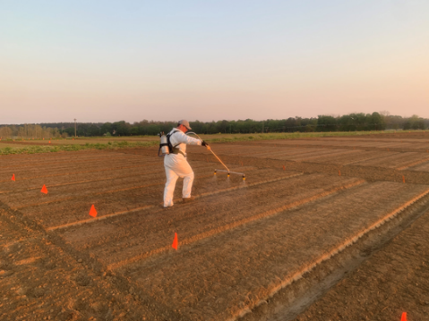
Materials and Methods
UGA Ponder Farm
small plots, 15 GPA, 11002AIXR, GA-06G, weed-free
2021
NTC, 2 oz/A-PRE, 1 or 2 oz/A-POST (30 DAP) + Induce @ 0.25% v/v
RCBD, 3 reps
2022
timing (4) X rate (3) factorial, 4 reps
PRE, 30 or 60 or 90 DAP (Induce @ 0.25% v/v))
0, 1 or 2 oz/A
ANOVA, P=0.10, Fisher’s

Slide 8
Results - 2021
Screven Co. 2021

Slide 9
Peanut Leaf Necrosis (32 DAP) As Influenced By Reviton® 2.83SC
*Applied 30 DAP and included Induce @ 0.25% v/v

Slide 10
Peanut Response to Reviton® 2.83SC - 2021
NTC
2 oz/A - PRE
PE-14-21
June 4
2 DAT (POST)
32 DAP
1 oz/A + Induce - POST
2 oz/A + Induce - POST

Slide 11
Peanut Stunting As Influenced By Reviton® 2.83SC
*Applied 30 DAP and included Induce @ 0.25% v/v

Slide 12
Peanut Response to Reviton® 2.83SC - 2021
NTC
2 oz/A - PRE
PE-14-21
June 11
9 DAT (POST)
39 DAP
1 oz/A + Induce - POST
2 oz/A + Induce - POST

Slide 13
Peanut Response to Reviton® - 2021
PE-14-21
June 29
27 DAT (POST)
57 DAP

Slide 14
Peanut Height/Width (84 DAP) As Influenced By Reviton® 2.83SC
*Applied 30 DAP and included Induce @ 0.25% v/v

Slide 15
Peanut Response to Reviton® - 2021
PE-14-21
July 26
54 DAT (POST)
84 DAP

Slide 16
Peanut Yield As Influenced By Reviton® 2.83SC - 2021
P=0.2037
CV=9.36
*Applied 30 DAP and included Induce @ 0.25% v/v

Slide 17
Results - 2022

Slide 18
Reviton® 2.83SC Applied 30 DAP
1 oz/A + Induce @ 0.25% v/v
2 oz/A + Induce @ 0.25% v/v
PE-01-22
June 2
2 DAT

Slide 19
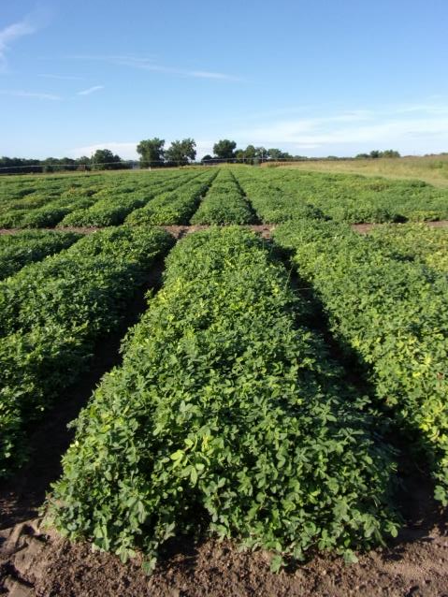
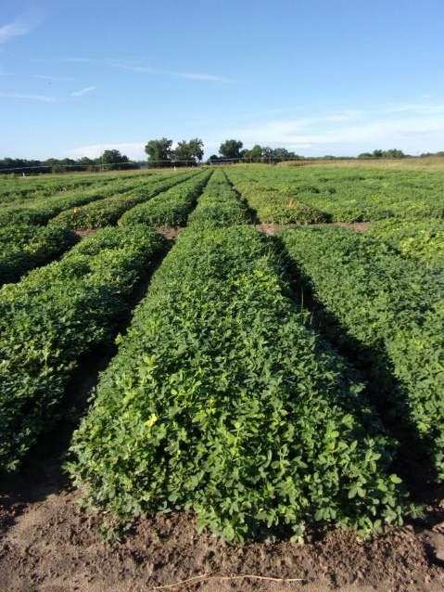
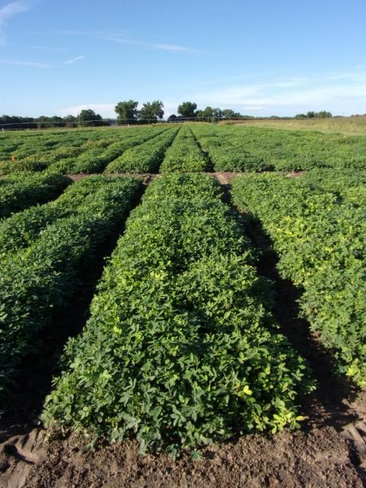
Peanut Response to Reviton® 2.83SC Applied PRE
0 oz/A
1 oz/A
2 oz/A
PE-01-22
August 9
98 DAP

Slide 20
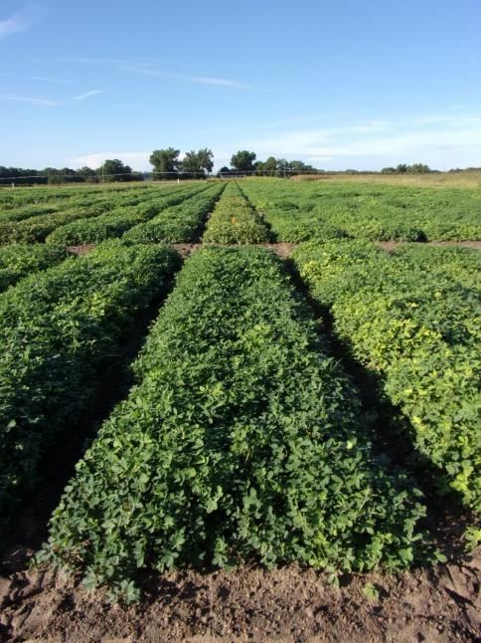
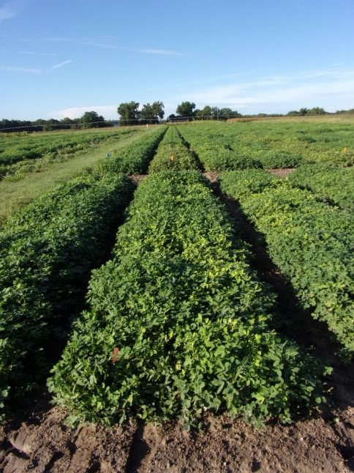
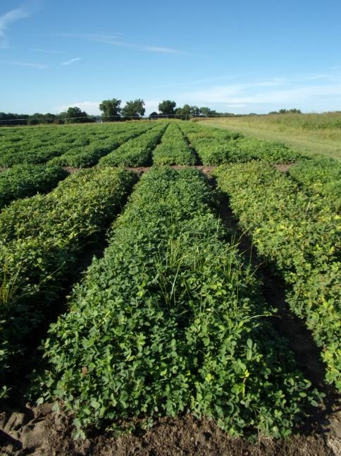
Peanut Response to Reviton® 2.83SC Applied POST (30 DAP)
PE-01-22
August 9
98 DAP

Slide 21
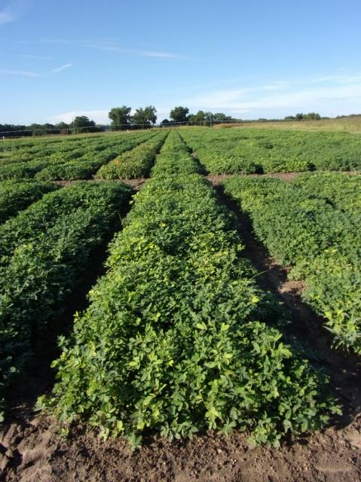
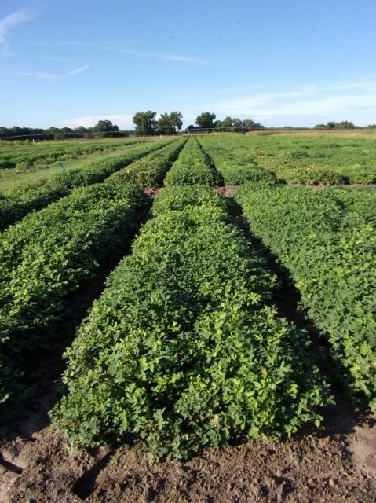
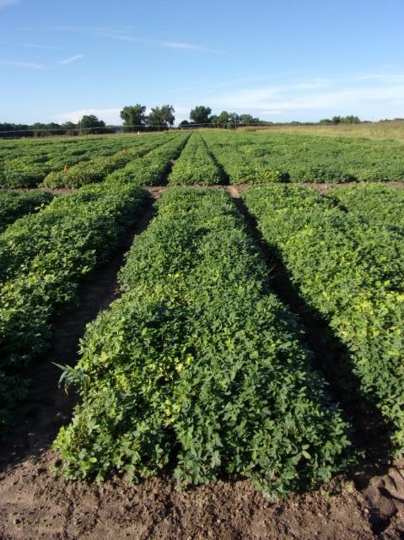
Peanut Response to Reviton® 2.83SC Applied POST (60 DAP)
PE-01-22
August 9
98 DAP

Slide 22
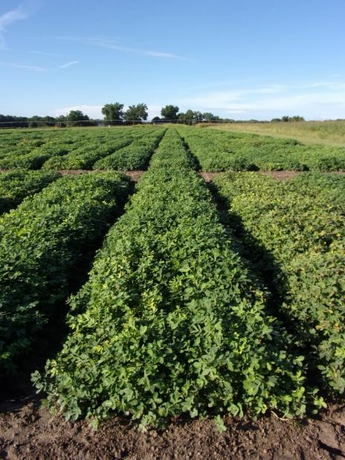
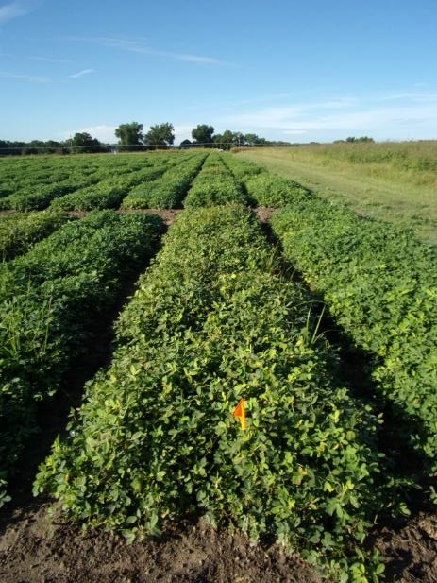
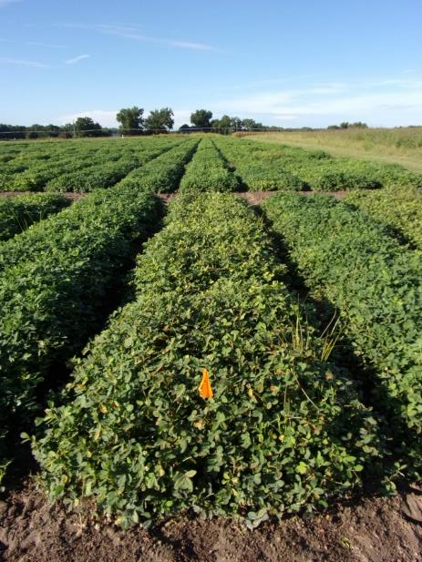
Peanut Response to Reviton® 2.83SC Applied POST (90 DAP)
0 oz/A
PE-01-22
August 9
98 DAP

Slide 23
Peanut Yield Response to PRE Applications of Reviton® 2.83SC - 2022

Slide 24
Peanut Yield Response to POST (30 DAP) Applications of Reviton® 2.83SC - 2022
~ 15% yield loss

Slide 25
Peanut Yield Response to POST (60 DAP) Applications of Reviton® 2.83SC - 2022
~19-25% yield loss
bc

Slide 26
Peanut Yield Response to POST (90 DAP) Applications of Reviton® 2.83SC - 2022
ab
~16-20% yield loss
cde
de

Slide 27
Summary
PRE applications little to no injury in both years
< 5%
POST applications cause leaf necrosis, stunting, and yield loss
2021 = no yield loss
2022 = 16-25% yield loss

Slide 28
Future Research/Direction
Repeated test in 2023
Reviton® is not a likely candidate for in-crop use
Proposed preplant 24-C label in 2023
0 days = 1 oz/A
7 days = 2 oz/A
On new Section 3 in 2025?

Slide 29
Peanut/Reviton – 2023 2 oz/A
NTC
PRE
30 DAP
56 DAP
PE-05-23
June 26
62 DAP

Slide 30
Questions/Comments?
Bulloch Co. 2021

