Slide 1
Weed Control in Field Corn 2021
Eric P. Prostko, Ph.D.
Professor/Extension Weed Specialist
Dept. Crop & Soil Sciences

Slide 2
Herbicide Carryover or Soil pH
Soil pH = 4.7

Slide 3
Field Corn Yield Loss (%) Caused by Uncontrolled Weeds in UGA Weed Science Research Trials (2007-2020). Treated vs. Non-treated
200 Bu/A X 0.34 X $4.00 = $272/A
What about harvest?
What about next year?

Slide 4
Field Corn Weed Control Questions for you?
What technologies are you planting?
RR, LL, Conventional, Enlist (2,4-D)?
Do you need Counter?
Is atrazine still working for you on pigweed?
Lets assume it does not
What will be planted after the field corn?

Slide 5
A general plan of attack?
MUST START CLEAN!
Use 1 qt/A of Atrazine 4L PRE (or Dual II Magnum, or Warrant, or Outlook)
Follow up with a timely POST program (V3-V5 stage) that includes an additional 1.5 qt/A of Atrazine 4L
Roundup + Atrazine probably not good enough anymore!
Lots of options depending upon how you answered previous questions?
Liberty, Laudis, Impact/Armezon, Halex GT, Callisto, Acuron, dicamba, 2,4-D

Slide 6
Herbicide Timing Effects on Spray Coverage - 2020
JD 4630
90’ boom length
20” nozzle spacing
10 GPA
32 PSI
11 MPH
8003EVS
Roundup + Atrazine + Quest + Grounded
CN-06-20
Miller Co.
30 DAP
April 16

Slide 7
Herbicide Timing Effects on Spray Coverage in Field Corn - 2020
V4: 9-10” tall
20 DAP
2’”
6”
V6: 14-16” tall
30 DAP
2”
6”
CN-06-20
JD 4630, 90’ Boom
20” Nozzle Spacing
10 GPA, 32 PSI
11 MPH
8003EVS Nozzles

Slide 8
Herbicide Timing Effects on Spray Coverage (%) in Field Corn - 2020
(LSD 0.10 = 2.1)
(LSD 0.10 = 2.1)
%
-39.6%
CN-06-20, Miller Co.
JD 4630, 90’ Boom
20” Nozzle Spacing
10 GPA, 32 PSI
11 MPH, 8003EVS Nozzles
Spray Card Height (in)

Slide 9
Roundup + Atrazine + Prowl Works Great For Me But……….
Roundup P-Max II @ 32 oz/A
Atrazine 4L @ 64 oz/A
Prowl H₂O @ 32 oz/A
Applied 19 DAP
NTC
CN-08B-20
May 21
23 DAT

Slide 10
Field Corn Weed Control - 2020
Roundup P-Max @ 32 oz/A
Atrazine @ 64 oz/A
Prowl H₂0 @ 32 oz/A
Applied 26 DAP
NTC
CN-14-20
May 15
10 DAT

Slide 11
Texas Panicum Control in Field Corn – 2020 (49 DAT)
Applied 38 DAP, V5 stage
Control (%)
Treatment
LSD 0.10 = 9.2
CV = 8.89
Source: C. Cahoon (NCSU)

Slide 12
Does POST Applied Prowl Cause Field Corn Yield Loss???
Bu/A
LSD 0.10 = NS
CV = 12.32
LSD 0.10 = 27.9
CV = 7.2
LSD 0.10 = NS
CV = 10.6
LSD 0.10 = NS
CV = 8.98

Slide 13
Field Corn Weed Control - 2020
Roundup P-Max II @ 32 oz/A
Laudis @ 3 oz/A
Atrazine @ 64 oz/A
Prowl H₂0 @ 32 oz/A
Applied 19 DAP
NTC
CN-07B-20
May 18
39 DAP

Slide 14
Laudis 3.45SC @ 3 oz/A + Atrazine 4L @ 64 oz/A + Dual Magnum 7.62EC @ 16 oz/A + MSO @ 1% v/v
CN-02-20
April 21
7 DAT

Slide 15
Field Corn Weed Control - 2020
Halex GT @ 58 oz/A
Atrazine 4L @ 32 oz/A
Induce @ 0.25% v/v
AMS @ 2.5% v/v
Applied 20 DAP
CN-09B-20
May 21
22 DAT

Slide 16
Field Corn Weed Control - 2020
Impact 2.8SC @ 1 oz/A
MSO @ 1% v/v
AMS @ 3 lb/A
Applied 19 DAP
NTC
CN-07B-20
May 18
20 DAT

Slide 17
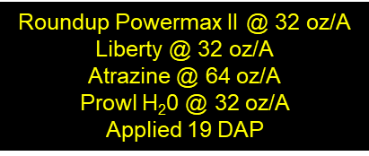
Field Corn Weed Control – 2020 Roundup + Liberty????
PE-15-20
May 21
23 DAT

Slide 18
Field Corn Weed Control – 2020 Roundup + Liberty????
PE-15-20
June 16
68 DAP

Slide 19
New(er) Products Being Tested
Sinate (glufosinate + topramezone)
AMVAC
Impact Core (topramezone + acetochlor)
AMVAC
Acuron GT (bicyclopyrone + s-metolachlor + mesotrione + glyphosate)
Syngenta
Shieldex (topyralate)
Summit Agro USA

Slide 20
Sinate - 2020
Sinate 2.57SL @ 21 oz/A
Atrazine 90DF @ 9 oz/A
MSO @ 1% v/v
AMS @ 3 lb/A
Applied 19 DAP
NTC
CN-07B-20
May 18
21 DAT

Slide 21
Impact Core - 2020
Impact Core 7.15EC @ 30 oz/A
Atrazine 4L @ 32 oz/A
NIS @ 0.25% v/v
AMS @ 2.5 lbs/A
Applied 19 DAP
NTC
CN-07B-20
May 18
21 DAT

Slide 22
Impact Core 7.15EC @ 40 oz/A + Atrazine 4L @ 32 oz/A + Induce @ 0.25%v/v + AMS @ 2.5 lb/A
CN-07B-20
April 30
2 DAT

Slide 23
Acuron GT - 2020
Acuron GT 4.29SC @ 60 oz/A
Induce @ 0.25% v/v
Applied 20 DAP
CN-10B-20
May 21
22 DAT

Slide 24
Shieldex - 2020
Bicep Lite II Magnum 6SC @ 53 oz/A (PRE)
Shieldex 3.33SC @ 1 oz/A (26 DAP)
Atrazine 4L @ 16 oz/A (26 DAP)
Agridex @ 1% v/v (26 DAP)
NTC
CN-14-20
May 27
47 DAP

Slide 25
Field Corn Lay-By (16 GPA, 30 PSI, 3.7 MPH, Floodjet TK-VS2)

Slide 26
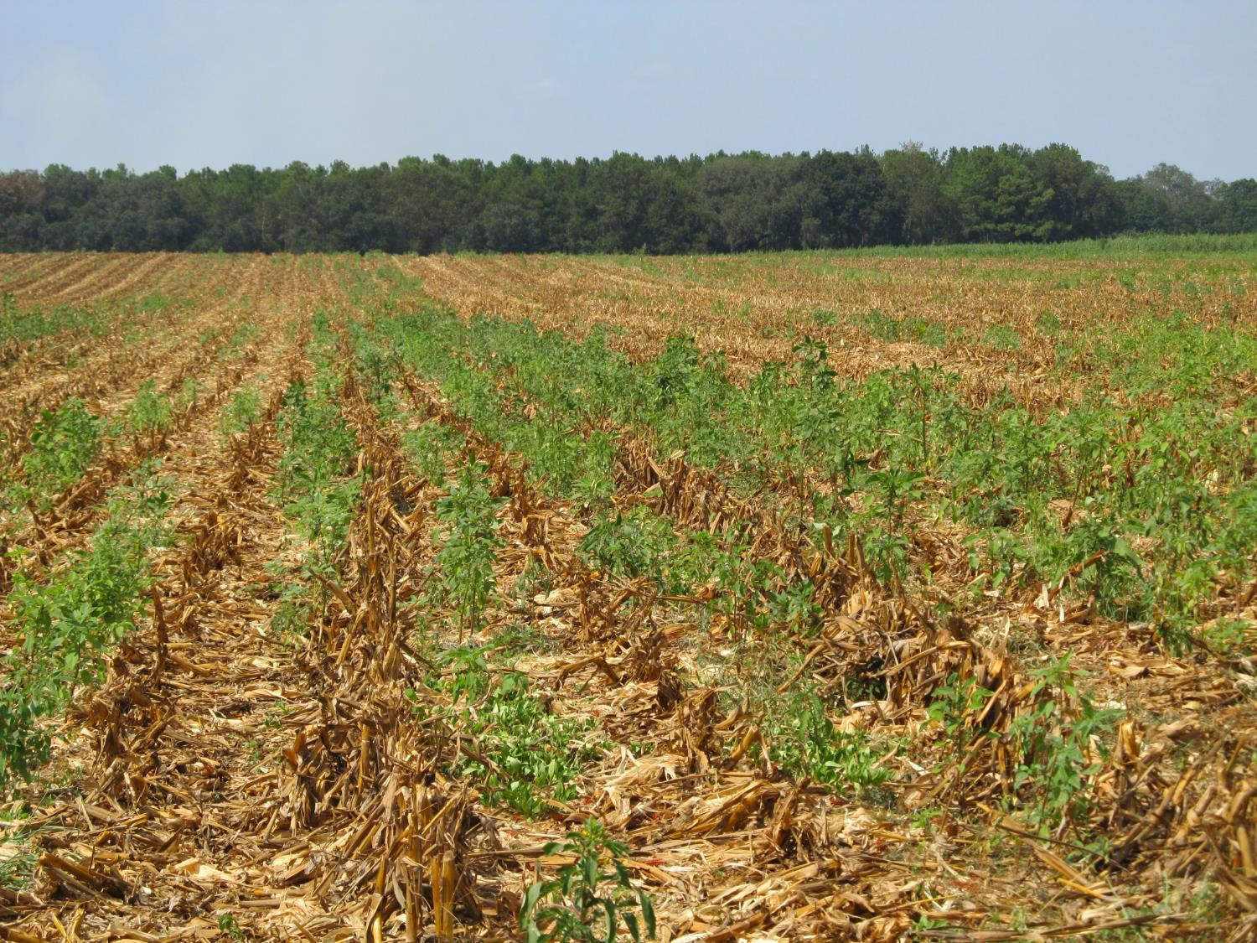
Post-Harvest Palmer Amaranth Populations Must be Managed!

Slide 27
Palmer Amaranth Burndown - 2019 (AMAPA 1-6” tall)
NTC
Gramoxone 3SL @ 32 oz/A
Tricor 4L @ 8 oz/A
Induce @ 0.25% v/v
NC-01-19
May 30
10 DAT

Slide 28
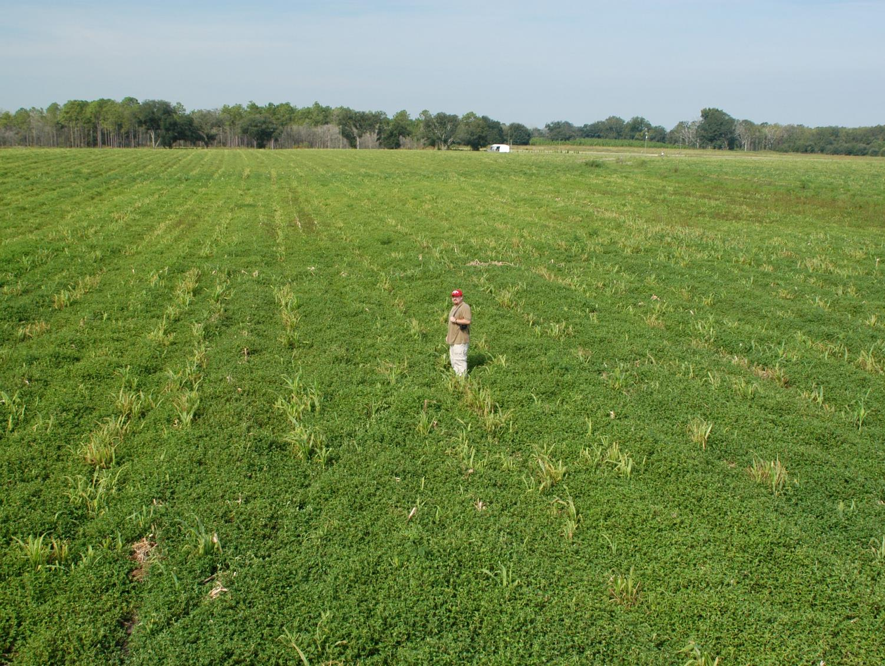
Tropical Spiderwort/Benghal Dayflower (TSW/BD) After Corn Harvest
(need tillage and/or 2 apps of Gramoxone or 2,4-D or Aim)

Slide 29
Post-Harvest Control of TSW/BD with 2 Applications (14 d apart) of Gramoxone (paraquat)
1 week after POST2

Slide 30
Questions/Comments?

