Slide 1
Common Mistakes That Reduce Peanut Profitability - Weed Management
Eric P. Prostko
Extension Weed Specialist
Department of Crop & Soil Sciences

Slide 2
Topics for Discussion
failure to start clean
weed size
mixing/loading/ cleaning
equipment issues
Pesticide IQ
labels
crop rotations

Slide 3
Not a good way to start out!

Slide 4
Starting Clean!!!!!
~$21A in extra tillage
and still had problems!
4-5’ tall AMAPA
Mowed
Disked
Rototilled 2X
Photo taken
17 Days later

Slide 5
Large (5”-23” tall) Palmer Amaranth Control with Gramoxone 2SL @ 2.5 pt/A.
6 hours
4 days
7 days
19 days

Slide 6
Cobra 2EC @ 12.5 ozs/A + COC @ 1% v/v applied to 17” tall pigweed
1 DAT
4 DAT
7 DAT
16 DAT

Slide 7
Estimated Yield Loss From Delayed Weed Removal in Peanut*
5% of 5000 lbs/A = 250 lbs/A
250 lbs/A @ $0.205 = $51.25/A Mistake
*Adapted from Everman et al. 2008. Weed Technology 22:63-67

Slide 8
Mixing/Loading/Sprayer Clean-Out

Slide 9
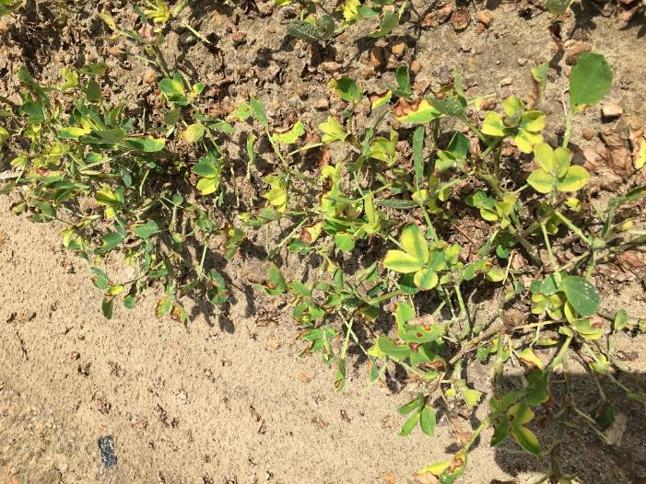
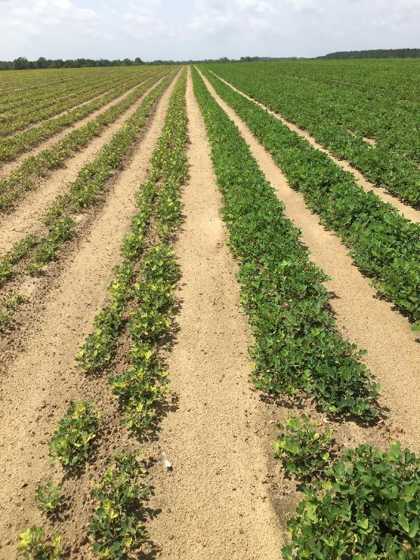
Glyphosate Mishaps Again in 2019
June 25
JK

Slide 10
Glyphosate Mishaps Again in 2019
June 28
BS

Slide 11
Glyphosate Mishaps Again in 2019
June 25
RB

Slide 12
Peanut Yield Loss Caused By Glyphosate Applied 75-105 DAP in Georgia.
4 oz/A = 8.6% yield loss
8.6% of 5000 lbs/A = 430 lbs/A
430 lbs @ $0.205/lb = $88/A mistake
Yield Loss (%)
2
Glyphosate Rate (5.5 lb ai/gal) – oz/A

Slide 13
Is this glyphosate? No, it’s diuron!
Planting Date: April 20
Sprayed: June 7
Picture: June 20
Tift Co. 2018
5900+ lbs/A

Slide 14
Diuron 4L Applied 93 DAP
NTC
4 oz/A
8 oz/A
16 oz/A
PE-02-19
August 14
106 DAP
13 DAT

Slide 15
Peanut (GA-06G) Yield Loss (%) From Diuron 4L
LSD (0.10) = 9
4 oz/A @ 57 DAP = 18% yield loss
18% of 5000 = 900 lbs/A
900 lbs @ $0.205/lb = $185/A mistake
PE-02-19
Time of Application (DAP)

Slide 16
Equipment Problems

Slide 17
Sprayer/Nozzle Problems
2,4-DB (14 DAP) then Gramoxone + Storm (21 DAP) then Gramoxone + Storm (28 DAP)
then Cadre + Dual Magnum + 2,4-DB (42 DAP)
~$51/A mistake (4 applications + product) – not counting any yield loss from rate/timing

Slide 18
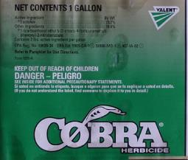
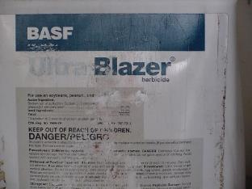
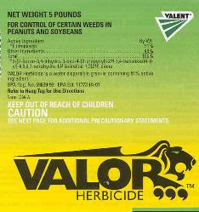
What’s Your Pesticide IQ?
How well do you know your products?
When was the last time you really read the label?
Label Bending?

Slide 19
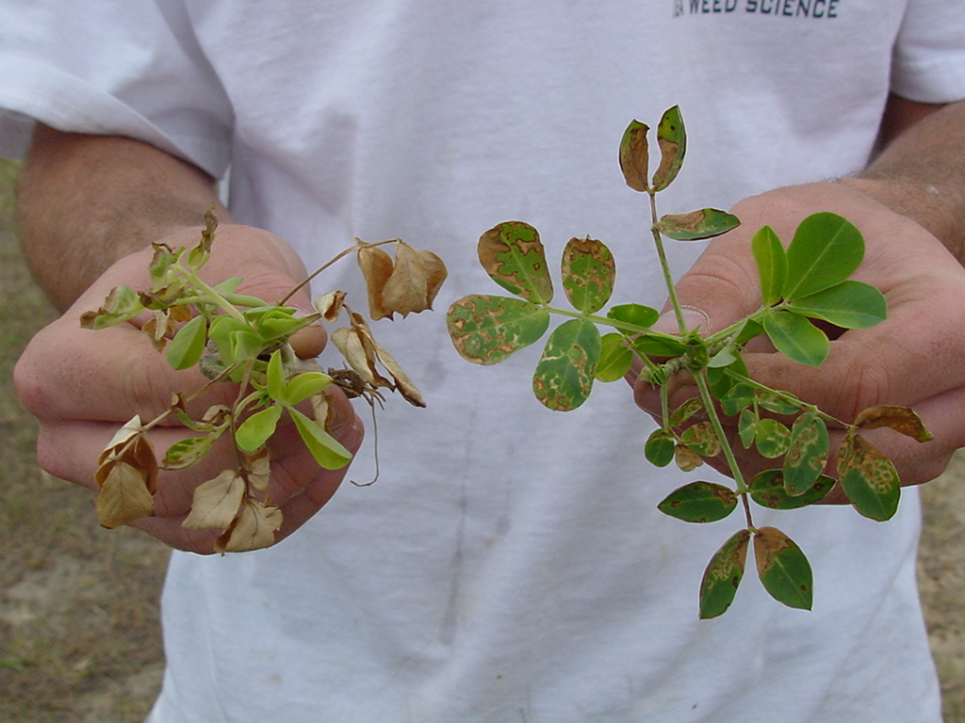
Treatments applied 6 DAC; Photo at 3 DAT
GA-02C
GI @ 8 oz/A +
NIS @ 0.25% v/v
GI @ 12 oz/A + Basagran @ 8 oz/A +
NIS @ 0.25% v/v

Slide 20
Peanut Yield (GA-16HO) As Influenced by Gramoxone Timing (Averaged over 9 Gramoxone treatments)
5.5% yield loss
5.5% of 5000 lbs/A = 275 lbs/A
275 lbs/A @ $0.205/lb = $56/A mistake
PE-07-18
weed-free
irrigated
THSD (0.10) = 246
CV = 6.5

Slide 21
Grazon P+D Injury

Slide 22
2.4 oz/A = 11.3% yield loss
11.3% of 5000 lbs/A = 565 lbs/A
565 lbs @ $0.205/lb = $116/A mistake
Yield Loss (%)
% of Labeled Rate
(24 oz/A)

Slide 23
Final Thoughts
Avoid self-inflicted problems!
STOP-DROP-ROLL
Rate X time of application (read label)
Sprayer clean-out
Pesticide containers
Rotation restrictions
Don’t wait until “all the weeds” have come up

Slide 24
Questions/Comments

