Slide 1
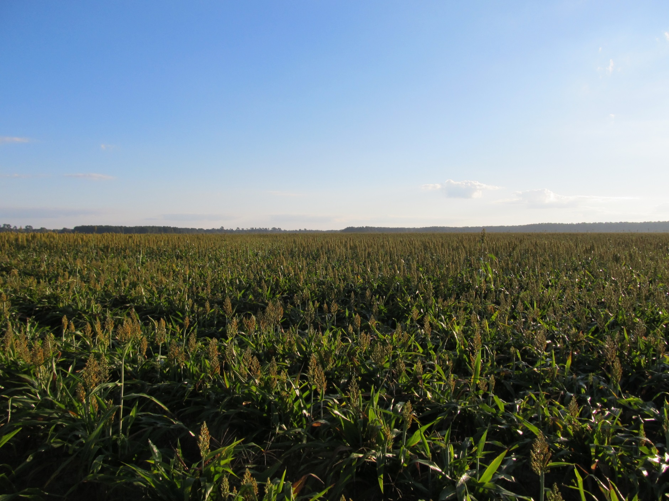
GRAIN SORGHUM WEED CONTROL UPDATE – 2018
Eric P. Prostko, Ph.D.
Professor and Extension Weed Specialist
Dept. Crop & Soil Sciences

Slide 2
GRAIN SORGHUM WEED CONTROL
Start clean!
Concep treated seed
Dual Magnum or Warrant (PRE)
Atrazine (POST) or Huskie + ATZ (POST)
Paraquat (Hooded sprayer)
Mechanical Cultivation

Slide 3
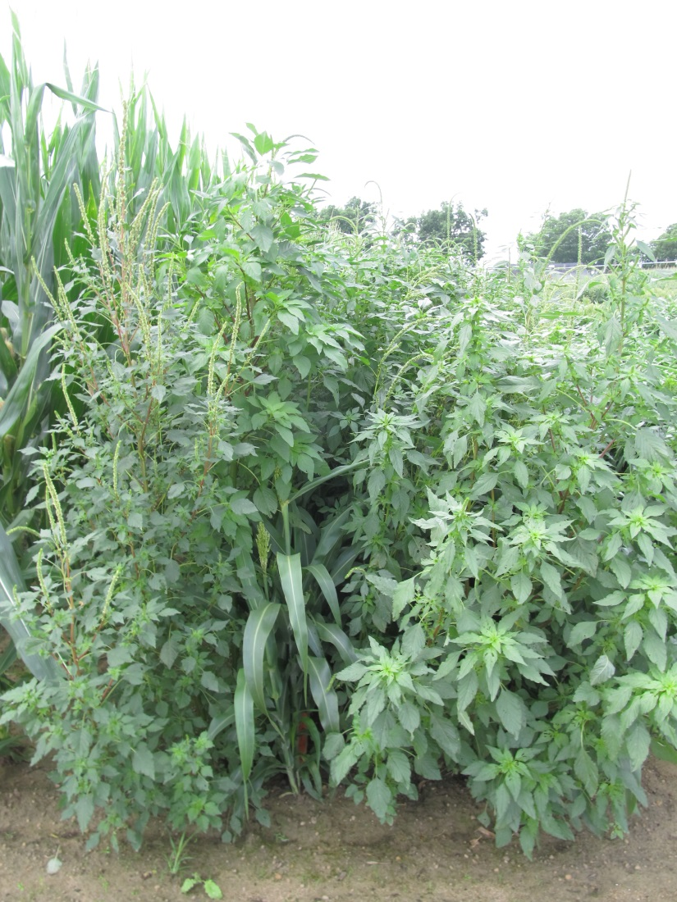
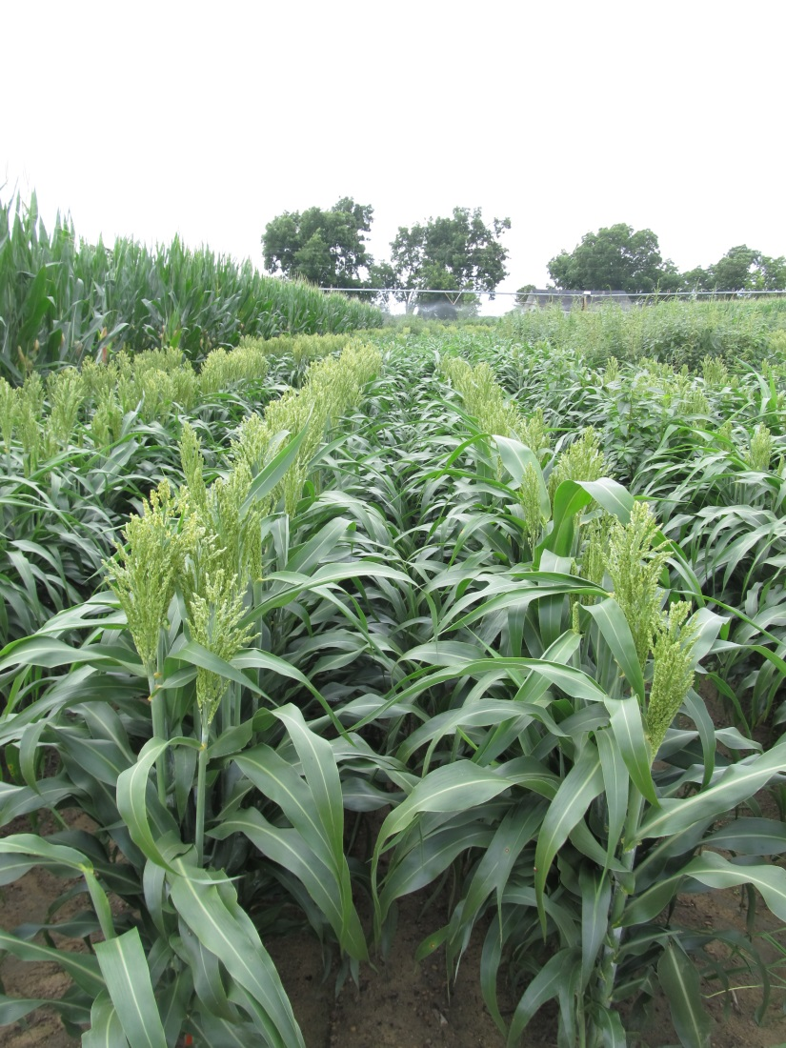
Grain Sorghum - 2017
NTC
Dual Magnum 7.62EC @ 16 oz/A (PRE)
Atrazine 4L @ 48 oz/A (30 DAP)
COC @ 1% v/v (30 DAP)
SG-02-17
June 8
59 DAP

Slide 4
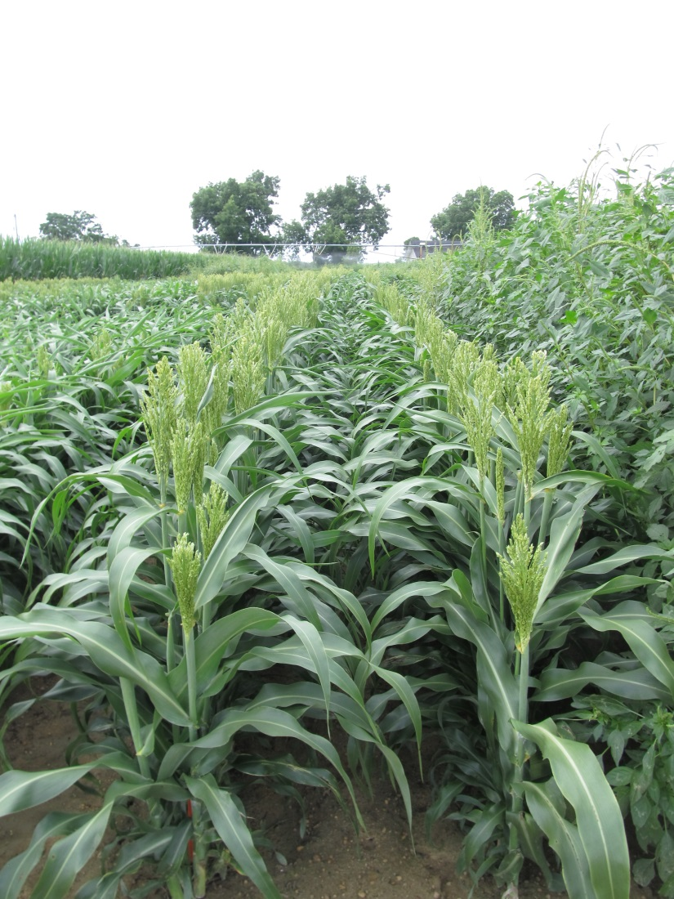
Grain Sorghum - 2017
Dual Magnum 7.62EC @ 16 oz/A (PRE)
Huskie 2.06EC @ 13 oz/A (30 DAP)
Atrazine 4L @ 16 oz/A (30 DAP)
AMS Xtra 3.4SL @ 2.5% v/v (30 DAP)
NIS @ 0.25% v/v (30 DAP)
NTC
SG-02-17
June 8
59 DAP

Slide 5
Huskie Injury on Sorghum

Slide 6
Huskie @ 13 oz/A + Atrazine @ 16 oz/A + AMS Xtra @ 2% v/v + Adept @ 0.25% v/v – 3 DAT
SG-02-17
April 27

Slide 7
Zest™ 75 WDG/Inzen™ Grain Sorghum
Dupont
Nicosulfuron (Accent)
NON-GMO
ONLY on Dupont Inzen™ traited grain sorghum
ADVANTA (Alta) and Pioneer
Limited performance data for SE
0.67 – 1.33 oz/A (75WDG)
Up to 20” tall sorghum
Tank-mix with atrazine
COC (1% v/v)
28% or 32% UAN (2 qt/A)
Dual, Warrant, or Cinch (PRE)
Concep treated seed
GA Label in November 2016

Slide 8
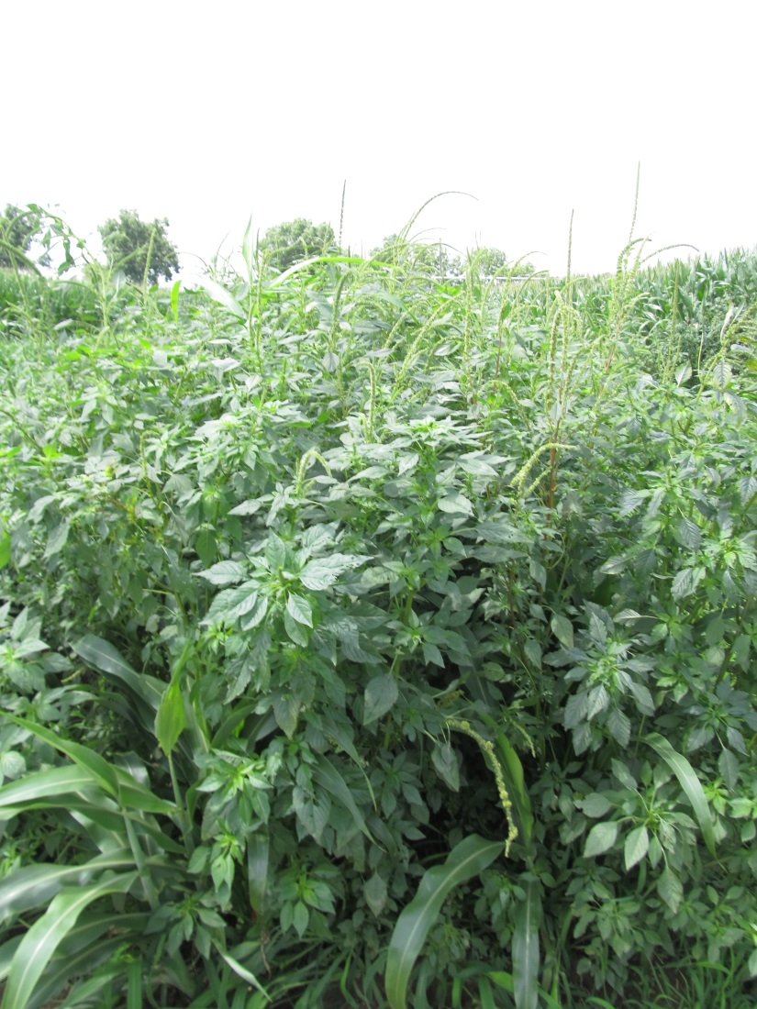
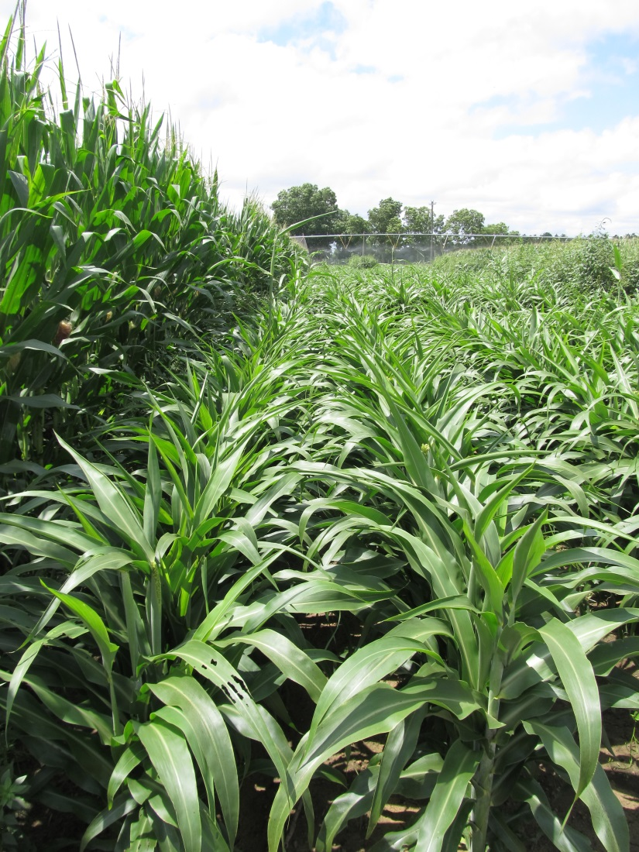
Inzen Sorghum - 2017
Cinch 7.64EC @ 16 oz/A (PRE)
Zest 75WG @ 0.67 oz/A (30 DAP)
Atrazine 4L @ 24 oz/A (30 DAP)
COC @ 1% v/v (30 DAP)
AMS Xtra 3.4SL @ 2% v/v (30 DAP)
NTC
SG-01-17
June 8
59 DAP

Slide 9
Inzen Sorghum – 2017 (ADV G3250ALS)

Slide 10
Zest Injury on Inzen Grain Sorghum
SG-01-16
May 18
9 DAT

Slide 11
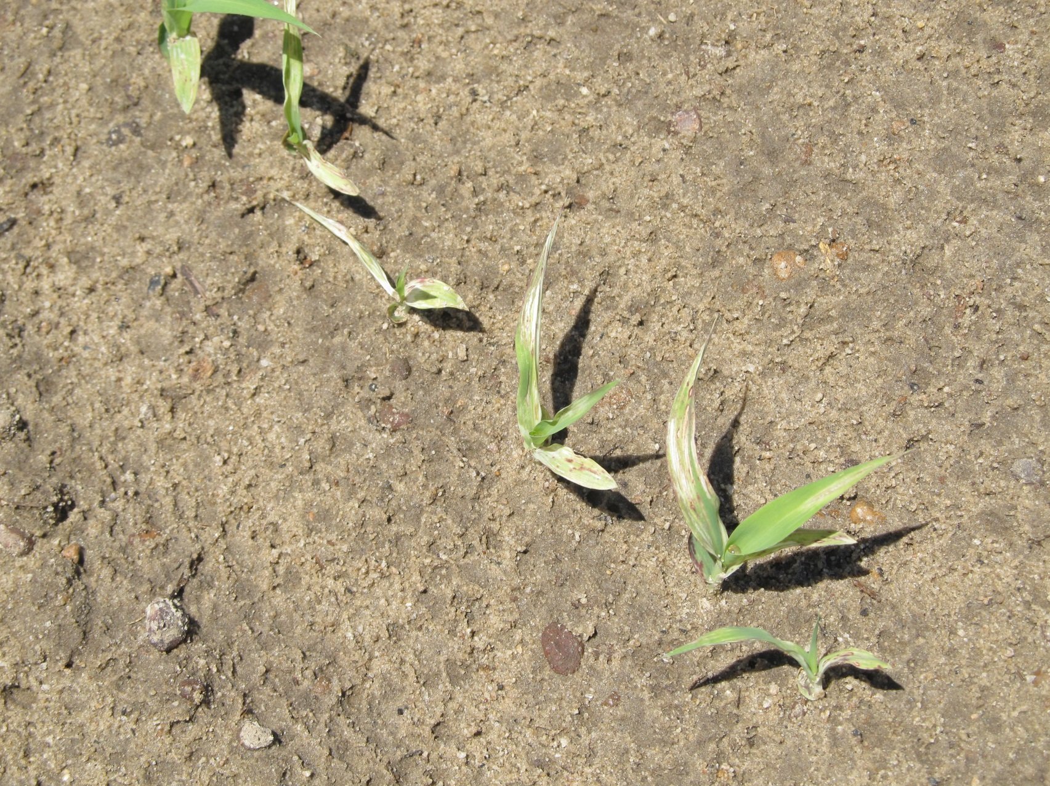
Grain Sorghum After Reflex? (10 month rotation restriction)
**Average ½-life in south GA soils was 80 to 128 days (~100 days) Potter et al. 2016. J. Agric. Food Chem. 64:5156-5163

Slide 12
Reflex Concentrations in Soil After PRE Applications Under Assorted Mulches
*Myakka sand (1% OM, 6.8 pH; 95% sand, 4% silt, 1% clay); Reflex concentration at application was 139-176 µg/kg
Source: Reed et al. 2017. Weed Science (FL)

Slide 13
Sunflower Weed Control
Eric P. Prostko
Extension Weed Specialist

Slide 14
Sunflowers Acres in Georgia
FSA Crop Acreage Reports

Slide 15
What is labeled? (not much)
PPI
Sonalan or Treflan
PPI or PRE
Prowl, Dual Magnum, Spartan
POST
Arrow, Assure II, Select, Poast, SelectMax (grasses only)
Beyond (imazamox)
only on Clearfield hybrids
Beyond same family as Cadre, Pursuit, and Scepter
Beyond costs about $525/gal (4 ozs/A = $16.41/A)
$157/bag (200,000 seed ~ 10 acres) = $15.70/A
Clearfield sunflower hybrids are not GMO’s
Hooded Sprayer
Aim 2EC @ 1-2 oz/A + COC @ 1% v/v
Pigweeds must be 4” or less

Slide 16
Consider Cultivation

Slide 17
Clearfield Sunflower Weed Control Results
Clearfield sunflower hybrids that I have worked with since 2003
include the following:
Mycogen 8N429CL
Mycogen 8N386CL
Mycogen 8H419CL
Mycogen 8F300CL
Dekalb DKF 3880CL

Slide 18
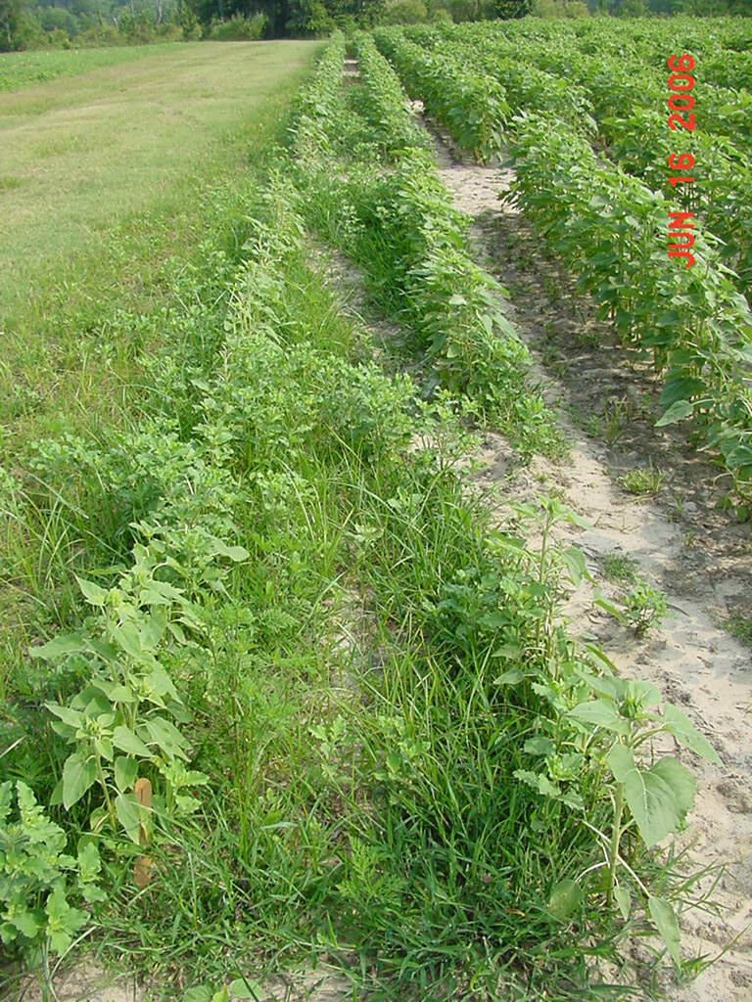
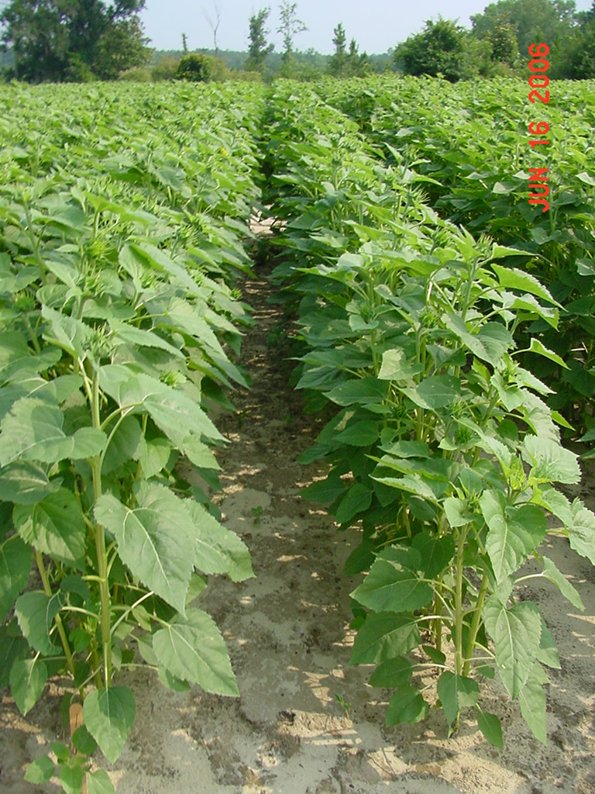
2006 (7 WAP)
Prowl H₂O @ 2.1 pt/A
Spartan 4F @ 4.0 oz/A
PRE
NTC

Slide 19
Harvest Aids for Sunflowers
Gramoxone (paraquat)
Roundup (glyphosate)
Sodium chlorate
Sharpen (saflufenacil)

Slide 20
Questions?

