Slide 1
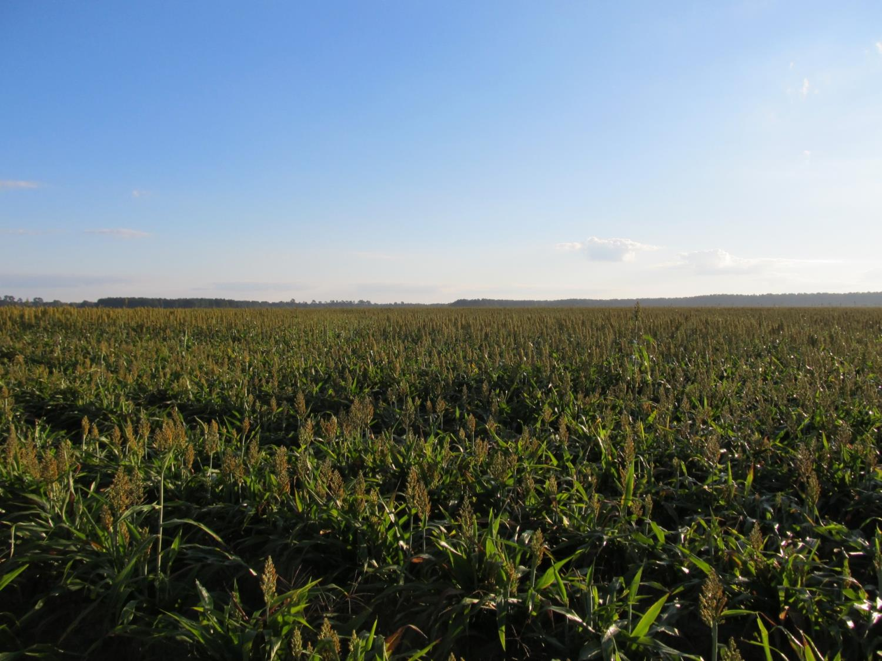
GRAIN SORGHUM WEED CONTROL UPDATE – 2017
Eric P. Prostko, Ph.D.
Professor and Extension Weed Specialist
Dept. Crop & Soil Sciences

Slide 2
GRAIN SORGHUM WEED CONTROL
Start clean!
Concep treated seed
Dual Magnum or Warrant (PRE)
Atrazine (POST) or Huskie + ATZ (POST)
Paraquat (Hooded sprayer)
Mechanical Cultivation

Slide 3
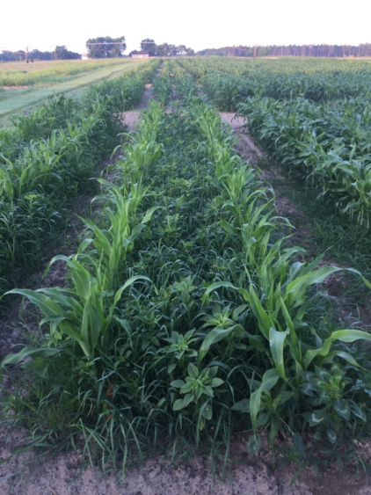
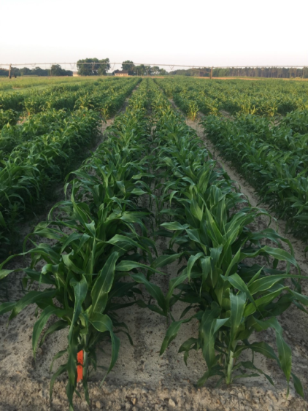
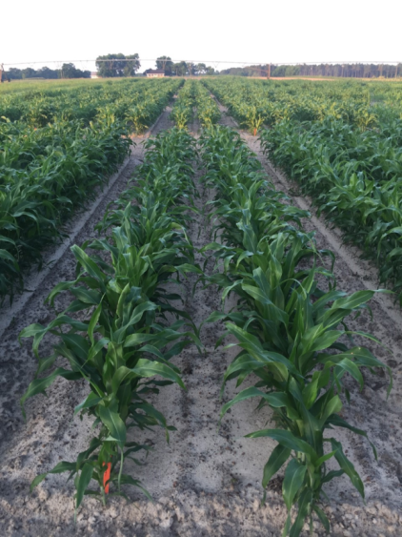
Weed Control in Grain Sorghum – 2016
NTC
Warrant (PRE)
Atrazine + COC (POST)
Dual Magnum (PRE)
Atrazine + COC (POST)
SG-02-16
May 27
51 DAP

Slide 4
Weed Control in Grain Sorghum – 2016
Dual Magnum – 16 oz/A (PRE)
Huskie – 13 oz/A (POST)
Atrazine – 16 oz/A (POST)
AMS (2.5% v/v)
NIS (0.25% v/v)
NTC
SG-02-16
May 27
51 DAP

Slide 5
Huskie Injury on Sorghum

Slide 6
Zest™ 75 WDG/Inzen™ Grain Sorghum
Dupont
Nicosulfuron (Accent)
NON-GMO
ONLY on Dupont Inzen™ traited grain sorghum
ADVANTA (Alta) Seed (???)
Limited performance data for SE
0.67 – 1.33 oz/A (75WDG)
Up to 20” tall sorghum
Tank-mix with atrazine
COC (1% v/v)
28% or 32% UAN (2 qt/A)
Dual, Warrant, or Cinch (PRE)
Concep treated seed
GA Label in November 2016

Slide 7
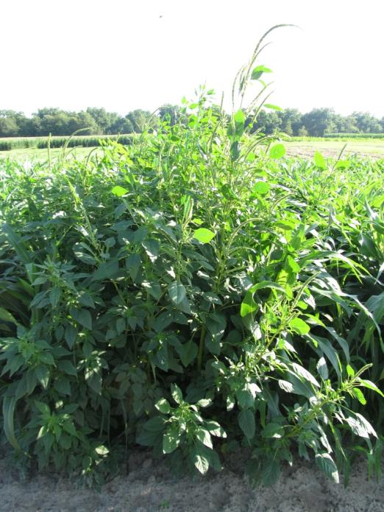
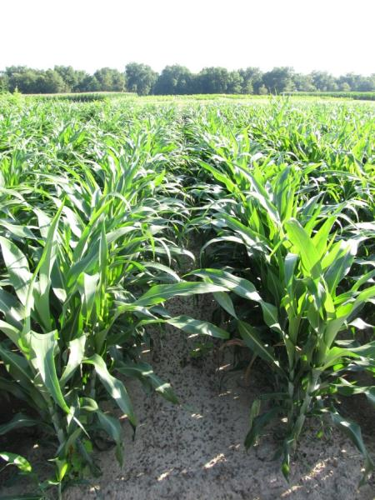
Weed Control in Inzen™ Sorghum - 2014
NTC
Dual II Magnum 7.62EC @ 16 oz/A – PRE
Zest 0.33SC @ 12 oz/A – 31 DAP
Atrazine 90DF @ 13.3 oz/A – 31 DAP
COC @ 1% v/v – 31 DAP
SG-01-14
June 19
41 DAP

Slide 8
Weed Control in Inzen™ Grain Sorghum - 2016
NTC
Cinch 7.64EC @ 16 oz/A – PRE
Zest 0.33SC @ 12 oz/A – 33 DAP
Atrazine 4L @ 32 oz/A – 33 DAP
COC @ 1% v/v – 33 DAP
AMS Xtra @ 2.5% v/v – 33 DAP
SG-01-16
May 18
42 DAP

Slide 9
Zest Injury on Inzen Grain Sorghum
SG-01-16
May 18
9 DAT

Slide 10
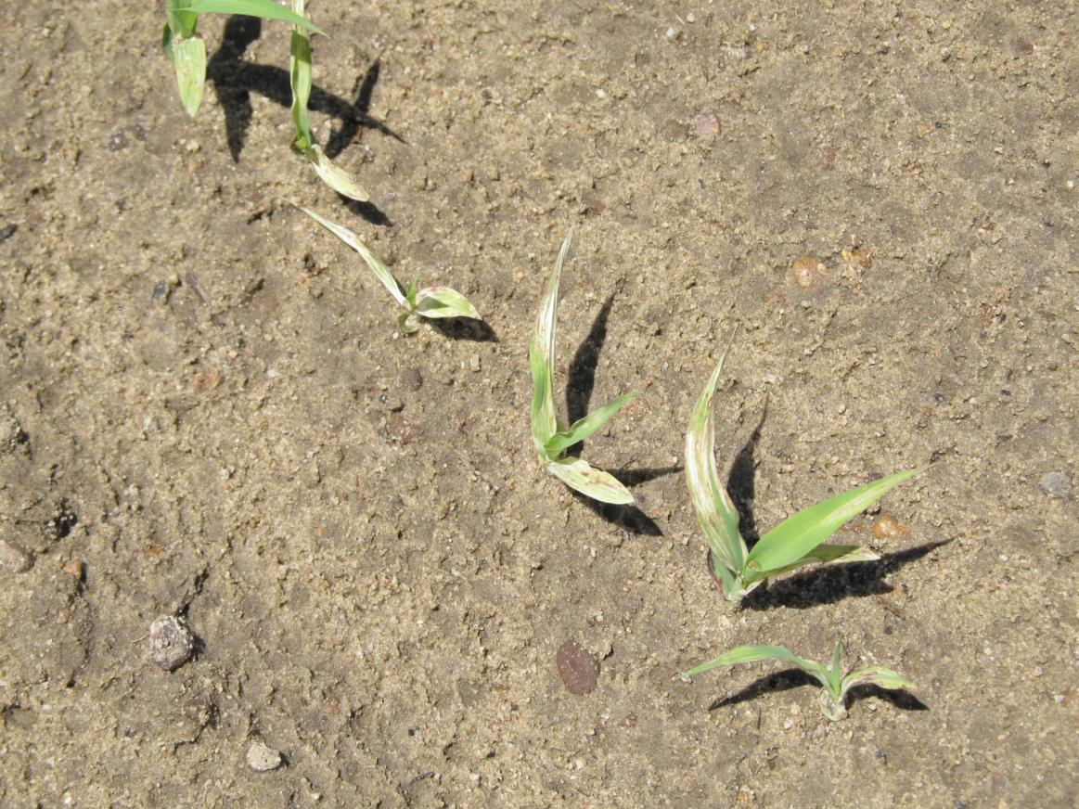
Don’t Plant Sorghum in Fields Treated with Reflex in the same year!!!!

Slide 11
GRAIN SORGHUM – Harvest Aids
Initial moisture was 24.4%
Source: Olson et al. 2001

Slide 12
Sunflower Weed Control
Eric P. Prostko
Extension Weed Specialist

Slide 13
Sunflowers Acres in Georgia
FSA Crop Acreage Reports

Slide 14
What is labeled? (not much)
PPI
Sonalan or Treflan
PPI or PRE
Prowl, Dual Magnum, Spartan ($400/gal = $9.38-12.50/A @ 3-4 ozs/A)
POST
Arrow, Assure II, Select, Poast, SelectMax (grasses only)
Beyond (imazamox)
only on Clearfield hybrids
Beyond same family as Cadre, Pursuit, and Scepter
Beyond costs about $525/gal (4 ozs/A = $16.41/A)
$157/bag (200,000 seed ~ 10 acres) = $15.70/A
Clearfield sunflower hybrids are not GMO’s
Hooded Sprayer
Aim 2EC @ 1-2 oz/A + COC @ 1% v/v
Pigweeds must be 4” or less

Slide 15
Consider Cultivation

Slide 16
Clearfield Sunflower Weed Control Results
Clearfield sunflower hybrids that I have worked with since 2003
include the following:
Mycogen 8N429CL
Mycogen 8N386CL
Mycogen 8H419CL
Dekalb DKF 3880CL

Slide 17
2004 (7 WAP)
NTC
Prowl H₂O @ 2 pt/A +
Spartan @ 4 ozs/A (PRE)

Slide 18
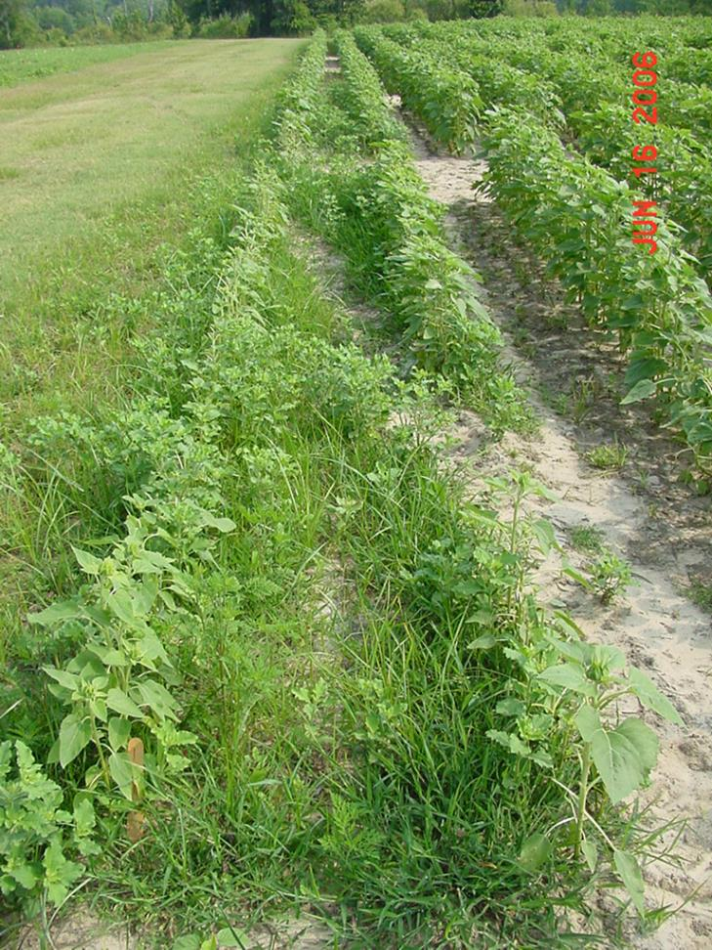
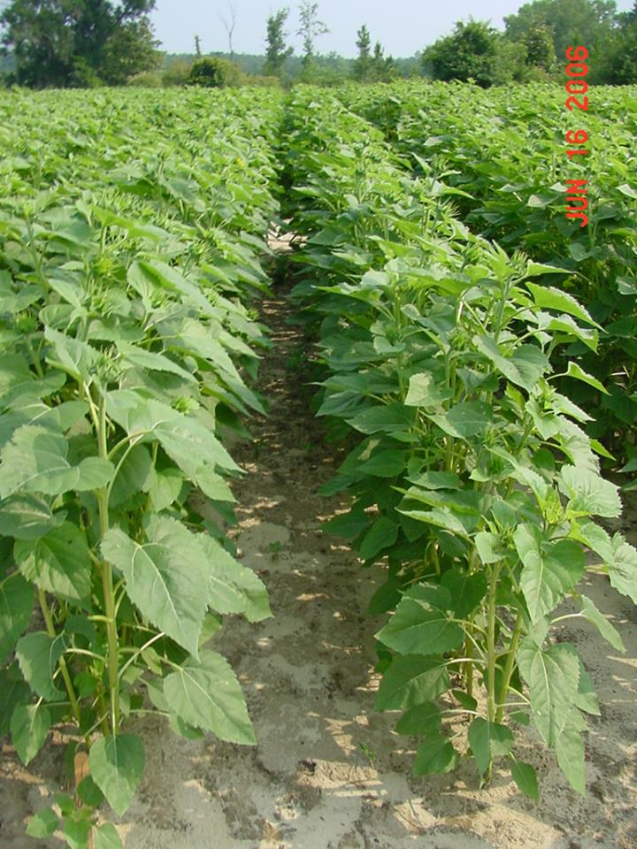
2006 (7 WAP)
Prowl H₂O @ 2.1 pt/A
Spartan 4F @ 4.0 oz/A
PRE
NTC

Slide 19
2004 (7 WAP)
NTC
Prowl H₂O @ 2 pt/A (PRE)
Beyond @ 4 ozs/A + 80/20 + UAN (POST)

Slide 20
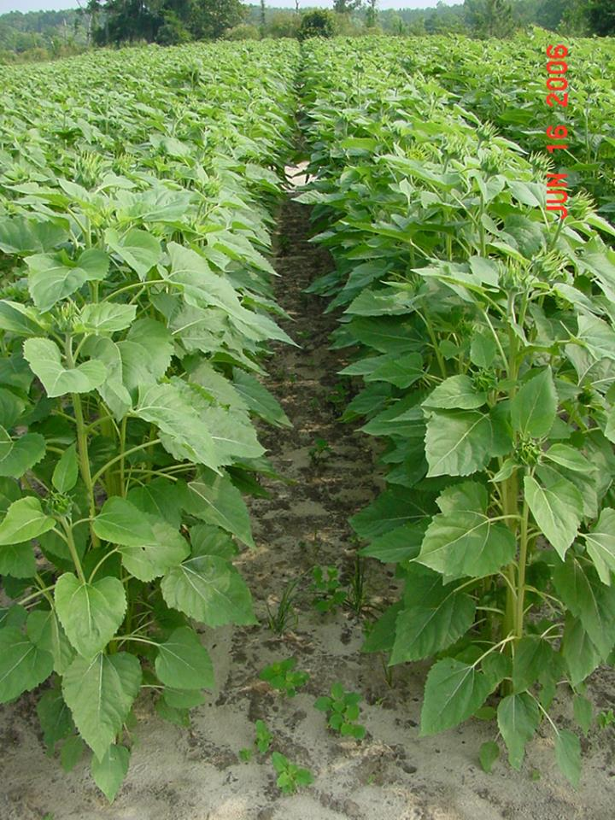
2006 (7 WAP)
Prowl H₂O @ 2.1 pt/A
Spartan 4F @ 4.0 oz/A
PRE
NTC
Prowl H₂O @ 2.1 pt /A (PRE)
Beyond @ 4 ozs/A + 80/20 + UAN (POST)

Slide 21
2004 (7 WAP)
NTC
Dual Magnum @ 1.33 pt/A (PRE)
Beyond @ 4 ozs/A + 80/20 + UAN (POST)

Slide 22
Harvest Aids for Sunflowers
Gramoxone (paraquat)
Roundup (glyphosate)
Sodium chlorate
Sharpen (saflufenacil)

Slide 23
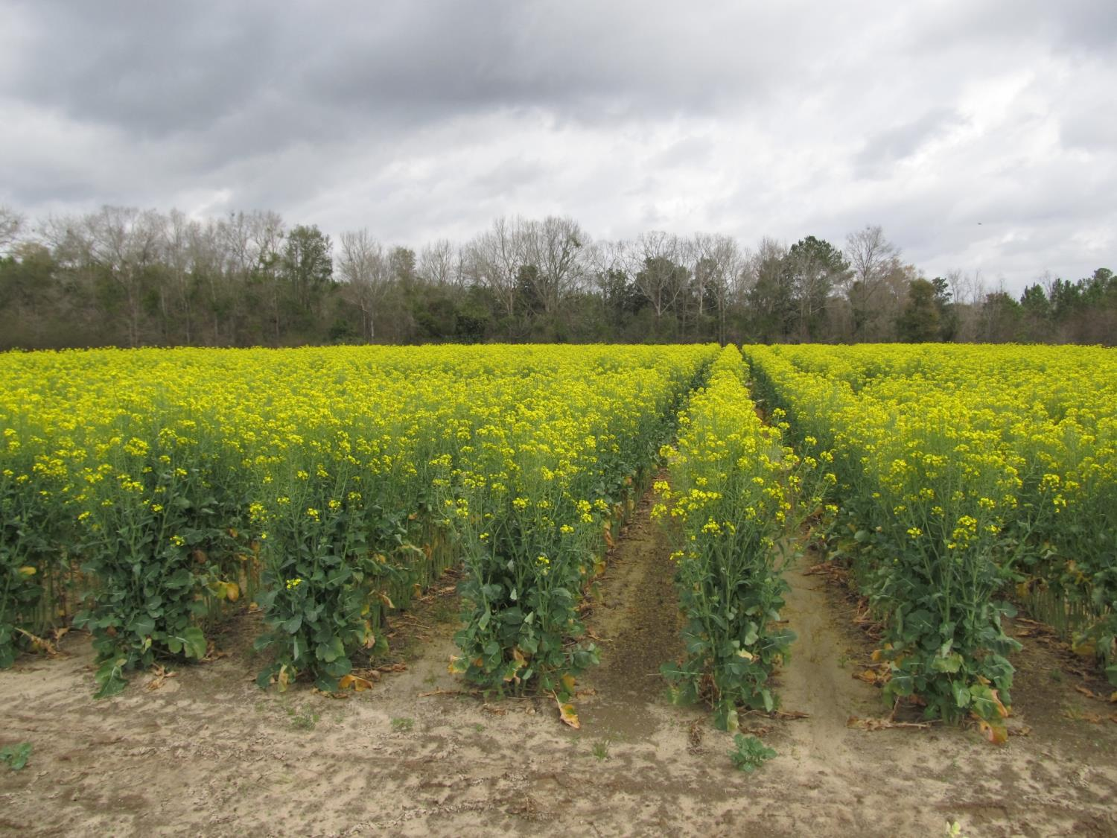
Canola Weed Control

Slide 24
Canola Acres in Georgia
Source: FSA Crop Acreage Reports

Slide 25
Canola Weed Management
consider herbicide residues from previous crop
Optimum Planting Date/Fertility
Use Treflan if you can
Clearfield Canola + Beyond may be best overall legal option
Critical period for weed control in canola is 4 leaf stage (17-38 DAP)

Slide 26
Do not plant canola is fields treated this year with the following herbicides:
Reflex
Prefix
Staple (could plant Clearfield*)
Cadre (could plant Clearfield*)
Steadfast Q (maybe Clearfield*?)
Strongarm (maybe Clearfield*?)
Envive (could plant Clearfield*)
Classic (could plant Clearfield*)
Envoke (could plant Clearfield*)
Diuron (???)
*Some crop stunting may still likely occur.

Slide 27
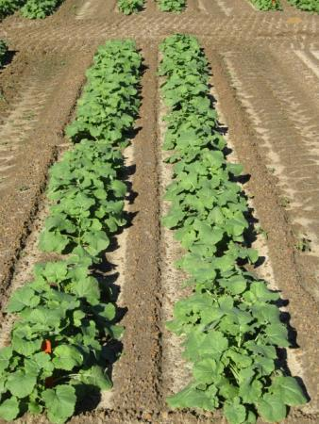
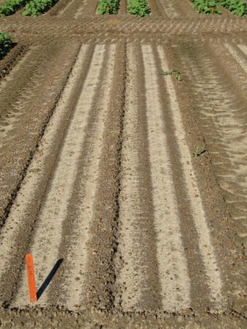
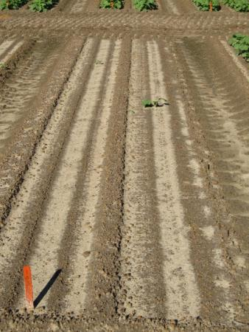
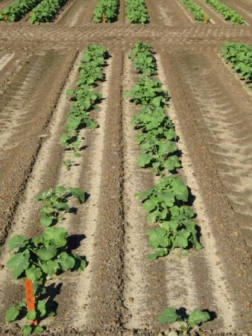
Clearfield Canola (5525CL) Response to Reflex – 2015/2016
NTC
Reflex 2SL @ 8 oz/A
Reflex 2SL @ 4 oz/A
Reflex 2SL @ 2 oz/A
CAN-02-15
11/11/2015
30 DAT

Slide 28
Clearfield Canola (5525CL) Response to Strongarm – 2015/2016
NTC
Strongarm 84WG @ 0.225 oz/A (PRE)
CAN-02-15
11/23/2015
42 DAT

Slide 29
Clearfield Canola (5525CL) Response to Strongarm – 2015/2016
Strongarm 84WG
@ 0.225 oz/A (PRE)
CAN-02-15
11/11/2015
30 DAT

Slide 30
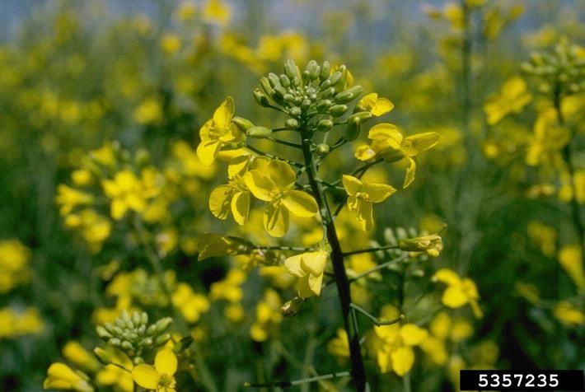
Current UGA Canola Weed Control Research
Howard F. Schwartz, Colorado State University, Bugwood.org

Slide 31
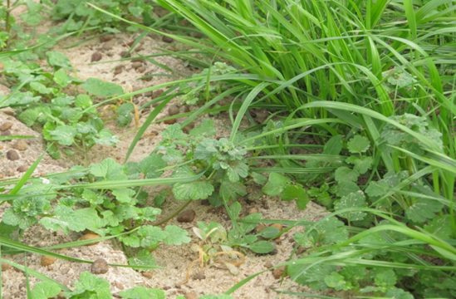
Henbit and Ryegrass Control?
** Command and Dual Magnum are NOT yet labeled for use in canola grown in GA. Research is underway to evaluate crop and weed response.

Slide 32
Canola Weed Control – 2015/2016
NTC
Command 3ME @ 3.5 oz/A - PRE
CAN-01-15
11/11/2015
30 DAT

Slide 33
Canola Weed Control – 2015/2016
NTC
Command 3ME @ 3.5 oz/A - PRE
CAN-01-15
11/23/2015
42 DAT

Slide 34
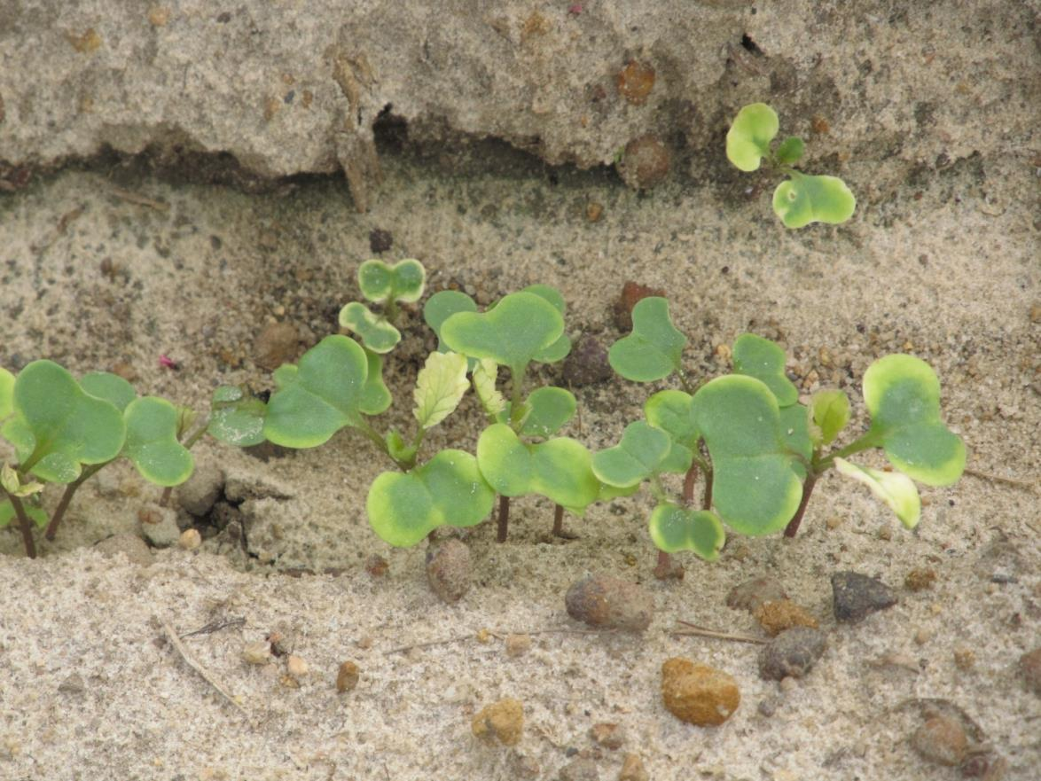
Command 3ME Injury on Canola - 2 WAT

Slide 35
Registration Status for Command
submitted required information to IR-4 Program in July 2013
Command received an A priority at IR4 – September 2015
IR-4 evaluating non US data for US tolerance.

Slide 36
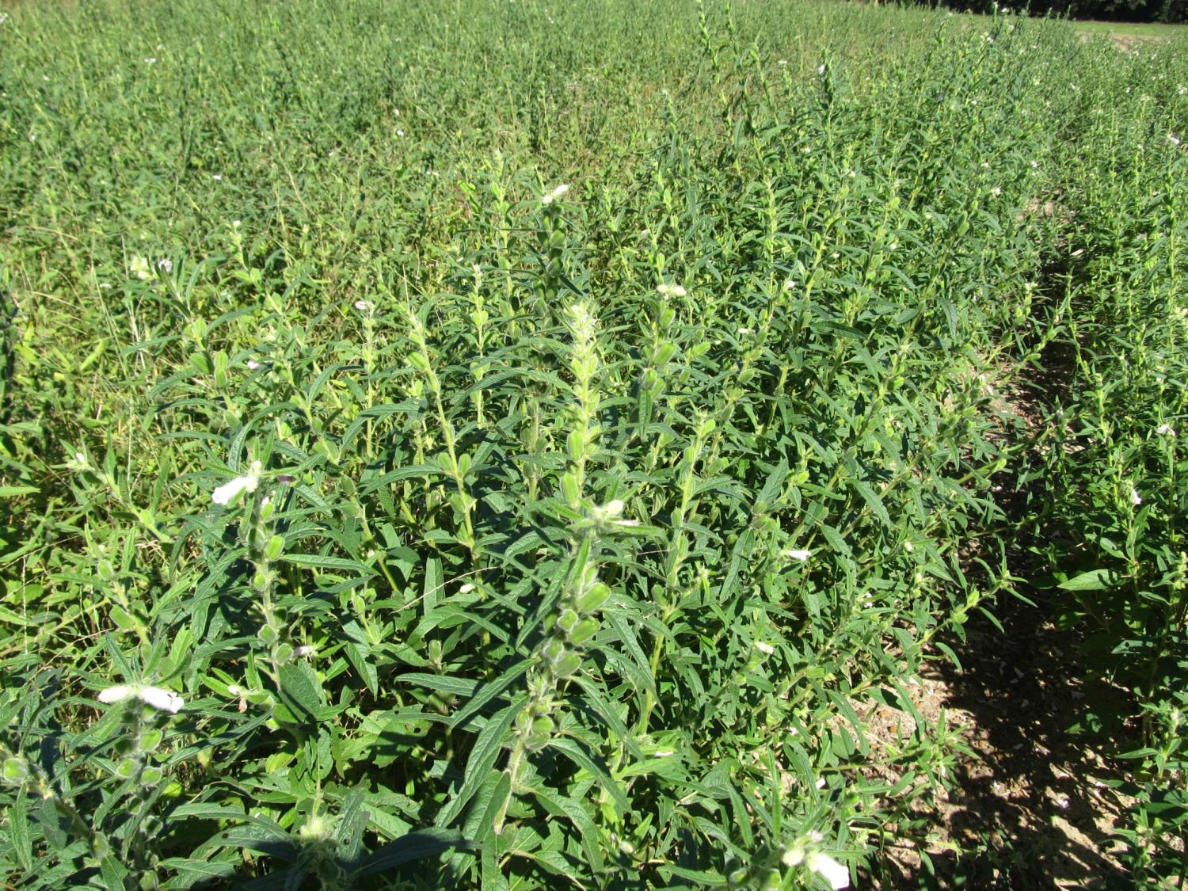
Sesame Weed Control

Slide 37
Sesame Acres in Georgia
Source: FSA Crop Acreage Reports

Slide 38
Sesame Weed Control
The only herbicide registered for use in sesame in GA is Select Max. Select Max can be applied from 9-16 oz/A + NIS @ 0.25% v/v. Select Max should not be applied during flowering.
Dual Magnum is labeled in other states (TX + FL) but not Georgia. Currently, I have conducted only 3 sesame trials in GA. In 1 trial, I observed minimal injury from Dual. In 2 trials, I observed significant sesame stunting/death from Dual (wetter conditions).
More work on sesame is needed but there are not enough acres yet in GA to justify a large-scale effort on my part. For every sesame trial I conduct, that is one less peanut, soybean or corn trial that I can conduct.

Slide 39
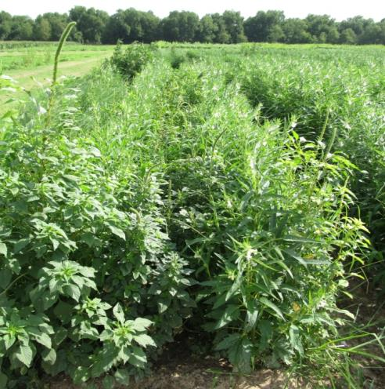
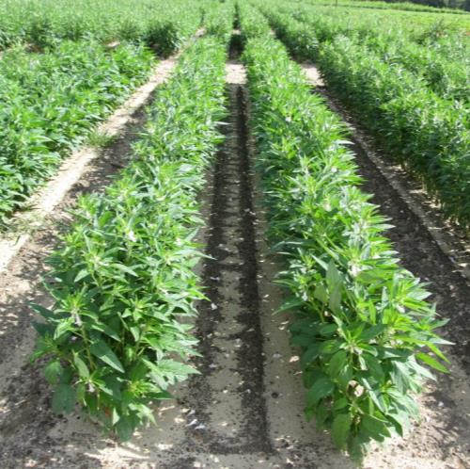
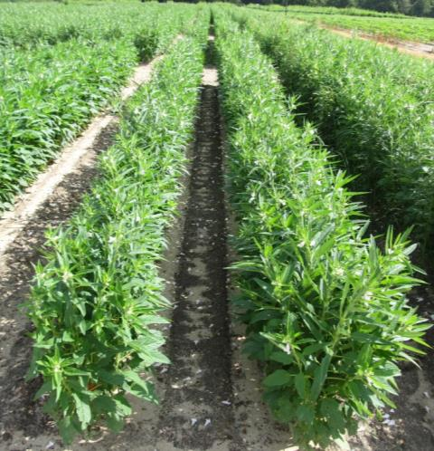
Weed Control in Sesame - 2015
NTC
Dual Magnum 7.62EC @ 16 oz/A – PRE
+
Direx 4L @ 32 oz/A – POST (36 DAP)
NIS @ 0.25% v/v – POST (36 DAP)
Warrant 3ME @ 48 oz/A – PRE
+
Direx 4L @ 32 oz/A – POST (36 DAP)
NIS @ 0.25% v/v – POST (36 DAP)
SM-02-15
June 30
68 DAP

Slide 40
Sesame Demo – August 11, 2015
19 DAT – Planted/Sprayed July 23
7/23- 0.3” I
7/27 – 0.5” I
7/28 – 0.06” R
7/29 – 0.37” R
7/30 – 0.04” R
7/31 – 0.16” R
8/1 – 0.06” R
8/2 – 0.71” R
8/6 – 1.44” R
8/7 – 0.03” R
8/11 – 1.21” R
NTC
Dual
Magnum
16 oz/A
Warrant
48 oz/A
Direx
32 oz/A

Slide 41
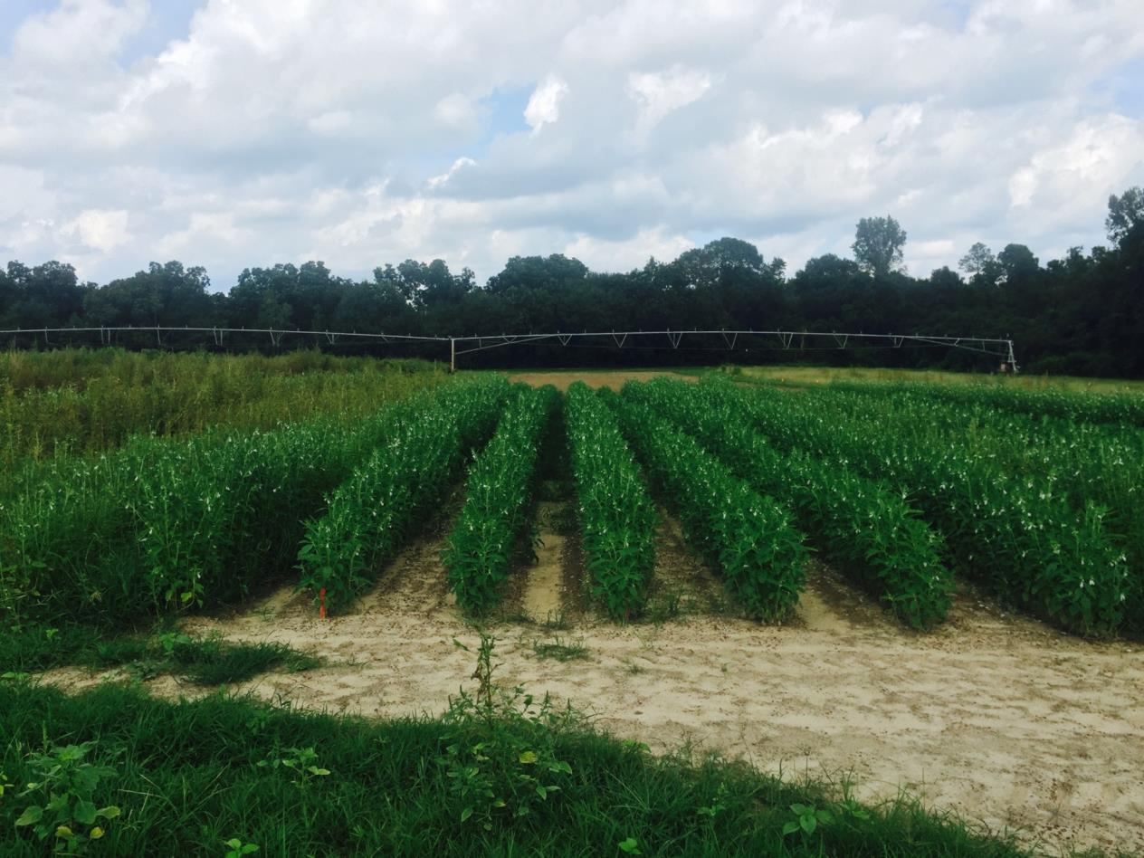
Sesame Demo – September 9, 2015
48 DAT – Planted/Sprayed July 23
7/23- 0.3” I
7/27 – 0.5” I
7/28 – 0.06” R
7/29 – 0.37” R
7/30 – 0.04” R
7/31 – 0.16” R
8/1 – 0.06” R
8/2 – 0.71” R
8/6 – 1.44” R
8/7 – 0.03” R
8/11 – 1.21” R
NTC
Dual
Magnum
16 oz/A
Warrant
48 oz/A
Direx
32 oz/A

Slide 42
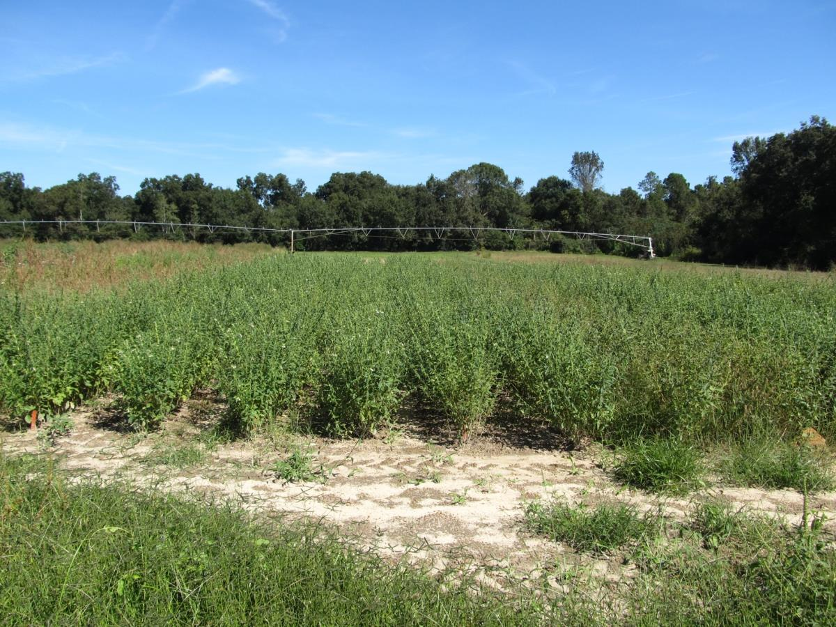
Sesame Demo – October 8, 2015
77 DAT – Planted/Sprayed July 23
7/23- 0.3” I
7/27 – 0.5” I
7/28 – 0.06” R
7/29 – 0.37” R
7/30 – 0.04” R
7/31 – 0.16” R
8/1 – 0.06” R
8/2 – 0.71” R
8/6 – 1.44” R
8/7 – 0.03” R
Dual
Warrant
Direx
NTC
Dual
Magnum
16 oz/A
Warrant
48 oz/A
Direx
32 oz/A

Slide 43
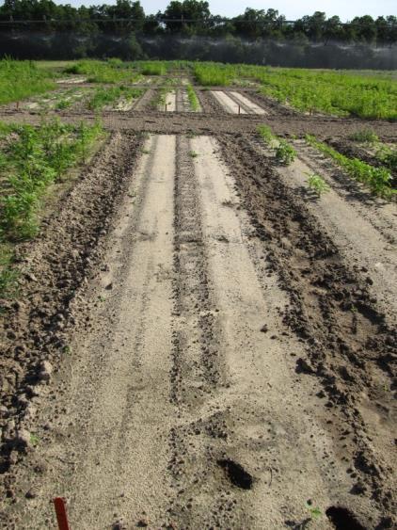
Sesame – 2016 Dual Magnum 7.64EC - PRE
11 oz/A
21 oz/A
43 oz/A
SESAME-01-16
June 24, 2016
43 DAT

Slide 44
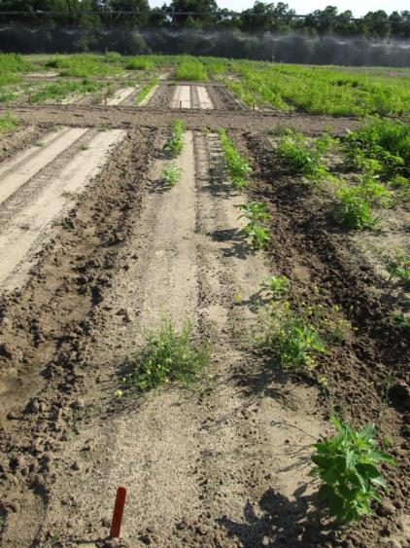
Sesame – 2016 Dual Magnum 7.64EC - 3 DAE
11 oz/A
21 oz/A
43 oz/A
SESAME-01-16
June 24, 2016
38 DAT

Slide 45
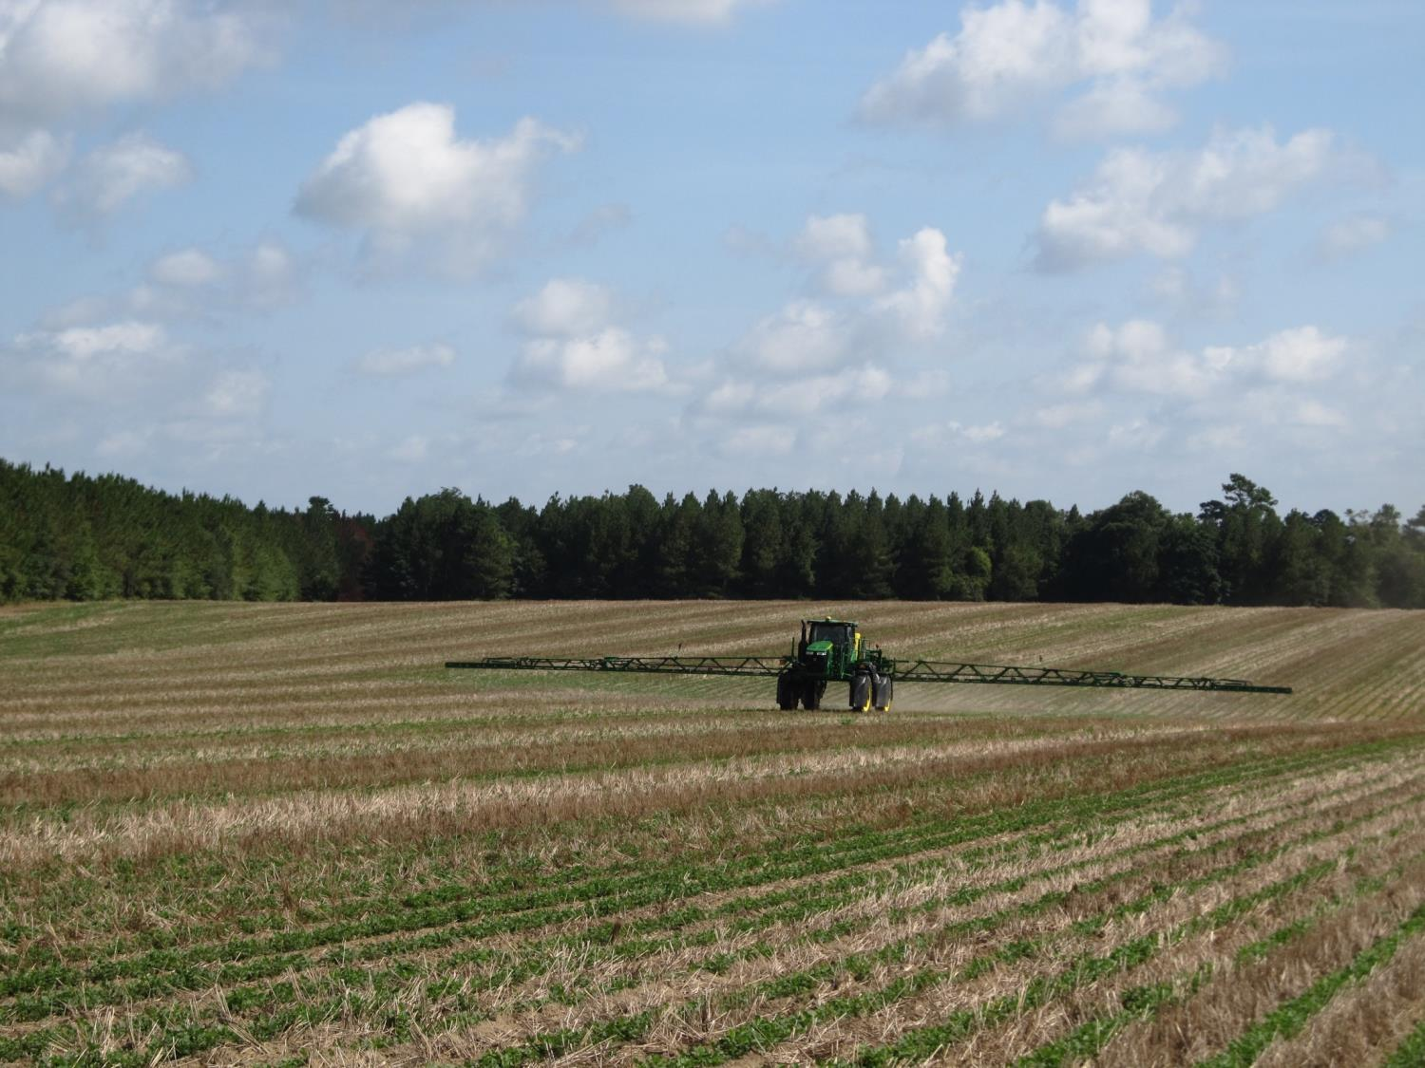
QUESTIONS?
eprostko@uga.edu
www.gaweed.com

