Slide 1
Tractor Speed and Boom Height Effects on Spray Coverage
Eric P. Prostko¹, Glen C. Rains², Justin Lanier³, Maryssa Davis²
¹Dept. Crop & Soil Sciences, ²Dept. of Entomology
³Former Crisp County Extension Agent

Slide 2
On-Farm vs. UGA Research?
Concerns
Tractor Speed
Boom Height
Coverage
Quality vs. Quantity?

Slide 3
2016 Peanut Weed Control Research
PE-08B-16
June 22, 2016
56 DAP

Slide 4
2016 Peanut Weed Control Research
PE-08B-16
August 9, 2016
104 DAP

Slide 5
A Growers Peanut Field in 2016 Who Spent $138/A on Herbicides
+ 0.3 oz/A Strongarm +
24 oz/A 2,4-DB
$55/A for hand-weeding (2X)
5250 lb/A
August 24, 2016

Slide 6
Is this a bad combination????
6 ft

Slide 7
Herbicide Efficacy
Coverage
Nozzle Type
GPA
Pressure
Boom Height
Tractor Speed
Time of Day

Slide 8
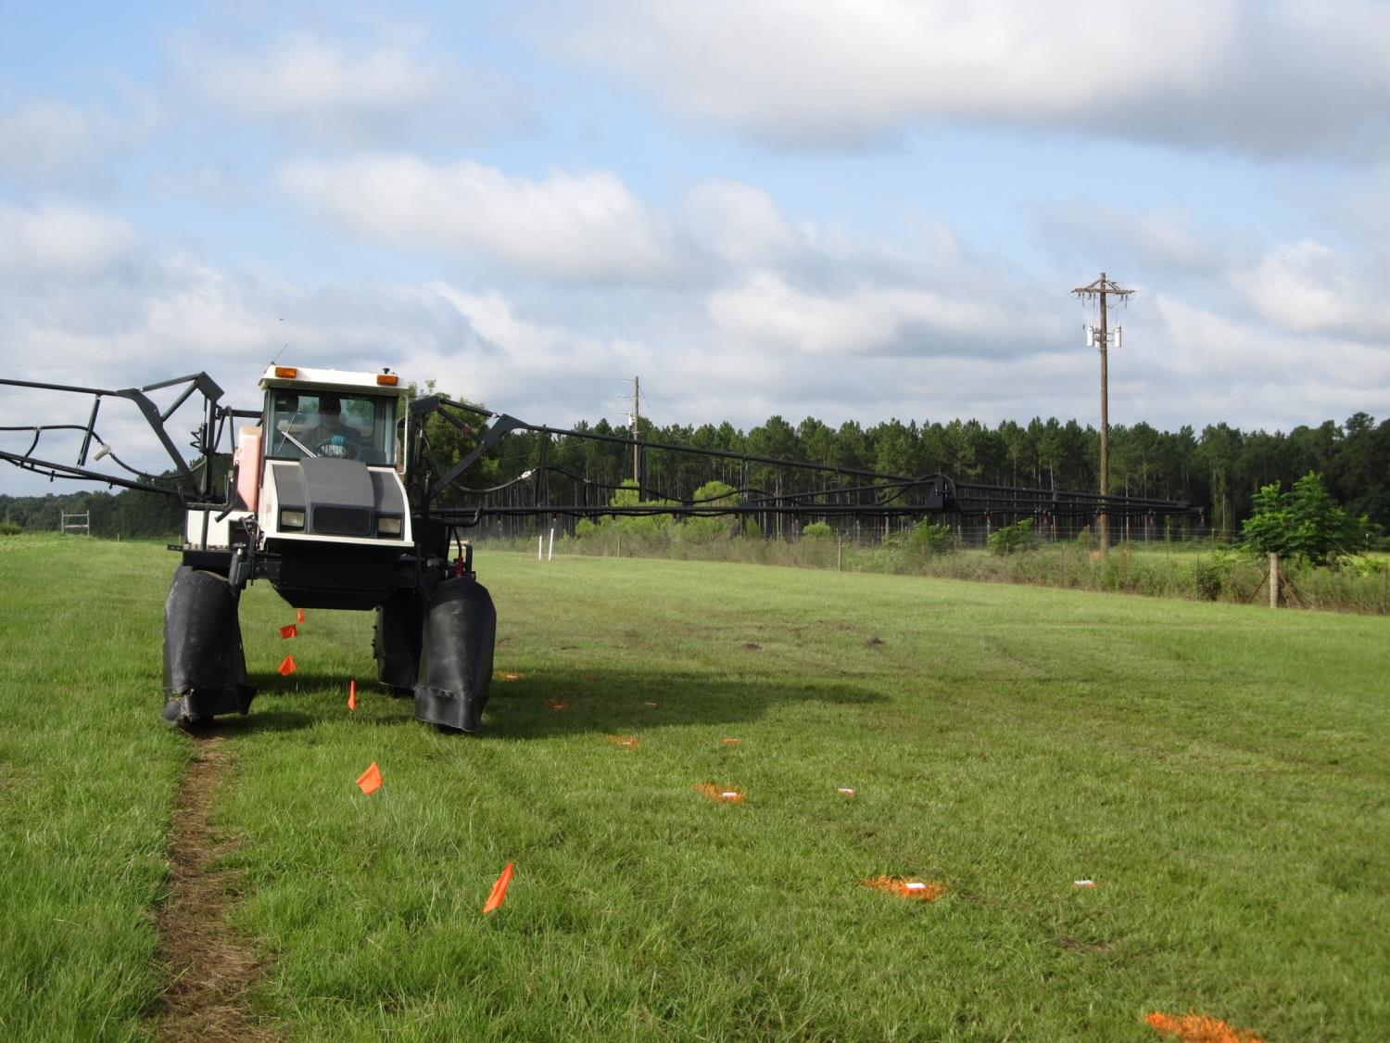
2015 Speed/Boom Height Test – UGA Ponder Farm
8’
10’
30”

Slide 9
Figure 1. Tractor Speed Effects on Spray Coverage (%) – 30” Boom Height – 15 GPA (2015)
8003DG (40 PSI)
8004DG (53 PSI)
N = 30

Slide 10
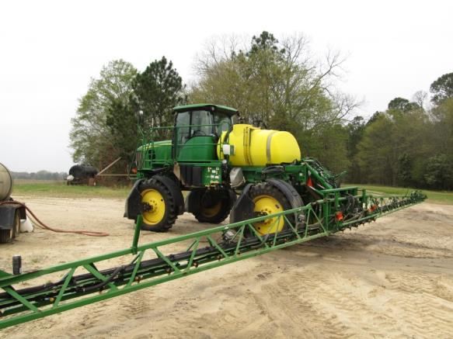
Objective
Evaluate the effects of tractor speed and boom height on spray quality
commercial sprayer
Coverage
VMD₅₀

Slide 11
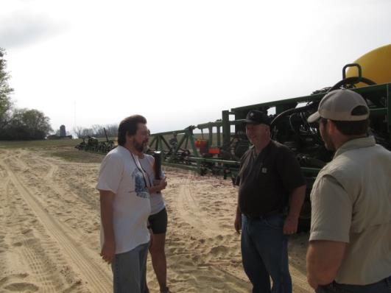
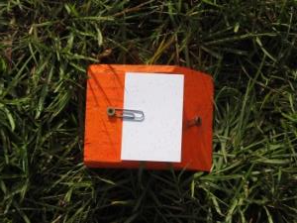
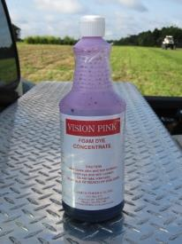
Materials and Methods
March 16, 2016
Crisp County
Steve and Stewart Whelchel
JD 4630
80’ boom
20” nozzle spacing
Tractor Speeds
8.5 and 13.0 MPH
Boom Heights
40 and 60 in
15 GPA (water + dye)
AI11004VS + AI11006VS spray tips
45 PSI
30 Kromekote cards (2” X 3”)
7” X 10’ apart
Dropletscan (WRK of Arkansas, LLC)

Slide 12
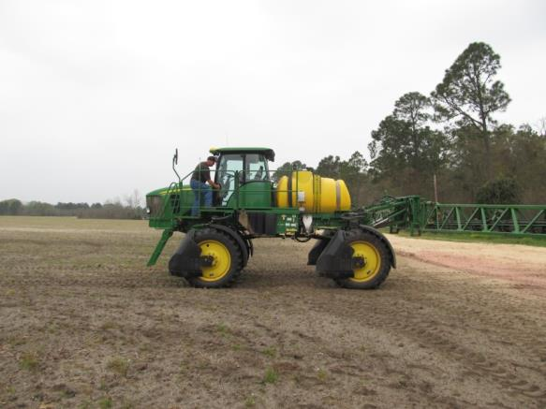
2016 Nozzle Test
JD 4630
80’ Spray Boom
20” nozzle spacing

Slide 13
2016 Speed/Boom Height/Nozzle Test

Slide 14
2016 Nozzle Test

Slide 15
Figure 2. The Influence of Tractor Speed and Boom Height on Spray Coverage (%) (15 GPA, 45 PSI, AI11004 and AI11006 nozzles)
P = 0.4566
P = 0.9208
*averaged over 2 boom heights (40” and 60”)
** averaged over 2 tractor speeds (8.5 and 13.0 MPH)

Slide 16
Figure 3. The Influence of Tractor Speed and Boom Height on Droplet Size (VMD₅₀) (15 GPA, 45 PSI, AI11004 and AI11006 nozzles)
LSD 0.10 = 3
P = 0.3107
*averaged over 2 boom heights (40” and 60“)
** averaged over 2 tractor speeds (8.5 and 13.0 MPH)

Slide 17
TurboDrop® Asymmetrical Dual Fan (Greenleaf Technologies)

Slide 18
Table 1. The Influence of Nozzle System on Spray Coverage and VMD₅₀ – 2016.
Nozzle Type | Pressure (PSI) | Speed (MPH) | Boom Height (in) | GPA | Coverage (%) | VMD₅₀ (microns)
AI11004VS | 45 | 8.5 | 40 | 15 | 9.85 | 418
AI11006VS | 45 | 13.0 | 40 | 15 | 10.20 | 446
TADF05-D | 38 | 10.0 | 40 | 15 | 9.76 | 450
LSD (0.10) |  |  |  |  | NS (P = 0.4142) | 6
CV |  |  |  |  | 3.84 | 0.79

Slide 19
Summary - 2016
No interaction between speed and boom height
No effect of speed or boom height on coverage (P > 0.45)
VMD₅₀ increased with speed but was not affected by boom height
2015 results different than 2016 results
sprayer, nozzles, methodology

Slide 20
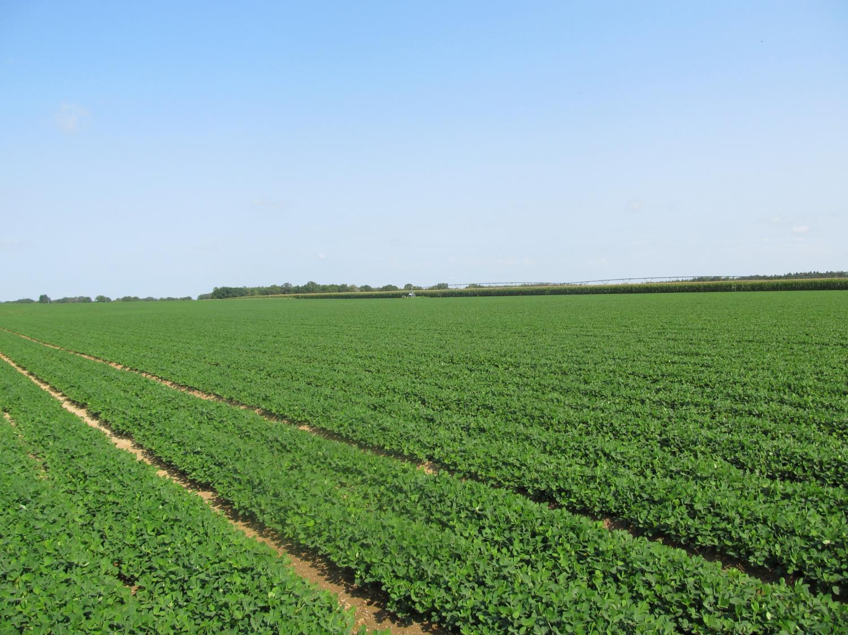
Questions?
eprostko@uga.edu
www.gaweed.com

