Slide 1

2016 Soybean Weed Control Update
Eric P. Prostko
Professor and Extension Weed Specialist
Dept. Crop & Soil Sciences

Slide 2
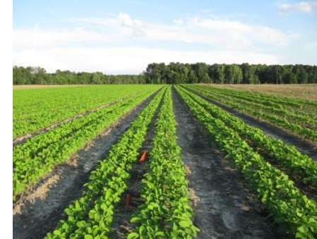
Narrow Rows and Weed Control - Soybeans
“A review of row spacing experiments in which an initial weed management practice had been accomplished revealed that in 64% of the cases (72 of 113 site-years), less late-season weed density and/or biomass, or greater late-season weed control, was achieved in narrow- compared to wide-row soybean production systems.”
Bradley, K. W. 2006. A review of the effects of row spacing on weed management in corn and soybean. Online. Crop Management doi:10.1094/CM-2006-0227-02-RV.

Slide 3
U.S Soybean Row Spacing - 2015
Source: NASS – Crop Production (November 2015)

Slide 4
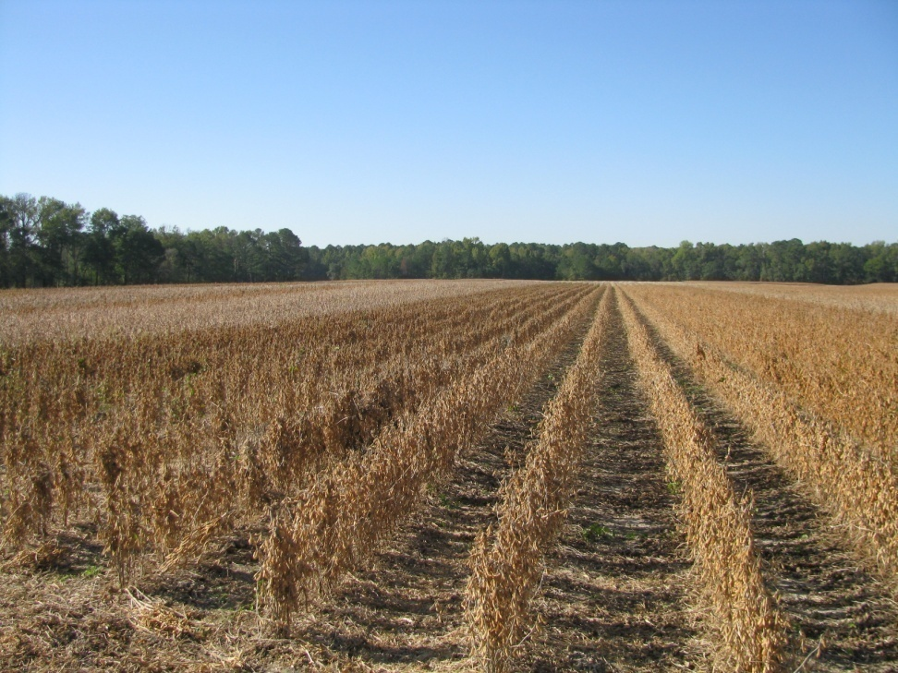
Row Spacing Effects on Soybean Yield In Georgia
Carter and Boerma, 1979 (Athens, GA)
  38” to 19” = 11% yield increase
Parker et al., 1981 (Tifton, GA)
  36” to 18” = 4% increase
Boerma and Ashley, 1982 (Plains, GA)
  36” to 20” = 17% yield increase
Ethredge et al., 1989 (Plains, GA)
  30” to 20” = 8% yield increase
  30” to 10” = 11% yield increase
  20” to 10” = 3% yield increase
Woodruff, 2007-2008 (Camilla, GA)
  36” to 24” = 8% yield increase
Washington County, GA (2008)

Slide 5

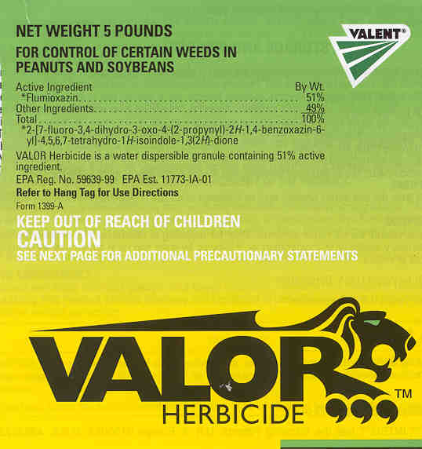
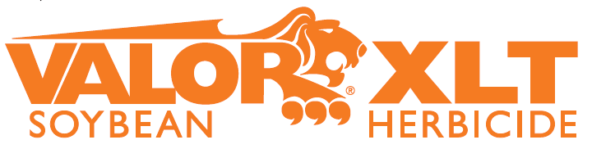
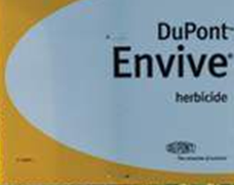

Just thinking???
Fierce or Valor or Envive or Valor XLT (PRE) followed by Reflex (POST) = great pigweed control but not great …….
  Resistance Management
    PPO followed by PPO
    Not great in cotton and peanut rotations relying on Valor and Reflex
    Might be OK in corn/soybean rotation when no PPO is used in corn

Slide 6

This Should Scare You!!!!!!

Slide 7
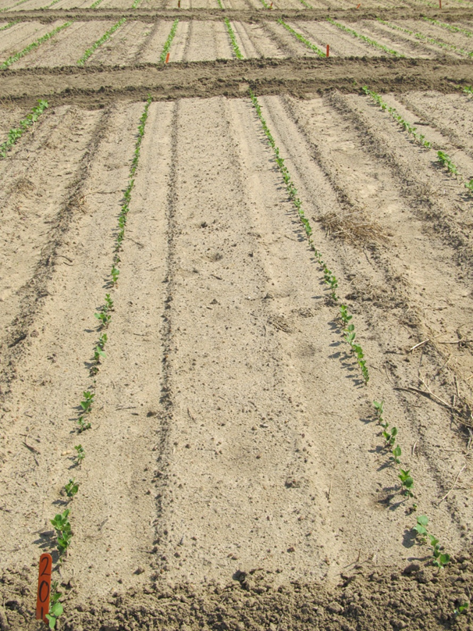
STS/SR Soybeans
(sulfonylurea tolerant, sulfonylurea ready)
May want to consider these if using Envive or Canopy
Help minimize PRE injury from Classic in adverse conditions (i.e. cool, wet)
Bolt Technology™
  DuPont

Slide 8


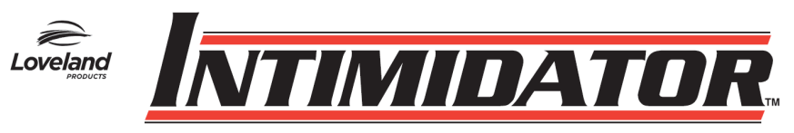
Don’t forget about metribuzin on soybean?
Not a PPO (Valor or Reflex)
Good on pigweed and sicklepod
Can be applied PPI
  Dryland fields?
Issues (Be careful!!)
  soil texture, OM, pH
  Varieties
  Rotations
  Company support
  Lack of incentive at dealer level
TriCor 75DF
Metribuzin 75DF

Slide 9
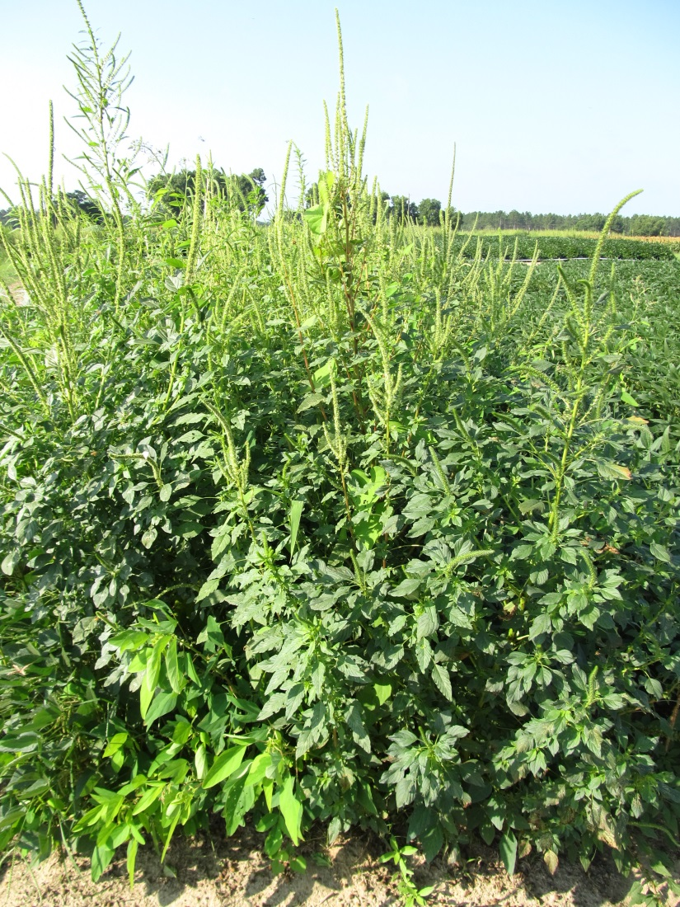
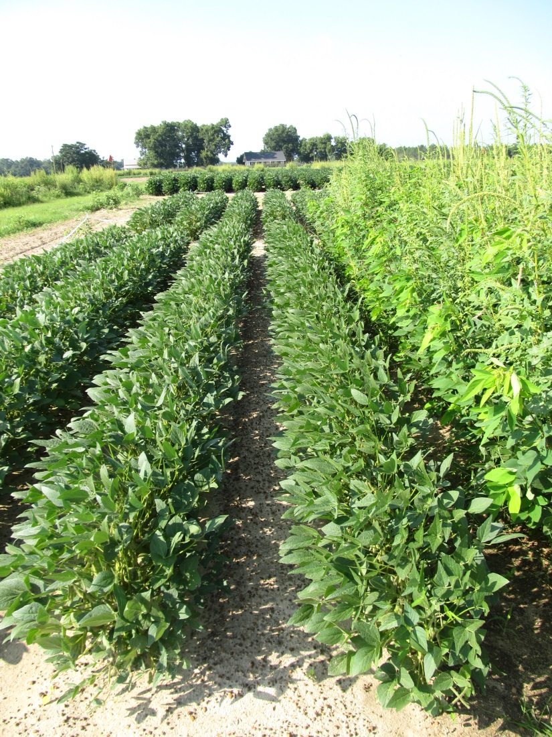
Metribuzin Based Soybean Weed Control Program - 2014
NTC
Boundary – PRE
Flexstar GT - POST
SB-14-14
July 24
66 DAP

Slide 10
For Growers in Peanut/Cotton Rotations Who Want to Protect Valor and Reflex
RR Soybeans
  Warrant or Dual Magnum or Zidua or Anthem fb Glyphosate + Reflex (Flexstar GT) or Glyphosate + Prefix/Statement or Warrant Ultra
  Tricor or Boundary or Canopy or Authority MTZ (metribuzin herbicides) fb Glyphosate + Reflex (Flexstar GT) or Glyphosate + Prefix/Statement or Warrant Ultra
LL Soybeans
  Warrant or Dual Magnum or Zidua or Anthem fb Liberty + Reflex or Prefix/Statement or Warrant Ultra
  Reflex or Valor or Prefix fb Liberty + Warrant or Dual Magnum or Zidua or Anthem
  No metribuzin on LL varieties
Herbicide
Resistance?

Slide 11



When/Where?

Slide 12
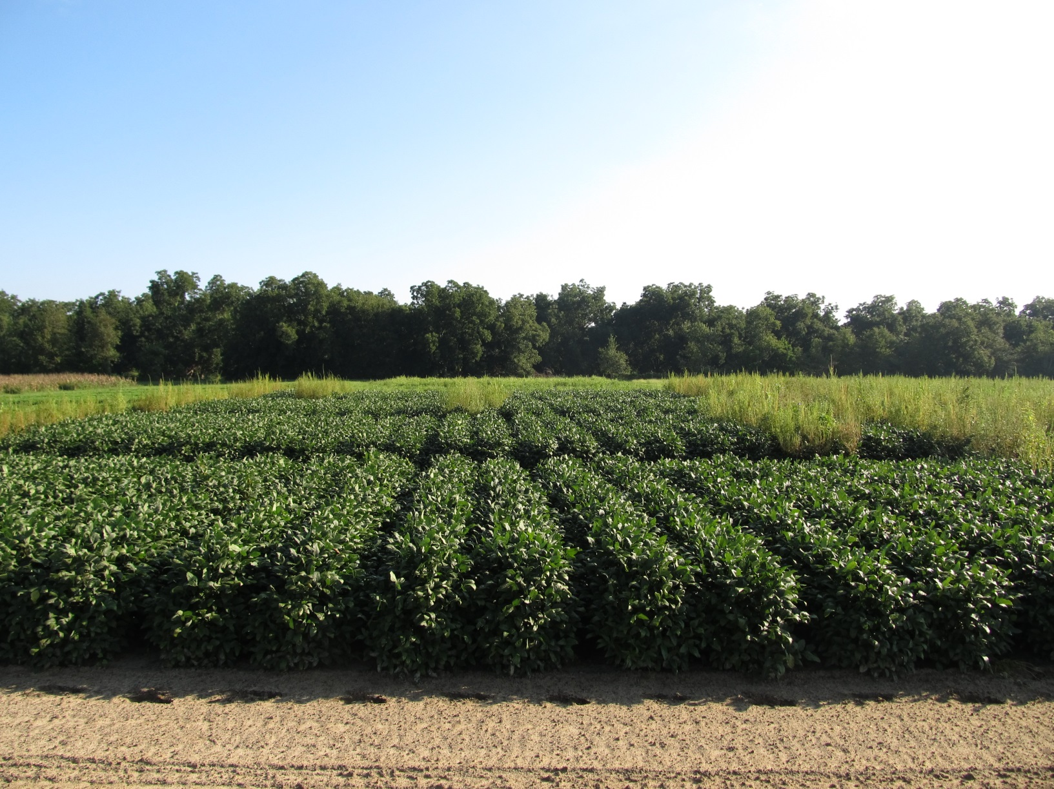
Soybean Weed Control
August 13, 2015 (99 DAP)
Started clean
Dual Magnum (PRE)
0.5” irrigation (1 DAT)
Roundup WM + Reflex or Prefix + Classic or FirstRate (23 DAP)
NTC
NTC
NTC
SB-01-15

Slide 13
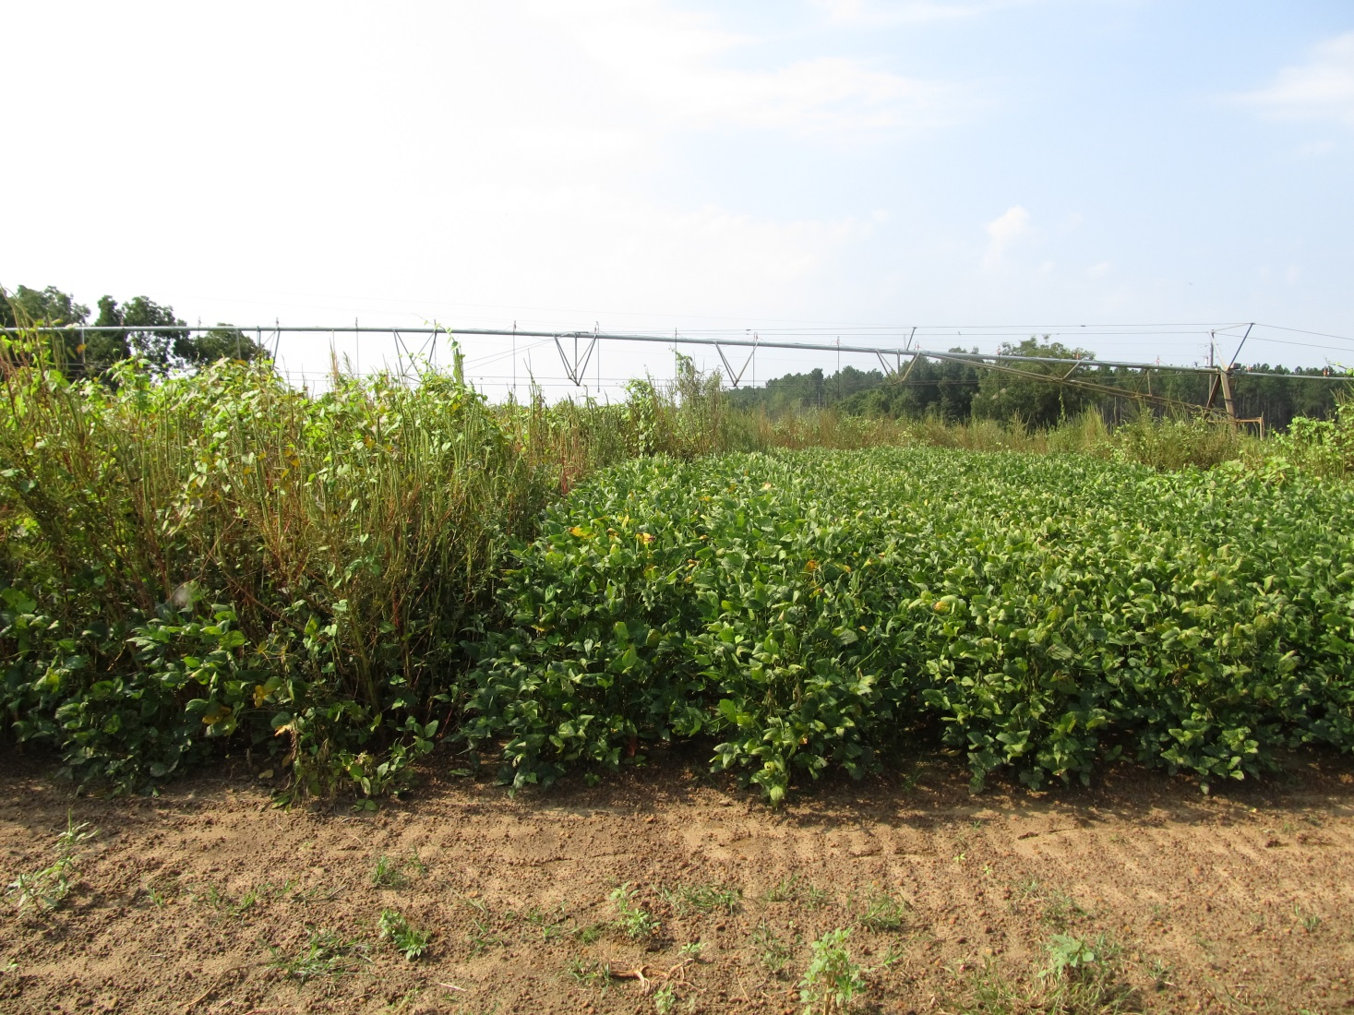
No PPO Pre Weed Control in Soybean
NTC
Dual Magnum 7.62EC @ 16 oz/A – PRE
Roundup WM 5.5SL @ 32 oz/A – 24 DAP
Reflex 2SL @ 24 oz/A – 24 DAP
SB-13-15
August 25
111 DAP

Slide 14



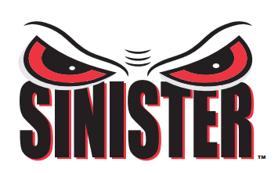
Fomesafen Formulations for Soybeans
(2.87 lb ai/gal)

Slide 15
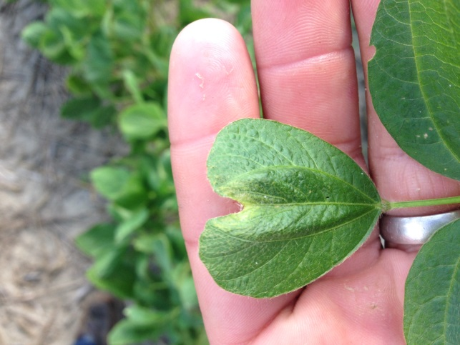
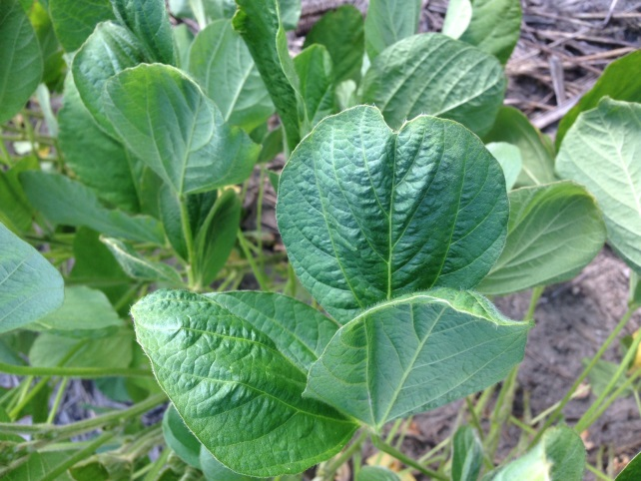
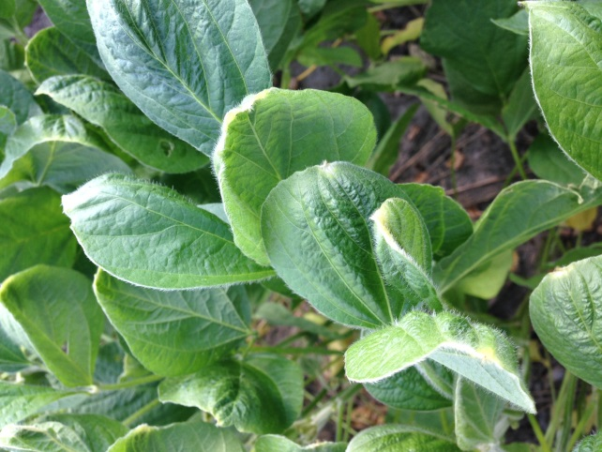
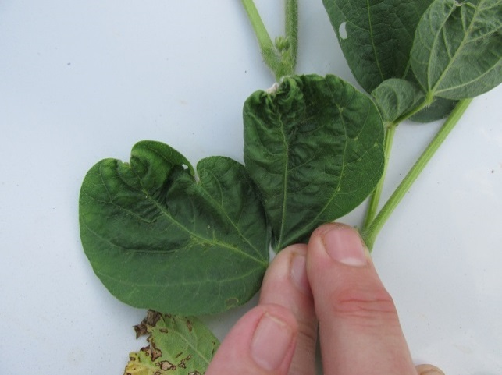
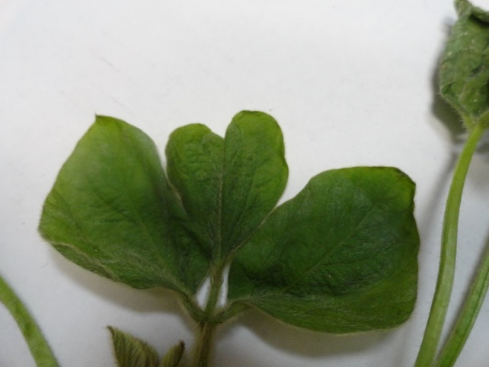
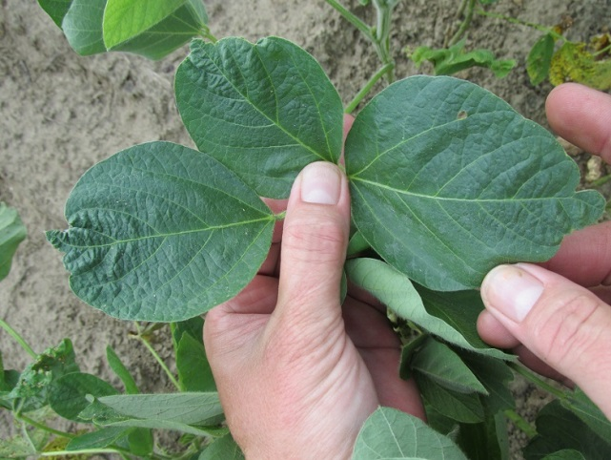
Warrant Injury on Soybean??

Slide 16
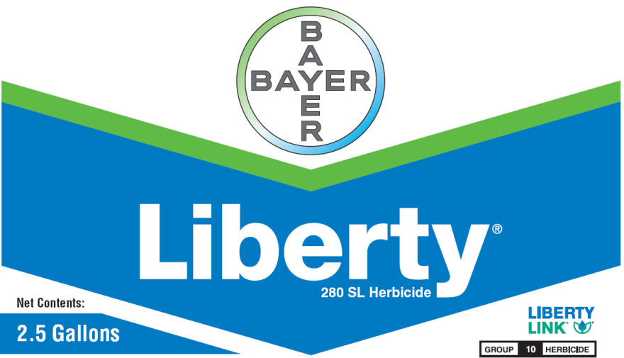
Liberty-Link® Soybeans
Liberty 2.34SL @ 22-36 oz/A
VE-R1
2 applications (65 oz/A/year total)
Tank-mixes with POST grass herbicides may reduce grass control
  Assure (10-21%); Fusilade (8-12%); Poast (25-41%); Select (4-22%)
Residuals still needed
Variety performance?
  Getting better
**Best Results
  15 GPA, medium droplet size, small weeds, 9 am - 6 pm

Slide 17

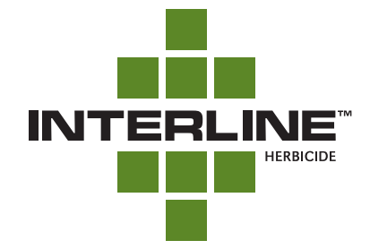
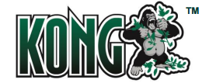
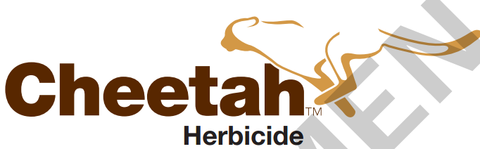

Glufosinate Formulations

Slide 18
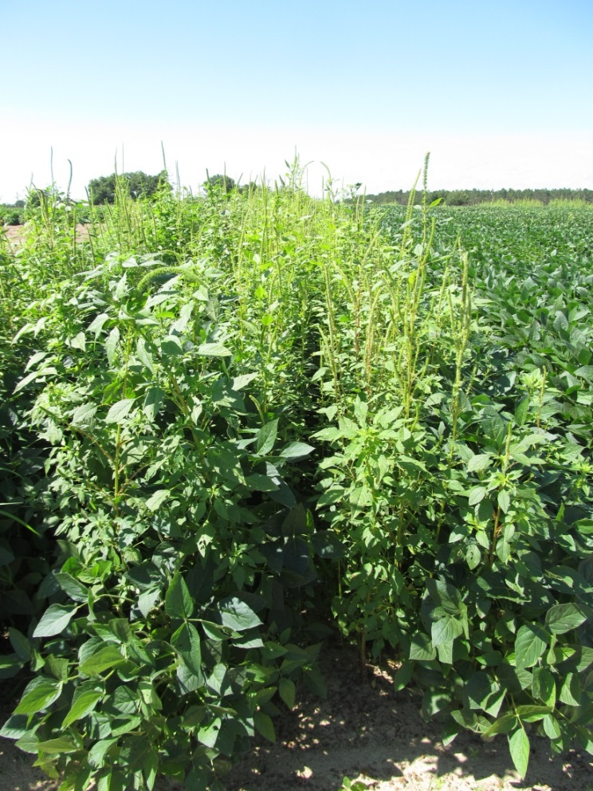
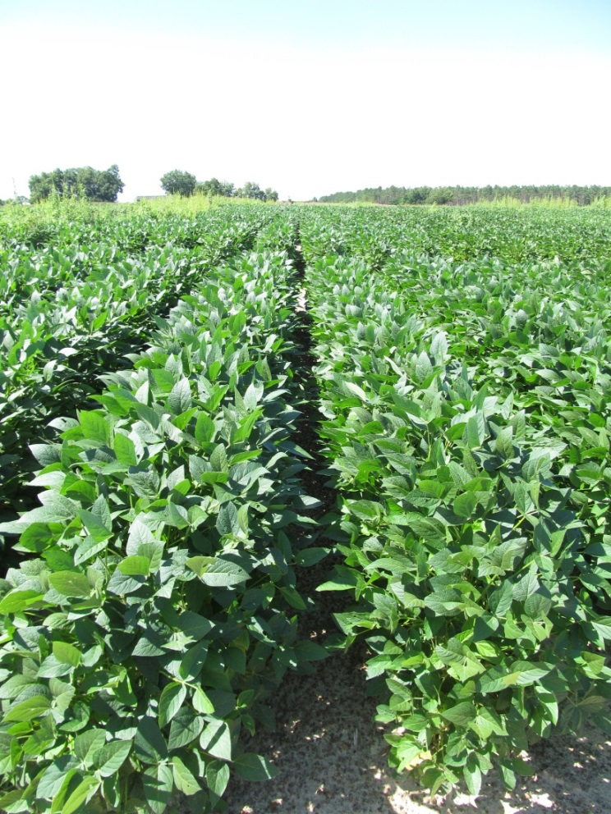
Weed Control in LL Soybeans
NTC
Dual Magnum @ 16 oz/A (PRE)
Liberty @ 29 oz/A (MPOST)
Reflex @ 16 oz/A (MPOST)
SB-23-13
July 17
64 DAP

Slide 19
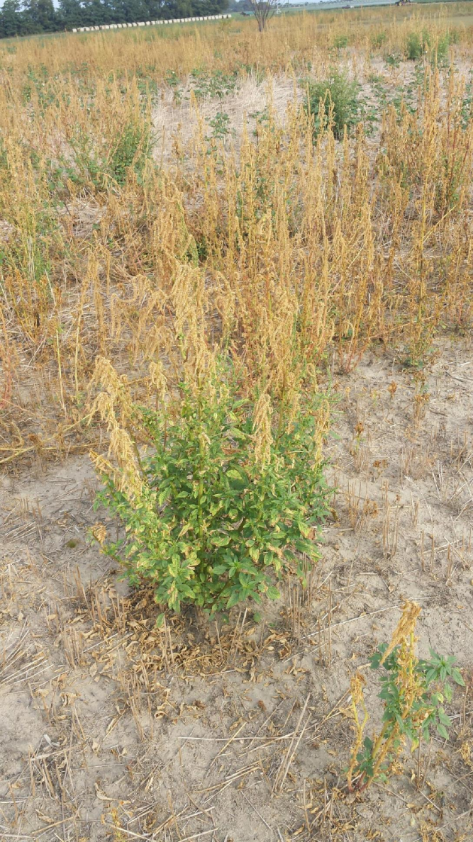
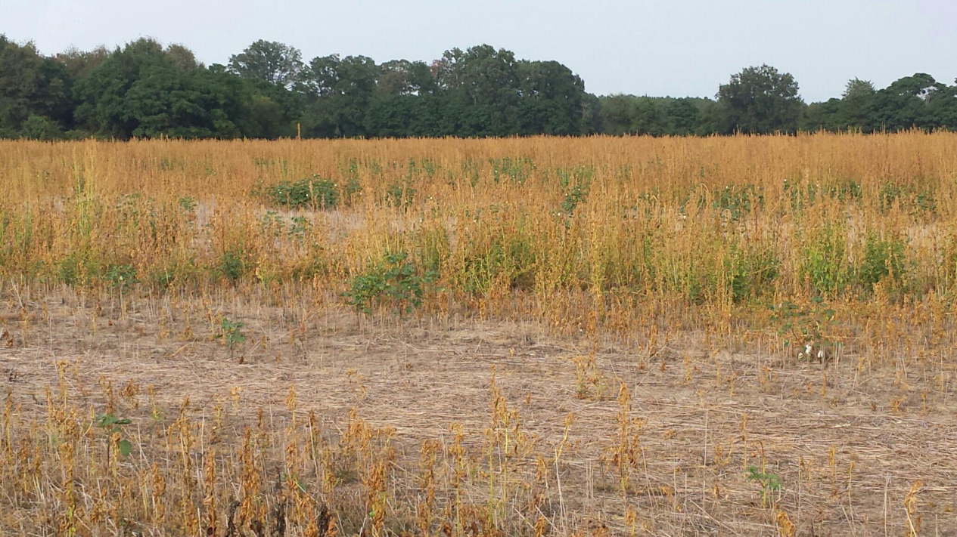
This Must Be Stopped!!!
Liberty on Large Pigweed!!!!!

Slide 20



On the Next Horizon
HPPD resistant soybeans
Bayer/MS Technologies
  “Balance” beans
    Glyphosate + isoxaflutole
      2015?????
Syngenta + Bayer
  “MGI” beans
    Mesotrione (Callisto)
    Glufosinate (Liberty)
    Isoxaflutole (Balance)
    2015-2020????

Slide 21
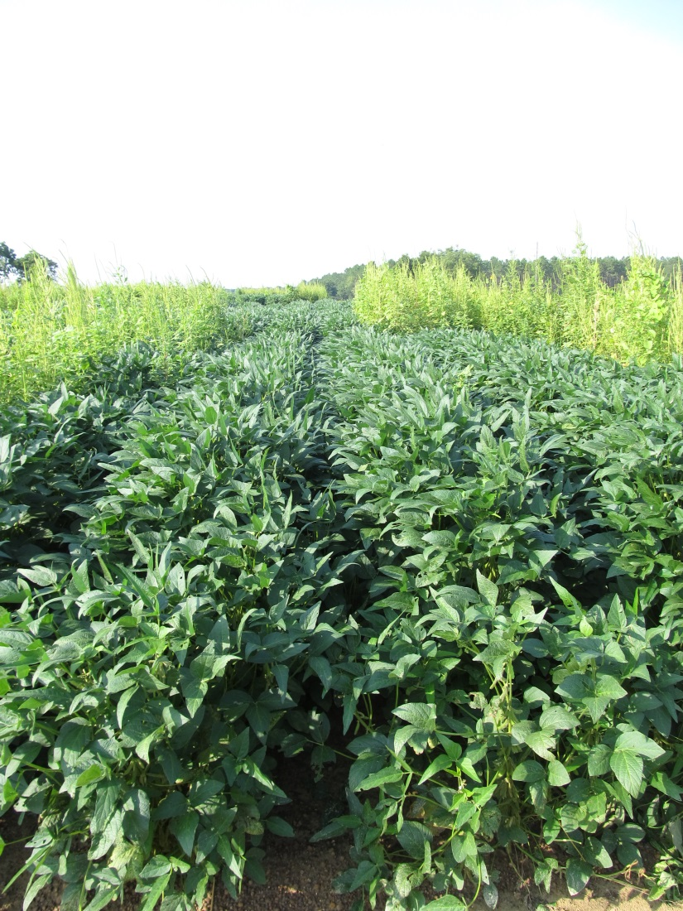
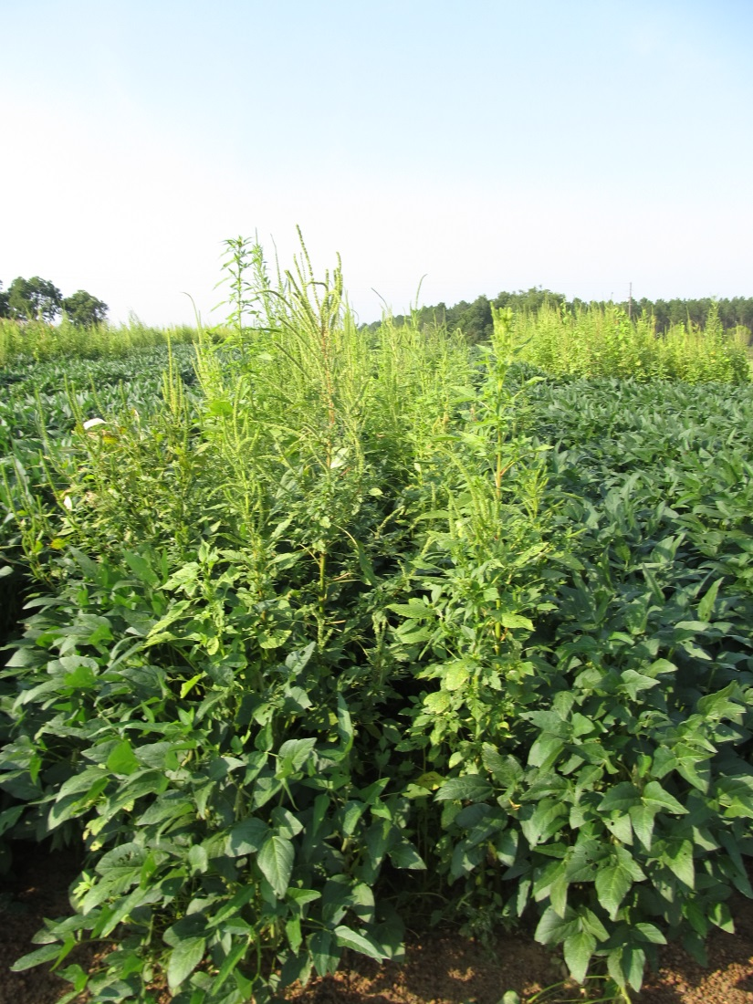
HPPD Soybeans - 2015
SB-09-15
July 21

Slide 22
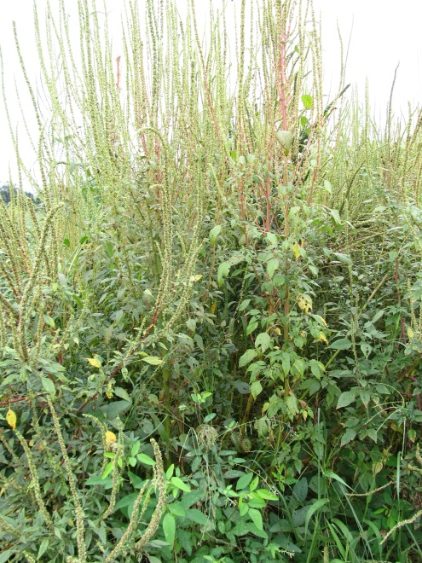
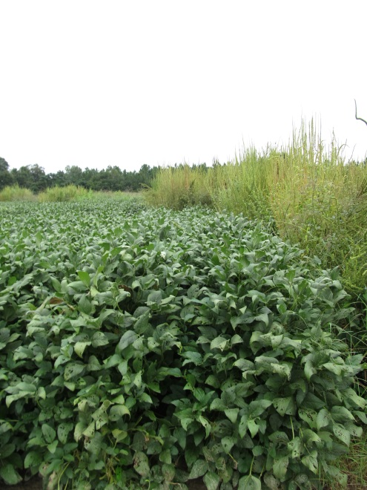
Warrant Ultra 3.45CS
Monsanto
Premix of Warrant (2.82 lb ai/A) + Reflex (0.63 lb ai/A)
  MOA = 15 + 14
  Compete with Prefix
PRE to R2
48-50 oz/A
  Warrant @ 45-47 oz/A
  Reflex @ 15-16 oz/A
NTC
Warrant @ 48 oz/A
(PRE)
+
Roundup P-Max @ 32 oz/A
Warrant Ultra @ 50 oz/A
(15 DAP)
Photo – 111 DAP
(SB-12-15)

Slide 23
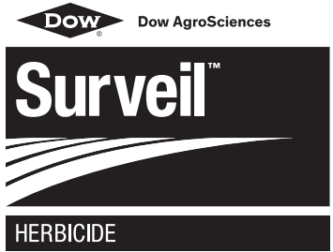
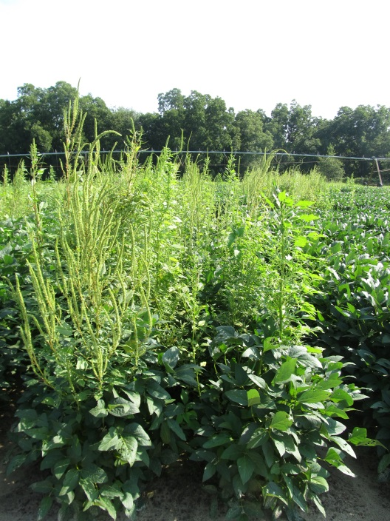
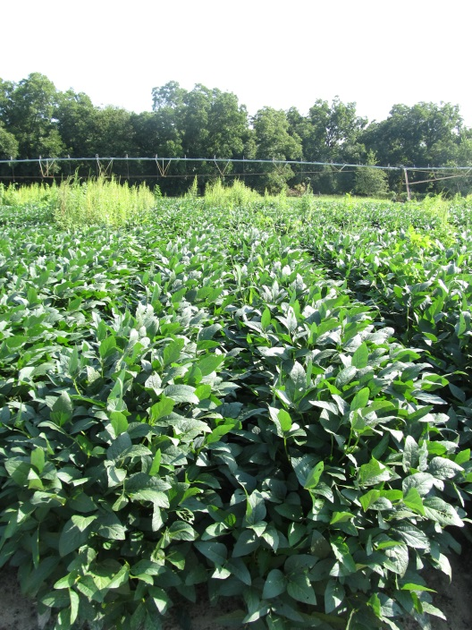
Surveil 48WDG
Dow AgroSciences
Valor (36%) + FirstRate (12%)
2.8 to 4.2 oz/A
PRE within 3 days of planting
Better residual control of annual mg than Valor alone?
2.8 oz/A
  2 oz/A Valor 51WG
  0.4 oz/A FirstRate 84WG
Left = Untreated
Right = Surveil 48WG @ 2.8 oz/A
July 21, 2015
75 DAT
SB-04-15

Slide 24
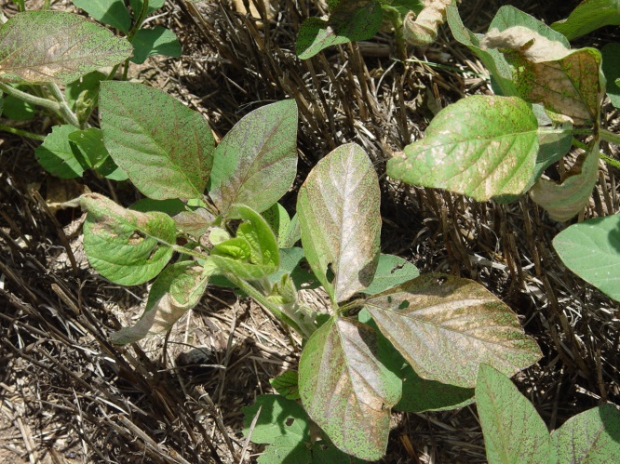
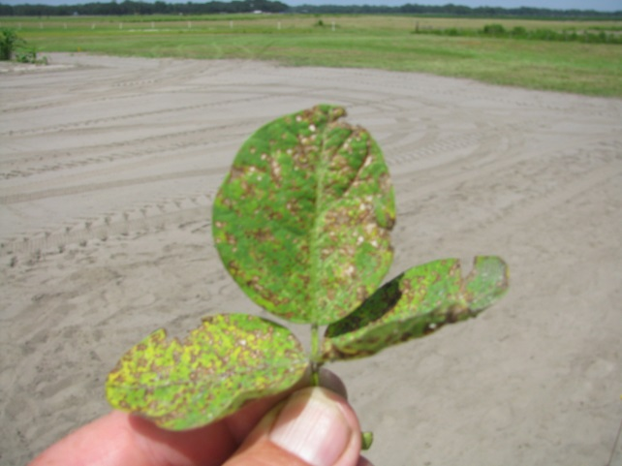
Do early applications of Cobra improve soybean yield?
Year (s) | State | Response
2013, 2014 | KY | No effect
2013, 2014 | MS | No effect
2012 | AR | 21% yield increase
2011 | AR | No effect
2011 | NE | Yield loss
2011 | IA | Yield Loss

Slide 25
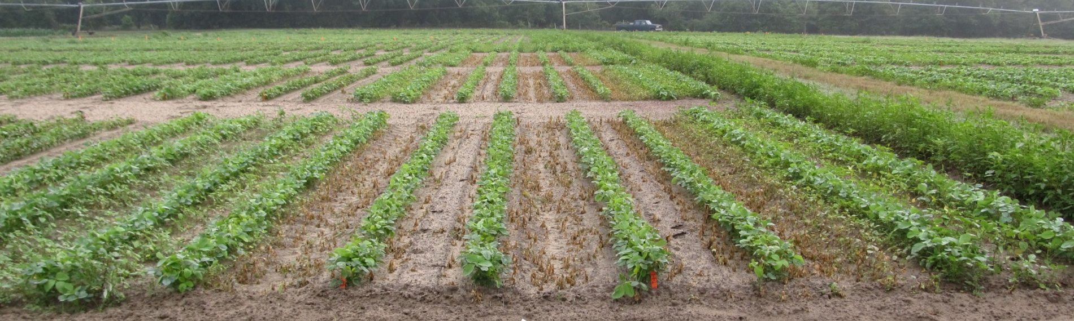
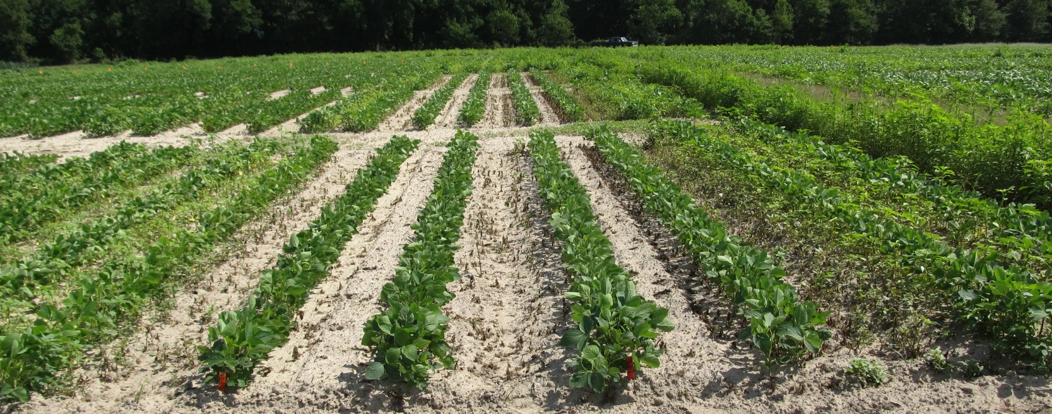
Roundup WM @ 32 oz/A + Reflex @ 24 oz/A + Pursuit @ 4 oz/A
5 DAT
10 DAT

Slide 26










2,4-D/Dicamba Technologies
2,4-D
dicamba

Slide 27

Enlist Duo Recent Problems

Slide 28
What happened in 2015 and what will happen in 2016?
Question | 2,4-D | Dicamba
Were there any commercial acres of 2,4-D or dicamba soybean planted in SE in 2015? | No | No
Were there any commercial soybean acres treated with 2,4-D or dicamba in 2015? | No | No
What is the cost of Enlist Duo or Roundup Xtend or Xtendimax or Engenia? | ?? | ??
How much for a 50 lb bag of seed? | ?? | ??
Realistic first commercial use in SE? | 2017 | 2016 if EPA label or seed sales (RR programs) i.e. like cotton

Slide 29

Less drift potential and less volatility does not mean 0 drift or volatility!!!

Slide 30
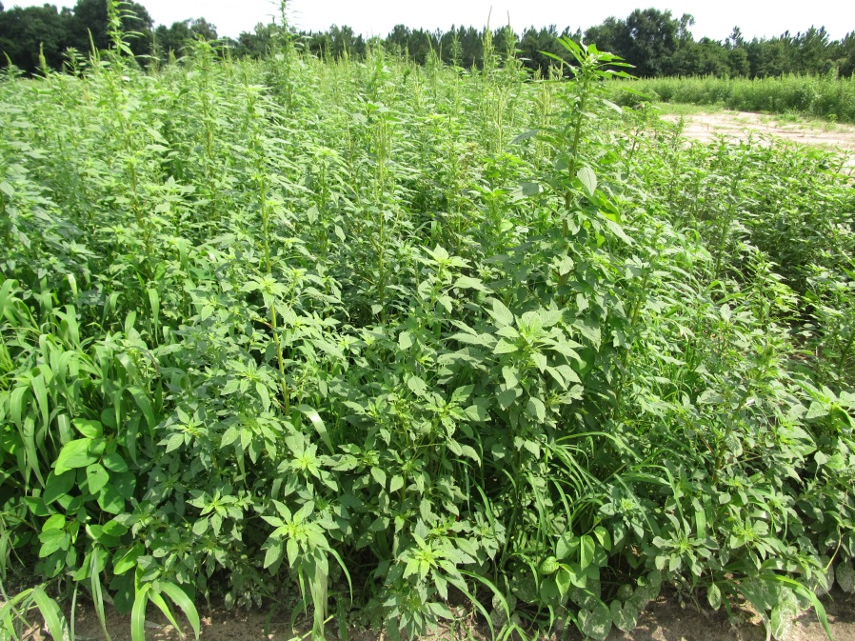
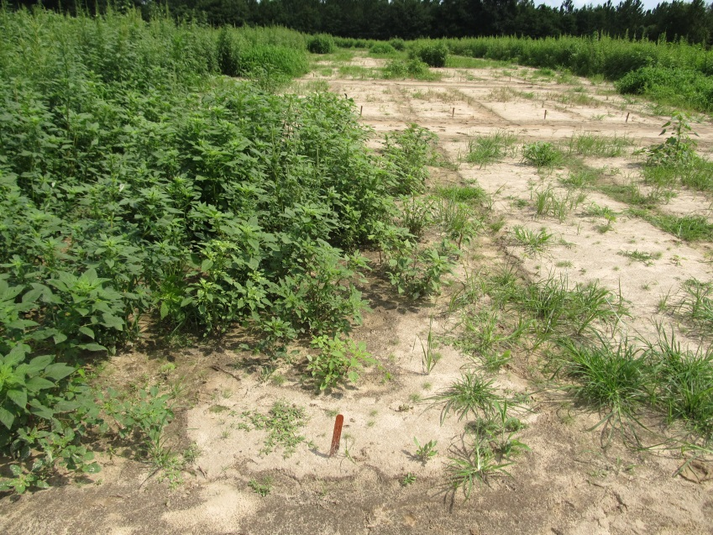
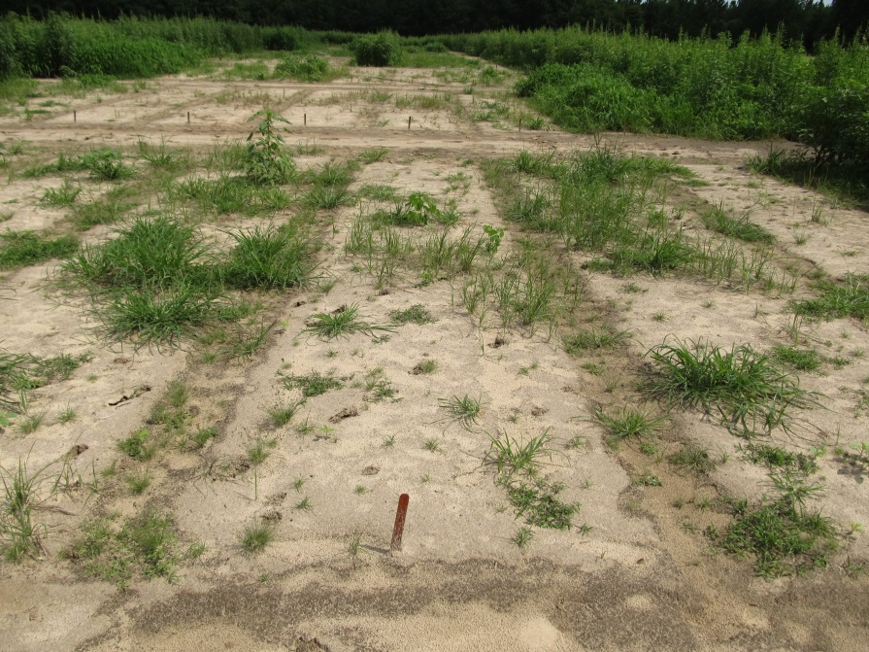
How good is dicamba on Palmer?
NTC
Roundup PM @ 22 oz/A
Clarity @ 16 oz/A
Roundup PM @ 22 oz/A
Cobra @ 16 oz/A
COC @ 1% v/v
SB-10-15
July 7
35 DAT
AMAPA – 1-8” tall
15 GPA
TTI02 tips

Slide 31
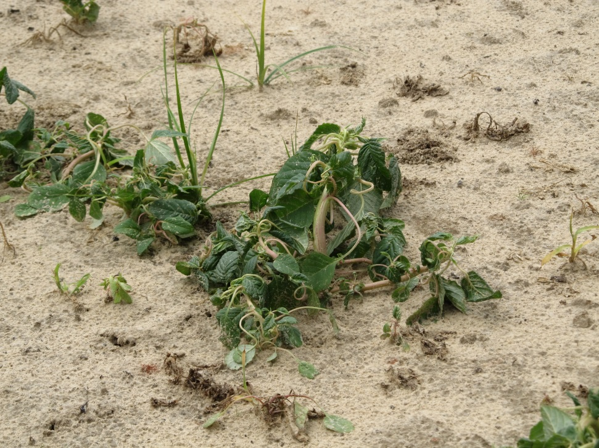
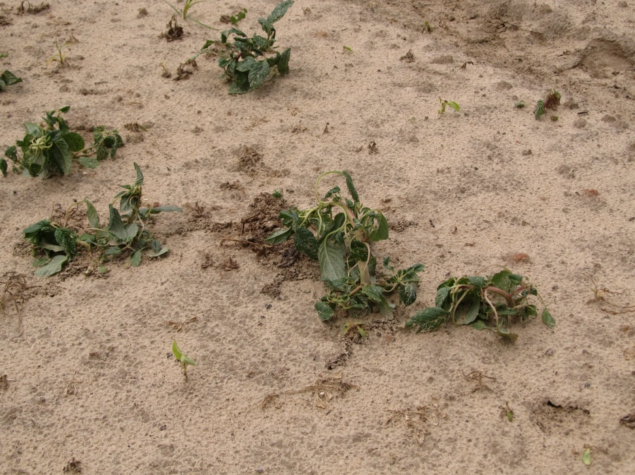
Dicamba/2,4-D Symptomology

Slide 32

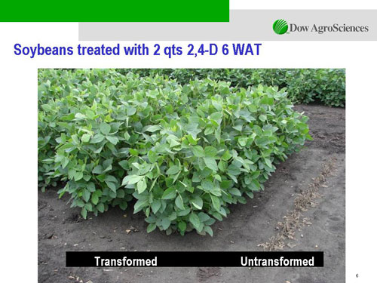

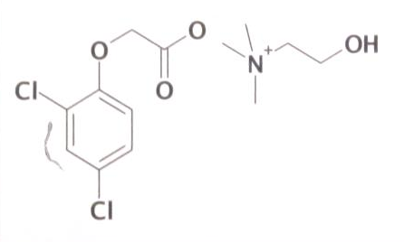
Enlist™ Herbicide Tolerant Soybean
tolerance to 2,4-D + glyphosate + glufosinate (Liberty)
Trait was deregulated in September 2014 and herbicide in October 2014
Colex-D™ technology
  2,4-D choline
  lower volatility
  lower drift potential
  enhanced handling/mixing characteristics
  reduced odor
1 Burndown/PRE application + 2 POST applications (R2 stage)
Enlist™ Duo
  DMA-Glyphosate (1.71 lb ae/gal) + 2,4-D choline (1.63 lb ae/gal)
2015 Product Launch
  IA, IL, IN, OH, SD, WI (first)
  AR, KS, LA, MN, MO, MS, NE, ND, OK, TN, (next)
2,4-D choline

Slide 33
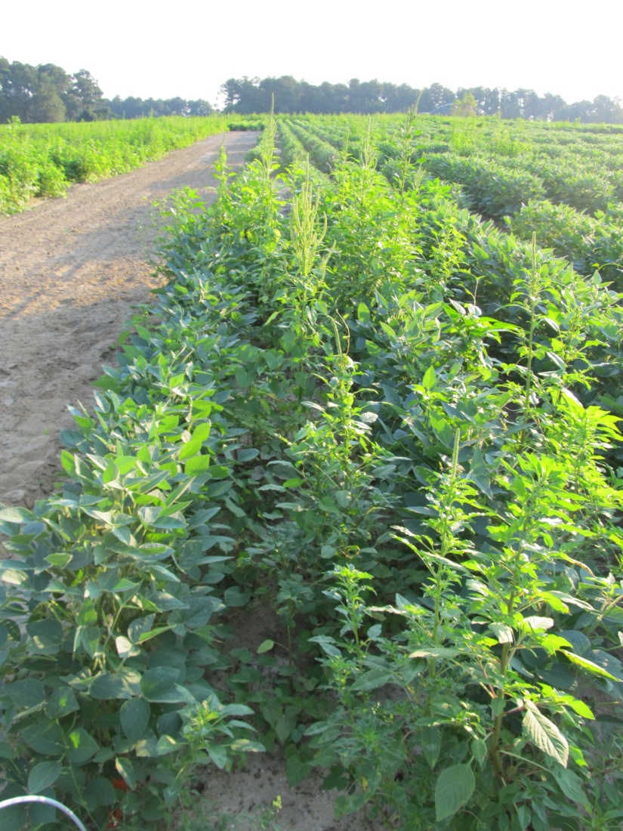
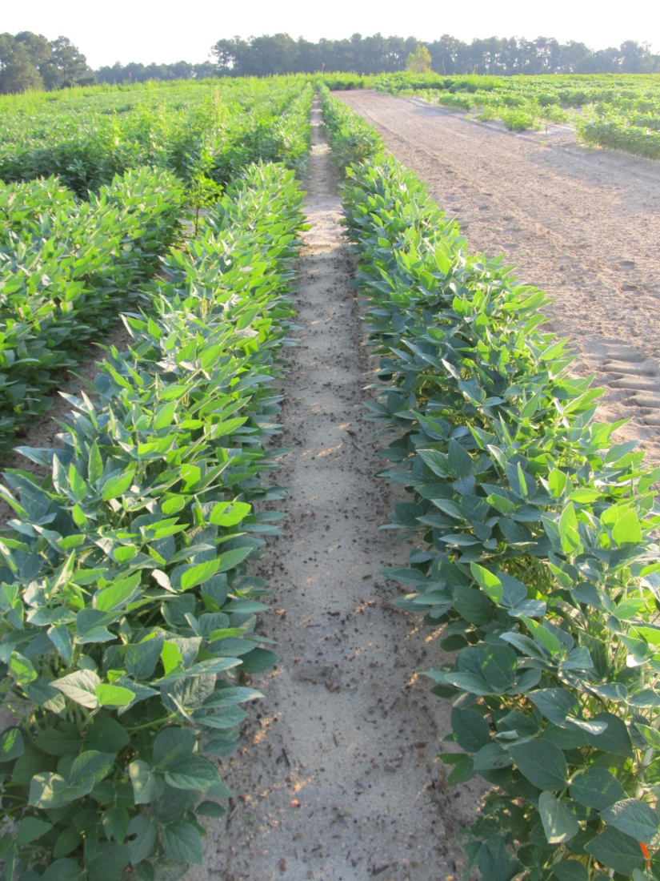
Enlist Soybeans - 2012
NTC
Valor SX 51WG - PRE (May 4)
Enlist Duo - MPOST (June 1)
N-PAK AMS - MPOST (June 1)
SB-09-12
Planted May 3
Photo: June 29

Slide 34



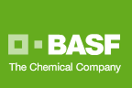

Dicamba-Tolerant (DT) Soybeans
Monsanto/BASF
Roundup Ready 2 Xtend (Monsanto)
  XtendiMax
    Reduced volatility dicamba
  Roundup Xtend
    Reduced volatility dicamba + glyphosate
Engenia™ (BASF)
  Reduced volatility formulation of dicamba
  Banvel = dicamba-DMA
  Clarity = dicamba-DGA
  Engenia = dicamba–BAPMA
PRE or POST
RESIDUAL STILL NEEDED!!!!!!!!!!!!!!!!!!!!!!!
2016?

Slide 35

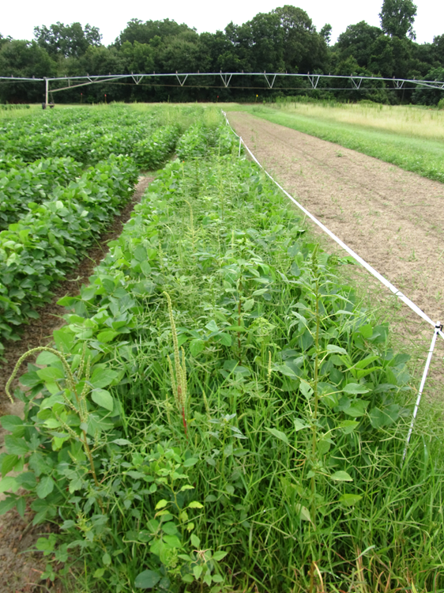
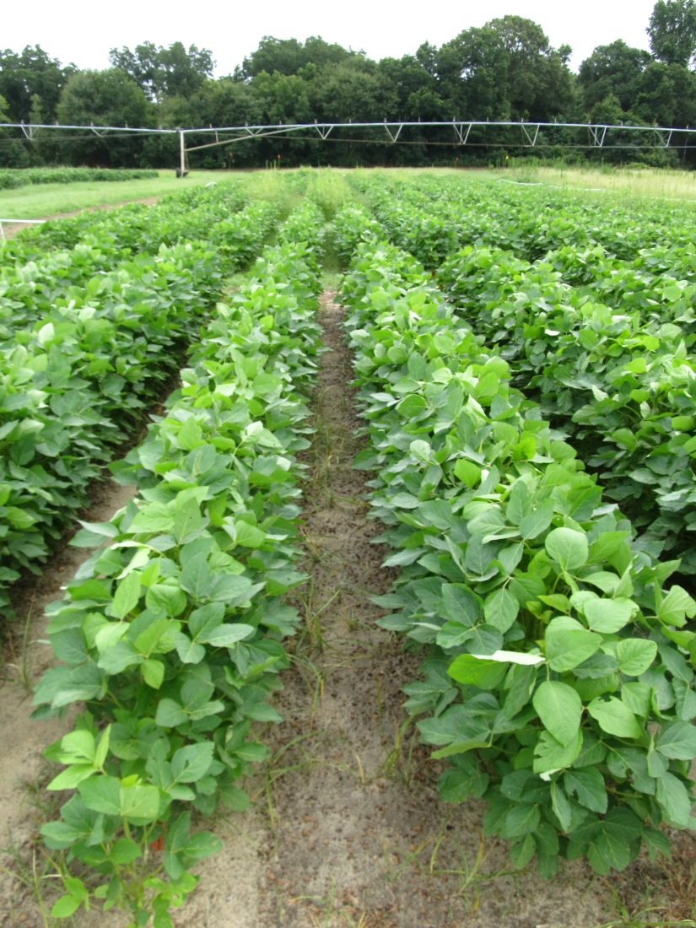
Roundup Xtend - 2014
NTC
Valor – PRE
Roundup Xtend - POST
SB-10-14
July 21
D after
POST

Slide 36

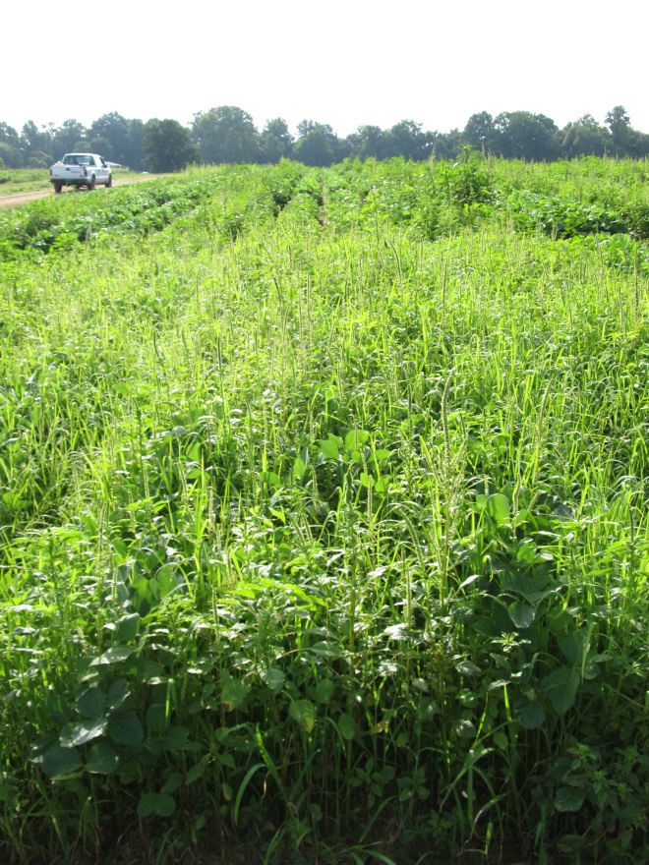


Engenia Program – DT Soybeans 2014
(EPOST Applied 13 DAP)
NTC
Roundup P-Max +
Induce
EPOST
Prowl H₂0 – PRE
Zidua + Roundup P-Max
+ ENGENIA + Induce
EPOST
New-2014, July 14
27 d after EPOST

Slide 37

2,4-D and Dicamba Tolerant Soybeans
Still need a residual!
Still need to be timely (3-4” tall weeds)!
Will also need Liberty!
  Not on Xtend beans though!
Must significantly improve in the areas of drift and sprayer contamination management

Slide 38

2,4-D and Dicamba Soybeans Stewardship
Droplet size (VMD)
Nozzle selection
Pressure
GPA
Tractor speed
Boom Height
Wind Speed/Direction
Buffers
Sprayer cleanout

Slide 39


Nozzles
TTI
AIXR
TDXL
(Greenleaf)
TeeJet

Slide 40


Enlist™ Duo Nozzle Tips/Pressure

Slide 41






XtendiMax, RoundupXtend, Engenia Nozzles
Engenia (EC to UC droplet size)
Roundup Xtend (VC to UC)
Greenleaf
Technologies
TDXL – TurboDrop XL

Slide 42




11002DG
VMD₅₀ = 322 (C)
AIXR 11002
VMD₅₀ = 402 (VC)
TTI 02
VMD₅₀ = 524 (EC)

Slide 43



Boom Height

Slide 44

Buffers
At the time of application, the wind cannot be blowing toward adjacent commercially grown tomatoes and other fruiting vegetables (EPA crop group 8), cucurbits (EPA crop group 9), grapes and cotton.

Slide 45
Sprayer Cleanout
Is it possible in this rig?

Slide 46

Enlist™ Duo Sprayer Cleanout

Slide 47


XtendiMax, RoundupXtend, Engenia Sprayer Cleanout

Slide 48
2,4-D and Dicamba Crops
(Don’t Get Messed Up!)
Crop | Glyphosate | Glufosinate | 2,4-D | Dicamba
2,4-D field corn | YES | NO/YES | YES | YES¹
2,4-D soybean | YES | YES | YES | NO
2,4-D cotton | YES | YES | YES | NO
Dicamba cotton | YES | YES | NO | YES
Dicamba soybean | YES | NO | NO | YES
¹Dicamba is already registered for use in field corn (up to a certain point). Not sure
at this point if new formulations will be specifically labeled.

Slide 49

QUESTIONS?
www.gaweed.com

