Slide 1
Herbicide Effects on Field Corn Yield in A High Input Environment
E.P. Prostko and O.W. Carter
Dept. Crop & Soil Sciences

Slide 2
Georgia Field Corn Production
Source: NASS

Slide 3
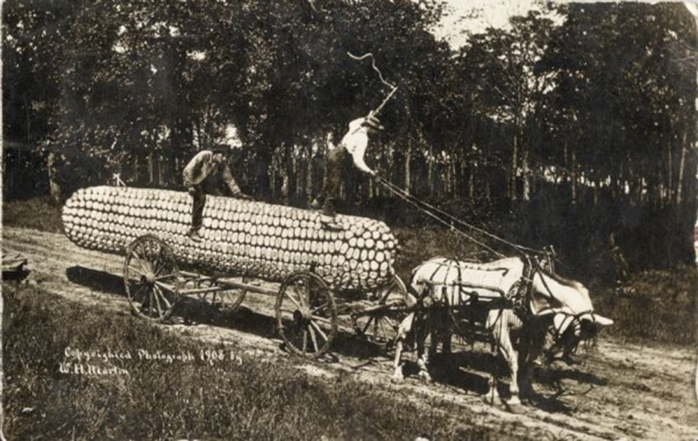
Something to think about?
Some GA growers are pushing yield limits (250+ Bu/A)
75%-80% irrigated
weed science researcher (me) typically does not make 225+ Bu/A yields
At lower yield/input levels, are herbicide stresses masked by other stresses?
At higher yield/input levels (i.e. most stresses are controlled), what about herbicides?

Slide 4
RR1 Field Corn (Pioneer 2023BVT) Yield Response to Roundup WeatherMax
Bu/A
Applied 28 DAP, V5, 5” tall corn
All trts included Aatrex 4L @ 64 oz/A +
COC @ 1% v/v
P = 0.2275
CV = 3.8

Slide 5
‘DKC 64-69’ Yield Response to POST Applications of Steadfast Q (RUWM @ 22 oz/A, ATZ @ 64 oz/A, STDQ @ 1.5 or 3 oz/A)
Bu/A
P = 0.5017
CV = 1.75
Applied 28 DAP
V4, 6” tall corn

Slide 6
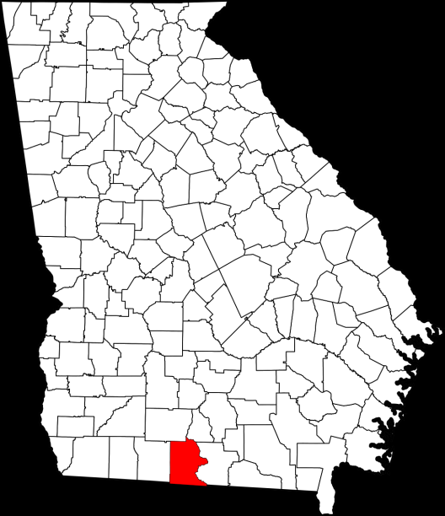
Materials and Methods
Brooks County, GA
Small plot techniques
Test 1
7 herbicides
1 timing (V3-V4, 4” tall, 21 DAP)
Test 2
1 herbicide
RUWM (32 oz/A) + ATZ (48 oz/A) + AMS (2.5% v/v)
4 timings
V2-V3, V4, V6-V7, V7-V8

Slide 7
Test 1 Herbicides
Trt # | Treatment*
1 | NTC
2 | RUWM (32 oz/A ) + Atrazine (48 oz/A) + Prowl H₂O (32 oz/A)
3 | RUWM (32 oz/A ) + Atrazine (48 oz/A)
4 | Liberty (29 oz/A) + Atrazine (48 oz/A)
5 | Steadfast Q (1.5 oz/A) + Atrazine (48 oz/A) + COC (1% v/v)
6 | Capreno (3.0 oz/A) + Atrazine (48 oz/A) + COC (1% v/v)
7 | Laudis (3.0 oz/A) + Atrazine (48 oz/A) + COC (1% v/v)
8 | Halex GT (64 oz/A) + Atrazine (48 oz/A) + NIS (0.25% v/v)
9 | RUWM (32 oz/A) + Atrazine (48 oz/A) + Sandea (0.67 oz/A)
*RUWM = Roundup WeatherMax, NIS = Adept, COC = Reliable

Slide 8
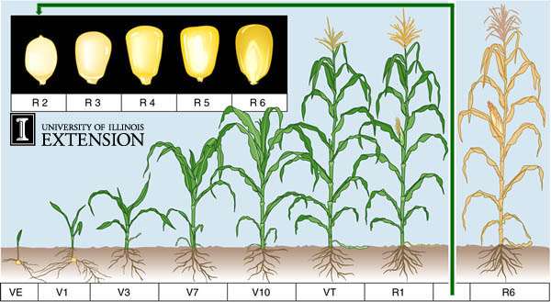
Test 2 Corn Info
Stage | Height (in) | DAP
V2-V3 | 3 | 19
V4 | 5-8 | 30
V6-V7 | 8-12 | 37
V7-V8 | 23-27 | 46

Slide 9
High Input Environment - 2014
Pioneer 1685
Planted March 22
Tifton loamy sand
Twin Row (48”-15”)
42,000 seed/A
340-60-150/A
5-6 apps of N via pivot
3 fungicides
Approach – V12 (1 app)
Approach/Prima + B (2 apps)
3 insecticides
Bifenthrin (with fungicides)
~27” rainfall (March 22 – Aug 12)
9” supplemental irrigation (pivot)

Slide 10
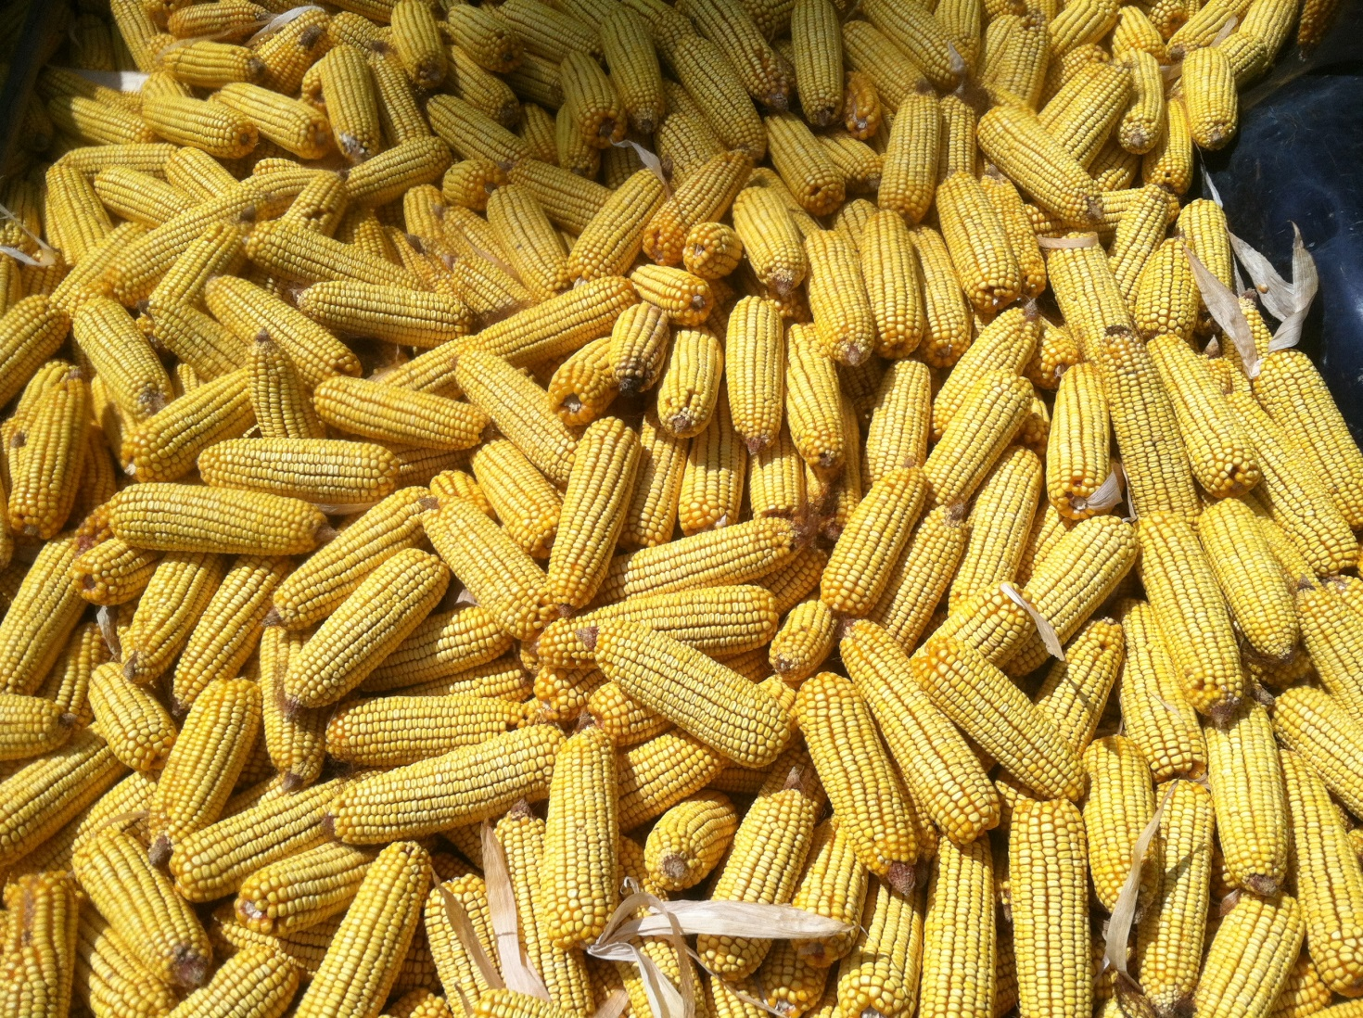
Results

Slide 11
Figure 1. Herbicide Effects on Field Corn Yield in a High Input Environment
P = 0.4165
CV = 12.32
CN-01-14
Applied 21 DAP
V3-V4
Pioneer 1685

Slide 12
Figure 2. Herbicide Effects on Field Corn Ear #/A in a High Input Environment
P = 0.8593
CV = 5.66
CN-01-14
Applied 21 DAP
V3-V4
Pioneer 1685

Slide 13
Figure 3. Herbicide Effects on Field Corn Ear Weight in a High Input Environment
P = 0.1126
CV = 9.17
CN-01-14
Applied 21 DAP
V3-V4
Pioneer 1685

Slide 14
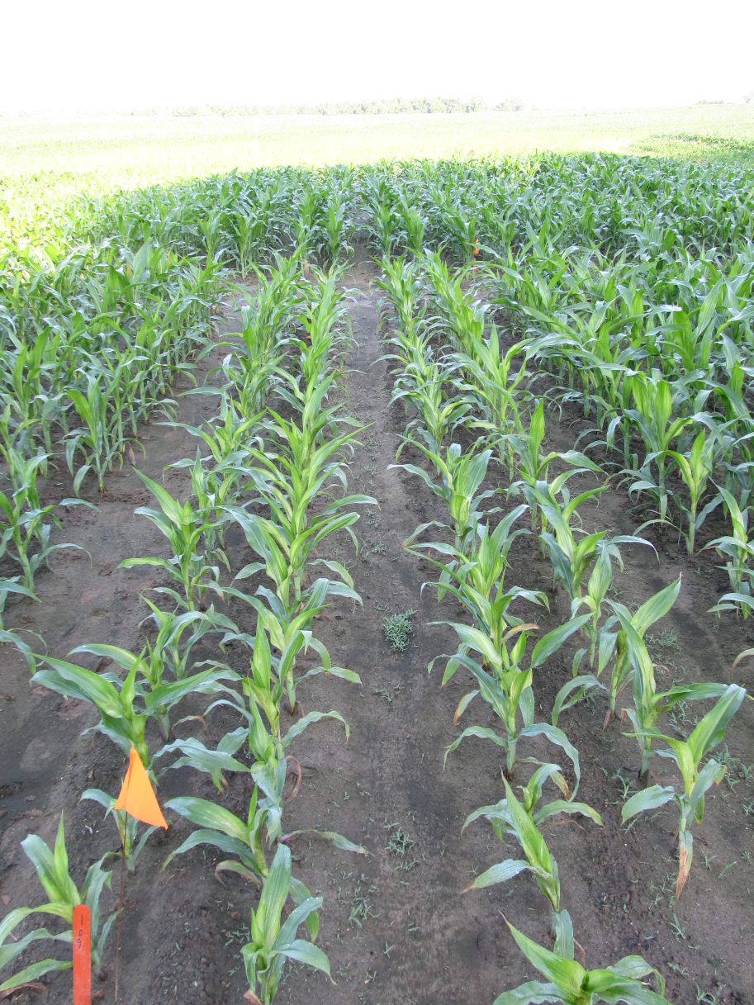
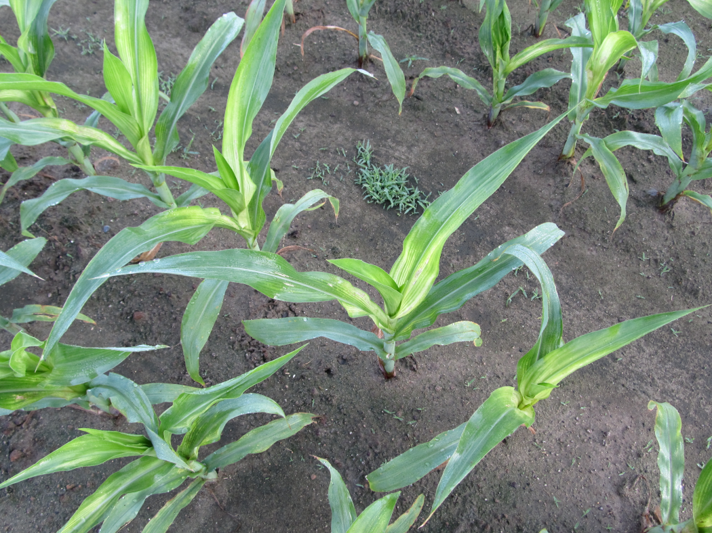
Roundup + Sandea + Atrazine?????? (26 DAT) - 2014

Slide 15
Figure 4. Roundup W-Max (32 oz/A) + Atrazine (48 oz/A) + AMS Xtra (2.5% v/v) Timing Effects on Field Corn Yield in a High Input Environment
P = 0.1430
CV = 6.56
Pioneer 1685

Slide 16
Figure 5. Roundup W-Max (32 oz/A) + Atrazine (48 oz/A) + AMS Xtra (2.5% v/v) Timing Effects on Field Corn Ear #/A in a High Input Environment
P = 0.8757
CV = 8.0
Pioneer 1685

Slide 17
Figure 6. Roundup W-Max (32 oz/A) + Atrazine (48 oz/A) + AMS Xtra (2.5% v/v) Timing Effects on Field Corn Ear Weight in a High Input Environment
P = 0.5334
CV = 6.48
Pioneer 1685

Slide 18
Summary
No effect of herbicides or timing in high input environment
Encouraging growers to be done by V5
But……
Sandea issues???
V7-V8 applications

Slide 19
Acknowledgements
Randy Dowdy
Brooks County, GA
Winner of National Corn Growers Association Yield Contest (Irrigated)
2011 = 352.3 Bu/A (2nd place)
2012 = 372.3 Bu/A (1st Place)
2013 = 405.1 Bu/A (2nd Place)
2014 = 503.7 Bu/A (1st Place)

Slide 20
Question/Comments
eprostko@uga.edu
www.gaweed.com

